Slide 1
Unit 1 Lesson 3

Slide 2
How can we find out what other people think about 3D printed houses?

Slide 3
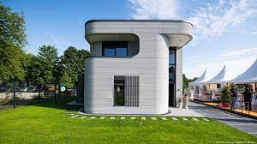
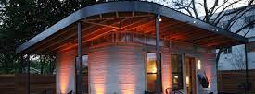
3D Printed Homes

Slide 5
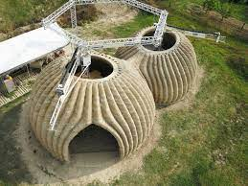
What do you want to Know?
Is it cheap?
Is it energy efficient?
Is it quick to build?
Is it resistant to natural disasters?

Slide 6
How can we find out what other people think about living in 3D printed home?

Slide 7
The ways you research people’s opinion
Interviews
Questionnaires
Surveys

Slide 9
Open Question
A question where the person asked can give any answer they want

Slide 10
Open Questions Examples
What do you think this story is about?
What was your favorite part?
How did that happened ?

Slide 11
closed Question
A question where the person asked chooses one of several given answers

Slide 12
Closed Questions Examples
Have you already completed your homework?
May I use the bathroom?
Will you please do me a favor?

