Slide 1
Disclaimer/s
We hope you find the information on our website and resources useful.
Animations
This resource has been designed with animations to make it as fun and engaging as possible. To view the content in the correct formatting, please view the PowerPoint in ‘slide show mode’. This takes you from desktop to presentation mode. If you view the slides out of ‘slide show mode’, you may find that some of the text and images overlap each other and/or are difficult to read.
To enter slide show mode, go to the slide show menu tab and select either from beginning or from current slide.
You may wish to delete this slide before beginning the presentation.

Slide 3
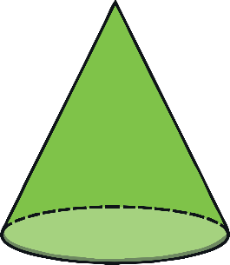
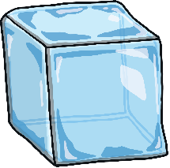
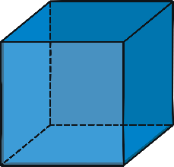
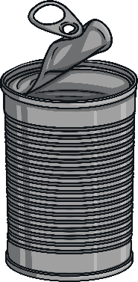
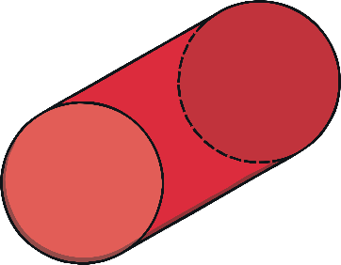
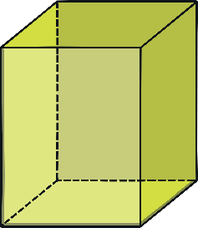
What Are 3D Shapes?
3D shapes are all around us.
3D shapes are solid shapes. 3D stands for 3-dimensional.

Slide 4
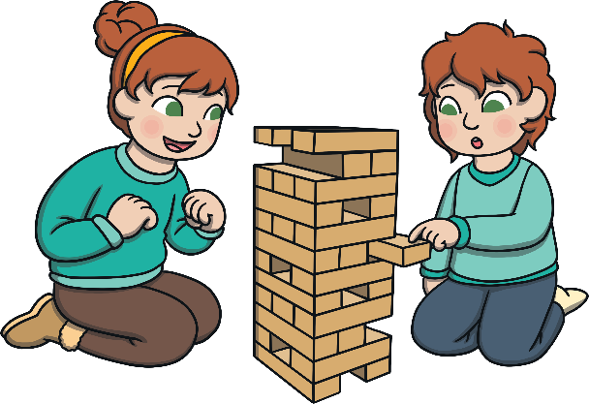
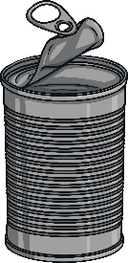
What Are 3D Shapes?
Some 3D shapes can stack.
Some 3D shapes can roll.
Some 3D shapes can do both!

Slide 5
Cube
I am a cube!
Do you think I can stack, roll, or both?
10 seconds!
Thumbs up for stack
Thumbs down for roll
Thumbs in the middle for both
Look around the classroom. Can you see any cubes?

Slide 6
Sphere
I am a sphere!
Do you think I can stack, roll, or both?
10 seconds!
Thumbs up for stack
Thumbs down for roll
Thumbs in the middle for both
Look around the classroom. Can you see any spheres?

Slide 7
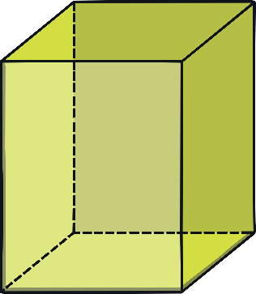
Cuboid
I am a cuboid!
Do you think I can stack, roll, or both?
10 seconds!
Thumbs up for stack
Thumbs down for roll
Thumbs in the middle for both
Look around the classroom. Can you see any cuboids?

Slide 8
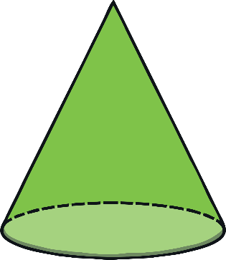
Cone
I am a cone!
Do you think I can stack, roll, or both?
10 seconds!
Thumbs up for stack
Thumbs down for roll
Thumbs in the middle for both
Look around the classroom. Can you see any cones?

Slide 9
Cylinder
I am a cylinder!
Do you think I can stack, roll, or both?
10 seconds!
Thumbs up for stack
Thumbs down for roll
Thumbs in the middle for both
Look around the classroom. Can you see any cylinders?

Slide 10
Instructions for Game (Next Slide)
There will be 3 items per shape section.
Ask the class what shape belongs where, before clicking on the shape for it to appear in the correct section.

Slide 11
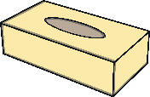
Sort the 3D Shapes
cube | cuboid | sphere
cylinder | cone | Can you organise these shapes? Click on the item to see what shape it is!

