Slide 2
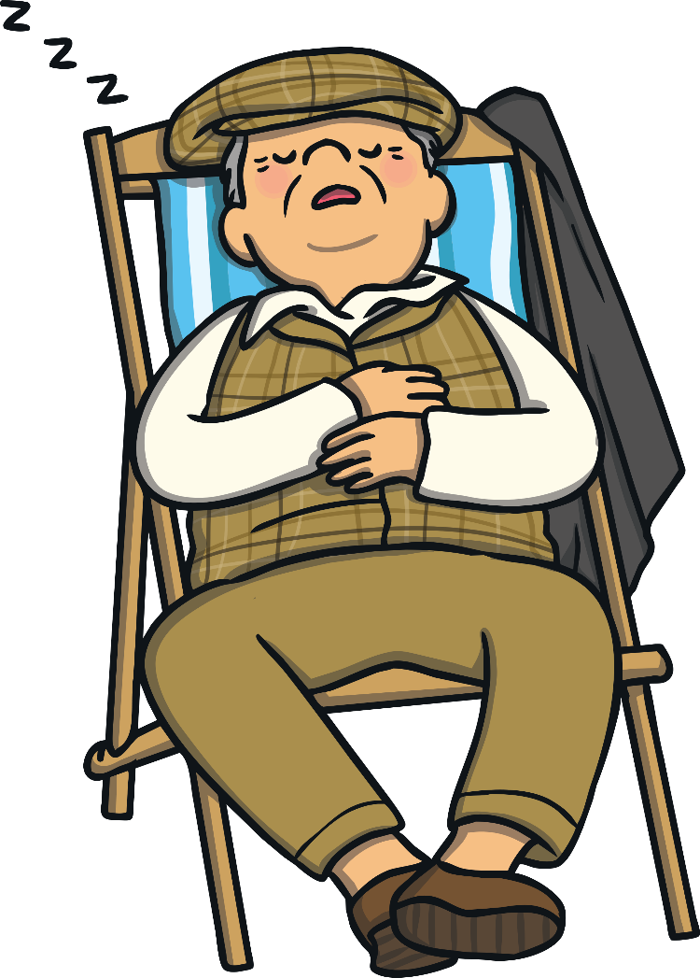
What is a Synonym?
What Is a Synonym?
A synonym is a word that means the same as another word or has a similar meaning.
Writers often use a synonym to make a sentence engaging.
For example:
The old man was tired.
The old man was sleepy.

Slide 3
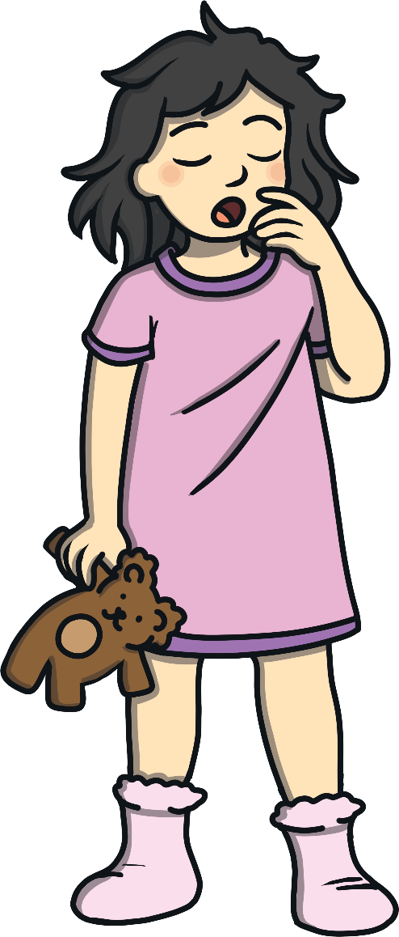
What is a Synonym?
Finding Synonyms
Can you think of some more words (synonyms) that could be used instead of ‘tired’?
Write down as many synonyms as you can.

Slide 4
What is a Synonym?
Tired Synonyms
How did you go? Here are some words that could have been used:
sleepy
drowsy
fatigued
drained
exhausted
weary

Slide 5
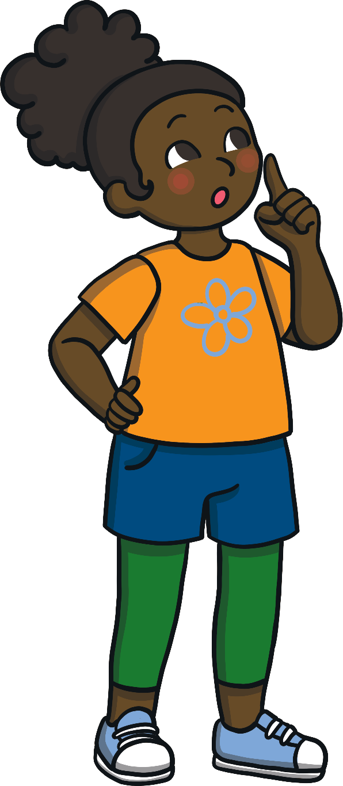
What is a Synonym?
Synonyms List
We are going to practise forming our own list of synonyms.
On the next few slides, you will see a selection of words.
When you read a word, write down
words that have the same meaning.
Write down as many as you can.

Slide 6
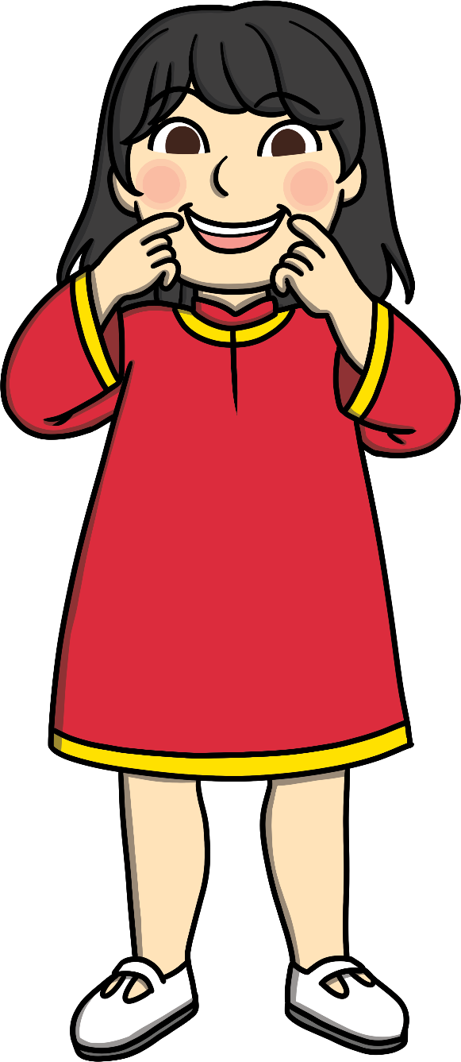
happy
happy

Slide 7
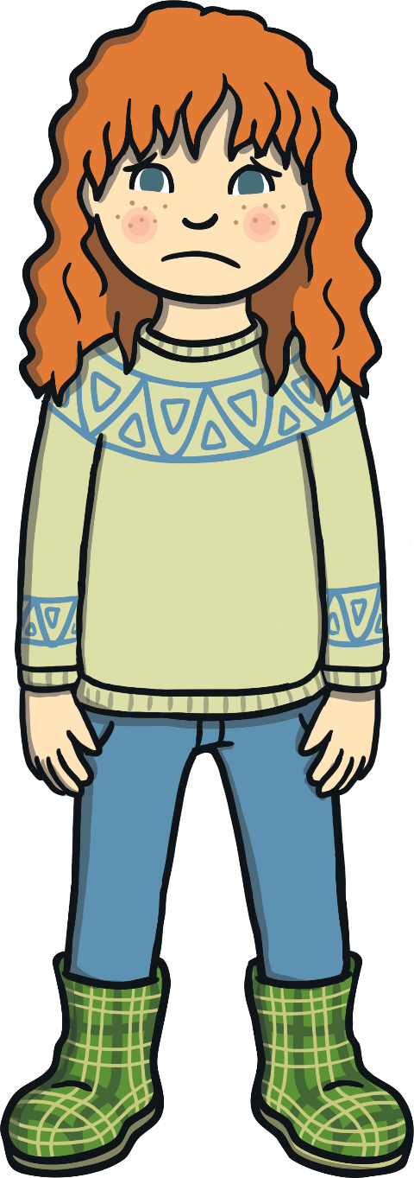
sad
sad

Slide 8
scared
scared

Slide 9
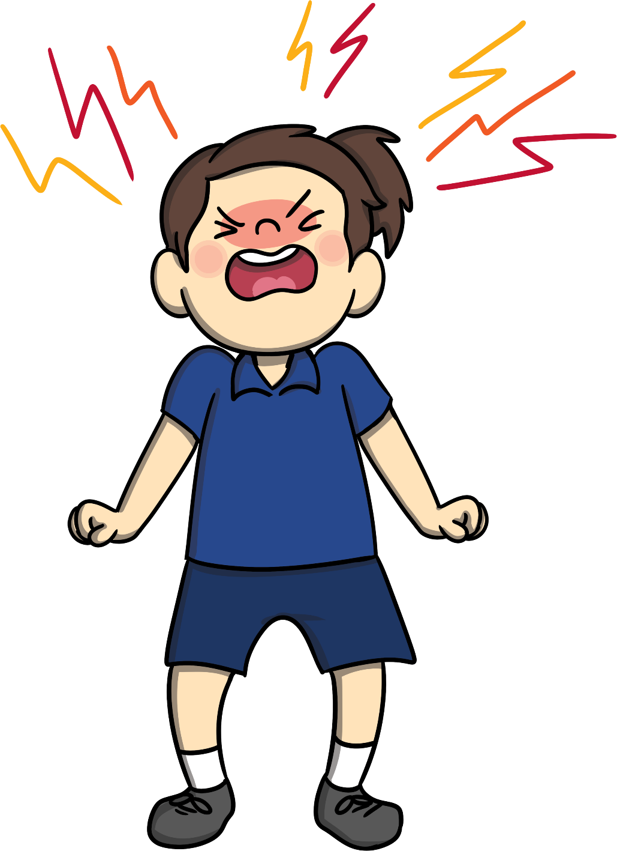
angry
angry

Slide 10
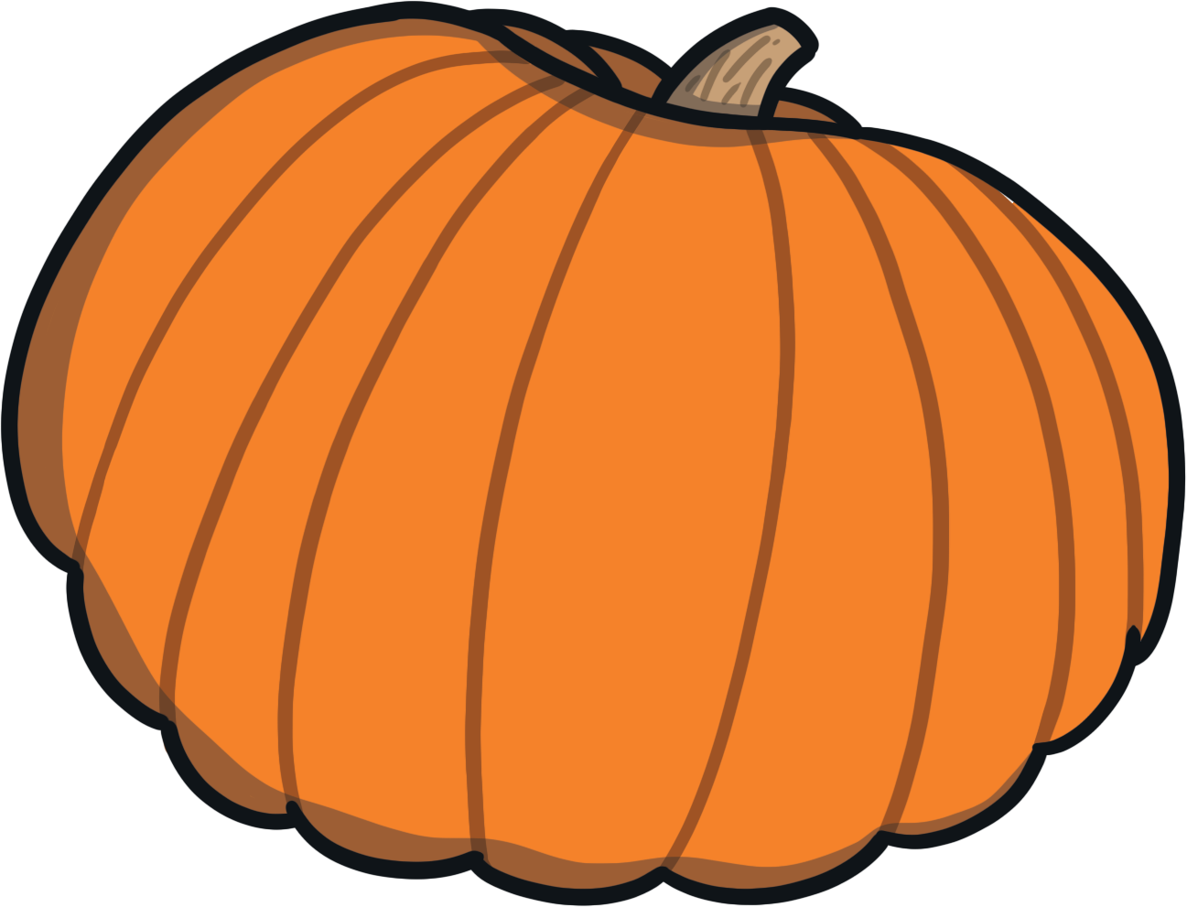
big
big

Slide 11
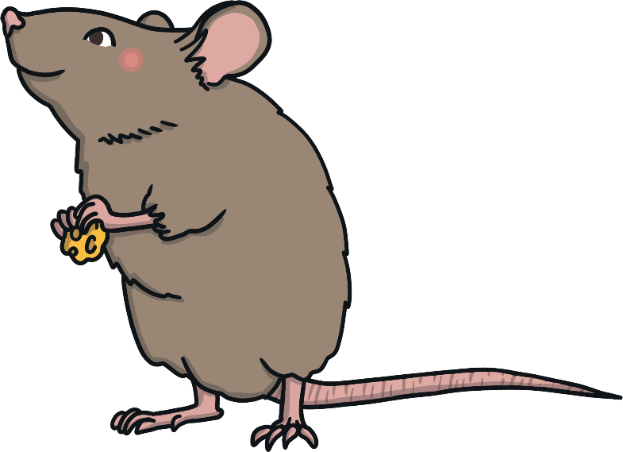
small
small

Slide 12
What is a Synonym?
Using Synonyms
We are going to practise using synonyms to improve a sentence.
For example:
Sally was sad because her dog was sick.
Look at the list of synonyms you made for the word sad then rewrite the above sentence.
You could have written:
Sally was upset because her dog was sick.
Sally was unhappy because her dog was sick.
Sally was miserable because her dog was sick.

Slide 13
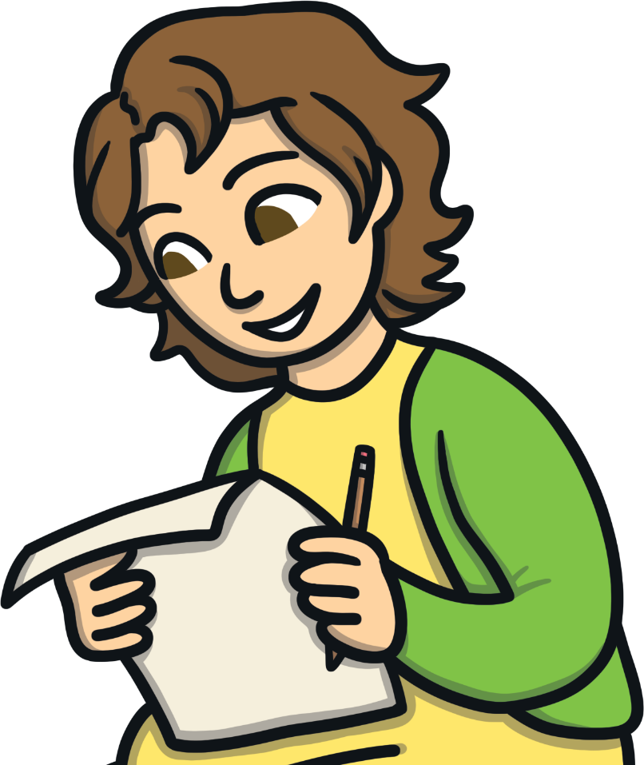
What is a Synonym?
Using Synonyms
Clancy was happy because it was his birthday.
Look at the list of
synonyms you made for
the word happy then
rewrite the above sentence.

Slide 14
What is a Synonym?
Using Synonyms
The big lion opened his mouth and roared.
Look at the list of
synonyms you made for
the word big then
rewrite the above sentence.

Slide 15
What is a Synonym?
Using Synonyms
The small mouse nibbled on the cheese.
Look at the list of
synonyms you made for
the word small then
rewrite the above sentence.

Slide 16
What is a Synonym?
Discuss
Turn to someone nearby and discuss:
Why do you think it is a good idea
to use synonyms in your writing?
How can using synonyms help a story
be more engaging?
What are some good ways to discover
synonyms for words?
Happy writing!

