Slide 1
Writing an Informative Report

Slide 2
Objectives:
Students would be able to:
Recap features of non chronological report
Learn the word bank
Apply the features to their first drafts using guided writing
Use the graphic organiser
Check the success criteria at the end

Slide 3
What is an informative report?
Informative/Explanatory writing is nonfiction writing about a topic.
It gives facts and information, explains how to do something, or tells readers about real people and events.

Slide 4
What is the main purpose of an informative report?
To inform the reader about a specific topic.

Slide 5
Introduction
The purpose of the introduction is to give the reader an understanding of the topic you are going to be writing about.
You should begin with a straightforward statement of the topic.
You may choose to use a rhetorical question such as “Did you know...?”
Once you’ve stated the main idea of your report, mention the categories each of your paragraphs will be unpacking.
Don’t include much detail here as you will be including this in the ‘category’ paragraphs.

Slide 6
Writing Category
1. Each category, which your facts and research fall into, should have its own paragraph in the information report.
2. Each paragraph should begin with a general statement about the category that these facts fall into and then go into more detail about what the facts are.
3. Do not introduce any information which doesn’t fit into the category you mention in your introduction. If you do find out new and interesting information that you would like to include, go back and add it to the introduction with a category that fits.
4. It is a good idea to sort your facts and research into at least two categories. You would expect to have at least two category paragraphs in your finished writing.

Slide 7
Conclusion
The conclusion paragraph is a bit like the
introduction, briefly restate the topic and
the general categories you have talked
about in your writing.

Slide 8
Optional: You could end your paragraph with an appeal to the reader.
For example,
“I hope you learned something interesting about cows.”
Do not introduce any new information in your conclusion, everything you discuss should have already been mentioned in the category paragraphs.

Slide 9
Features of an Informational report
Sub-headings for each paragraph
Usually written in present tense
Pictures of the subject
Captions under each picture to explain what is in the picture
Lists of facts in bullet points
Graphs or charts showing information about the subject
Boxes containing interesting individual facts to grab the attention of the reader
Technical vocabulary in bold, possibly with a glossary at the end

Slide 11
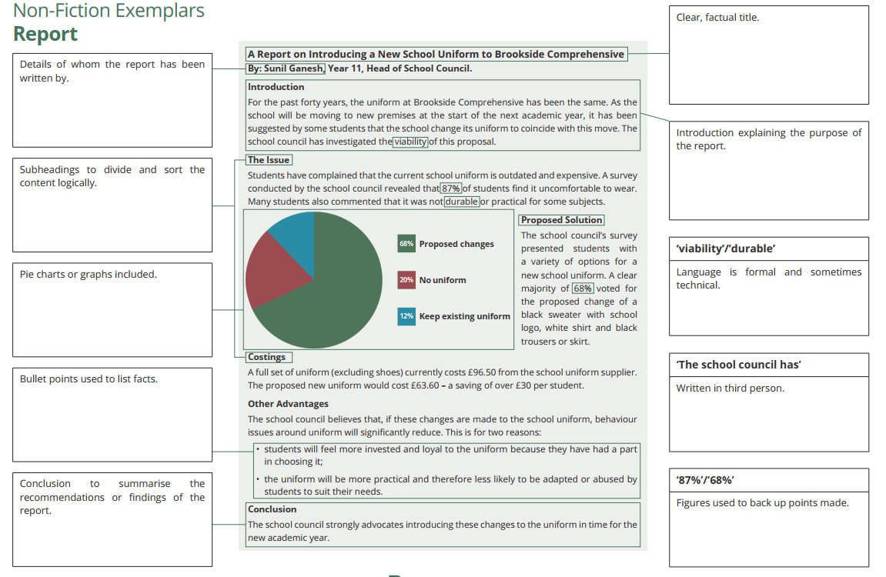

Slide 12
Text structure:
Headline/Title: tells what the topic is about
Introduction: 2-3 lines paragraph introducing the topic and stating the purpose and content of your report.
Main body: 2-3 paragraphs providing facts and information about your topic. Use sub-headings to introduce each paragraph. Each paragraph must start with a opening statement. Each paragraph deals with a new/different idea.
Conclusion: summary of your topic. Try to link back to your introduction and add more interesting facts about your topic.

Slide 13
Home Work
Write an information report about the extra-curricular activities and the classroom activities in your school. (Check the ppt to help you)
Use the following ideas to help you:
Kinds of activities whether in class or outside of it
Effect on students’ academic performance
Effect on students’ morale (mental and emotional condition)
Student- student and student-teacher relationship
Addressing different learning styles
Improvement of the overall educational process and school experience

Slide 14
Success Criteria
Features | S | T
A Heading
Subheadings
Third person
Present tense
The first sentence in each paragraph gives the key idea
Formal impersonal language
Facts
Technical words to do with the subject
Varied sentence openers
At least SIX Compound sentences
At least SIX complex sentences
A variety of punctuation marks: dashes, brackets, colons & semi-colons

