Slide 1
English

Slide 2
Lessons Objectives
By the end of the lesson, learners will be able to :
recognize and read the sounds.
01
blend and segment the words.
02
Write words related to these sounds.
03
04

Slide 3
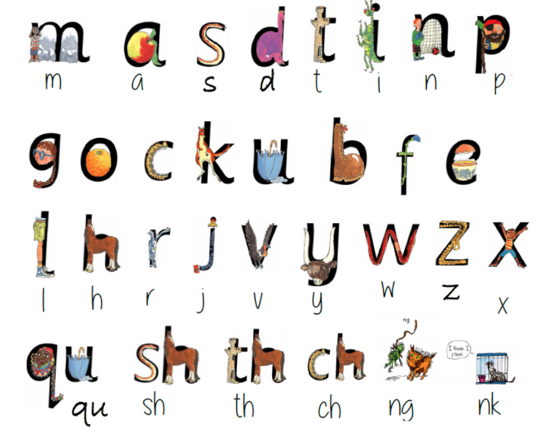
Warm- up Activity

Slide 4
Listen to the video

Slide 5
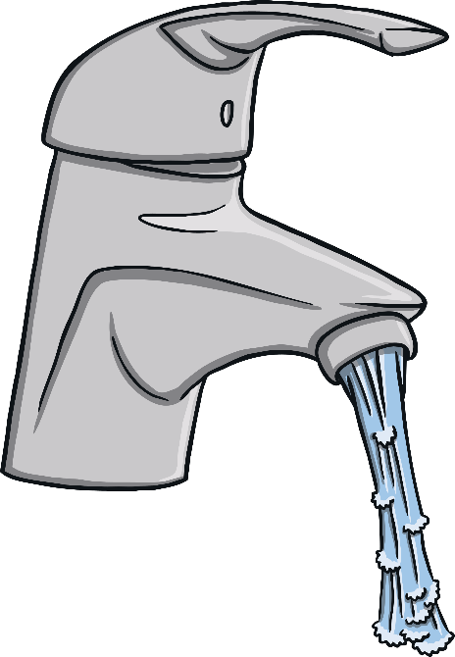
The tap is on.
next

Slide 6
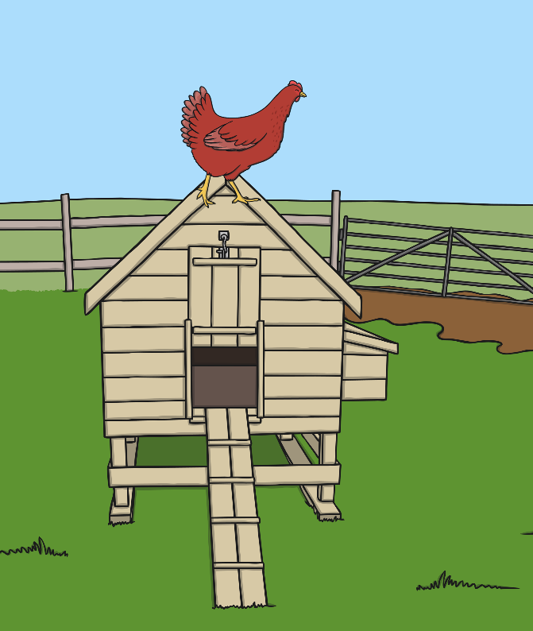
The red hen is on the hut.

Slide 7
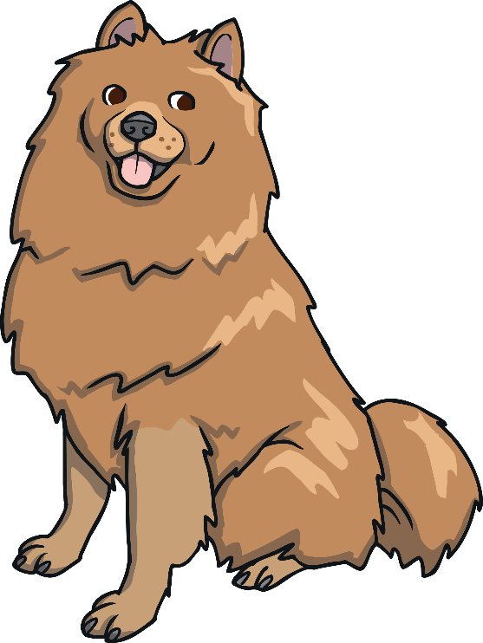
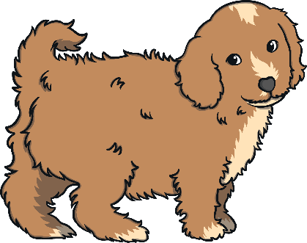
The dog has a pup.

Slide 8
The pen is red.

Slide 9
Time to read

Slide 10
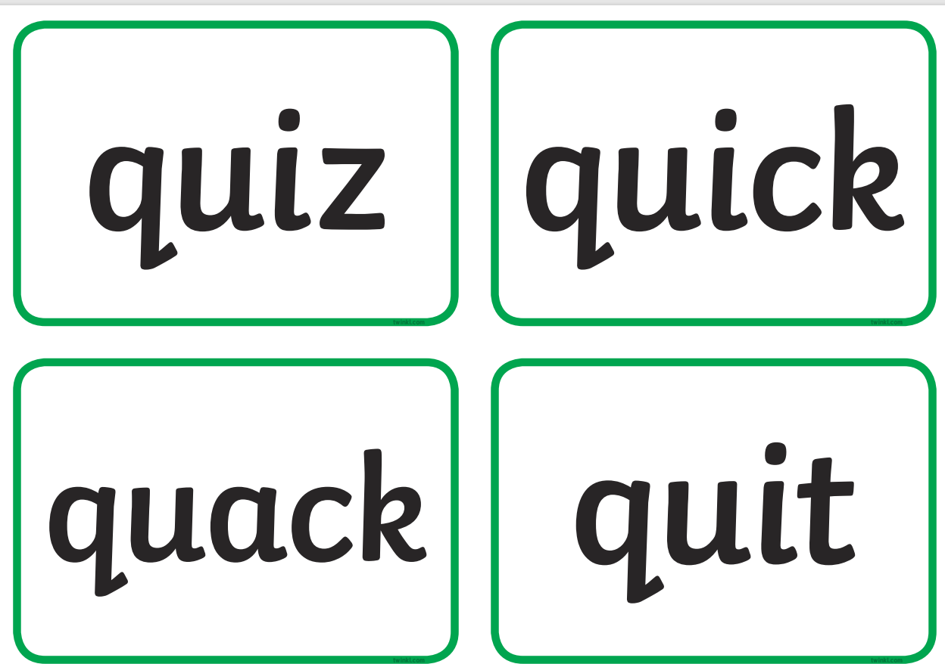

Slide 16
Practice time
Write some words that start with these sounds:
ng, sh, ch, qu, th, nk

Slide 17
Lessons Objectives
Objectives check:
recognize and read the sounds.
01
blend and segment the words.
02
Write words related to these sounds.
03
04

