Slide 1
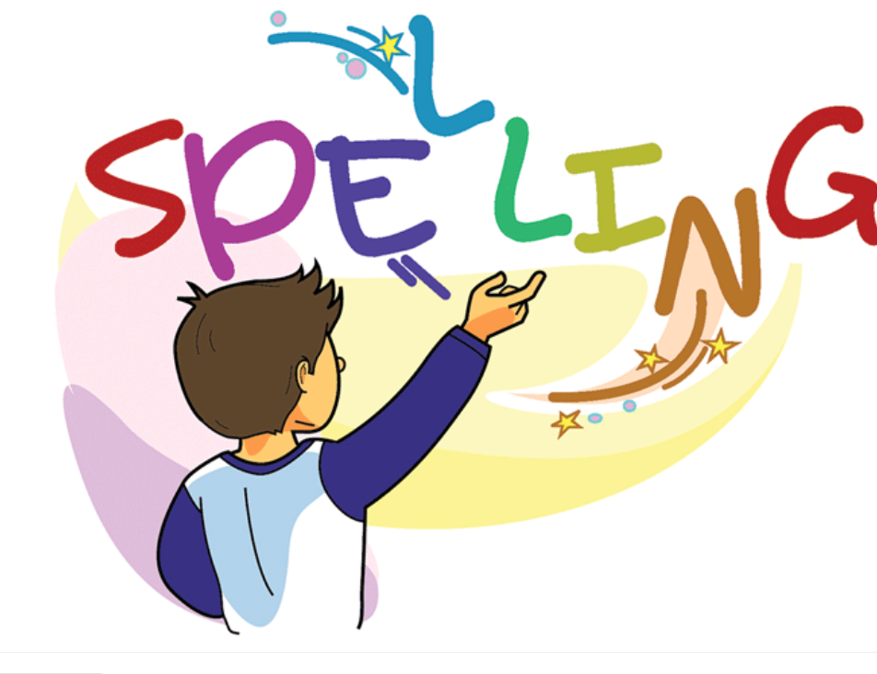

Slide 2
Spelling Test Simple Present Tense Adding “s” 10 minutes
Pop Up Quiz 30 minutes
First Session Completed

Slide 3
Adding “er” to the Verbs to become Nouns
Explain to students that adding “er” to a verb
changes the word into a noun and therefore changing the
meaning of the word.
Ex
Verb Noun
eat eater
↓ ↓
To eat Someone who eats a lot

Slide 4
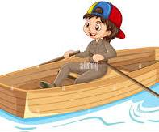
Spelling Words Adding “er” to the verb to make a noun
rower
A rower is a person who rows a boat, especially as a sport.
Andrew is a fast rower.

Slide 5
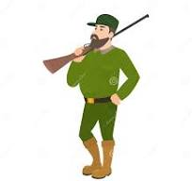
hunter
A hunter is a person who hunts wild animals for food or as a sport.
My uncle Ted is a good deer hunter.

Slide 6
printer
A printer is a machine that can be connected to a computer in order to make copies on paper of documents or other information held by the computer.
My printer ran out of ink.

Slide 7
reader
A reader is a person who reads, especially one who reads for pleasure.
David is an avid reader. He reads all sorts of books.

Slide 8
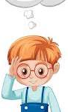
thinker
A thinker is a person who spends a lot of time thinking deeply about important things, especially someone who is famous for thinking of new or interesting ideas.
Albert Enstein was a great thinker.

Slide 9
cleaner
A cleaner is someone who is employed to clean the rooms and furniture inside a building.
Sarah is an amazing cleaner the rooms are shiny after she cleans them.

Slide 10
sweeper
A person employed to sweep, such as a roadsweeper.
Dan is our classroom sweeper. Our classroom is spotless after he finishes sweeping.

Slide 11
cooker
A cooker is a large metal device for cooking food using gas or electricity. A cooker usually consists of a grill, an oven, and some gas or electric rings.
Dad bought a new cooker for my Mum’s Birthday.

Slide 12
singer
A singer is a person who sings, especially as a job.
Sarah is the lead singer in our school band.

Slide 13
gardener
A gardener is someone who enjoys working in their own garden growing flowers or vegetables.
Mr. Smith is a great gradener he takes good care of the
flowers and vegetables he grows.

Slide 14
Thank You

