Slide 2
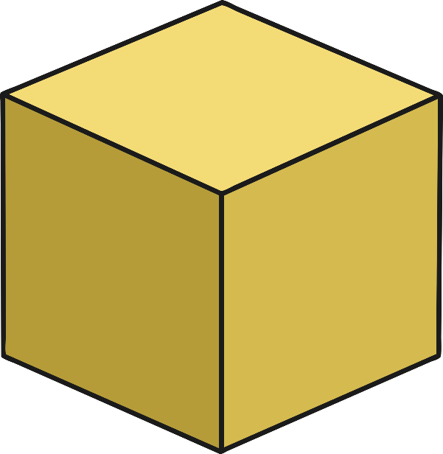
Cube
Cubes have:
6 faces;
12 edges
8 vertices;
edges that are all the same length.

Slide 3
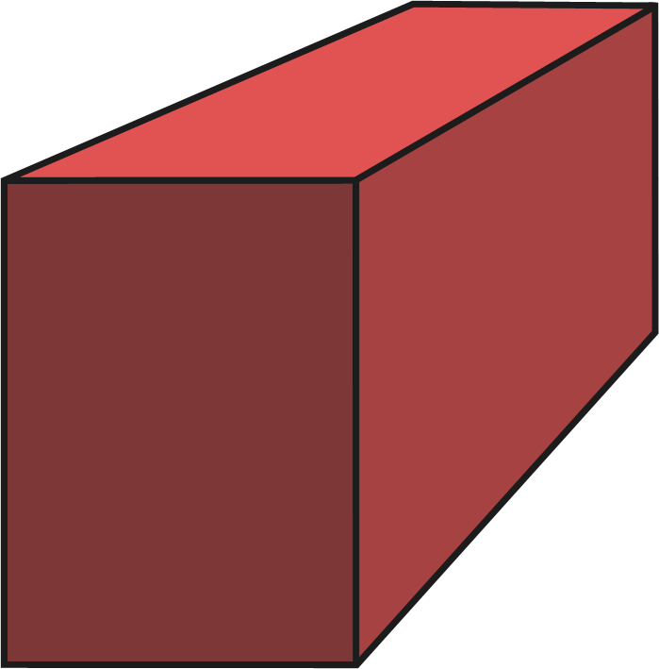
Cuboid
Cuboids have:
6 faces;
12 edges
8 vertices;
edges that are not all the same length.

Slide 4
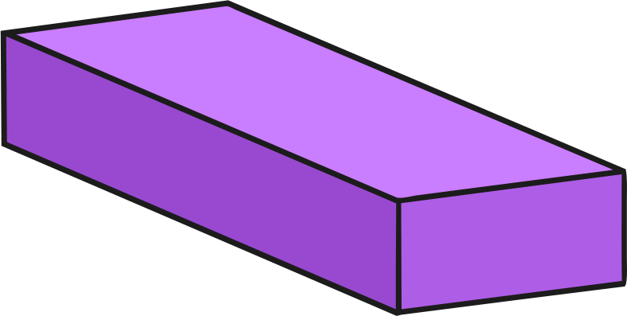
Rectangular Prism
Rectangular prisms have:
6 faces;
12 edges
8 vertices;
edges that are not all the same length.

Slide 5
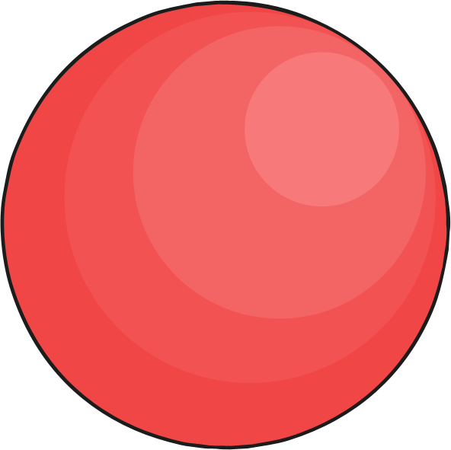
Sphere
Spheres:
are perfectly round;
have no edges;
have no vertices.
1 curved surface

Slide 6
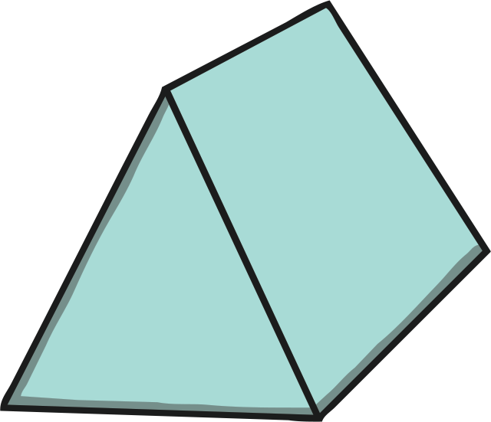
Triangular Prism
Triangular prisms have:
5 faces;
2 triangular faces;
3 rectangular faces;

Slide 7
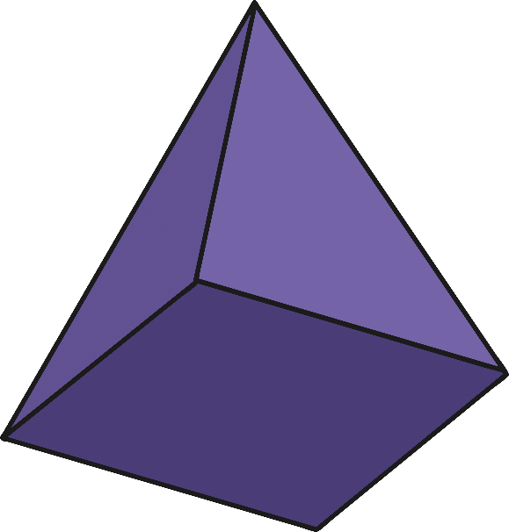
Square-Based Pyramid
Square-based pyramids have:
a square base;
4 triangular faces that make a sharp point;
5 faces.

Slide 8
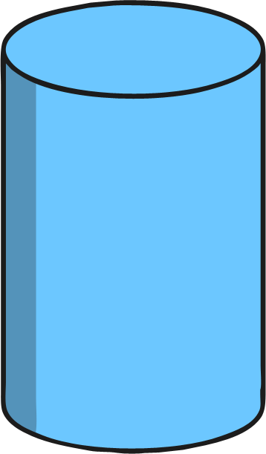
Cylinder
Cylinders have:
2 flat and circular faces;
1 curved surface;
no vertices.

Slide 9
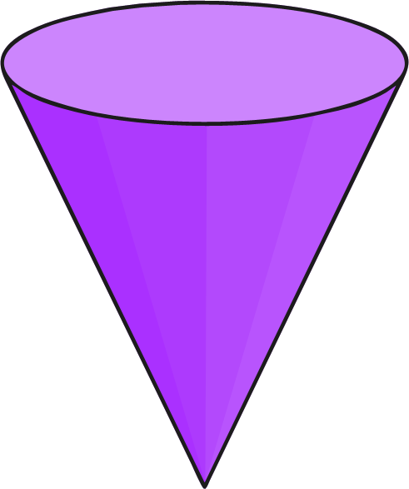
Cone
Cones have:
1 flat face which is a circle;
1 vertex;
1 edge;
1 curved surface.

