Slide 1
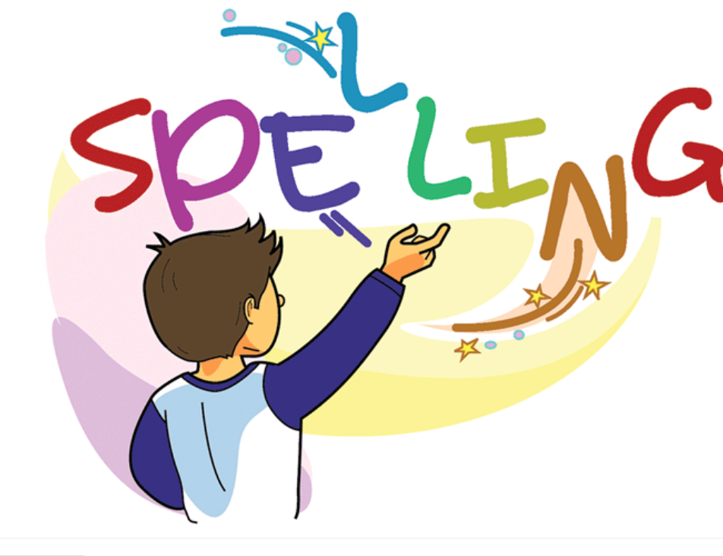

Slide 2
Pop Up Quiz (30 mins)
Students are to read the comprehension on their own.
Once done they get to answer the questions independently. (15 mins)
Once done after 15 mins Teacher is to read the comprehension and
questions one by one. As the struggling students get a chance to
answer and the independent students could check their work.

Slide 3
Spelling Test words with /air/ sound. (15 mins)

Slide 4
Words with the /are/ sound
Bingo Game Activity (Group Work)
Explain the Bingo game to students. (5 mins)
1.Teacher will have 10 word mats for the bingo game.
2.Divide your class in a way that each group has 2 mats.
3.Explain to students that picture cards will be distributed on the tables.
4.Explain to students that the teacher will say a word. The aim is put the picture on the correct word.

Slide 5
5.The students who match their pictures first are the winners.
6.Ps. Explain to students that in the bingo game not all pictures match the words.
Some words would be written and without a picture to match it.

Slide 6
Bingo Picture Cards

Slide 11
air | ow

Slide 27
Spelling Words Words with /are/ sound
hare
A hare is an animal like a rabbit but larger with long ears, long legs, and a small tail.
The fox was chasing the hare.

Slide 28
care
If you care about something, you feel that it is important and are concerned about it
Adam takes good care of his little cat.

Slide 29
glare
A glare is an angry, hard, and unfriendly look.
Amy glared at her brother for not listening to her.

Slide 30
bare
If a room, cupboard, or shelf is bare, it is empty.
His fridge was bare apart from three very small tomatoes.

Slide 31
share
If you share something that you have with someone, you give some of it to them or let them use it.
Sara shared her new toy with Steven.

Slide 32
scare
If something scares you, it frightens or worries you.
Sitting in a dark room scares me.

Slide 33
spare
You use spare to describe something that is not being used by anyone, and is therefore available for someone to use.
Nancy gave me her spare buttons to use.

Slide 34
dare
If you dare someone to do something, you challenge them to prove that they are not frightened of doing it.
Lina dared Omar to jump into the cold water.

Slide 35
rare
Something that is rare is not common and is therefore interesting or valuable.
Diamonds are rare precious rocks..

Slide 36
square
A square is a shape with four sides that are all the same length and four corners that are all right angles.
My lunch box looks like a square.

Slide 37
Thank You

