Slide 1
READING LESSON
ONE SNOWY NIGHT
Comprehension
Skills
P. 4-5

Slide 2
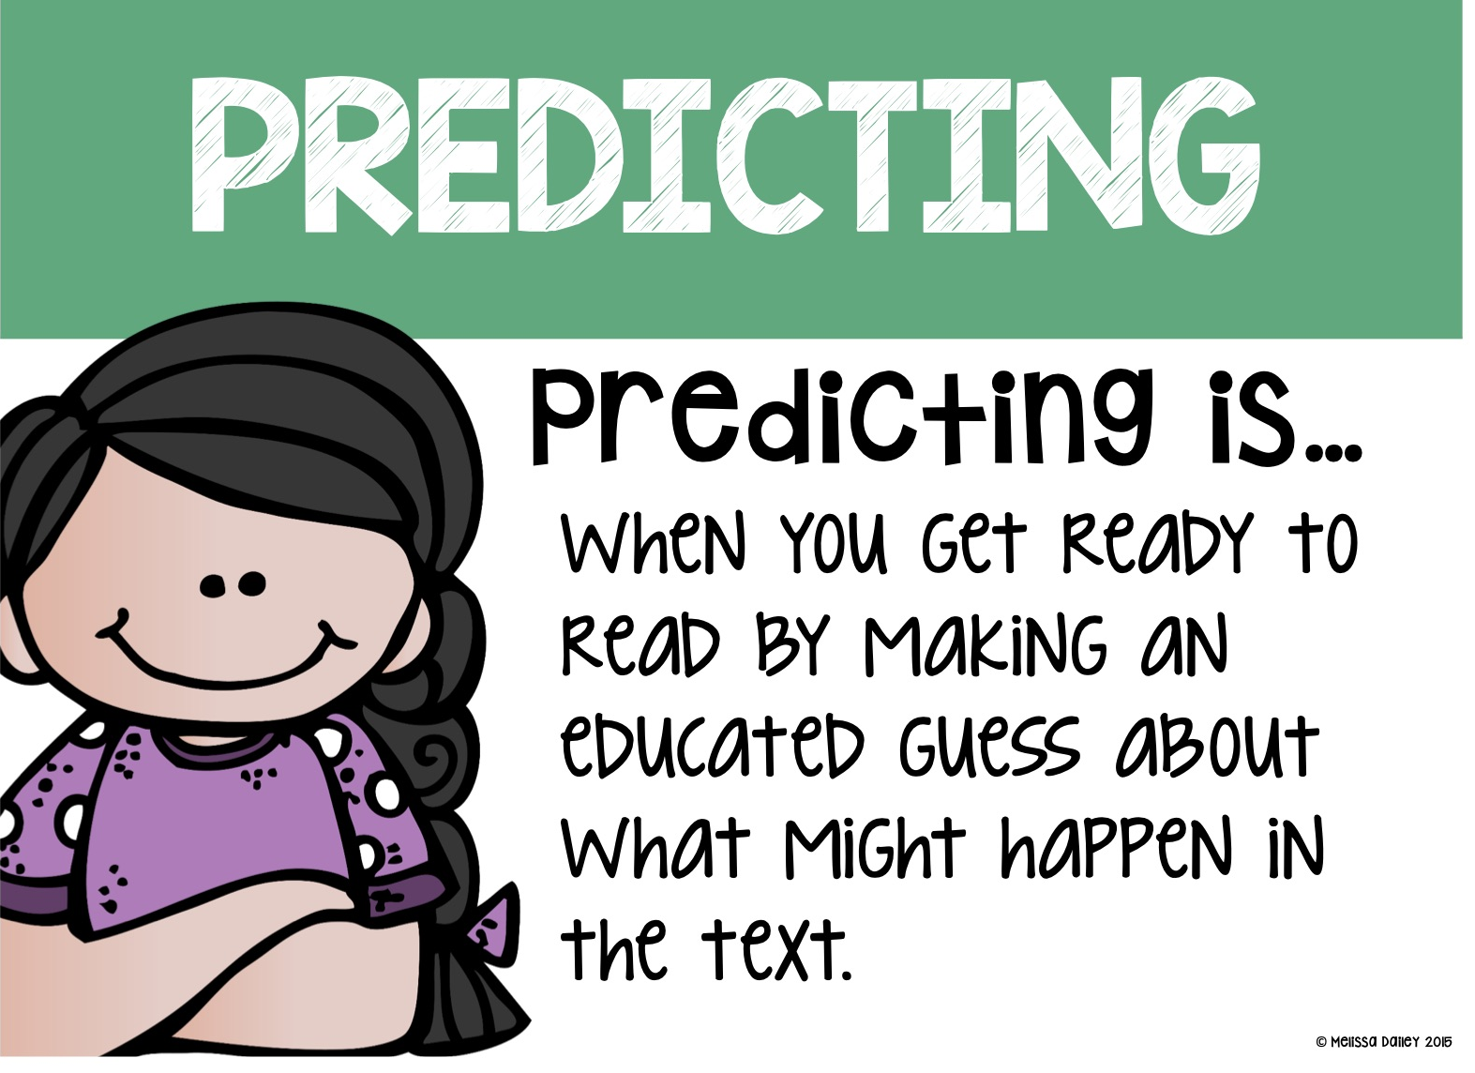
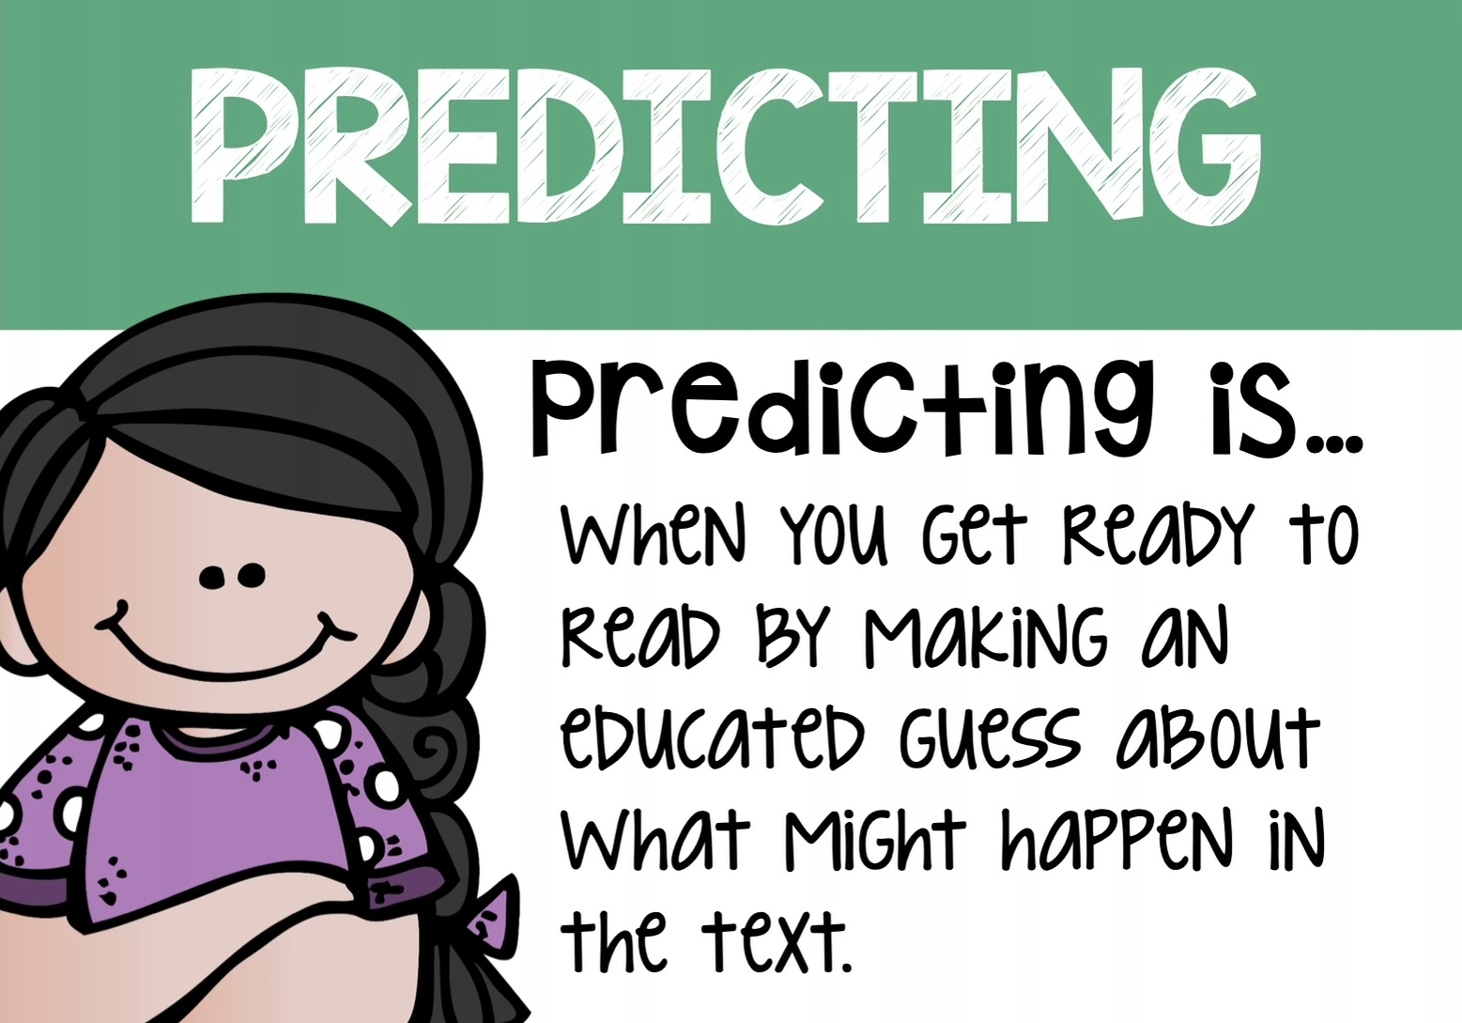
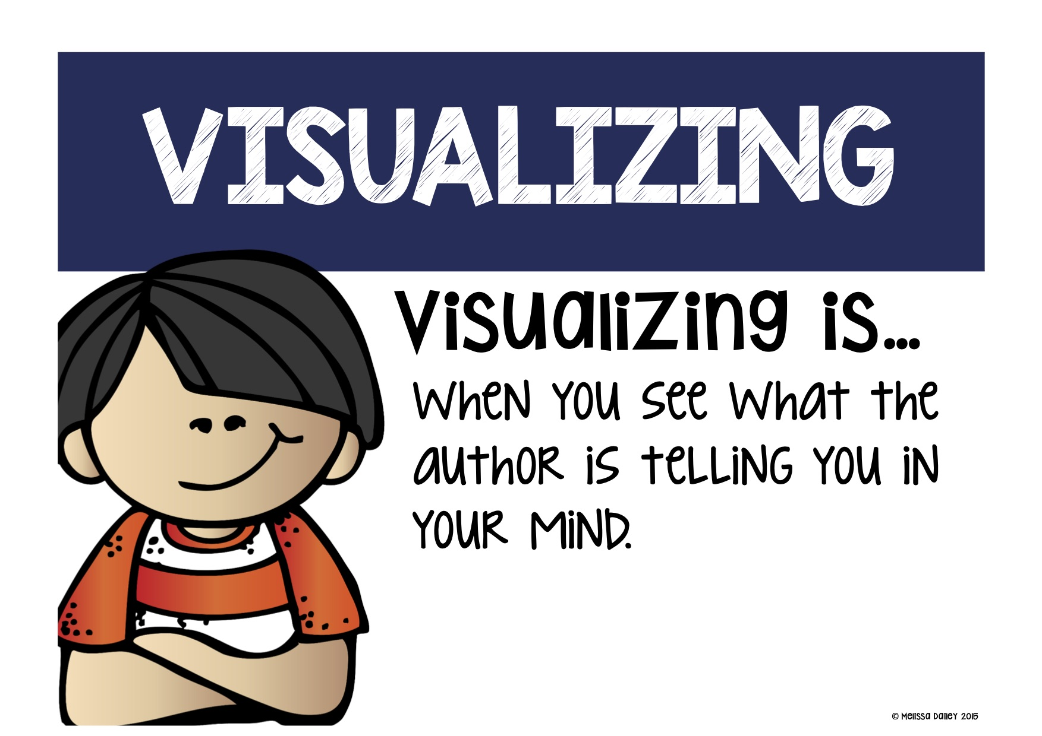
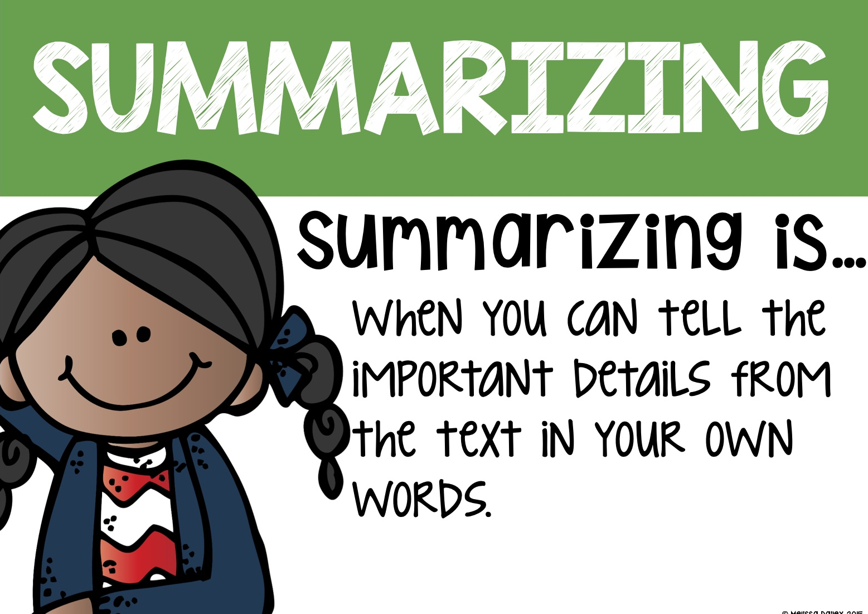
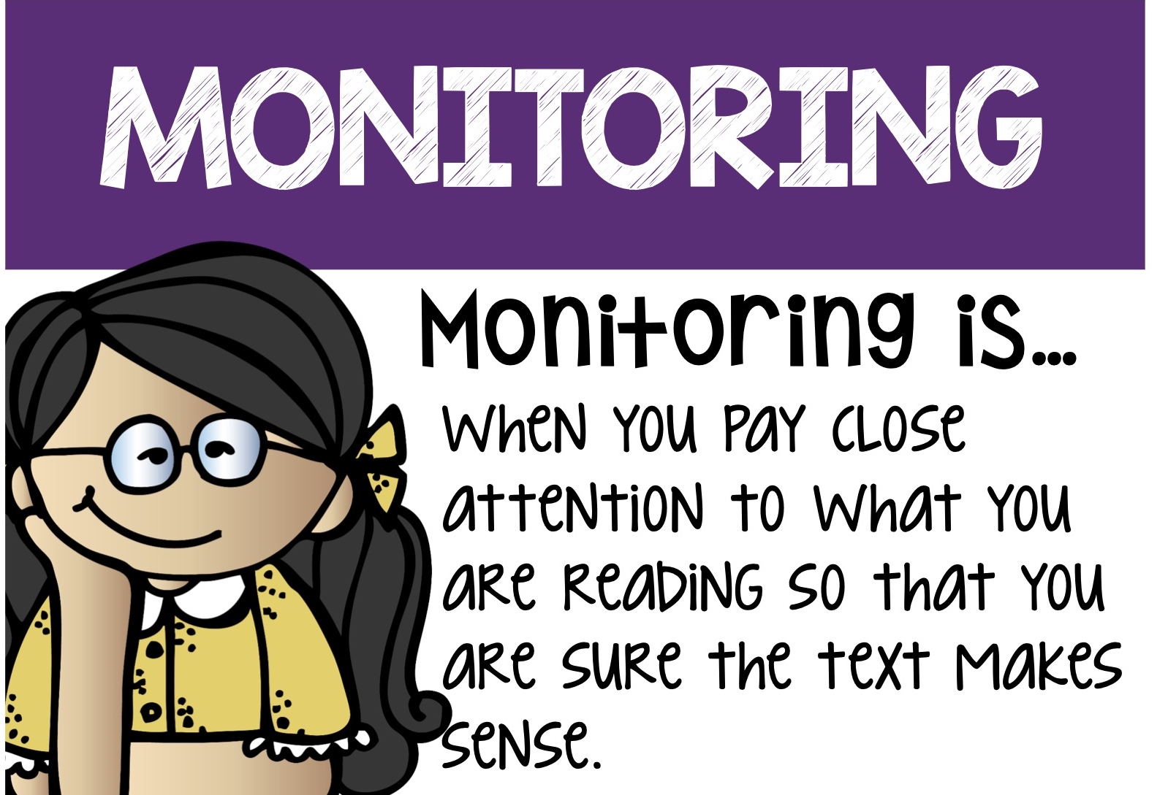
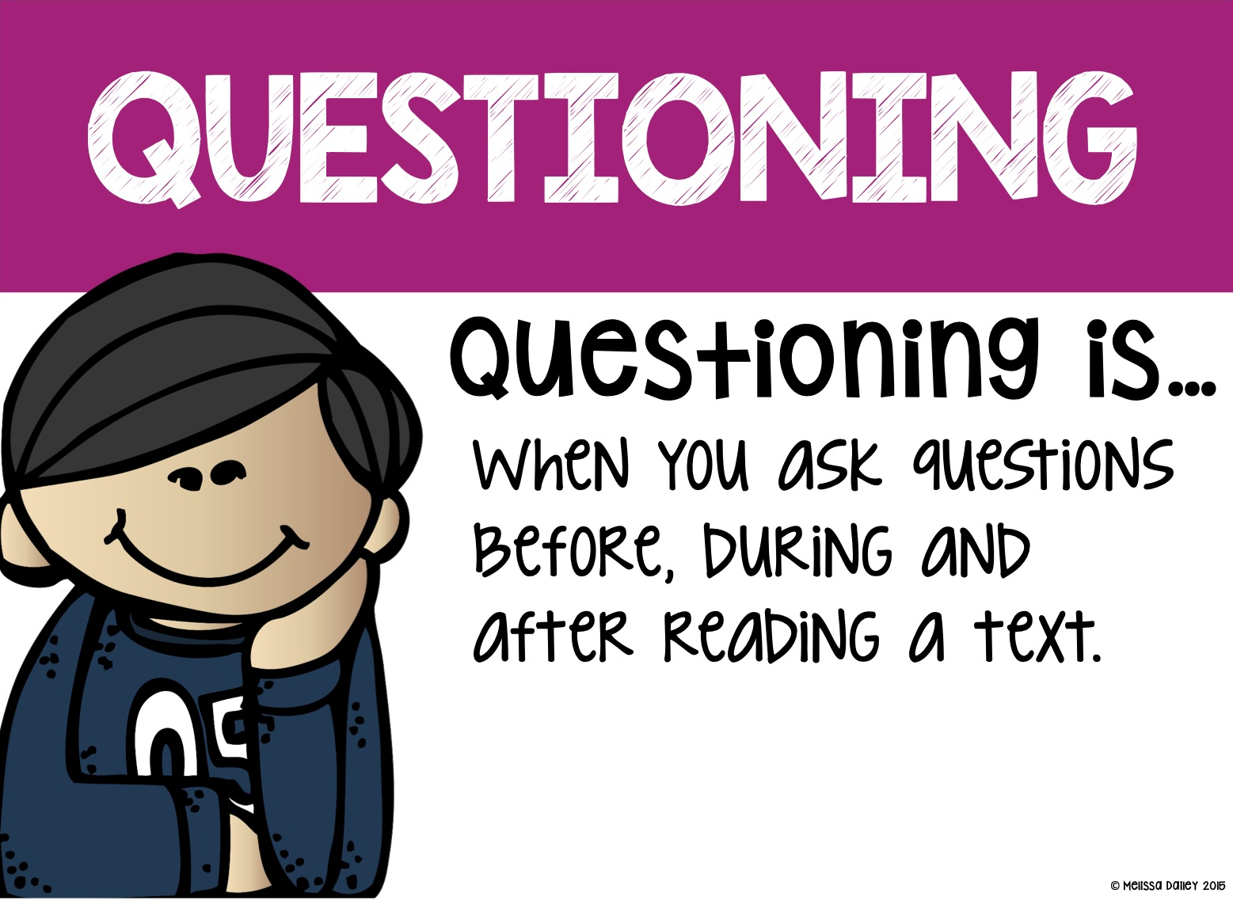
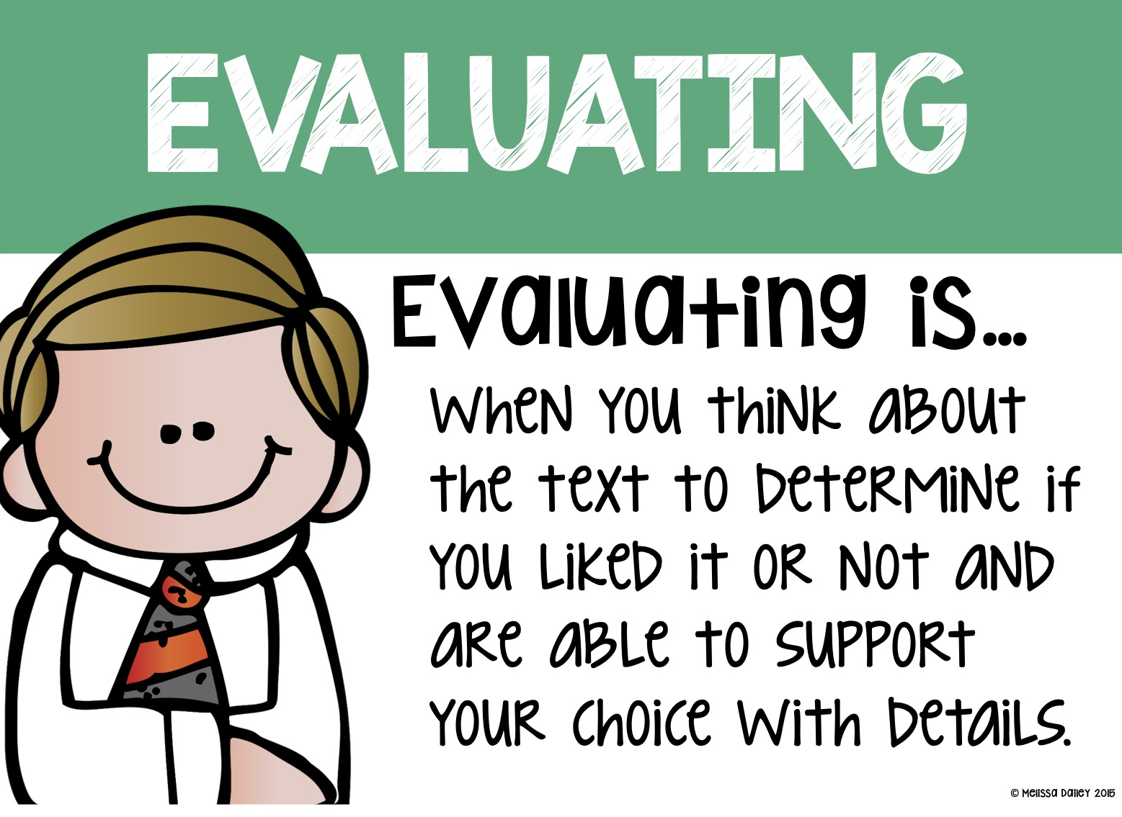
Reading Comprehension Strategies

Slide 3
01
Reading Strategies

Slide 4
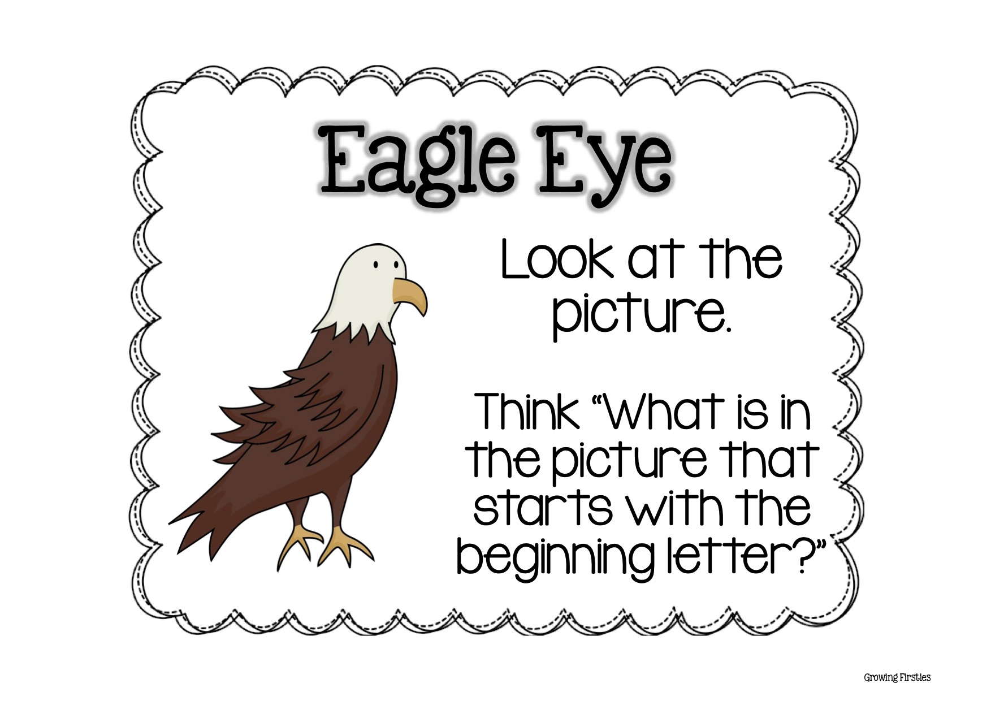
Notes:
Eagle eye is a reading strategy that reminds students to check the picture when they are stuck on a word.

Slide 5
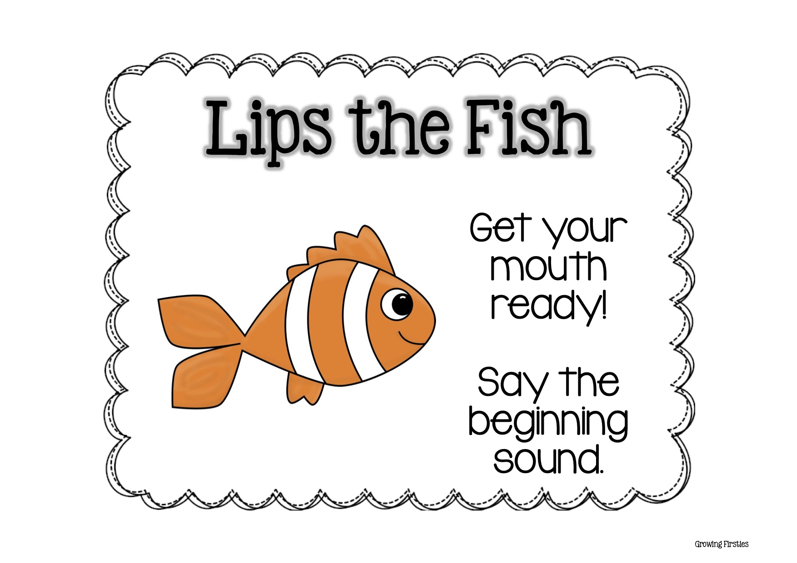
Notes:
Lips the Fish reminds readers to look at the beginning of a word and get their lips ready to say the first sound. This essential strategy centers on the Graphophonic or Visual cues students see as they focus on the printed letters of a word.

Slide 6
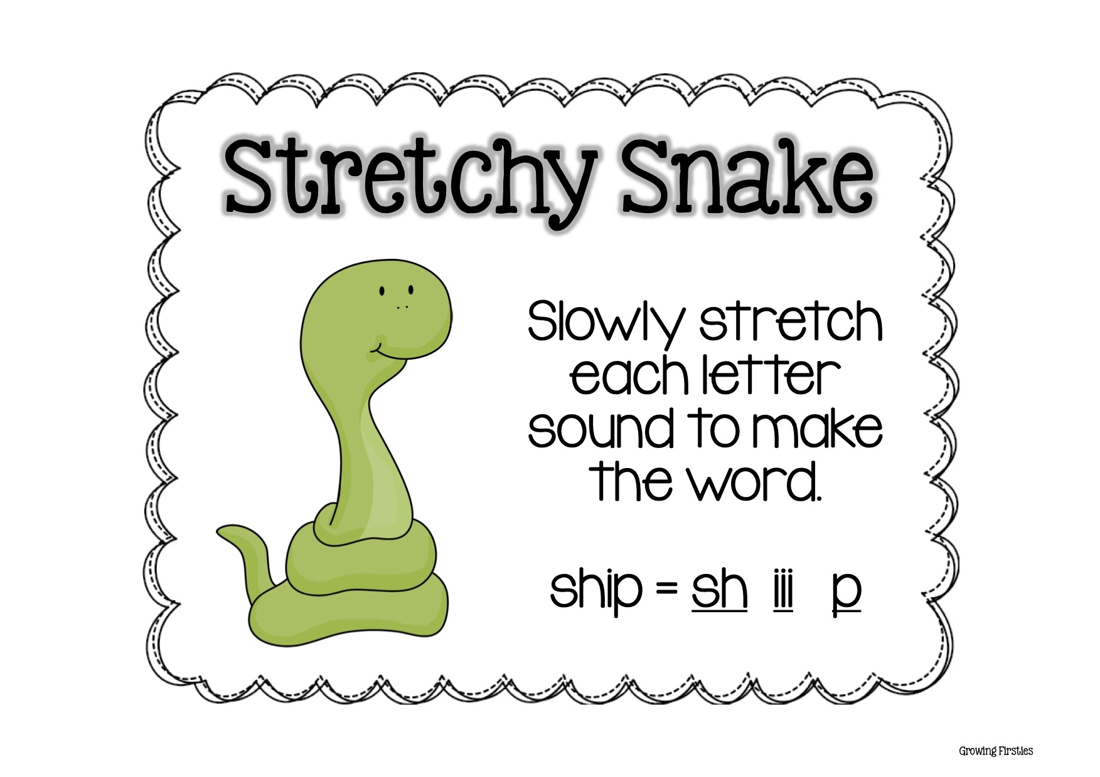
Notes:
Stretchy Snake is an important tool that helps readers decode by stretching out letter sounds and blending them together to form words

Slide 7
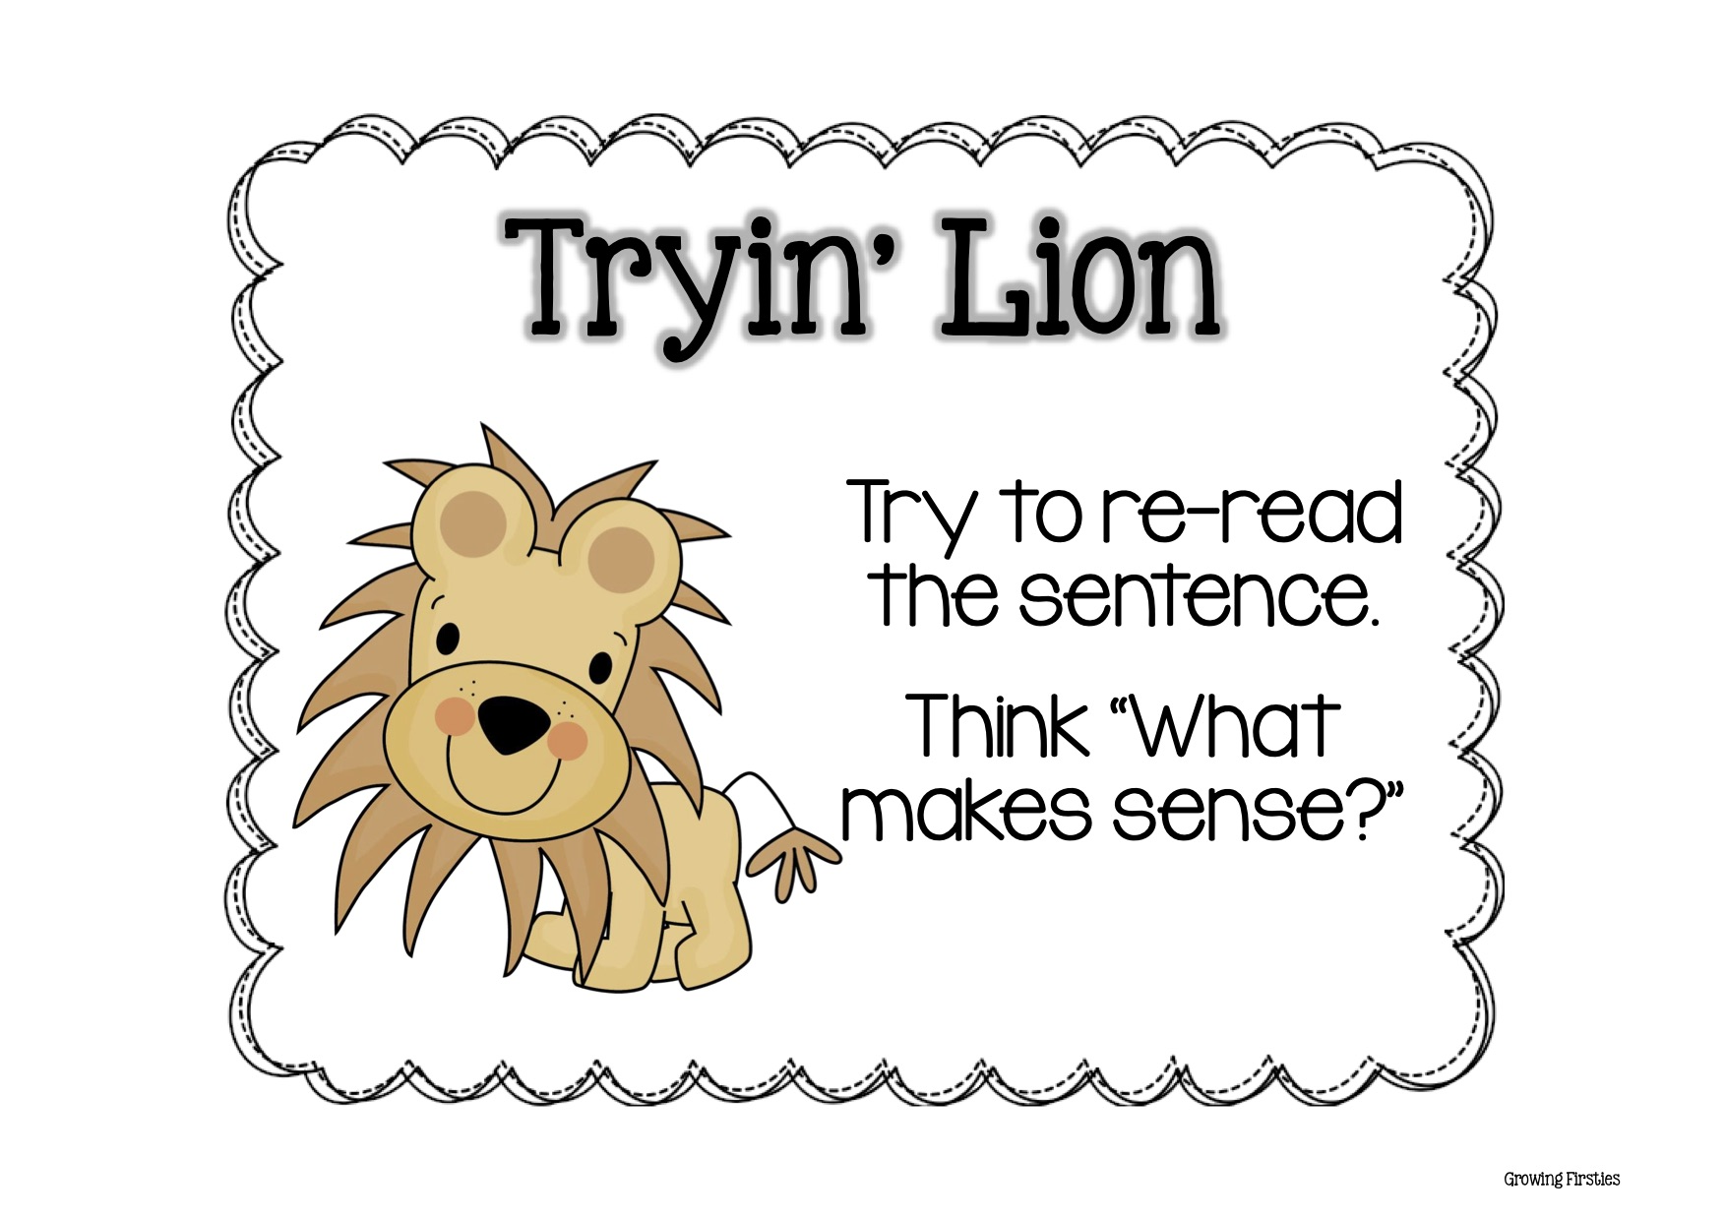
Notes:
When readers come to a word they don't know, Tryin' Lion teaches them to try all the other strategies first. Then if they still can't solve the unknown word, they should read the sentence and just try out a word they think will make sense.

Slide 8
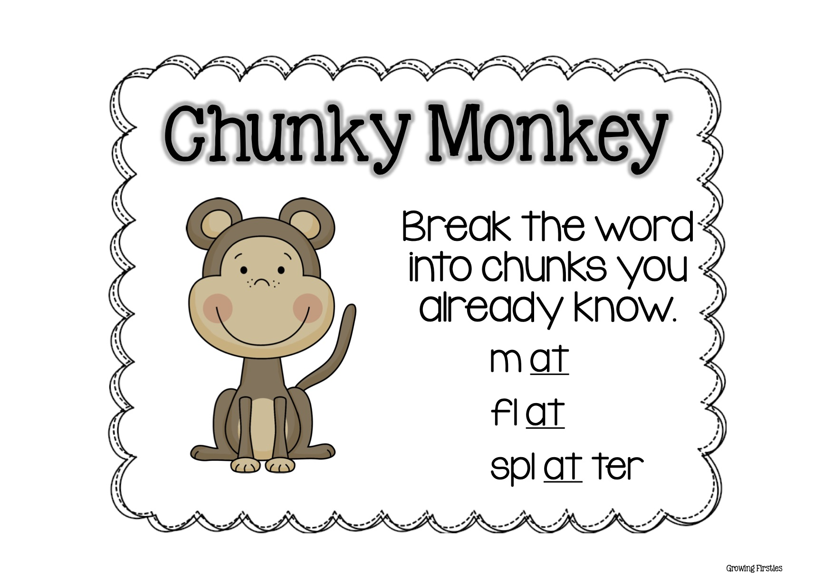
Notes:
"Chunky Monkey" is a decoding strategy that can be taught to help students when they approach a word they don't know. Chunky Monkey teaches them to look for small "chunks" they know in a bigger word.

Slide 9
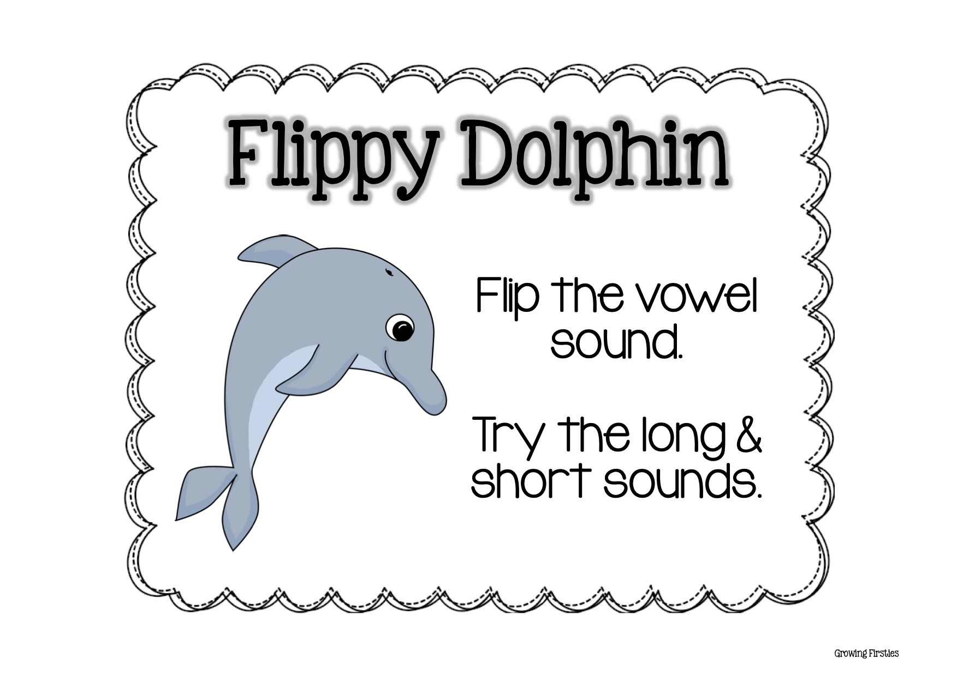
Notes:
Flippy Dolphin teaches them to try the long vowel sound if the short vowel sound doesn't make sense.

Slide 10
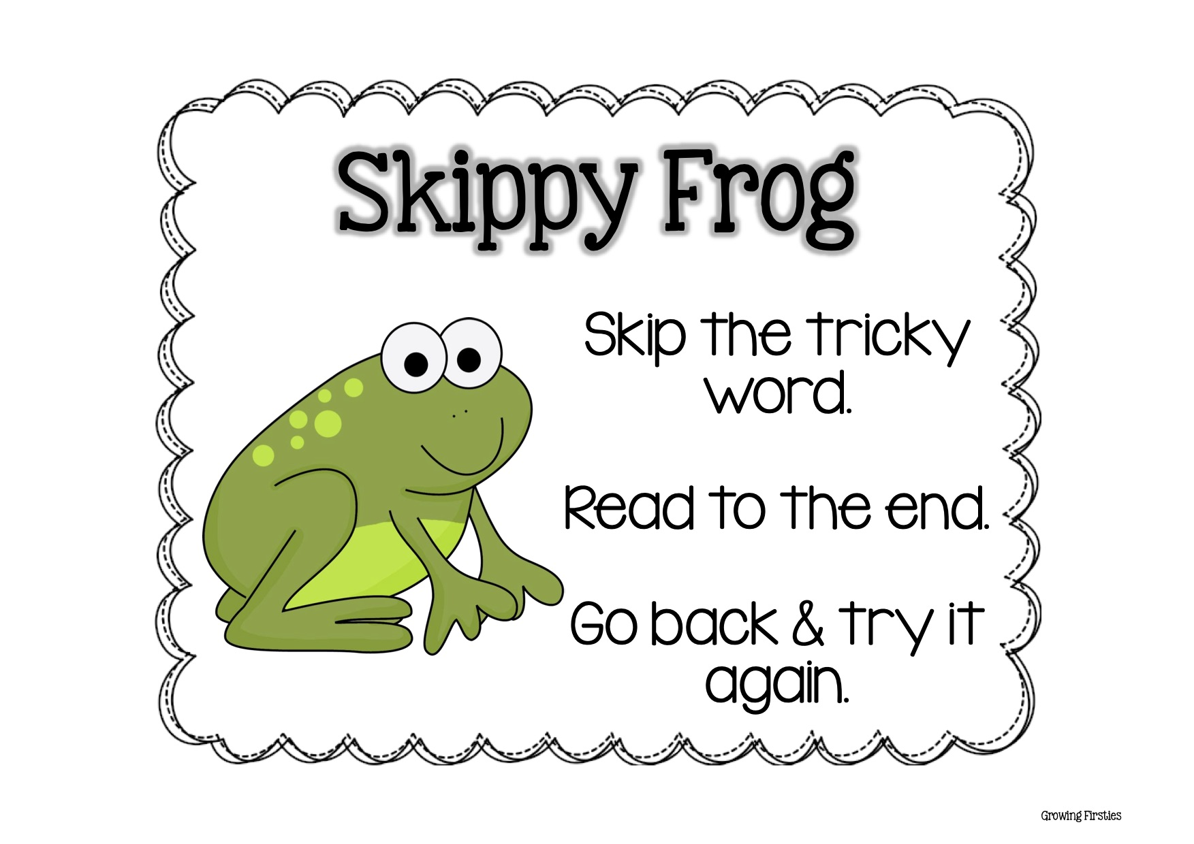
Notes:
Skippy Frog is a reading strategy that teaches young readers to skip the tricky word, read to the end of the sentence, and then come back and try it again. I purposefully wait to introduce this strategy until they've learned many others because students have a tendency to over-use this strategy.

