Slide 1
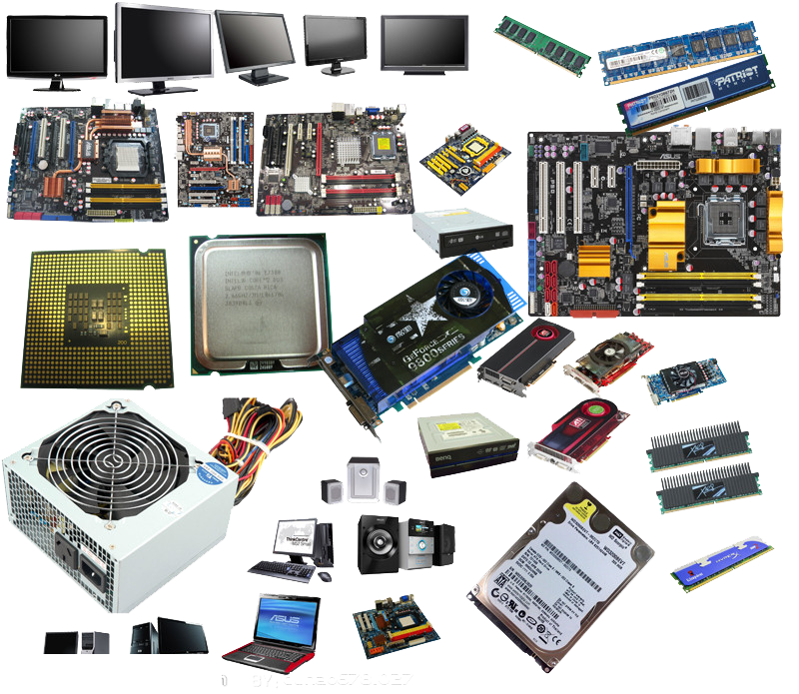
Hardware and software

Slide 2
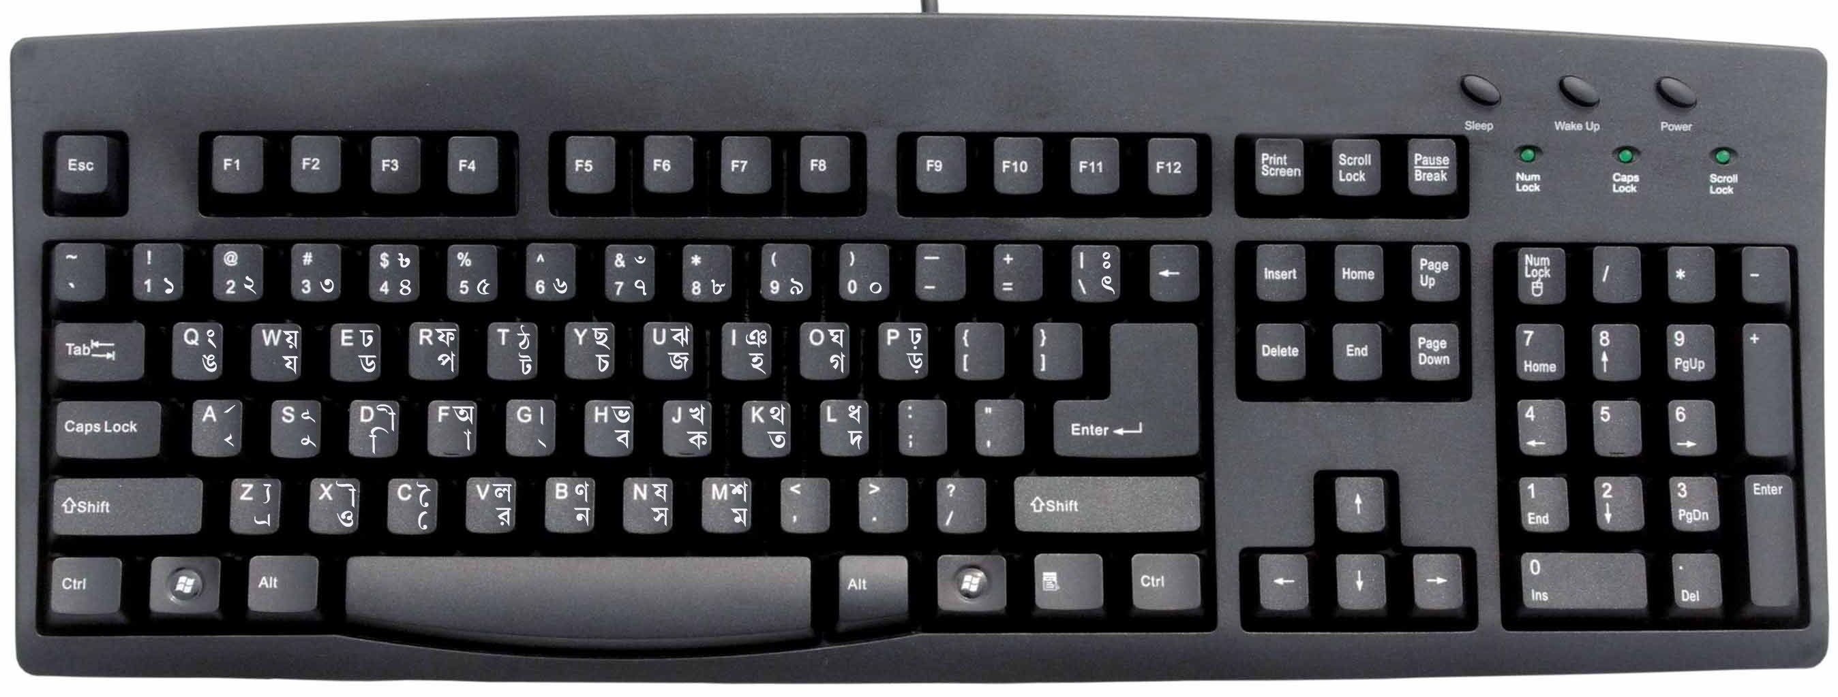
Hardware
Mouse
Keyboard
Monitor

Slide 3
Soft Ware
Google Chrome
Firefox

Slide 4
Difference Between Hardware and Software

