Slide 1
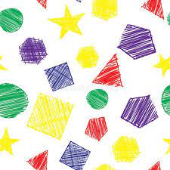
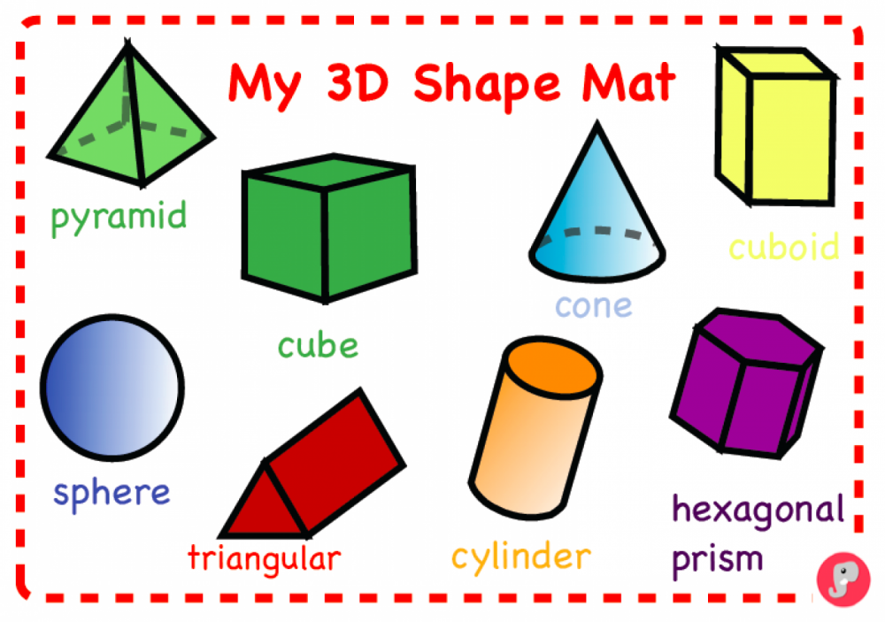

Slide 2
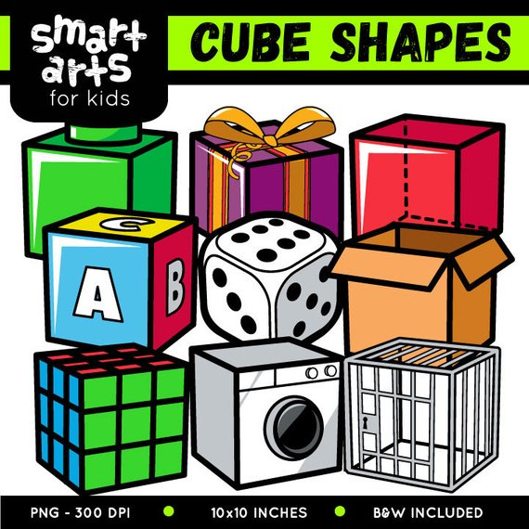

Slide 3
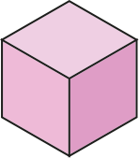
I am a cube, I neatly stack, Upon my other brother’s back.

Slide 4
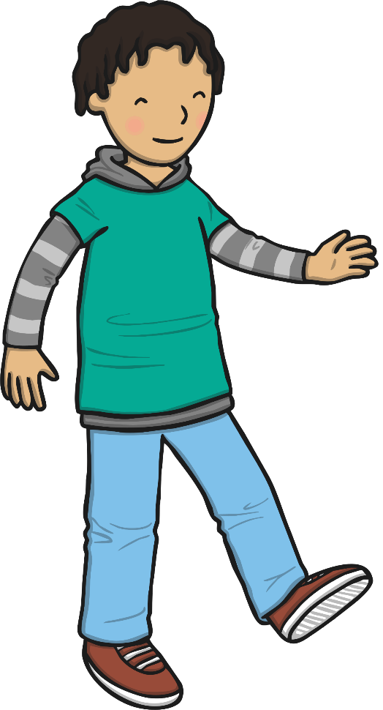
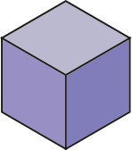
Build me up into a tower, Knock me down, and down we shower.

Slide 5
I have 6 faces, all the same, You can use me for a game,

Slide 6
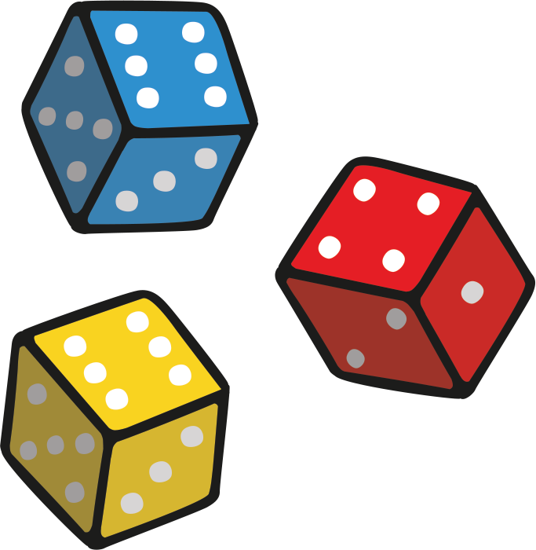
For I’m a dice and I will show, How many spaces you can go.

Slide 7
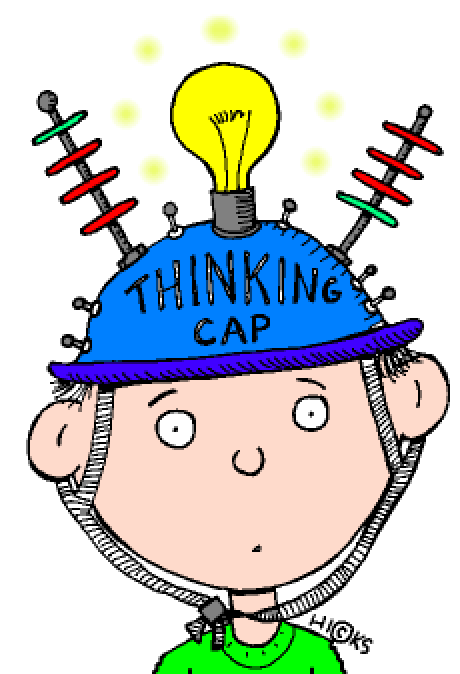
Now, put your thinking cap on! Can you find the cube?

Slide 8
Can you find the cube?

Slide 9
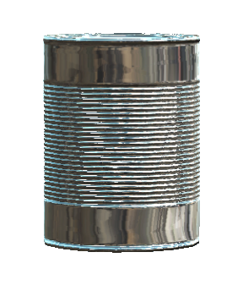
Can you find the cube?

Slide 10
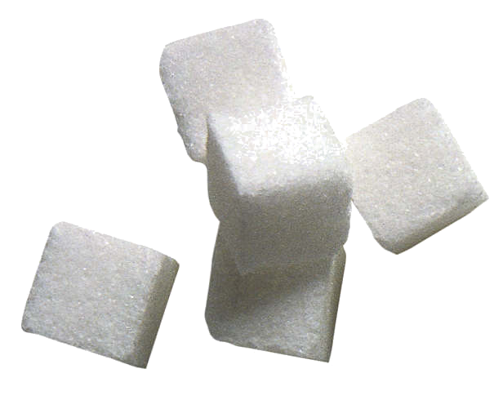
Can you find the cube?

Slide 11
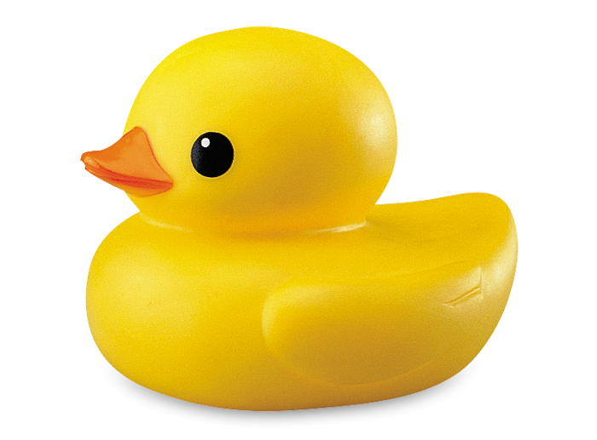
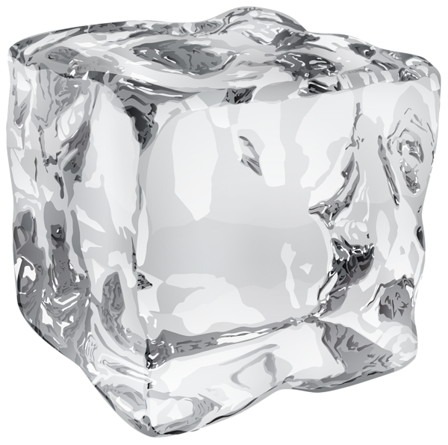
Can you find the cube?

Slide 12
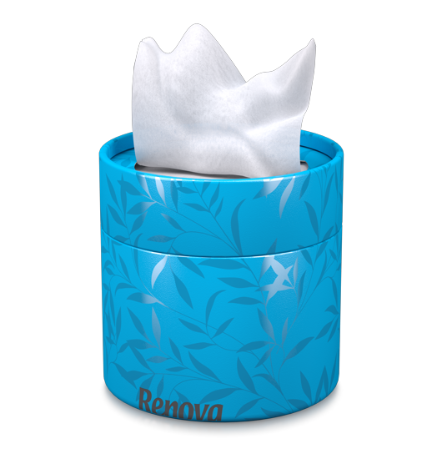
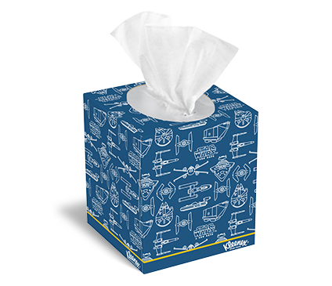
Can you find the cube?

Slide 13
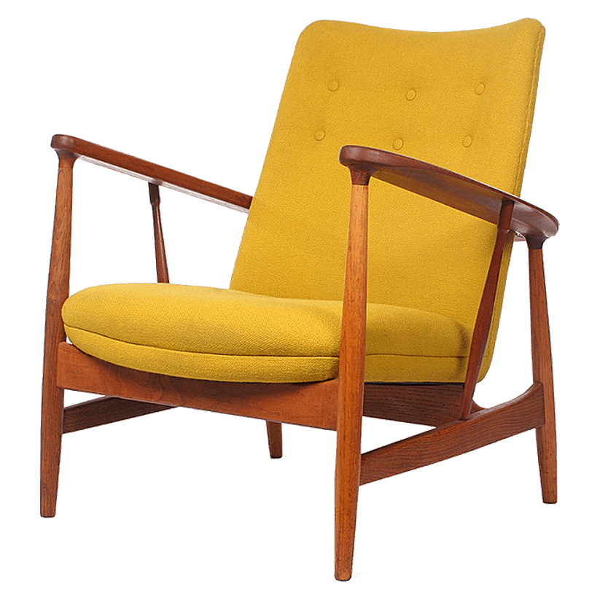
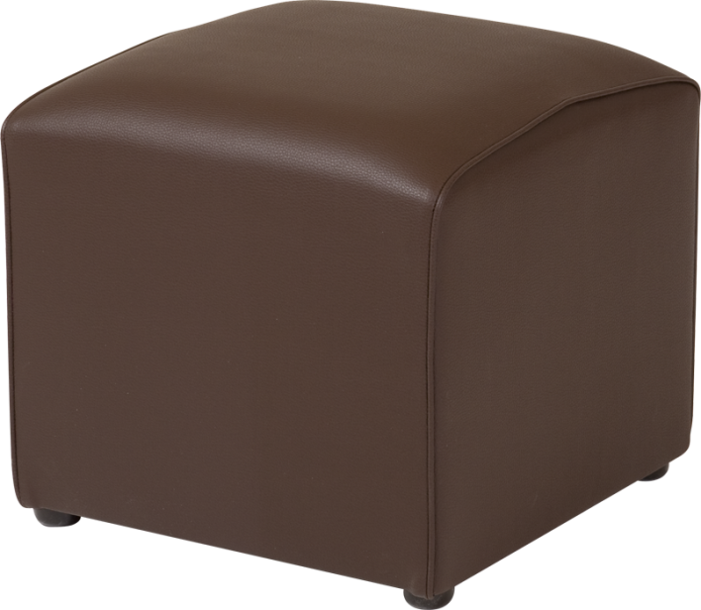
Can you find the cube?

Slide 14
You are Stellar!

