Slide 1
Revision
Y4

Slide 2
Contents Of This Template
Add and subtract numbers with up to three digits, using formal written methods of columnar addition and subtraction. Using a formal written method, find the answers
a) 43 + 62 =
c) 372 + 559
b) 403 - 178 =
3 9
1
1
2
4 0 3
-
1 7 8
3 7 2
+
5 5 9
4 3
+
6 2
1
10 5
5
1
3
9
2
2

Slide 3
3 b
2 + 8 10
Use this calculation to answer the following:
10 - 2 =
8
10 - 8 =
2
2 | 8
10
8 + 2 =
10

Slide 4
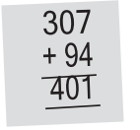
3 b
Use this calculation to answer the following:
307
94
307 | 94
401

Slide 5
+ addition plus
Missing number in addintion
subtract -
5
10 + ….. = 15
15 – 10 = 5
13
..….. + 2 = 15
15 – 2= 13

Slide 6
- subtraction Minus
Missing number
in the middle -
Missing number
in the beginning +
5
17
20 - ….. = 15
..….. - 2 = 15
20 – 15 = 5
15 + 2= 17
4
34 - ….. = 30
27
..….. - 12 = 15
34– 30 = 4
15 + 12= 27

Slide 7
4)
125
19
200- 75= 125
100- 81= 19
135
432
99+ 36= 135
713 - 281= 432

Slide 8
Solve these problems: b) Sonny has £4.50. He wants to buy a present for his dad that costs £6.25. How much more money does he need to save?
4)
4.50 + ……. = 6.25
6.25 - 4.50 =
5
6 . 2 5
-
4 . 5 0
1
1 .
5
7

Slide 9
Remember to
Jack, Tom and Leanne have collected
World Cup football cards.
Jack has 46,
Tom 59
And Leanne 124.
i) How many more
does Leanne have than Tom?
59 + ….. = 124
124 - 59 =
1
1
1
1 2 4
-
5 9 =
6
5

Slide 10
Remember to
Jack, Tom and Leanne have collected
World Cup football cards.
Jack has 46,
Tom 59
And Leanne 124.
ii) How many cards to Jack,
Tom and Leanne have altogether?
46 +59 + 124
1
1
1 2 4
+ 5 9
+ 4 6
2
2
9

Slide 11
On Red Nose Day, two Year 3 classes sell iced biscuits. One class raises £5.20 and theother £6.85. How much do they raise altogether?

Slide 12
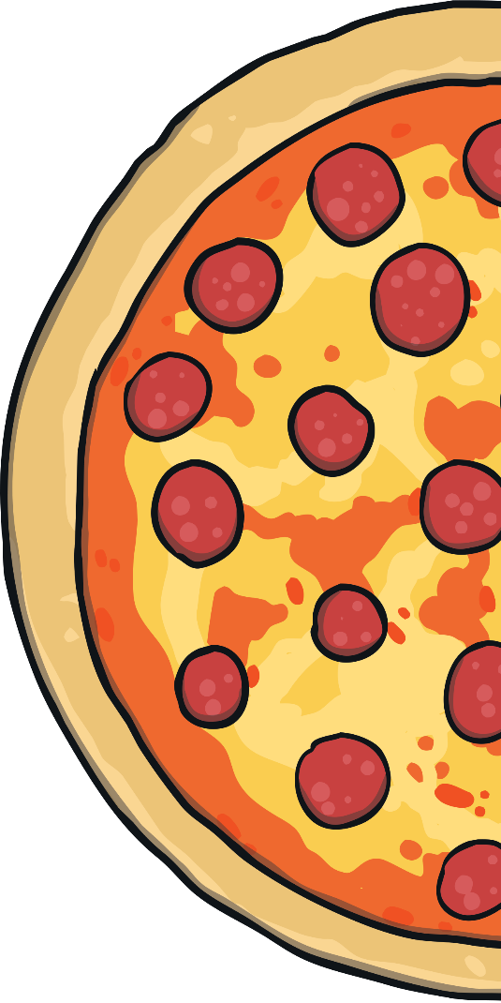
$$\frac{1}{2}$$
1 out of 2
1 from each 2
1 over 2
1 ÷ 2
One half

Slide 13
Fraction complete the missing boxes in this sequence :
$$\frac{5}{10}$$
$$\frac{7}{10}$$
$$\frac{6}{10}$$
$$\frac{4}{10}$$
$$\frac{3}{10}$$
$$\frac{2}{10}$$
$$\frac{8}{10}$$

Slide 14
Fractions

Slide 15
Ring $\frac{8}{10}$ of these apples

Slide 16
fractions
$$\frac{4}{10}$$

