Slide 1
Activity Time.

Slide 2
Noun, Verb and Adjective Word and Picture Sorting Activity Group Work
Different flash cards with noun, verb and Adjective words. Divide students into groups and have them sort the words into nouns, verbs and adjectives
Noun | Verb | Adjective

Slide 3
Noun, Verb and Adjective Words

Slide 4
Noun, Verb and Adjective Words

Slide 5
Noun, Verb and Adjective Words

Slide 6
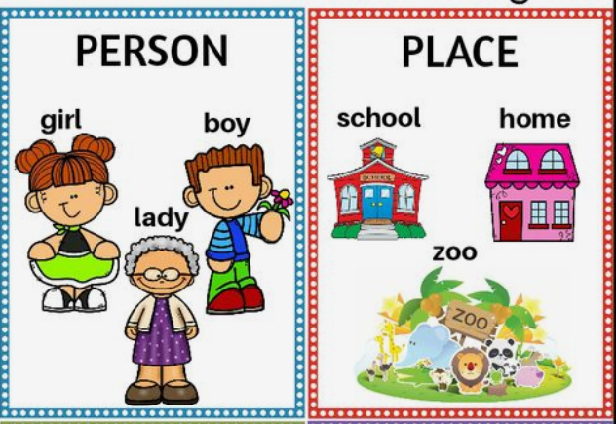

Slide 8
Verbs
A verb is an action word.
Verbs describe what some one or something is doing.

Slide 9
Verbs
A verb is an action word.
Verbs describe what some one or something is doing.

Slide 10
Verbs
A verb is an action word.
Verbs describe what some one or something is doing.

Slide 11
Adjectives
Adjectives are words that describe a noun.
Noun: Suri
Adjectives: Colour (red)
Size (small)
feeling (sad)
age (young)

Slide 15
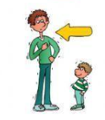
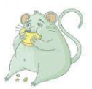
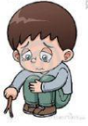
Ben has a red hat.
My dad is tall.
A fat rat is on the rug.
The candy is sweet.
The boy is sad.

