Slide 1
VOCABULARY WORDS
Term 2
Week 6

Slide 2
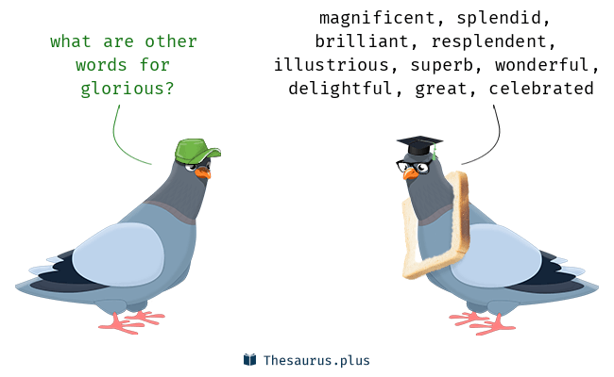
glorious
Meaning:
Marvelous- wonderful
Sentence:
"the most glorious victory of all time"

Slide 3
accomplished
Meaning: to finish successfully
Sentence:

Slide 4
devoted
Meaning:
Dedicated- loyal- committed
Sentence:

Slide 5
essential

Slide 6
microscopic
Meaning:
so small as to be visible only with a microscope.
Sentence:
Skin cells, bacteria, and some kinds of algae are all microscopic, or too small to see without a microscope.

Slide 7
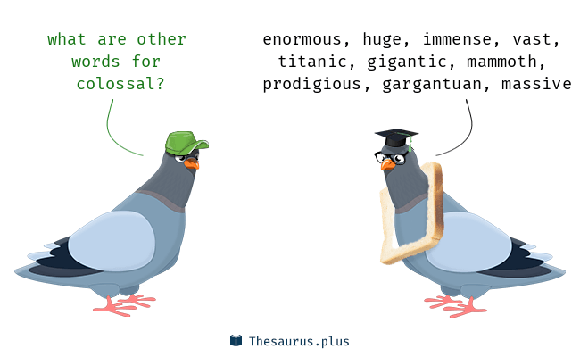
colossal
Meaning:
enormous
Sentence:

