Slide 1
Instructions
Please make sure you view this PowerPoint in Presentation mode.
When you start the game, choosing the correct question word on each slide will enable you to move on to the next. If the wrong word is clicked on, you'll be unable to progress until you click the correct answer.

Slide 3
A Quick Chance to Revise
Click on the word to show it in the past simple.
have
go
get
do
eat
had
went
got
did
ate
run
win
swim
sing
tell
ran
won
swam
sang
told
sell
fall
feel
meet
know
sold
fell
felt
met
knew
hear
think
pay
come
break
heard
thought
paid
came
broke
wear
lose
make
write
buy
wore
lost
made
wrote
bought
drink
say
see
find
bring
drank
said
saw
found
brought

Slide 4
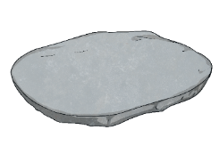
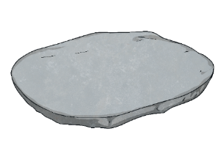
Rules of the Game
This game will help you revise irregular verbs.
You must help an alien, Puchu, choose the right verb in the past simple and step on the right stone to avoid the lava. If you choose the wrong stone, you must go back to the beginning of the game.
Everyone can join in by shouting ‘The floor is lava!’ If that happens, everyone must make sure that they aren’t touching the floor by jumping on a chair or other furniture.

Slide 5
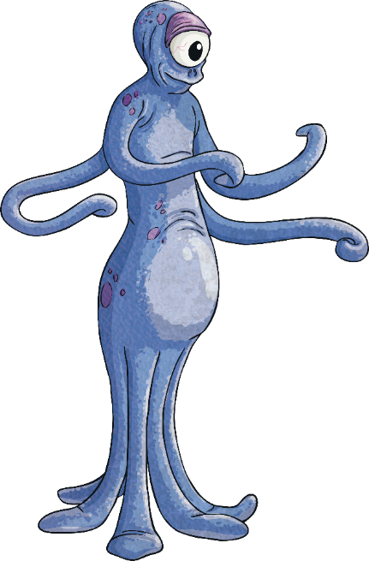
The Floor Is Lava
This is Puchu the alien. Help her get across the lava by choosing the correct form of the verb in the past simple.
Don’t get a question wrong because if you do, the floor turns to…
A
A
L
V
!
Start the Game

Slide 6
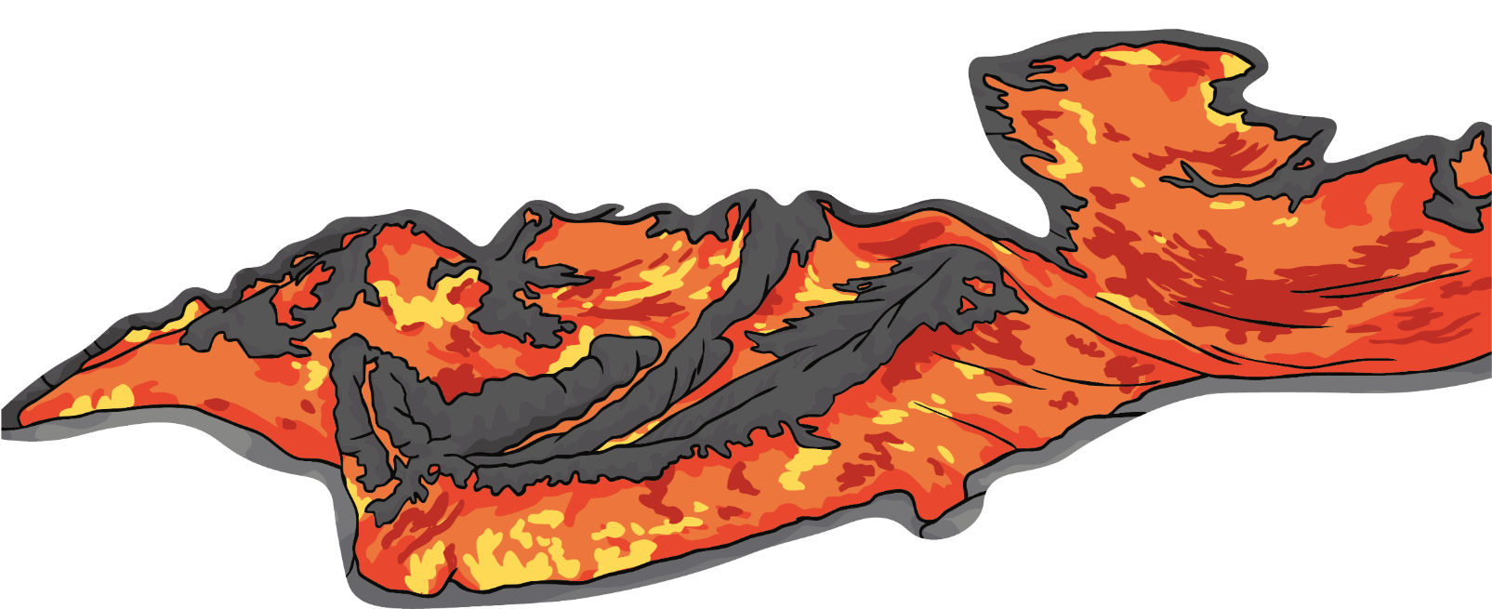
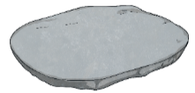
Step 1
What’s the past simple form of ‘have’?
hud
had
hadden
Next step

Slide 7
Step 2
What’s the past simple form of ‘go’?
went
what
good
Next step

Slide 8
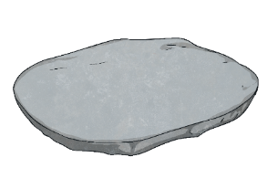
Step 3
What’s the past simple form of ‘get’?
gut
gotten
got
Next step

Slide 9
Step 4
What’s the past simple form of ‘do’?
dod
dun
Next step
did

Slide 10
Step 5
What’s the past simple form of ‘eat’?
8
ate
Next step
nine

Slide 11
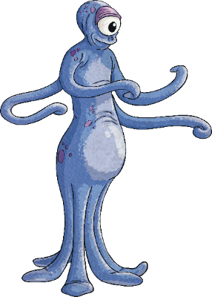
Step 6
What’s the past simple form of ‘drink’?
drun
drinked
drank
Next step

Slide 12
Step 7
What’s the past simple form of ‘run’?
ran
ron
rin
Next step

Slide 13
Step 8
What’s the past simple form of ‘win’?
one
wun
won
Next step

Slide 14
Step 9
What’s the past simple form of ‘swim’?
swing
sing
swam
Next step

Slide 15
Step 10
What’s the past simple form of ‘sing’?
sang
sim
singe
Next step

Slide 16
Step 11
What’s the past simple form of ‘tell’?
old
told
toll
Next step

Slide 17
Step 12
What’s the past simple form of ‘say’?
said
soy
sed
Next step

Slide 18
Step 13
What’s the past simple form of ‘sell’?
seld
sold
soil
Next step

Slide 19
Step 14
What’s the past simple form of ‘fall’?
fell
felt
foll
Next step

Slide 20
Step 15
What’s the past simple form of ‘feel’?
foil
fell
felt
Next step

Slide 21
Step 16
What’s the past simple form of ‘meet’?
meat
mut
Next step
met

Slide 22
Step 17
What’s the past simple form of ‘know’?
old
knew
Next step
new

Slide 23
Step 18
What’s the past simple form of ‘see’?
said
sow
saw
Next step

Slide 24
Step 19
What’s the past simple form of ‘hear’?
heard
here
ear
Next step

Slide 25
Step 20
What’s the past simple form of ‘think’?
thunk
thawt
thought
Next step

Slide 26
Step 21
What’s the past simple form of ‘pay’?
pied
poid
paid
Next step

Slide 27
Step 22
What’s the past simple form of ‘come’?
came
coom
cam
Next step

Slide 28
Step 23
What’s the past simple form of ‘break’?
beak
broke
brook
Next step

Slide 29
Step 24
What’s the past simple form of ‘find’?
food
fawn
found
Next step

Slide 30
Step 25
What’s the past simple form of ‘wear’?
war
wore
ware
Next step

Slide 31
Step 26
What’s the past simple form of ‘lose’?
lost
list
less
Next step

Slide 32
Step 27
What’s the past simple form of ‘make’?
mate
mute
made
Next step

Slide 33
Step 28
What’s the past simple form of ‘write’?
right
ring
Next step
wrote

Slide 34
Step 29
What’s the past simple form of ‘buy’?
boy
bought
Next step
boot

Slide 35
Step 30
What’s the past simple form of ‘bring’?
bought
brought
brong

Slide 36
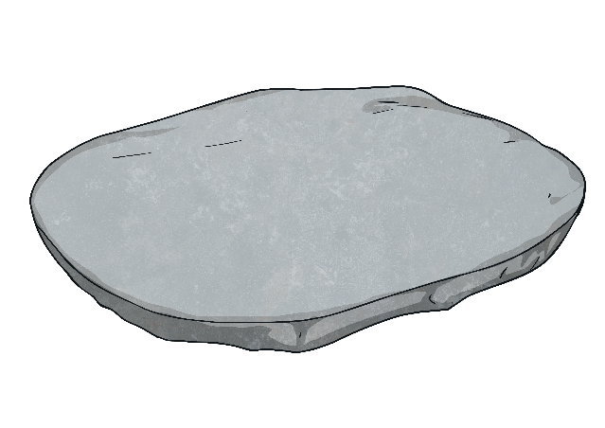
Congratulations!
You made it to the other side!

