Slide 1
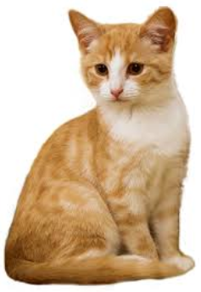
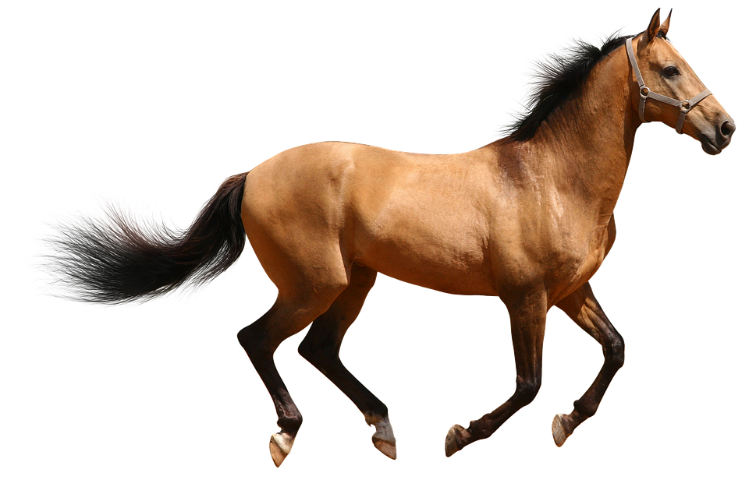
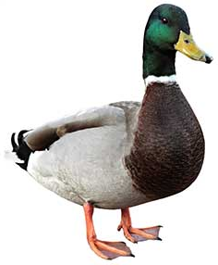
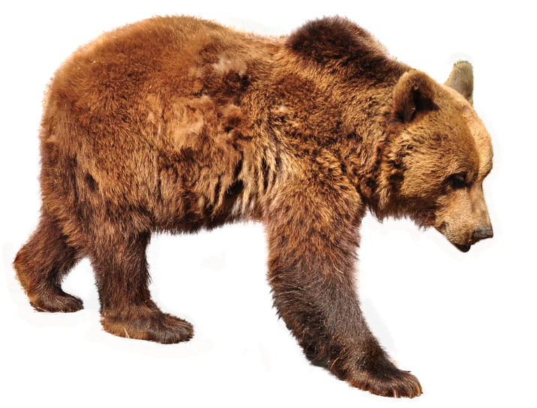
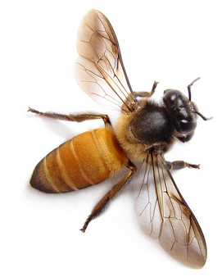
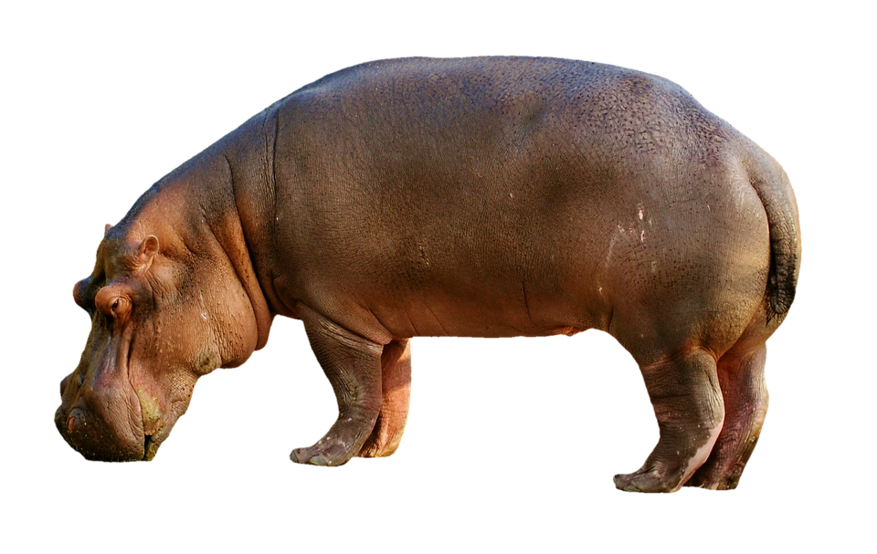
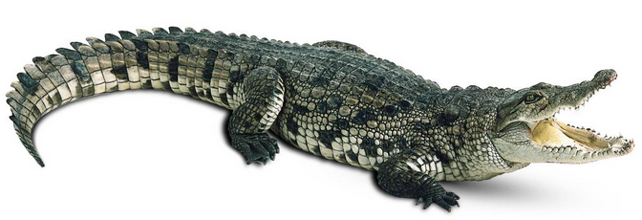
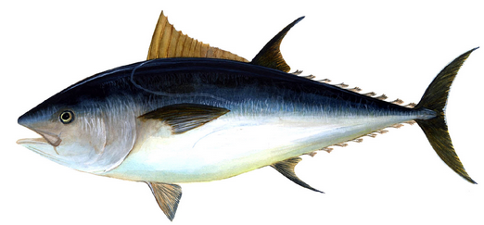
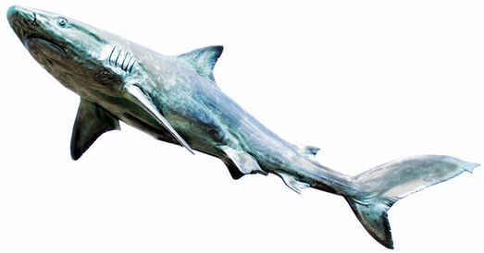
How could we
categorise (group)
these animals?
List 5 ways.

Slide 2
How have they been organised?
Dangerous
Not dangerous

Slide 3
How have they been organised?
2 legs
No legs
4 legs
6 legs

Slide 4
Venn Diagrams

Slide 5
Live on land
Live in water
Which group would these animals go into?

Slide 6
Live on land
and
in water
Live on land
Live in water

Slide 7
Live on land
and
in water
Live on land
Live in water
This is called a Venn diagram.
They help organise data and compare groups.
They are very useful when some things are in both groups
(like a hippo!)

Slide 8
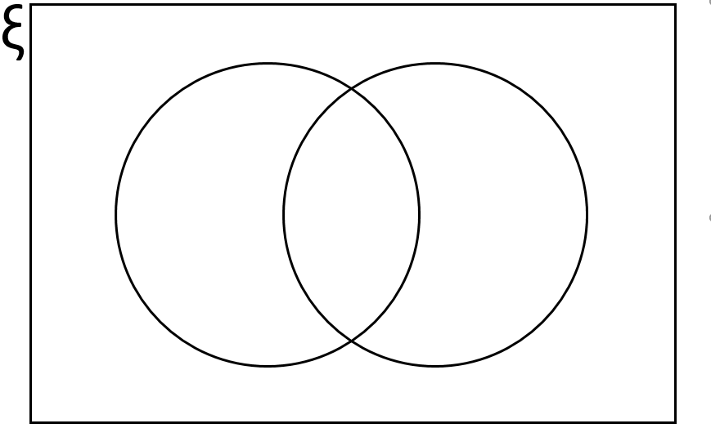
What are the different groups in these Venn diagrams?
Football Teams
Red
Flying Animal
Insect
Tomato
Hawk
Ant
Chelsea
Man U
Arsenal
Fly
Everton
Stop
Light
Seagull
Spider
Real Animals
Human-eaters
Circular
Food
Cow
Zombies
Wheel
Pizza
Chicken
Lions
Goat
Sharks
Werewolf
Pie
Dolphin
Cup
Chips

Slide 9
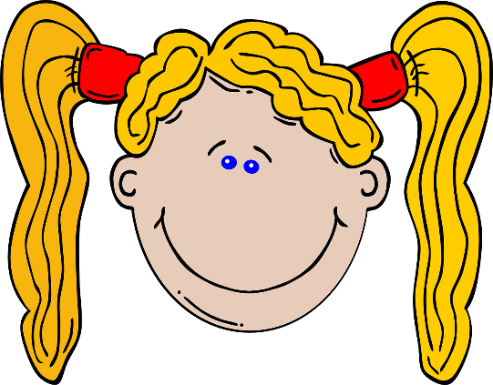
4 students were picked from Year 7
ξ =
(Ksi)
This means the
total group.
Anna
Tom
Mary
Jack
Beth
ξ
Long hair
Blonde hair
Jack doesn’t have long or blond hair.
But he’s still in the group.

Slide 10
4 students were picked from Year 7
ξ =
Anna
Tom
Mary
Jack
Beth
ξ
Long hair
Blonde hair
Anna
Tom
Beth
Mary
Jack

Slide 11
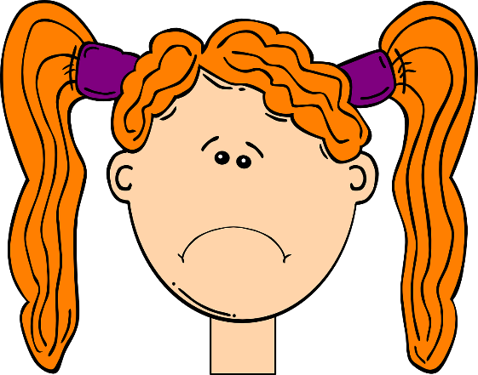
ξ
Long hair
Short hair
What’s wrong with these
Venn Diagrams?
ξ
Human
Insect
ξ
Boy
Male
ξ
Even
Multiple of 4

Slide 12
Complete the Venn diagram.
Boy
Wears glasses
Anna
Jess
Jo
Tom
May
Rob
Pete

Slide 13
Complete the Venn diagram.
ξ =
ξ
Boy
Wears glasses
Anna
Jess
Tom
Jess
Rob
Pete
Jo
Tom
May
May
Jo
Rob
Pete
Anna

Slide 14
Check your success!
I can complete Venn diagrams with data.
I can complete Venn diagrams with totals.
I can calculate missing values in Venn diagrams.

Slide 15
Check your success!
I can complete Venn diagrams with data.
I can complete Venn diagrams with totals.
I can calculate missing values in Venn diagrams.

Slide 16
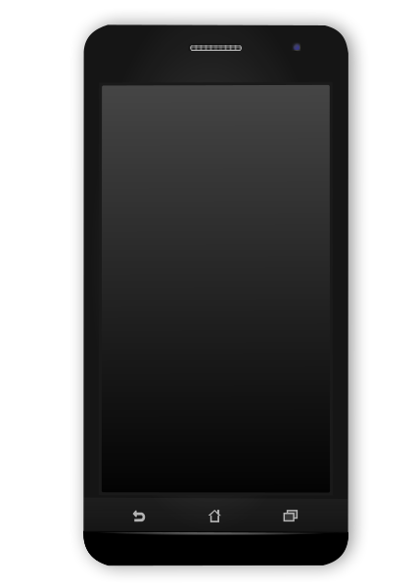
Write a text message to a friend describing…
What a
Venn diagram
shows.

