Slide 1
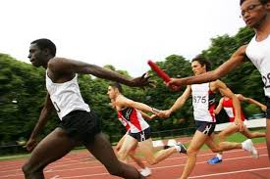
Relay baton

Slide 2
javelin

Slide 3
High jumper

Slide 4
hurdling

Slide 5
archery

