Slide 1
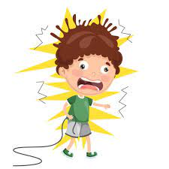
6.5 Changing the number of components in a circuit

Slide 2
Our objectives:
Determine how changing the number or type of components in a circuit make a lamp shine more brightly or less brightly

Slide 3
Vocabulary
Battery
brightness
brightly
dimly

Slide 4
What components have you used so far to build a circuit?

Slide 5
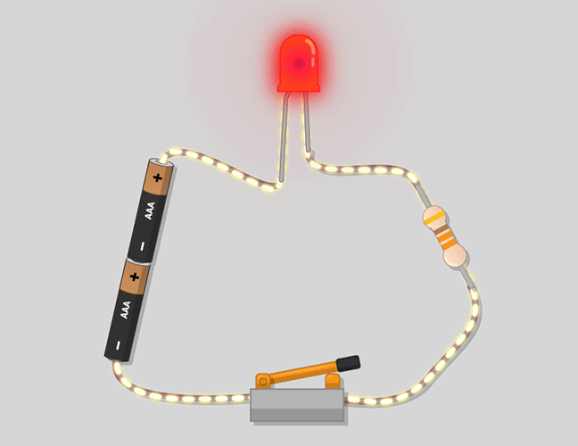
Where is the electricity in the circuit?
In the wire
What pushes the electricity around the circuit?
The cell
What opens and closes the circuit?
The switch

Slide 6
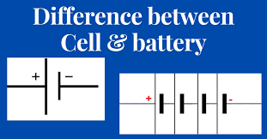
What is the difference between cells and batteries?

Slide 7
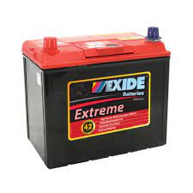
Each cell stores 1.5 V of electricity.
When we have two or more of these cells connected together we call it a…………
Battery
The car battery in the picture is 12 V.

Slide 8
When the cell or battery is part of a circuit, the stored energy pushes electricity around the circuit.
Does this circuit contain a cell or a battery?

Slide 9
Lets investigate

Slide 11
Did the lamps shine more brightly or more dimly when you removed one lamp from the circuit?
More brightly
Why do you think this happened?
The same strength of current had to light up one less lamp. This made the remaining lamps shine more brightly

Slide 12
What happened when you used only one lamp and three cells in the circuit?
The lamp will pop or burn out.
Why do you think this happened?
Because the current passing through it is too strong.

Slide 13
Identify a pattern in your results.
Choose the correct alternatives to complete these sentences:
The lamps shine less / more brightly when you add more lamps to the circuit.
The lamps shine less / more brightly when you add more cells to the circuit.

