Slide 2
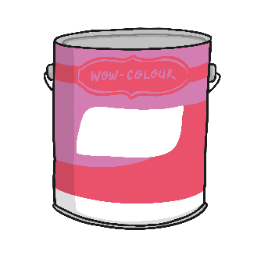
Buying Paint
Jonathan is buying tins of paint to sell in his shop.
How much paint has he bought?
How do you know?

Slide 3
Buying Paint
Jonathan is buying tins of paint to sell in his shop.
10
20
30
40
50
What can you see?
What is the same in each number?
What is different in each number?

Slide 4
Buying Paint
How much paint has he bought?
10
20
30
40
50
60
70
80
90
100

Slide 5
Labelling the Paint
Let’s count again.
10
20
30
40
50
60
70
80
90
100

Slide 6
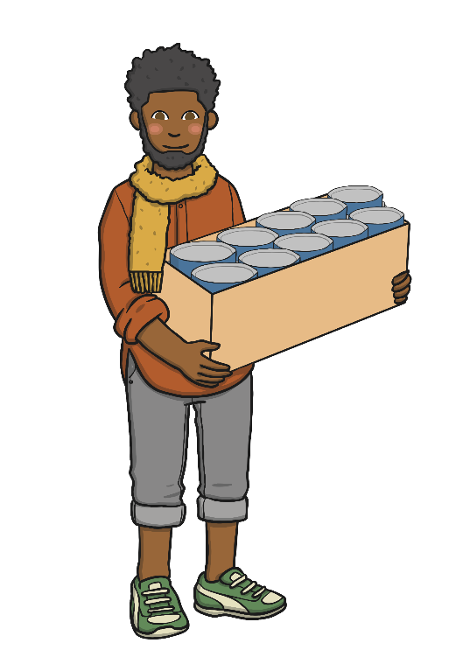
Boxes of Paint
Jonathan put the paint into boxes. There are 10 tins of paint in each box.

Slide 7
Boxes of Paint
Can you help Jonathan to count the paint?
100
90
80
70
60
50
40
30
20
10

Slide 8
Boxes of Paint
Let’s count again.
100
90
80
70
60
50
40
30
20
10

Slide 9
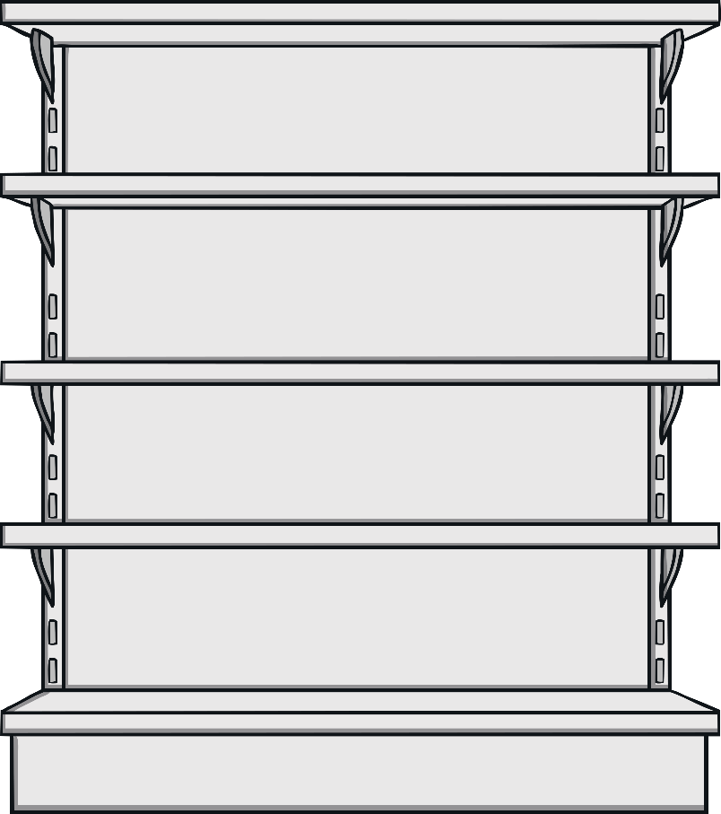
Storage Shelves
Jonathan lines the boxes up on a shelf. He labels them so he knows how many tins of paint he has.
10
20
30
40
50
60
70
80
90
100
Can you finish the labelling for him?

Slide 10
Spilt Paint!
Oh no! Spilt paint! Jonathan can’t see his labels.
10
20
30
40
50
60
70
80
90
100
What are the missing numbers?

Slide 11
Spilt Paint!
Oh no! Spilt paint! Jonathan can’t see his labels.
10
20
30
40
50
60
70
80
90
100
What are the missing numbers?

Slide 12
Spilt Paint!
Oh no! Spilt paint! Jonathan can’t see his labels.
10
20
30
40
50
60
70
80
90
100
What are the missing numbers?

