Slide 1
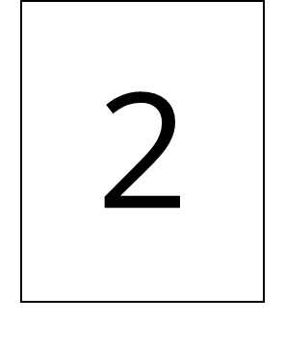
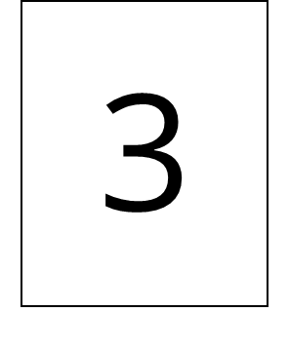
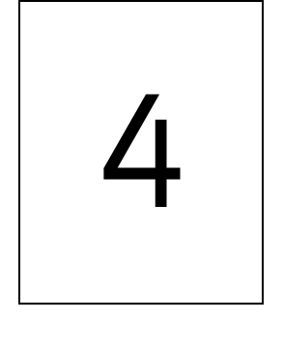
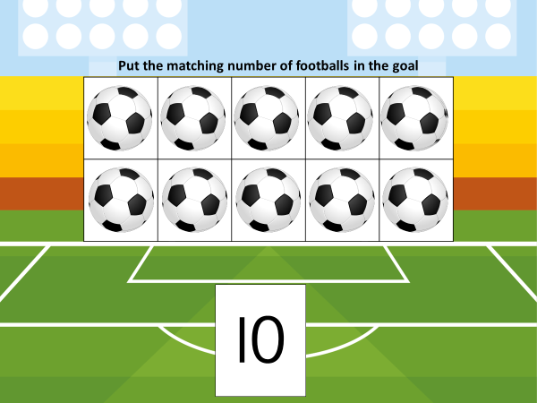
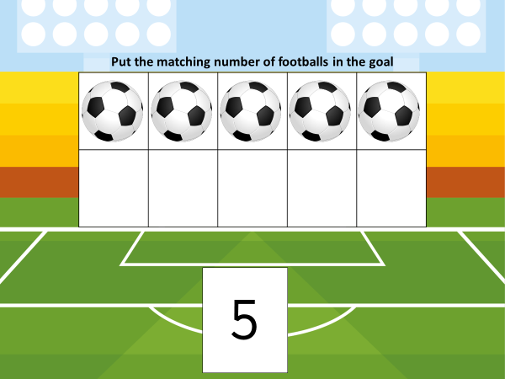
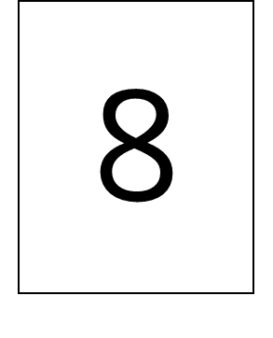
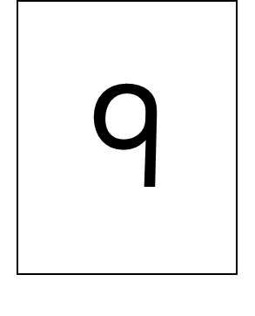
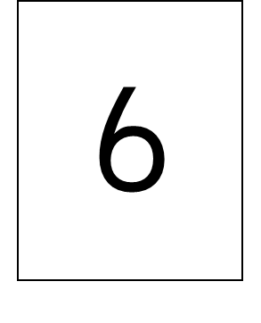
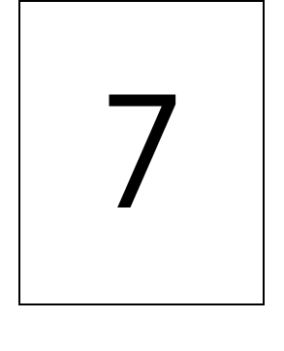
World Cup Football 2022
Ten-frame Counting Mats

Slide 2
Put the matching number of footballs in the goal
l

Slide 3
Put the matching number of footballs in the goal
2

Slide 4
Put the matching number of footballs in the goal
3

Slide 5
Put the matching number of footballs in the goal
4

Slide 6
Put the matching number of footballs in the goal
5

Slide 7
Put the matching number of footballs in the goal
6

Slide 8
Put the matching number of footballs in the goal
7

Slide 9
Put the matching number of footballs in the goal
8

Slide 10
Put the matching number of footballs in the goal
9

Slide 11
Put the matching number of footballs in the goal
l0

Slide 12
Put the matching number of footballs in the goal
l

Slide 13
Put the matching number of footballs in the goal
2

Slide 14
Put the matching number of footballs in the goal
3

Slide 15
Put the matching number of footballs in the goal
4

Slide 16
Put the matching number of footballs in the goal
5

Slide 17
Put the matching number of footballs in the goal
6

Slide 18
Put the matching number of footballs in the goal
7

Slide 19
Put the matching number of footballs in the goal
8

Slide 20
Put the matching number of footballs in the goal
9

Slide 21
Put the matching number of footballs in the goal
l0

Slide 22
l
2
3

Slide 23
4
5
6

Slide 24
7
8
9

Slide 25
l0

