Slide 1
6.2 Does water conduct electricity?

Slide 2
our objectives;
Determine that some materials are good electrical conductors, especially metals, and some are good electrical insulators.
Investigate if water conducts electricity

Slide 3
Our New Vocabulary;
Distilled water
Pure water

Slide 4
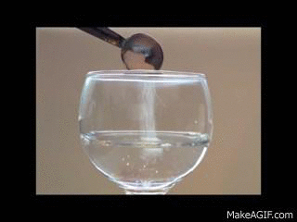
If we put salt into water and stir it, what happens to the salt?

Slide 5
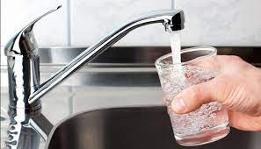
Is water from a river or the tap a pure water?
No
It has salts dissolved in it.

Slide 6
What is Distilled water ? is it pure water?

Slide 7
Distilled water is water that has been boiled and the steam has been allowed to cool down to form liquid water again.
This water is distilled water and contains NO SALTS.

Slide 8
Do you know that Al living things contain water?
Our bodies are about 65% water!
But……….. Is this water pure?
This water has salts dissolved in it so it is not pure.

Slide 9
Let’s Investigate whether water conducts electricity or no.
Compare the results you got with pure water and with salty water.
Pure water did not allow electricity to pass through it . Salty water did allow electricity to pass through it.
What conclusion can you make about whether water conducts electricity?
Pure water is not a conductor but salty water is a conductor of electricity.
Would your body be a good or a bad conductor of electricity? Explain why.
Yes, my body would be a good conductor of electricity because the water in my body contains salt.
Explain why it is not safe to touch the bare wires when the circuit is closed.
My body is a good conductor so if I touch bare wires the electricity will pass into my body and I could get an electric shock.

Slide 10
Why is it dangerous to swim in the sea when there is a thunderstorm with lightning?
Sea water is salty so it conducts electricity.

Slide 11
Thank you

