Slide 2
glue
I have a glue stick.
Start Timer
Start Timer
Next
Use Timer
Show Answer

Slide 3
blue
The sky is blue.
Start Timer
Start Timer
Next
Use Timer
Show Answer

Slide 4
true
Write true or false to answer the question.
Start Timer
Start Timer
Next
Use Timer
Show Answer

Slide 5
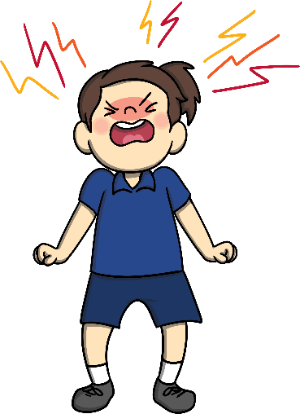
argue
To fight with someone using words only.
The boys always argue about being first in line.
Start Timer
Start Timer
Next
Use Timer
Show Answer

Slide 6
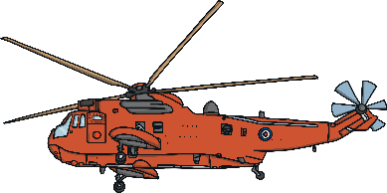
rescue
To save someone or something.
We need to rescue the sick animals.
Start Timer
Start Timer
Next
Use Timer
Show Answer

Slide 7
statue
An object made from a hard material, especially stone or metal, to look like a person or animal.
I saw the statue of Mr. Been in England.
Start Timer
Start Timer
Next
Use Timer
Show Answer

Slide 8
clue
We saw a clue to solve the mystery of the flying carpet.
Start Timer
Start Timer
Next
Use Timer
Show Answer

Slide 9
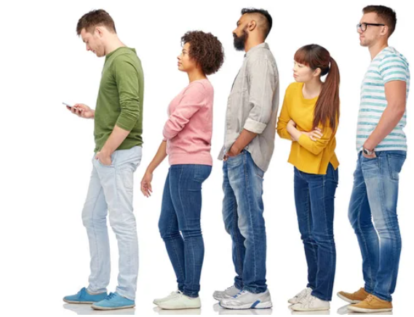
queue
A line.
We need to stand in a straight queue.
Start Timer
Start Timer
Next
Use Timer
Show Answer

