Slide 2
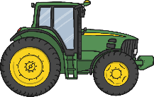
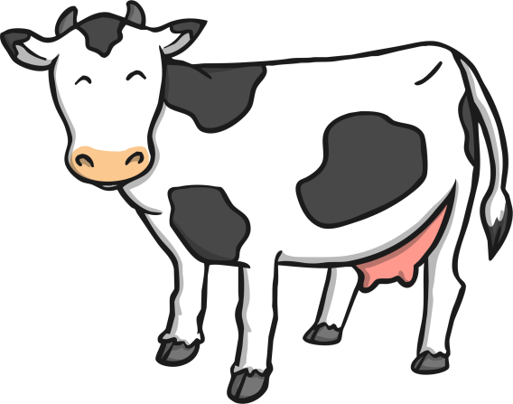
Click on the tractors for clues.
I am a mammal.
I have black and white.
I like to chew grass.
What am I?
I am a cow!

Slide 3
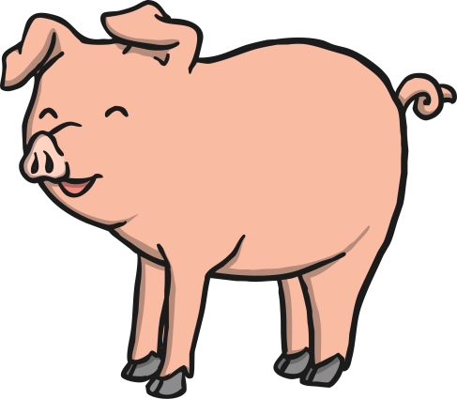
Click on the tractors for clues.
I am a mammal.
I like to roll around in mud.
I have pink skin.
What am I?
I am a pig!

Slide 4
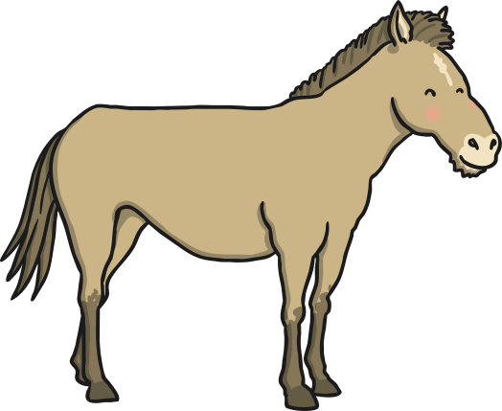
Click on the tractors for clues.
I am a very fast mammal.
People ride me.
I live in a stable.
What am I?
I am a horse!

Slide 5
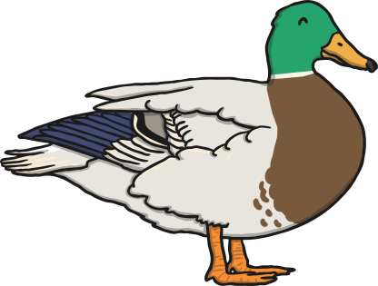
Click on the tractors for clues.
I am a flying bird.
I waddle when I walk.
I have webbed feet.
What am I?
I am a duck!

Slide 6
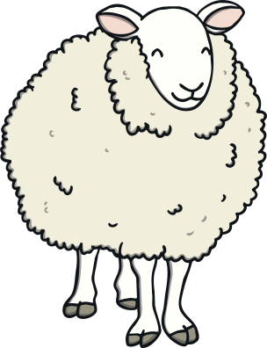
Click on the tractors for clues.
I am a mammal.
I eat grass.
I have a fluffy, thick and warm coat.
What am I?
I am a sheep!

Slide 7
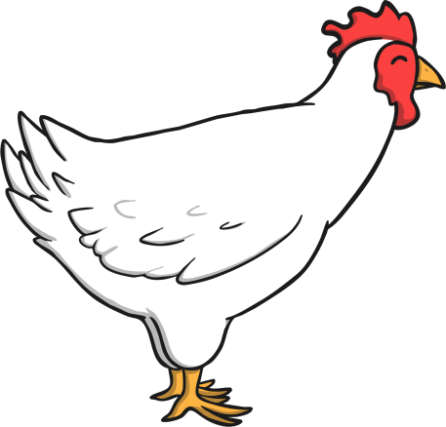
Click on the tractors for clues.
I am a bird.
I am a good source of protein.
I make clucking noises.
What am I?
I am a chicken!

