Slide 2
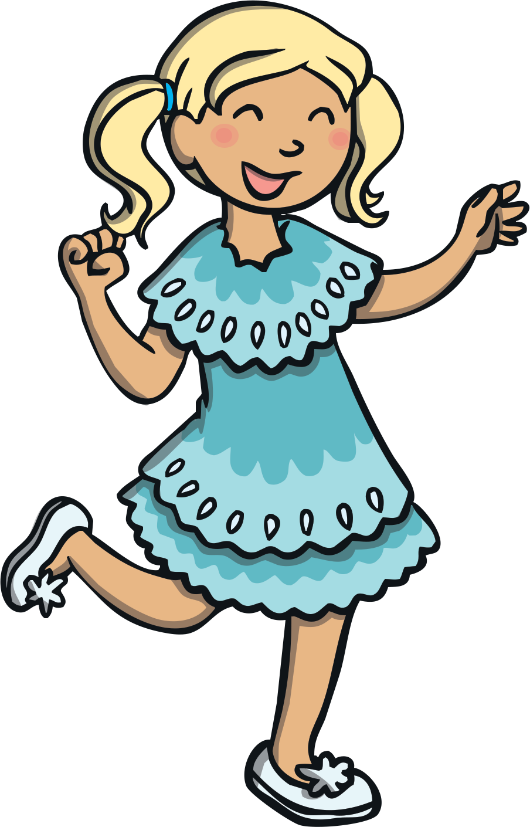
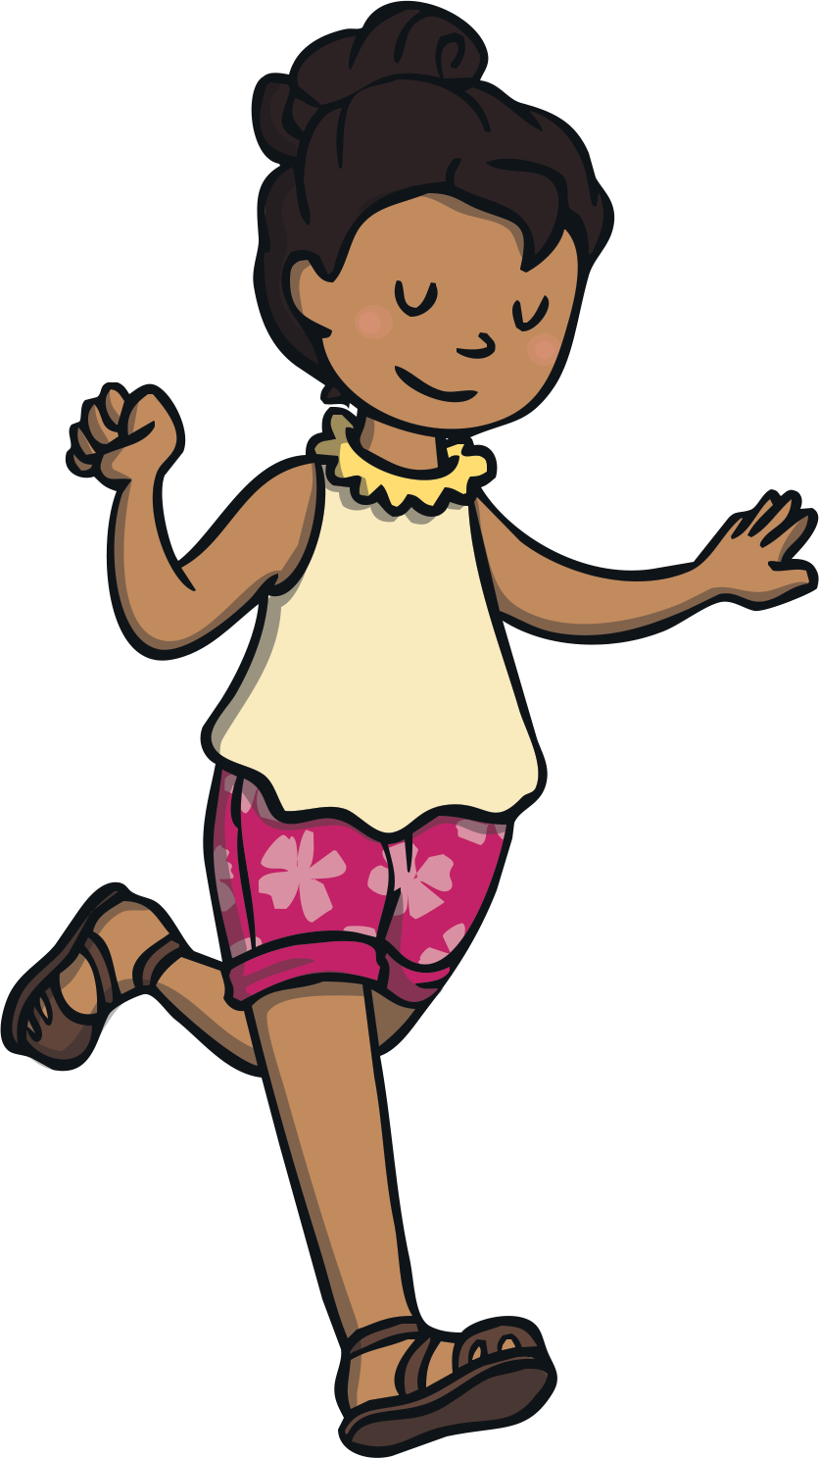
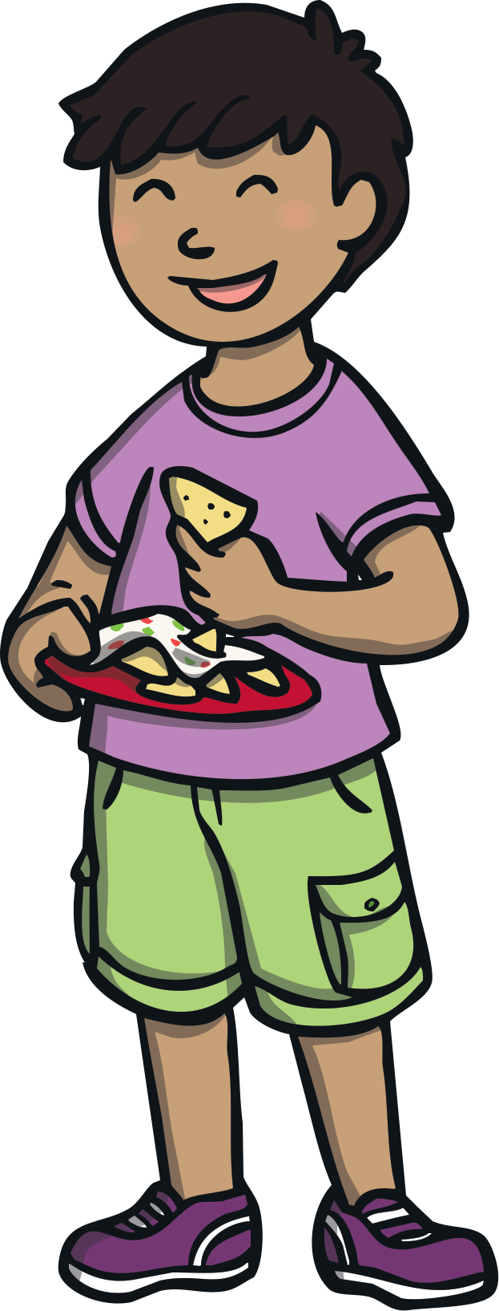
Who’s going to the party?
Some children have already arrived at the party.
More children are just arriving.
Can you count how many children will be at the party altogether?
Click the question mark to check your answer.

Slide 3
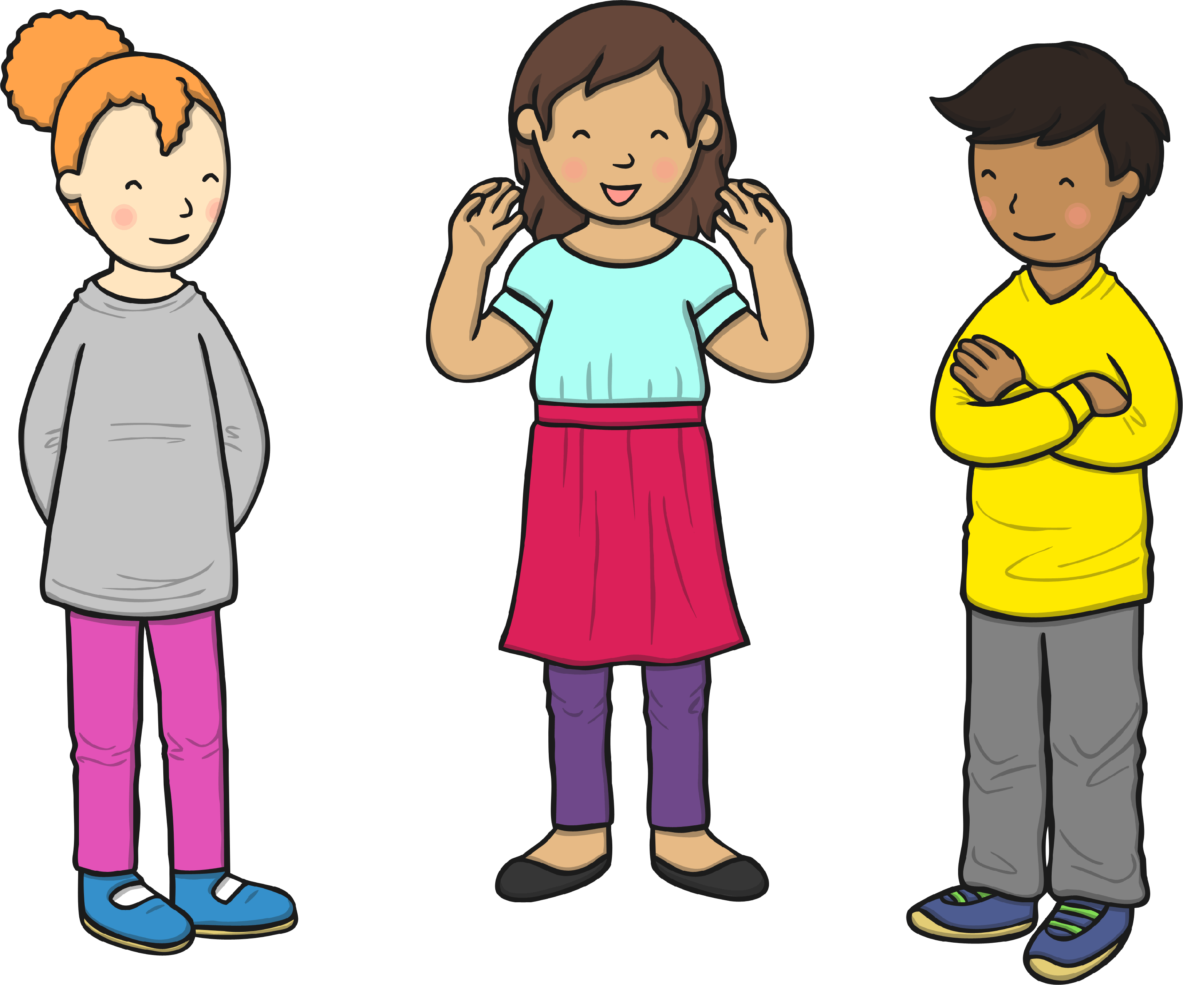
There are 6 children at the party already.
Can you count how many children will be at the party altogether?
+
=
10
?
6
0
1
2
3
4
5
6
7
8
9
10
11
12
13
14
15
16
17
18
19
20

Slide 4
There are 7 children at the party already.
Can you count how many children will be at the party altogether?
+
=
14
?
7
0
1
2
3
4
5
6
7
8
9
10
11
12
13
14
15
16
17
18
19
20

Slide 5
There are 9 children at the party already.
Can you count how many children will be at the party altogether?
+
=
15
?
9
0
1
2
3
4
5
6
7
8
9
10
11
12
13
14
15
16
17
18
19
20

Slide 6
There are 8 children at the party already.
Can you count how many children will be at the party altogether?
+
=
13
?
8
0
1
2
3
4
5
6
7
8
9
10
11
12
13
14
15
16
17
18
19
20

Slide 7
There are 10 children at the party already.
Can you count how many children will be at the party altogether?
+
=
16
?
10
0
1
2
3
4
5
6
7
8
9
10
11
12
13
14
15
16
17
18
19
20

