Slide 1
3.4 Moving from hot to cold

Slide 2
Learning objectives
Discover that thermal energy always transfers from hotter places to colder places
Understand what is meant by heat dissipation.

Slide 3
Pre-Assessment

Slide 4
Feeling heat
Mention the flow of thermal energy in the following diagram
When you put your hands around a hot drink, you can feel heat in your hands.
This will only happen if the drink is hotter than your hands.
Hotter means at a higher temperature.
Thermal energy moves from the drink, through the container and into your hands.

Slide 5
Thermal energy always moves from hotter places to colder places. Colder means at a lower temperature. Explain how the food becomes colder in the refrigerator
When you put food into a refrigerator, thermal energy transfers out of the food, and the food becomes colder.

Slide 6
Explain How to stop the engine overheating
There is water inside a car engine to remove thermal energy from the metal engine parts.
This stops the engine overheating.

Slide 7
Why animals tend to swim in water ?
Animals go in water to cool down.
Thermal energy moves from the animal’s body into the colder water
N.B: When thermal energy is removed from a hot object, we say that the thermal energy has dissipated.

Slide 8
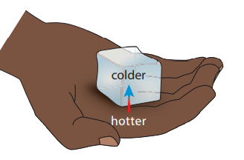
What will happen to your hand if you hold a cube of ice and why?
When you hold the ice, thermal energy transfers away from your hand and into the ice.
You feel cold because thermal energy has been transferred away from your hands.
You can damage your skin by holding ice for too long, as your skin needs the correct quantity of thermal energy to function.

Slide 9
Look to the following diagram , then answer the question.
When it is colder outside and you open a window, the inside cools down. Mention the reason?
This is because thermal energy from the hotter inside moves to the colder outside.

Slide 10
Energy Dissipation

Slide 11
Dissipation
Dissipation is used to describe energy that spreads out and becomes less useful.
When thermal energy moves from a hotter place to a colder place, we say that thermal energy has dissipated from the hotter place.
The rate, or speed, of thermal energy transfer increases :
When the temperature difference between the hot place and the cold place increases.

Slide 13
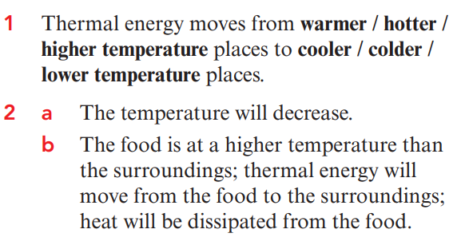
Quick Assessment

Slide 15
