Slide 1
VOCABULARY WORDS
Term 2
Week 1

Slide 2
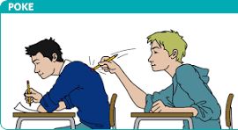
poke
poked: When you poke something, you use your finger or a pointed object to gently push or tap it.

Slide 3
scuttled
Scuttled means to move quickly and hurriedly, like a little animal crawling or running.

Slide 4
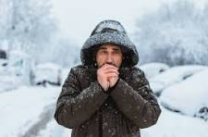
Shiver
shiver: A shiver is a sudden shaking or trembling movement that happens when you feel cold, scared, or excited.

Slide 5
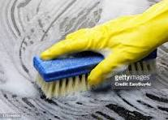
scrubbed
scrubbed: Scrubbed means to clean or rub something hard with a brush or sponge and soapy water to make it clean and shiny.

Slide 6
share
share: To share means to give some of what you have to someone else, so that both of you can have or use it. It's a way of being kind and letting others have a turn.

Slide 7
resilient
Don’t give up

