Slide 2
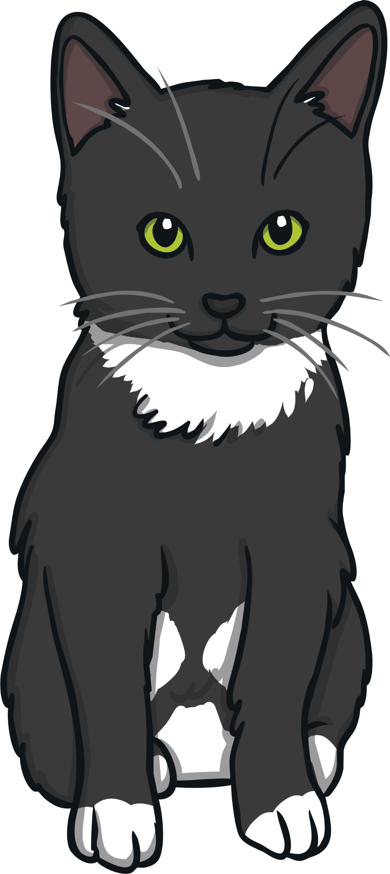
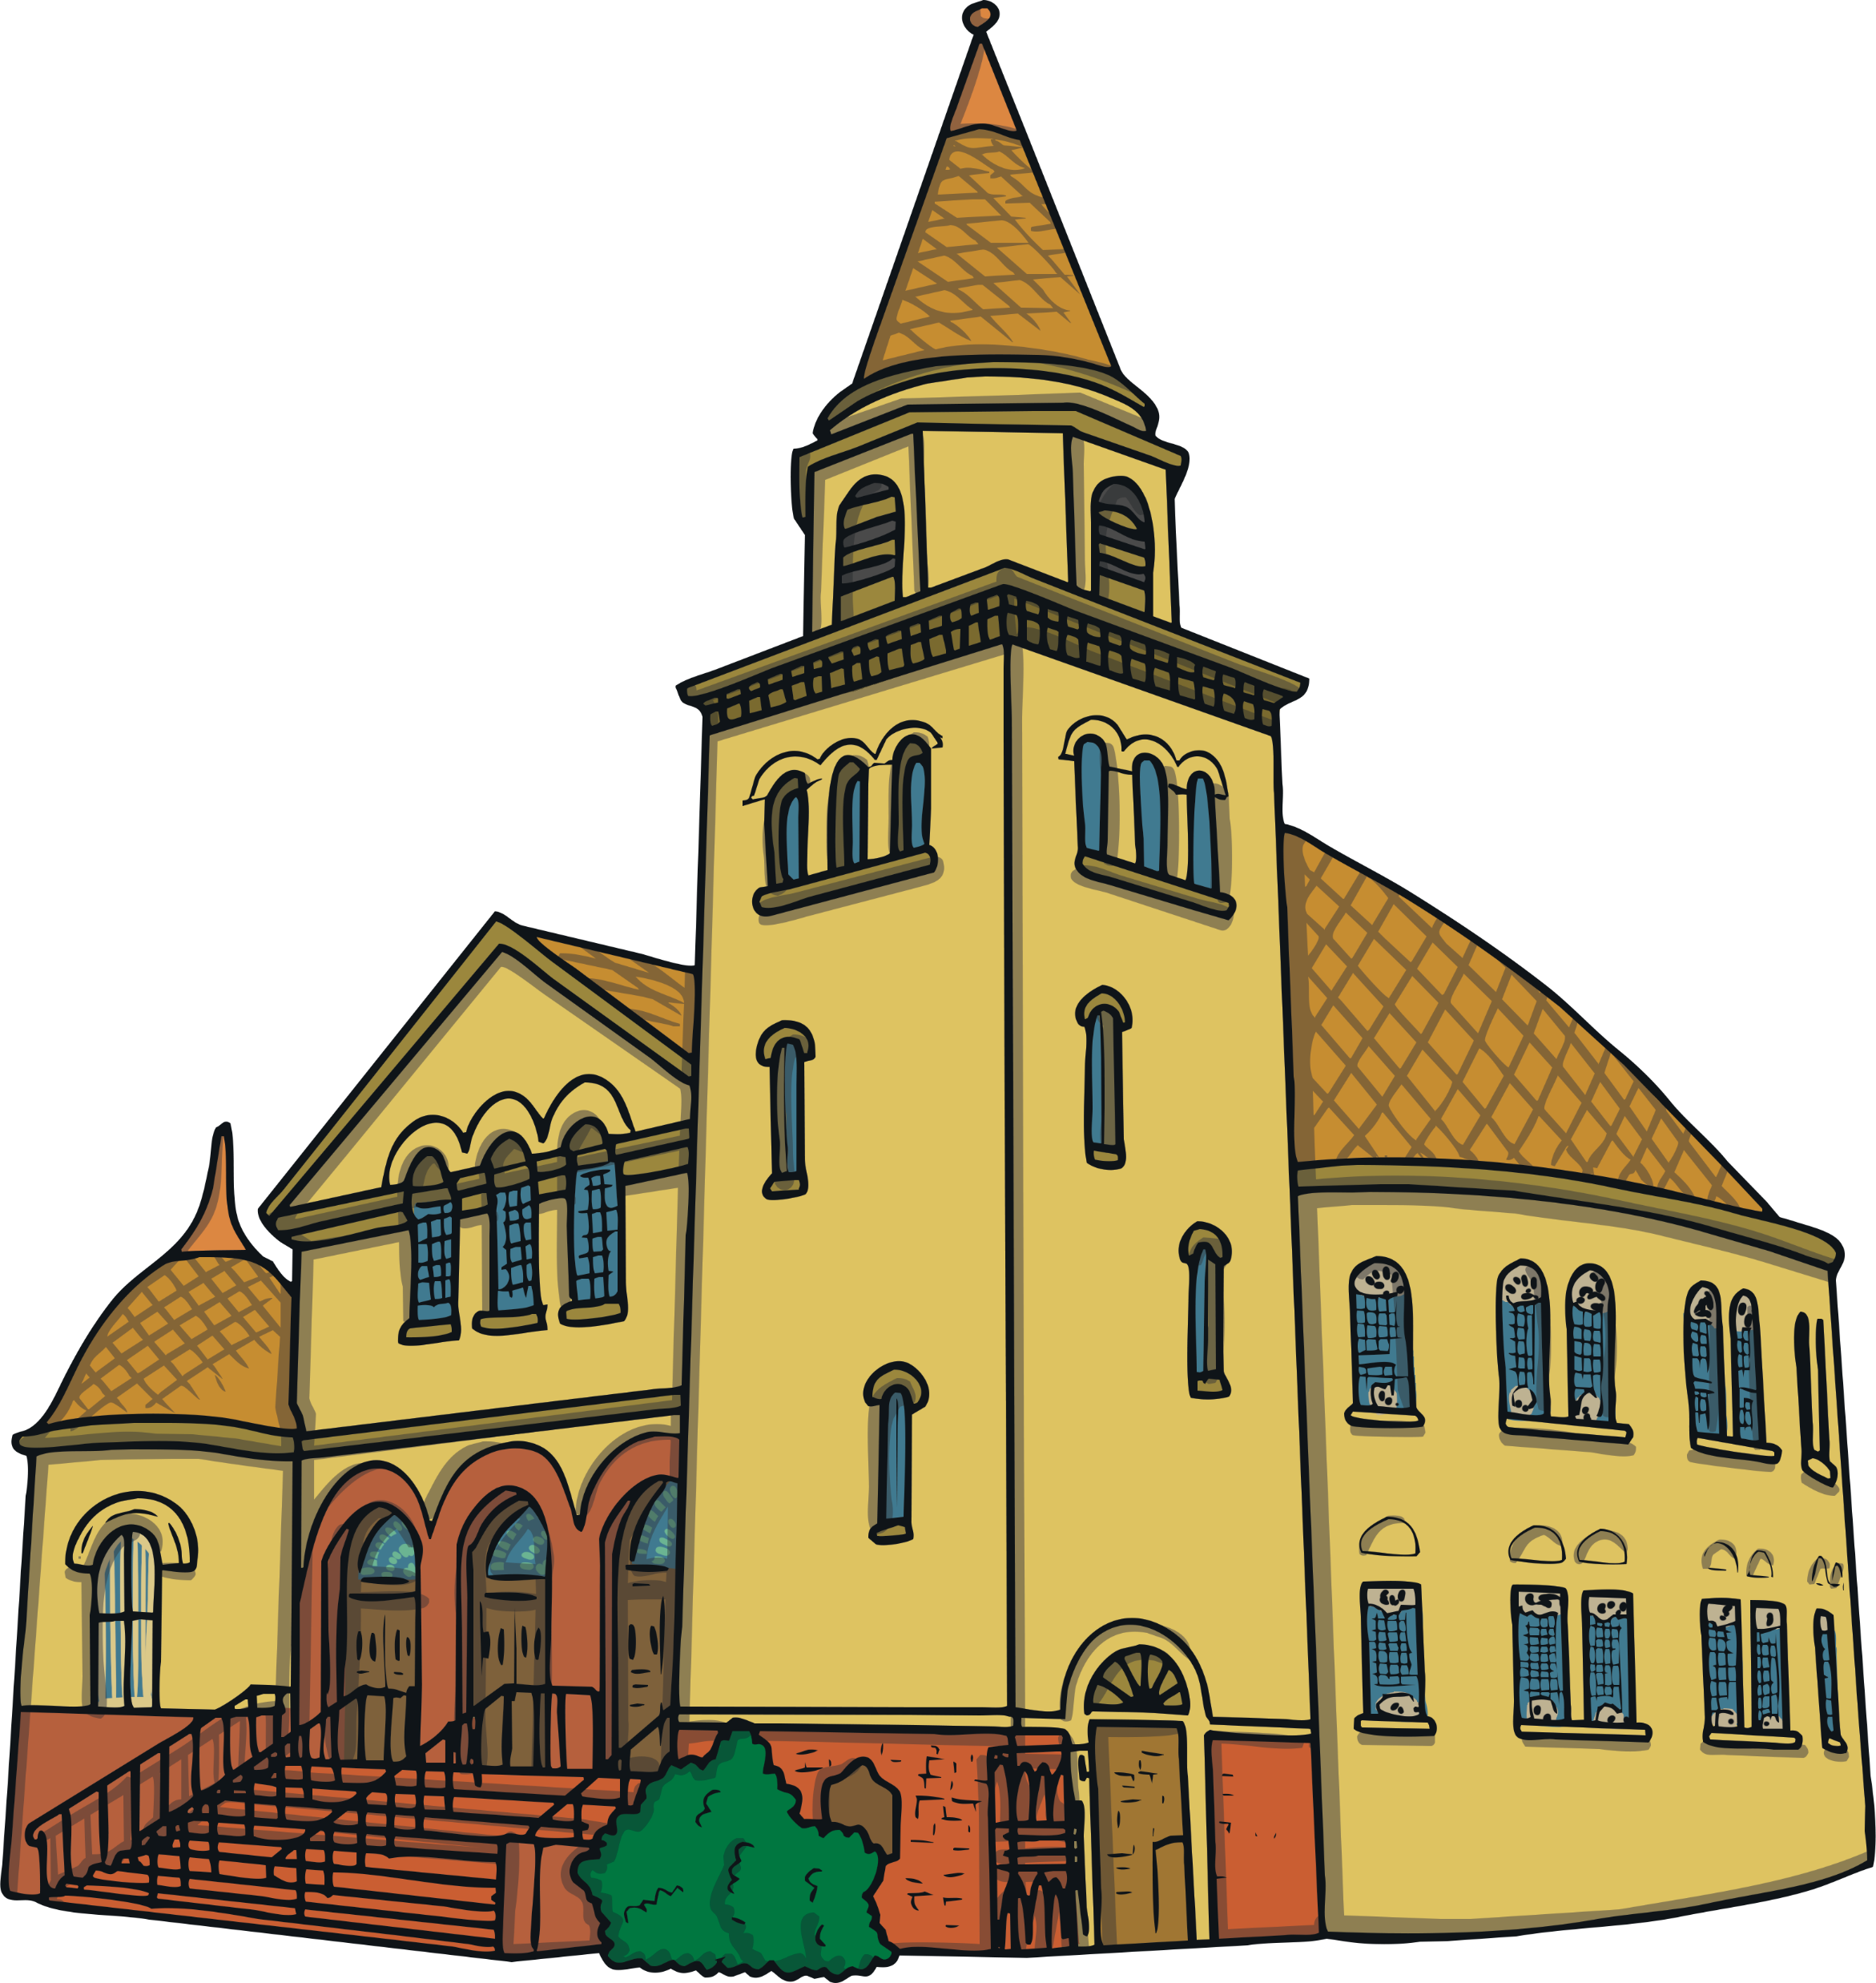
Getting Started
What is a noun?
A noun is a naming word. They are used to identify a person, place, thing, animal, or idea. There are several different types of nouns. The most widely used are called common nouns.
What is a common noun?
Common nouns are the general names for:
people
places
things
animals

Slide 3
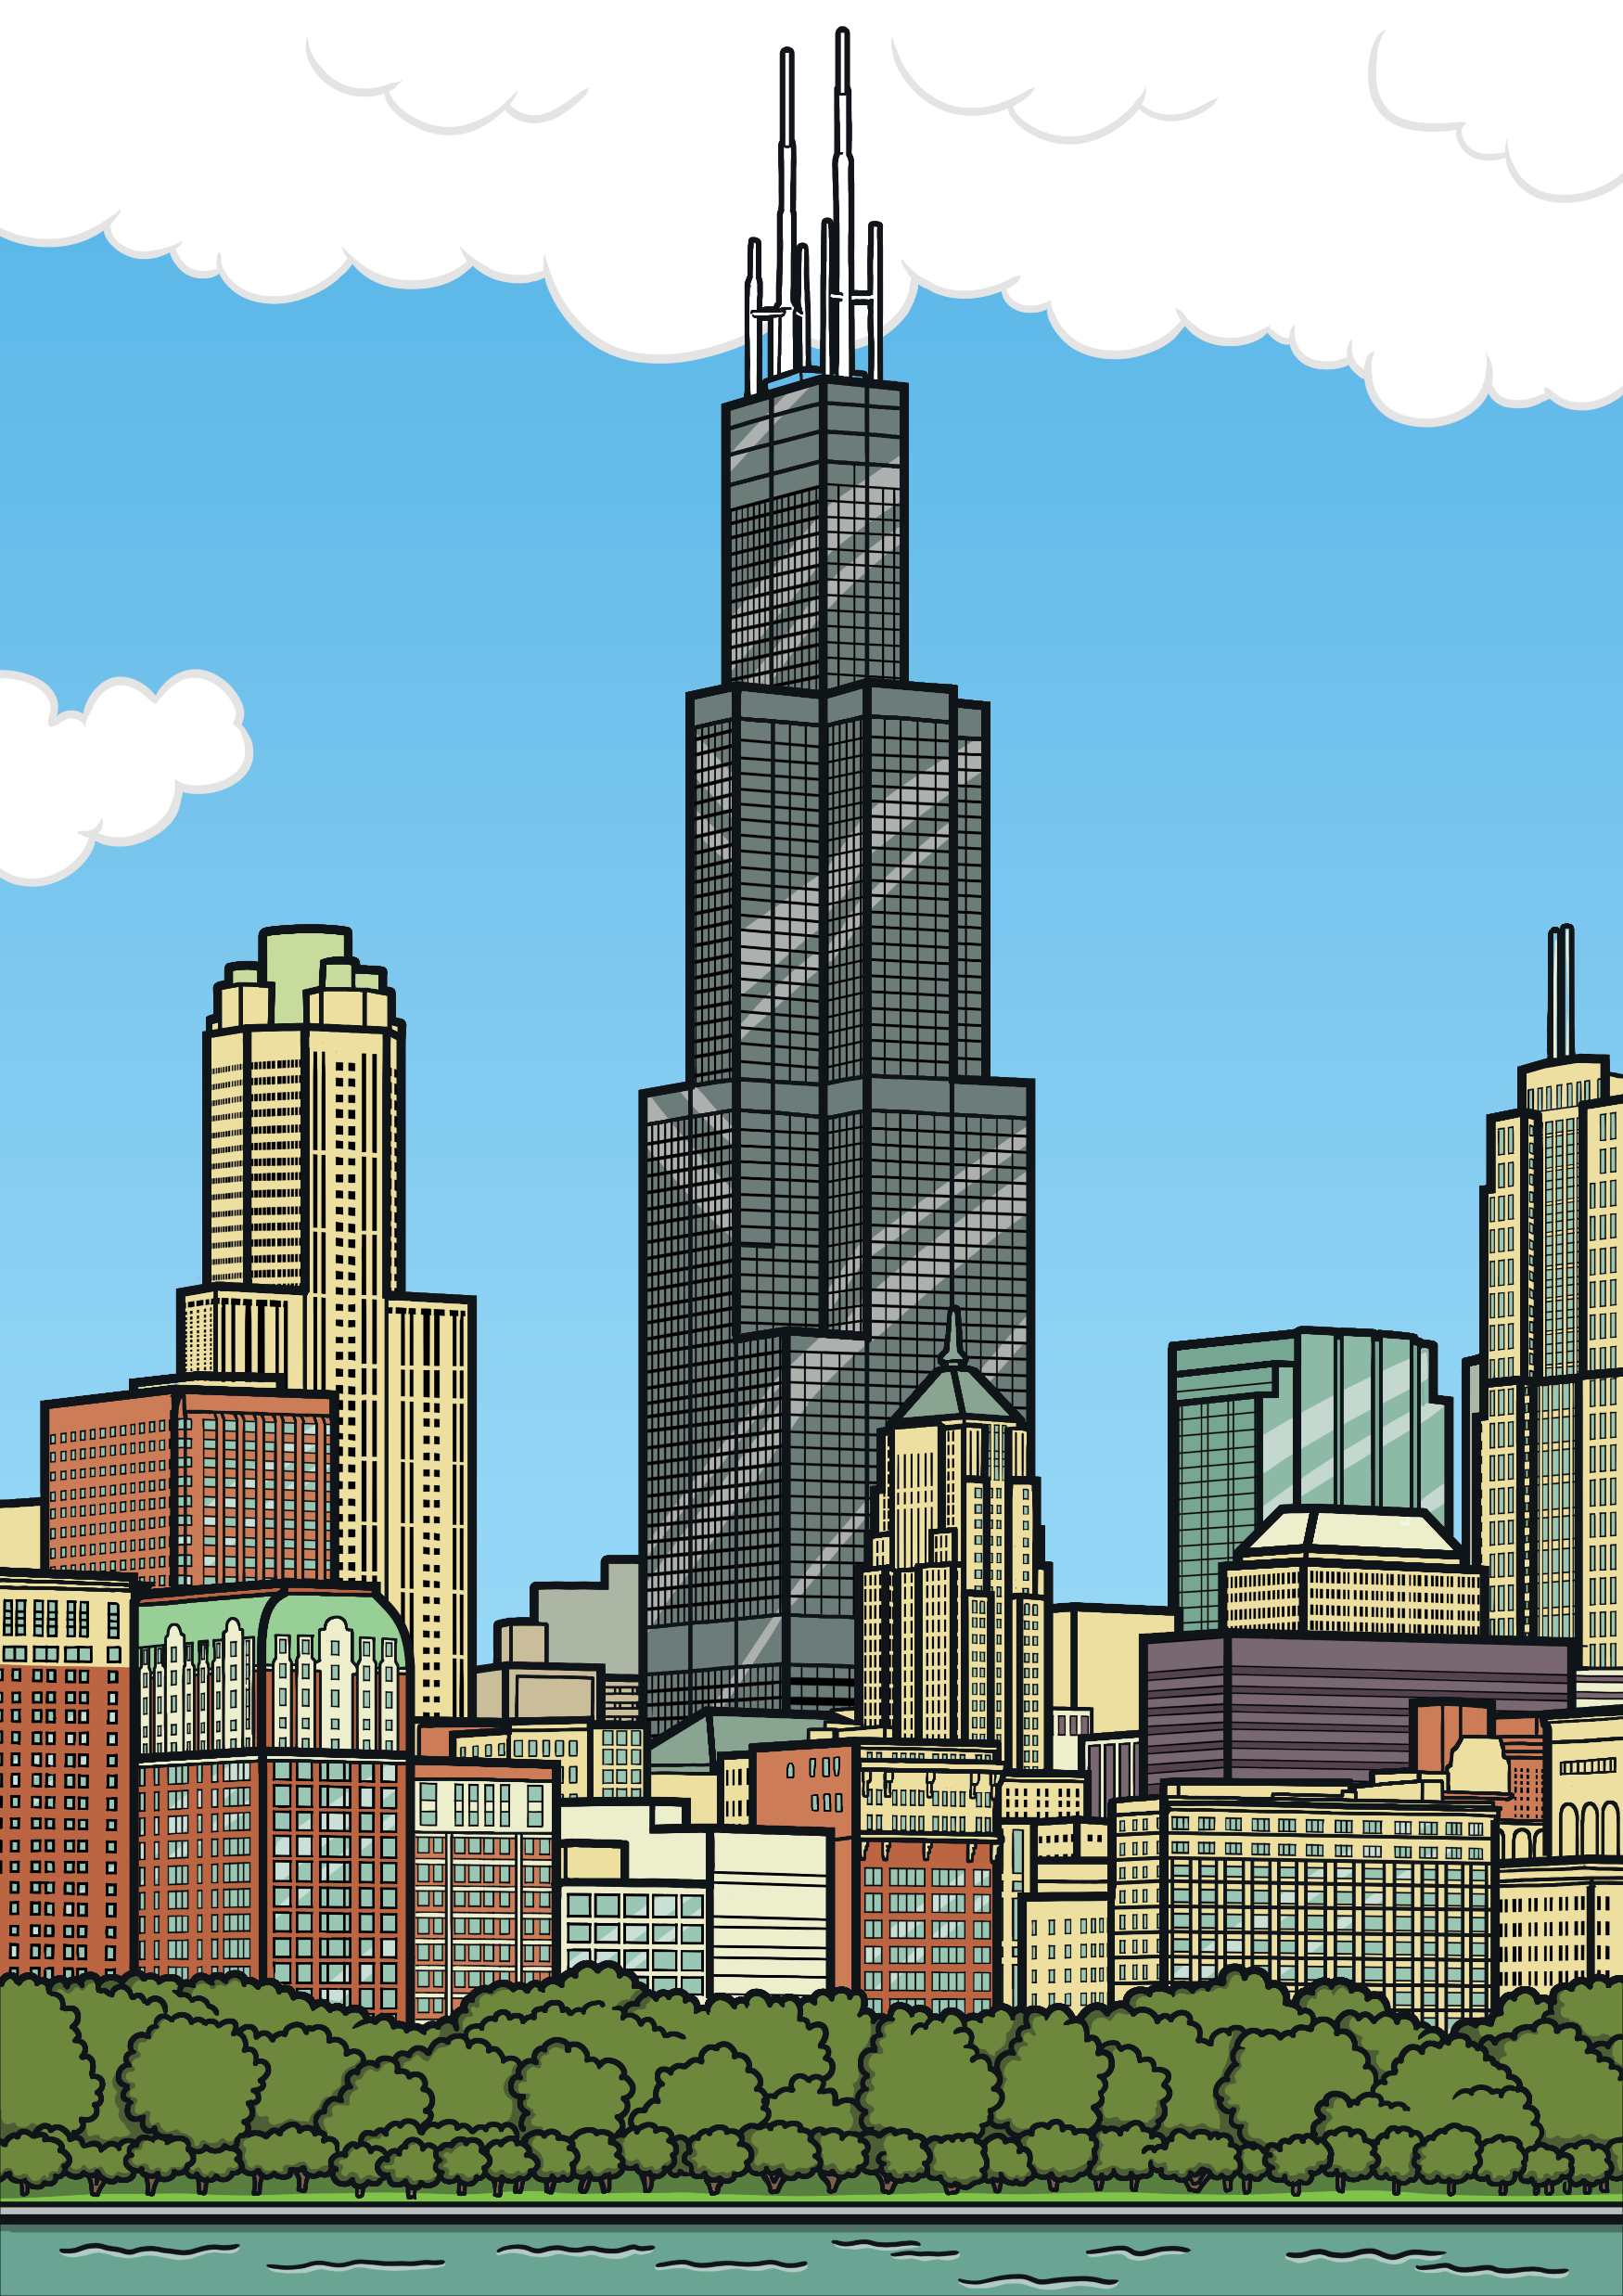
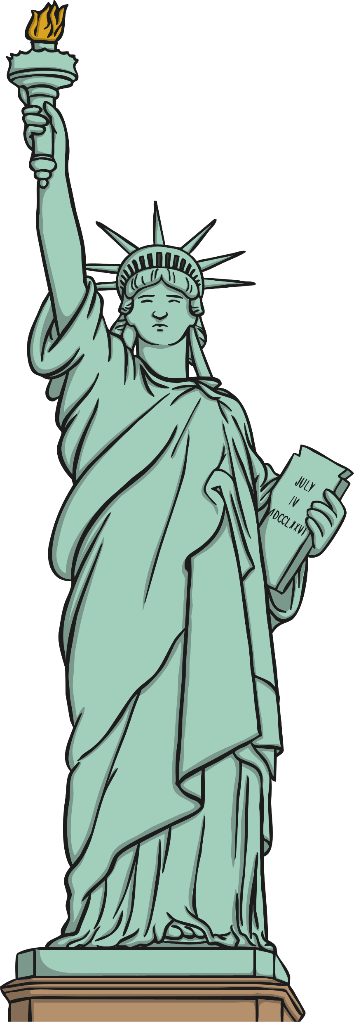
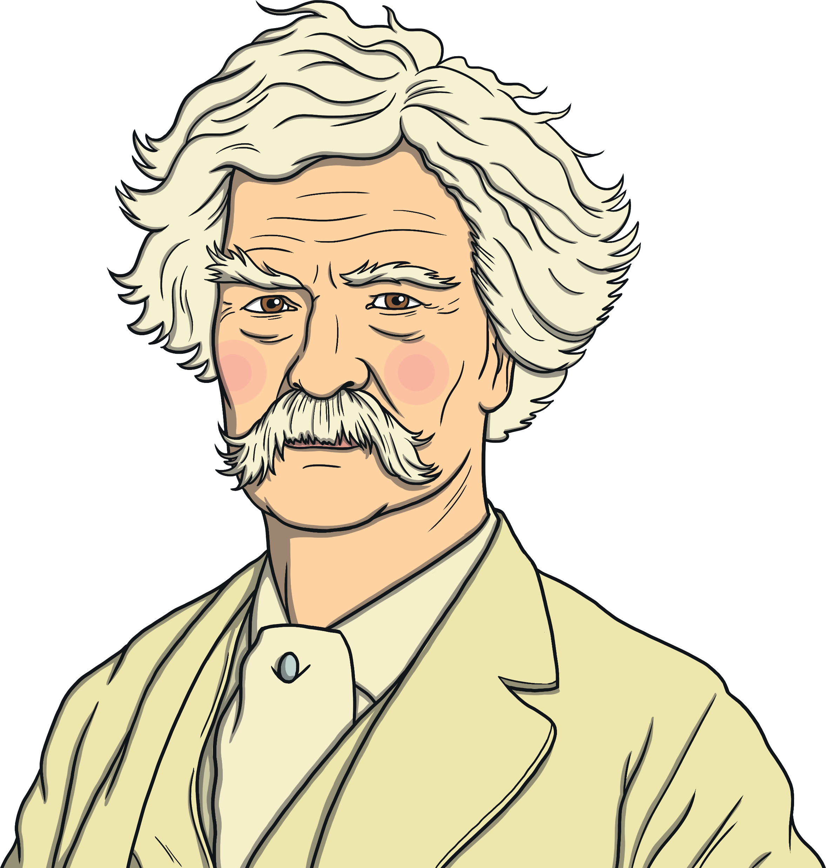
Getting Started
Proper nouns are different because they name a specific place, thing, or person. They should also always start with a capital letter.
Chicago
Mark Twain
The Statue of Liberty
Months of the year, days of the week, some religious events, and brand names are also considered to be proper nouns.

Slide 4
Next Steps
Fill out this common and proper noun chart.
Common Noun | Proper Noun
teacher | Mrs. Smith
country
 | Africa
cartoon character
famous landmark
 | August
day of the week
city
restaurant

Slide 5
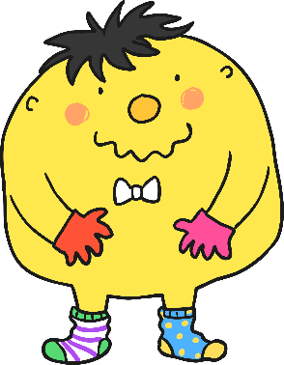
Proper Noun Hunt
Can you spot the missing capital letters for the proper nouns in Mr. Whoops’ letter?
12 green lane,
whoopsville, whoops
01234
Dear mr. williams,
I am writing to you to complain about my recent visit to your supermarket, costsavers, on Thursday, january 12, 2020. After a recent vacation to europe (where I visited portugal, spain, and italy), I came to your store to purchase some ingredients to make a mediterranean meal like the one I had eaten near the colosseum.
Continued on next page…

Slide 6
Proper Noun Hunt Continued
while I was in the produce section, I tripped over a red onion. Two of your workers laughed at me. Their names were michael and renee. it was very embarrassing and inappropriate. Please handle this situation and teach your employees to be kinder. Thank you.
sincerely,
mr. whoops

Slide 7
Proper Noun Hunt
Which proper nouns did you spot that needed capital letters?
Could we sort them into this table?
Specific Places | Specific People | Specific Things | Months of the Year | Days of the Week | Brand/ Company Names
Green Lane Whoopsville Europe Spain Portugal Italy Mediterranean | Mr. Whoops Michael Renee Mr. Williams | Colosseum | January March | Thursday Wednesday | Costsavers

Slide 8
Let’s Play!
Do you think you could shout out a proper noun for each letter of the alphabet before you run out of time?
It might be a person’s name, a country, a landmark, a city or town, a month or day, an event, or a brand name.
You must think quickly!
Q
S
P
T
A
K
H
Z
J
E
X
W
M
V
B
I
L
C
U
R
G
N
O
D
F
Y

Slide 9
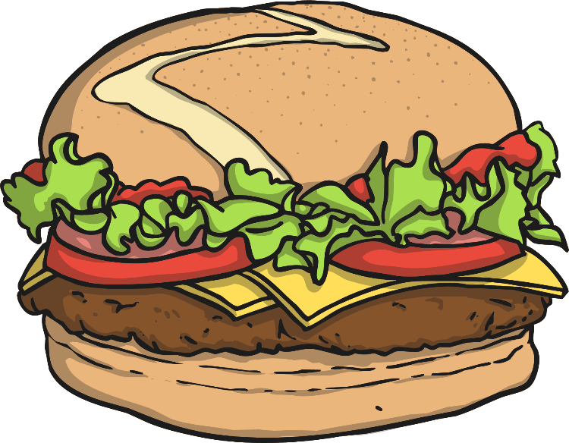
Quiz Question 1
Can you spot all the proper nouns that need to be capitalized in this paragraph?
marie and mark are twins, who live at 132 rosemary road in texas. Their birthday is in september. They love to visit bernie’s burger bar in their hometown of austin.
Marie and Mark are twins, who live at 132 Rosemary Road in Texas. Their birthday is in September. They love to visit Bernie’s Burger Bar in their hometown of Austin.

Slide 10
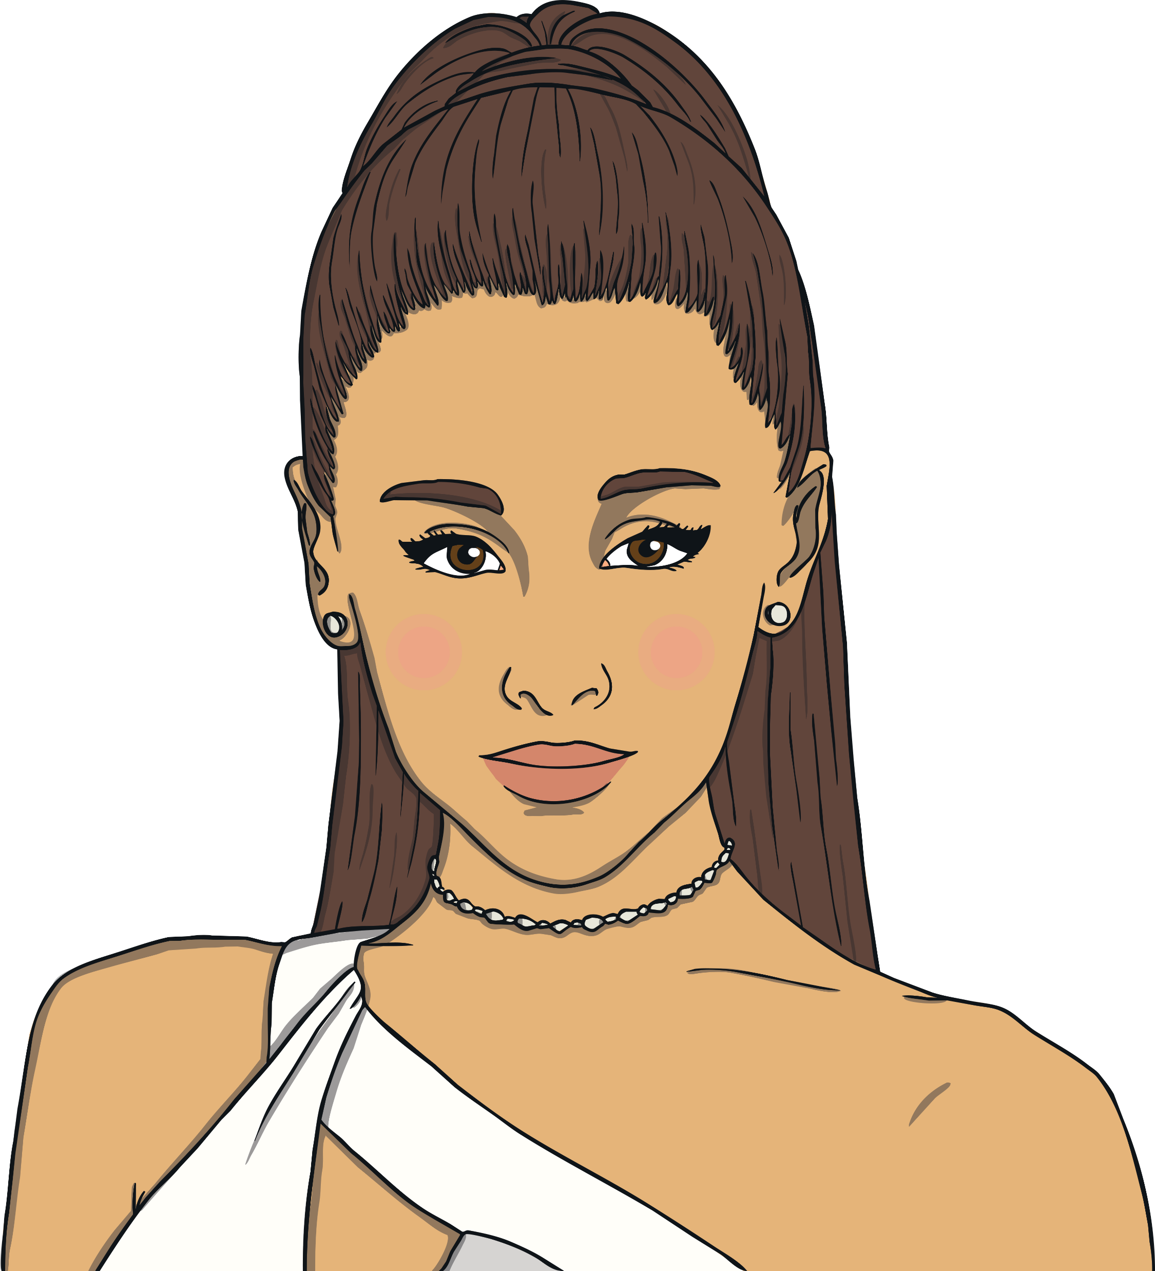
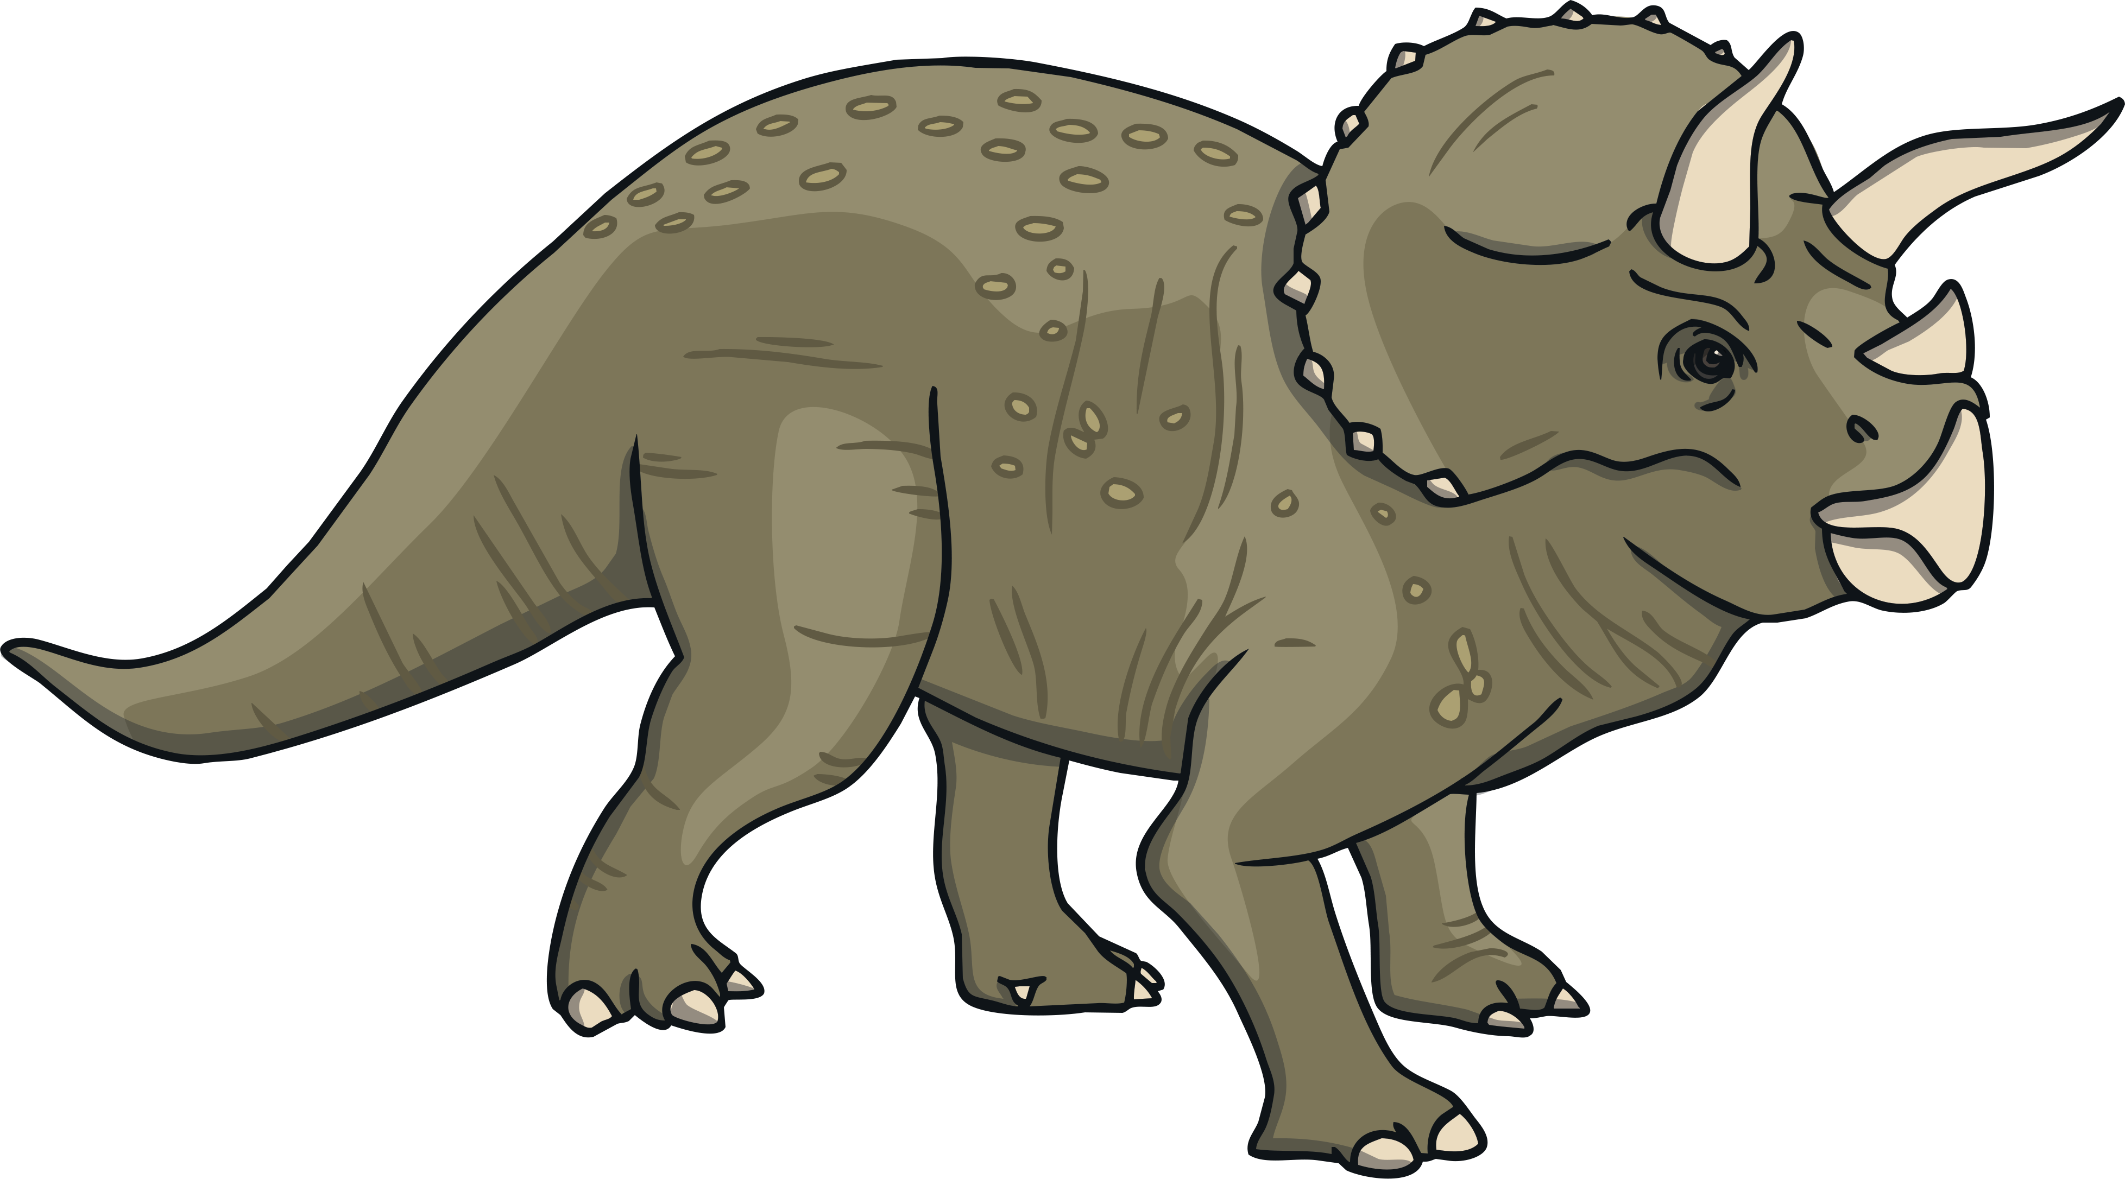
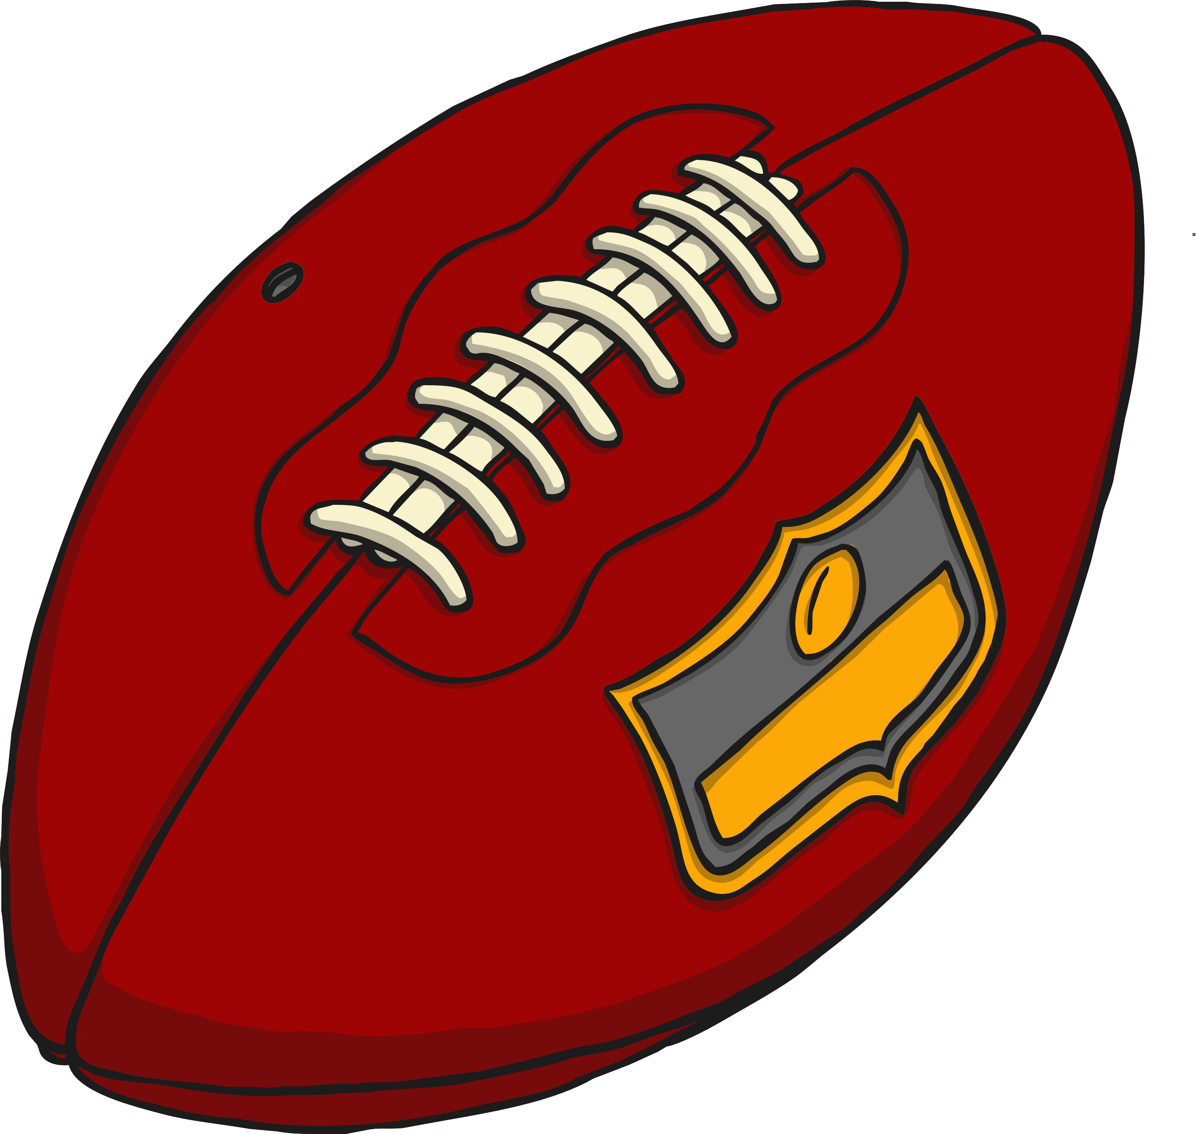
Quiz Question 2
What proper nouns can you think of for these common nouns?
dinosaur -
pop star -
football team -

Slide 11
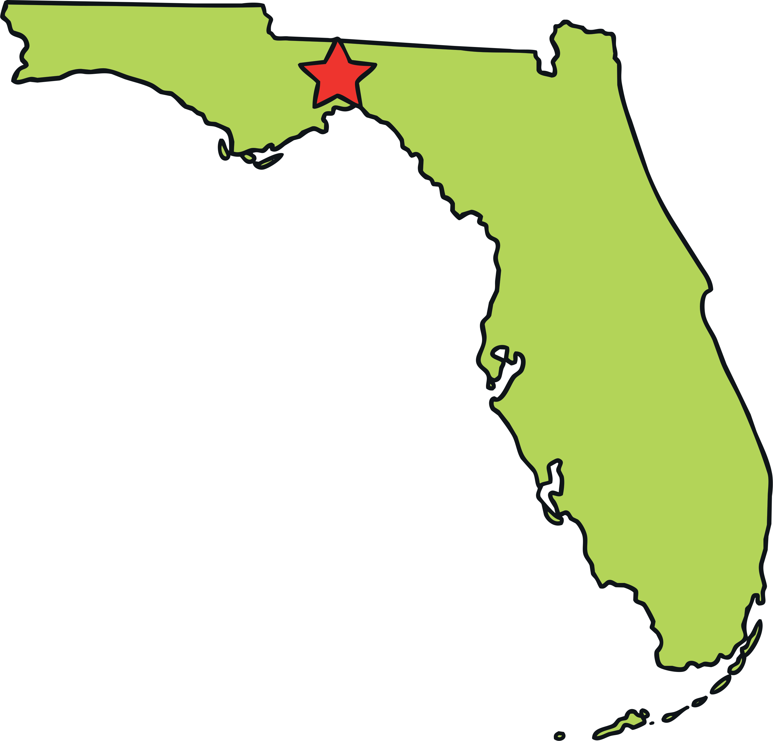
Quiz Question 3
Which words are the proper nouns in the following sentences?
On friday, I went to see my grandmother at her house.
Last year, I took a vacation to florida.
At the weekend, we went to the movie theater in town to see the new movie by pixar.
Friday
Florida
Pixar

