Slide 1
How can we care for our environment?
Year 2 W7 L3

Slide 2
How to Take Care of the Environment (Learning Videos For Kids) https://youtu.be/belXC_IoW4o

Slide 3
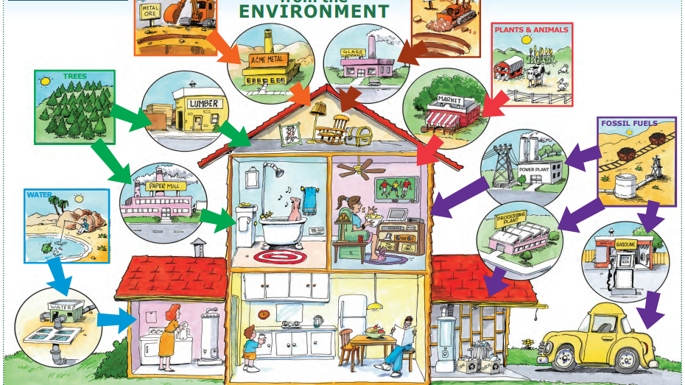
What are the natural resources?

Slide 4
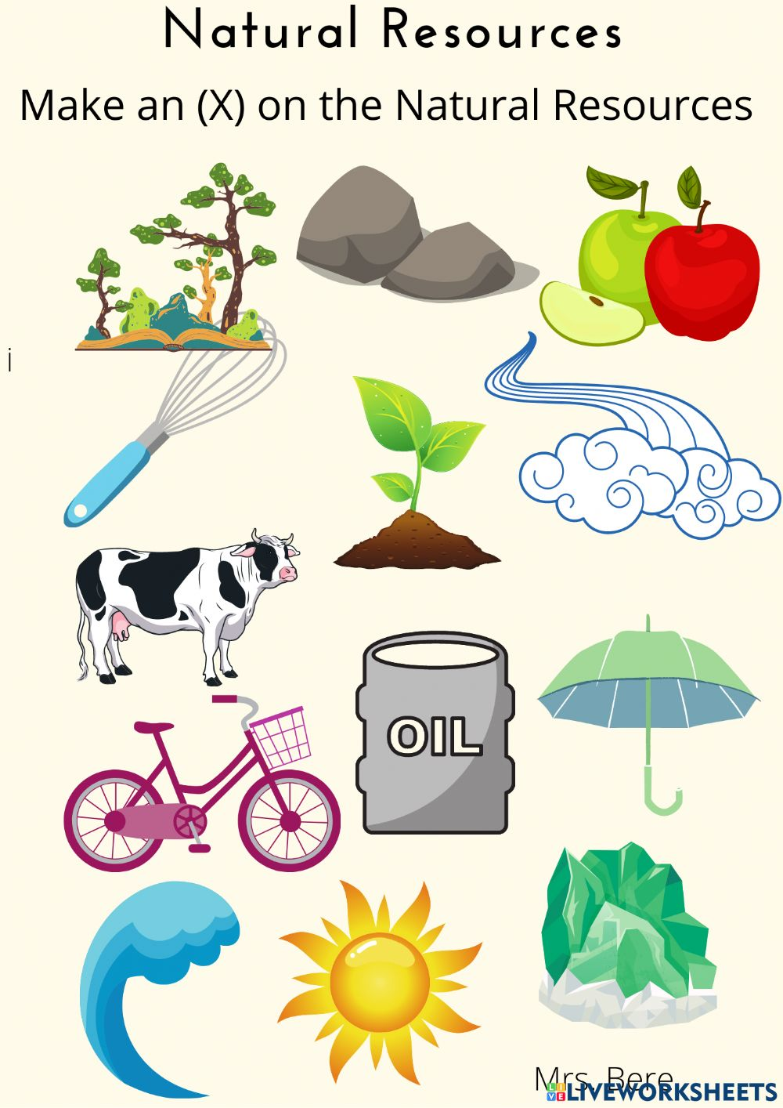
In groups write the name of the natural resource.

Slide 5
Conserve = Reduce

Slide 6
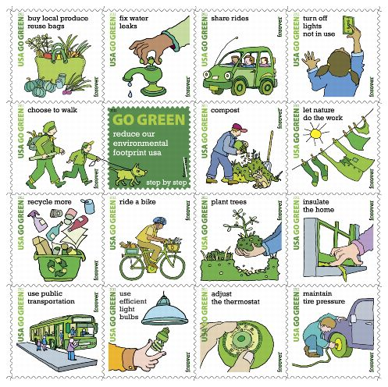
How can we Help?

Slide 7
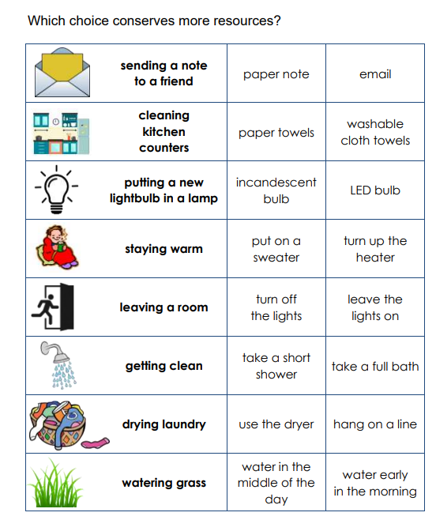
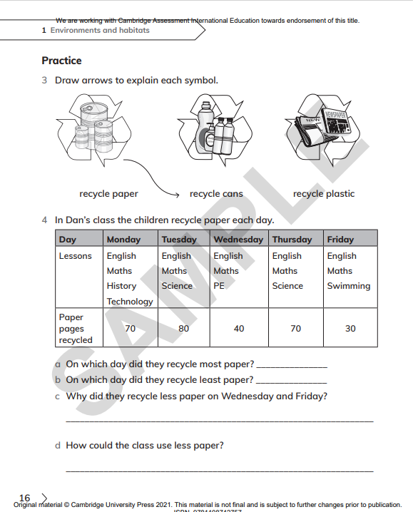
C.W

