Slide 1
Measuring mass
IN METRIC UNITS

Slide 2
REVIEW
How is MASS measured in the METRIC SYSTEM?
milligram, gram, kilogram

Slide 3
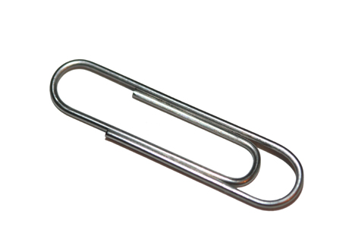
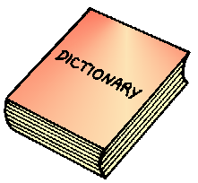
Take out your math notebooks and open to a blank page. Divide your page into three sections.
MILLIGRAMS
GRAMS
KILOGRAMS
1 kg = 1,000 g
1 kg = 1,000,000 mg
1 g = 1000 mg
1,000 g = 1kg
1000 mg = 1 g
1,000,000 mg = 1kg

Slide 4
We can use our metric conversion ladder to convert metric mass
kilo –
1,000 units
hecto –
100 units
deca –
10 units
meters liters grams (base)
deci-
0.1 unit
centi-
0.01 unit
milli –
0.001 units

Slide 5
King
How can I remember the metric conversion ladder?
kilo –
1,000 units
Henry
hecto –
100 units
Doesn’t
mind
like
gag
deca –
10 units
meters liters grams (base)
Drinking
deci-
0.1 unit
Chocolate
centi-
0.01 unit
Milk
milli –
0.001 units

Slide 6
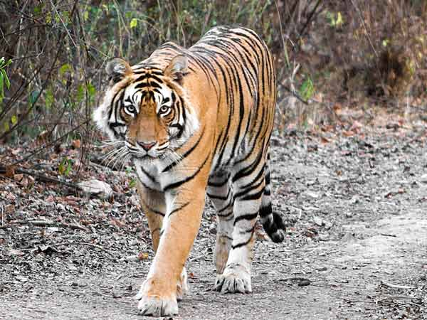
Watch me solve this one
kilo –
1,000 units
Some tigers can have a mass of 250 kilograms.
How many grams is this?
hecto –
100 units
Jump from kilograms to grams
deca –
10 units
meters liters grams (base)
3 steps down to the right =
move decimal 3 spaces to the right
deci-
0.1 unit
0
0
250.
0
.
centi-
0.01 unit
milli –
0.001 units
250 kg = 250000 grams

Slide 7
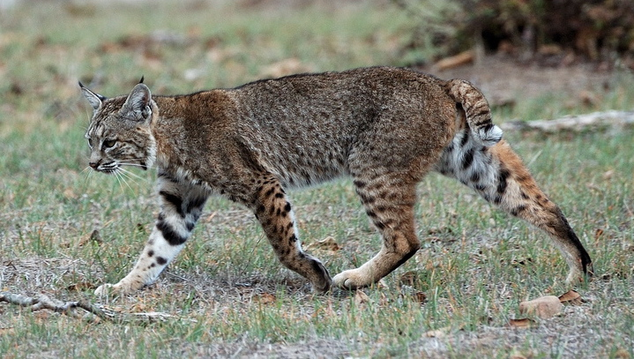
Try this one with me
kilo –
1,000 units
Some bobcats have a mass of 8618 grams.
How many kilograms is this?
hecto –
100 units
Jump from grams to kilograms
deca –
10 units
meters liters grams (base)
3 steps up to the left =
move decimal 3 spaces to the left
.
deci-
0.1 unit
8618.
centi-
0.01 unit
milli –
0.001 units
8618 grams = 8.618 kilograms

Slide 8
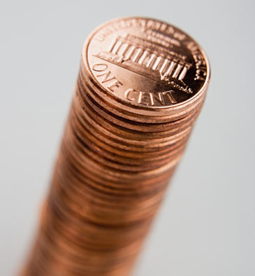
You try this one!
kilo –
1,000 units
hecto –
100 units
Ms. Smith has a stack of pennies that
has a mass of 2247 milligrams. What is this in grams?
deca –
10 units
2.247 grams
meters liters grams (base)
deci-
0.1 unit
centi-
0.01 unit
milli –
0.001 units

Slide 9
You try this one!
kilo –
1,000 units
hecto –
100 units
Jenny’s new puppy has a mass of 4 kilograms.
How many grams is Jenny's new puppy?
deca –
10 units
4000 grams
meters liters grams (base)
deci-
0.1 unit
centi-
0.01 unit
milli –
0.001 units

Slide 10
Closure
Tell your partner about “King Henry” and see if you can write out the metric conversion ladder without using our notes ☺

