Slide 2
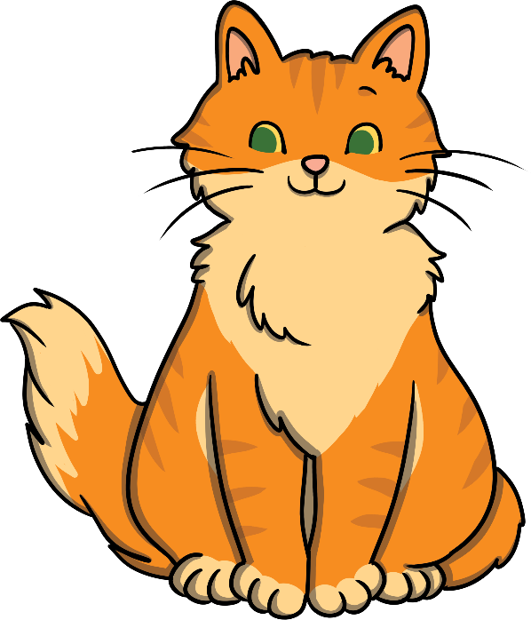
What order should the letters be in?
a
Click on the letters to spell the word
t
c
Next Slide

Slide 3
What order should the letters be in?
f
Click on the letters to spell the word
n
a
Next Slide

Slide 4
What order should the letters be in?
a
Click on the letters to spell the word
t
h
Next Slide

Slide 5
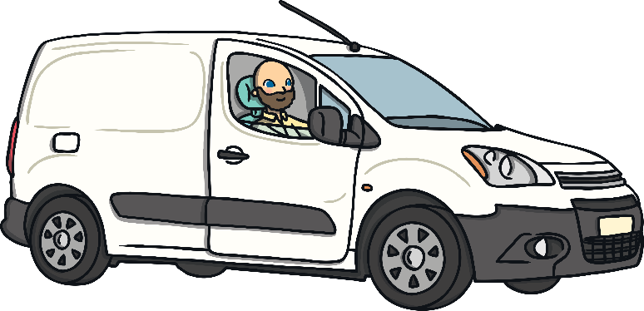
What order should the letters be in?
n
Click on the letters to spell the word
a
v
Next Slide

Slide 6
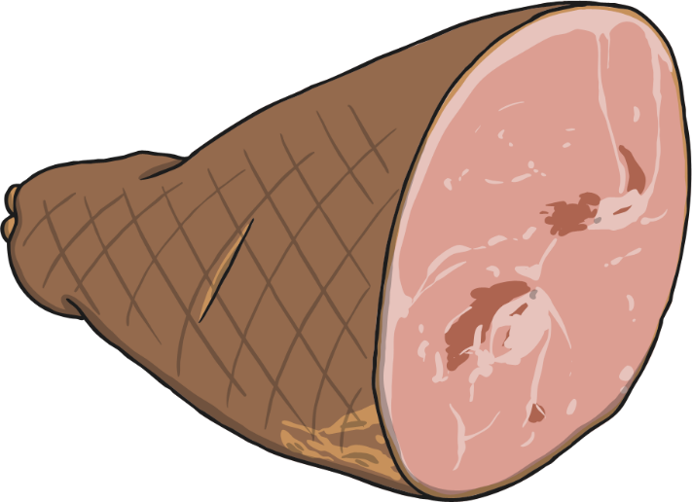
What order should the letters be in?
h
Click on the letters to spell the word
m
a
Next Slide

Slide 7
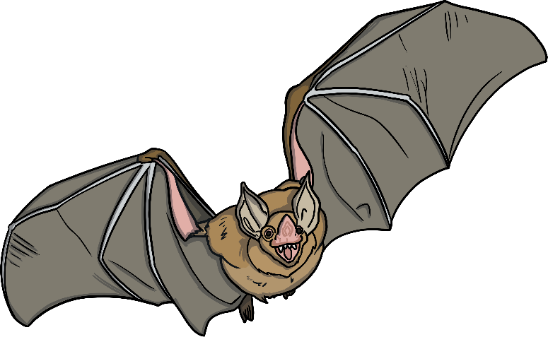
What order should the letters be in?
a
Click on the letters to spell the word
t
b
Next Slide

Slide 8
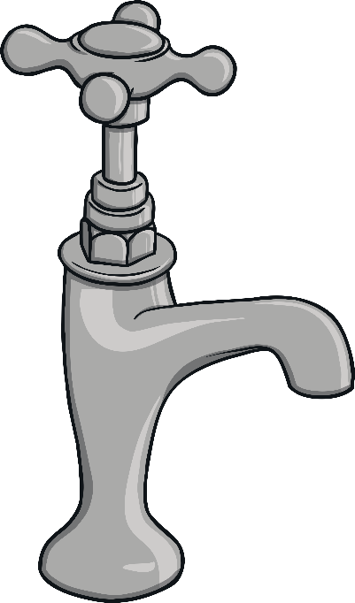
What order should the letters be in?
a
Click on the letters to spell the word
t
p
Next Slide

Slide 9
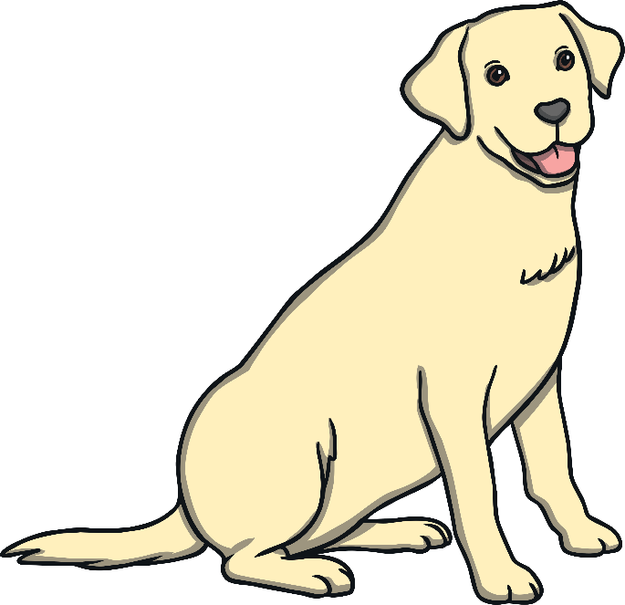
What order should the letters be in?
o
Click on the letters to spell the word
g
d
Next Slide

Slide 10
What order should the letters be in?
m
Click on the letters to spell the word
n
a
Next Slide

Slide 11
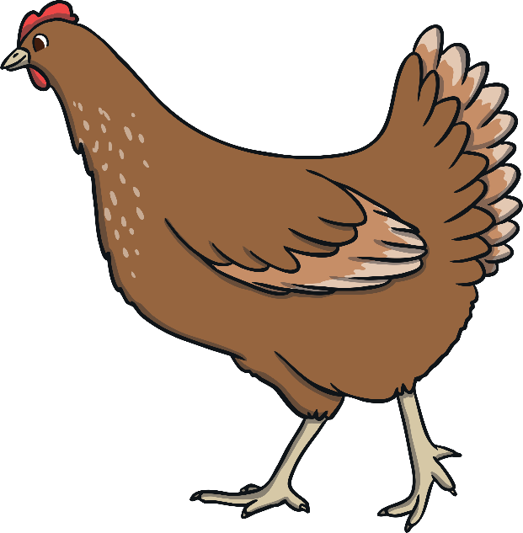
What order should the letters be in?
n
Click on the letters to spell the word
h
e
Next Slide

Slide 12
What order should the letters be in?
a
Click on the letters to spell the word
n
p
Next Slide

Slide 13
What order should the letters be in?
e
Click on the letters to spell the word
l
g
Next Slide

Slide 14
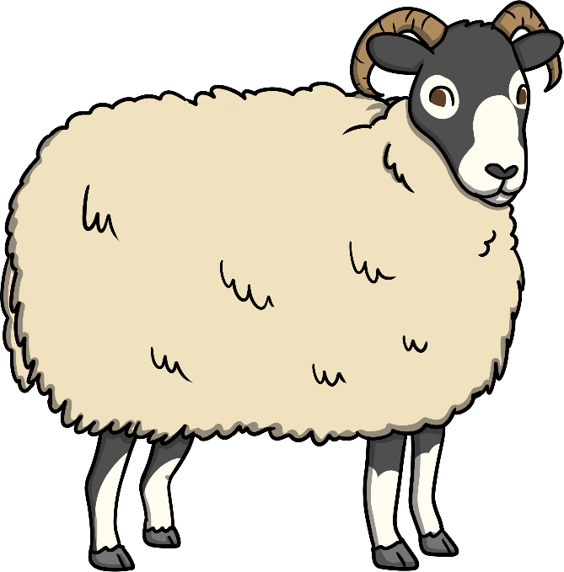
What order should the letters be in?
r
Click on the letters to spell the word
m
a
Next Slide

Slide 15
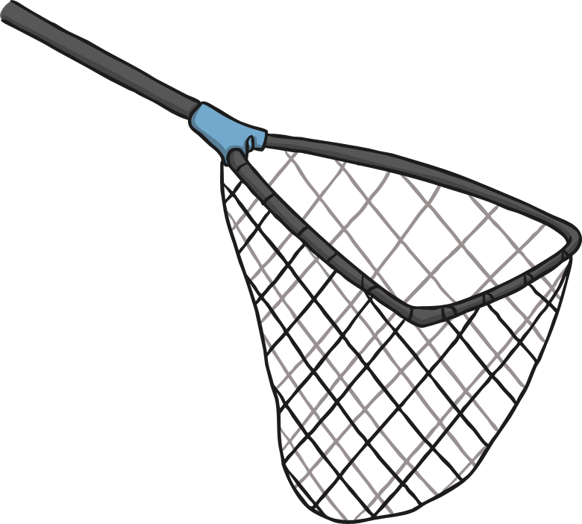
What order should the letters be in?
n
Click on the letters to spell the word
t
e
Next Slide

Slide 16
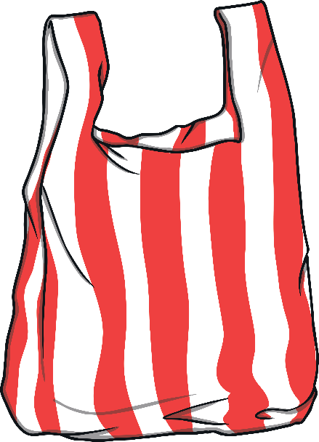
What order should the letters be in?
b
Click on the letters to spell the word
g
a
Next Slide

Slide 17
What order should the letters be in?
g
Click on the letters to spell the word
p
e
Next Slide

Slide 18
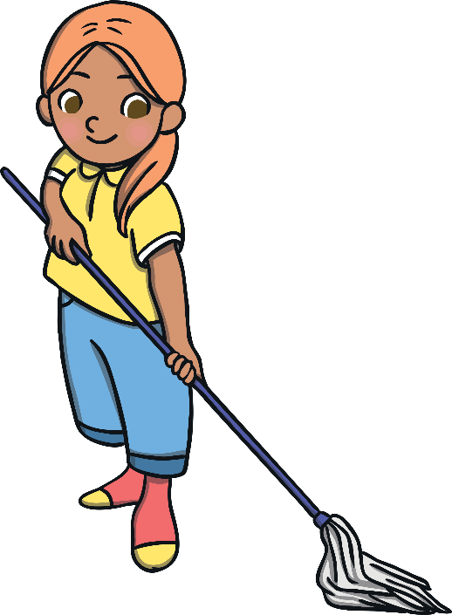
What order should the letters be in?
p
Click on the letters to spell the word
o
m
Next Slide

Slide 19
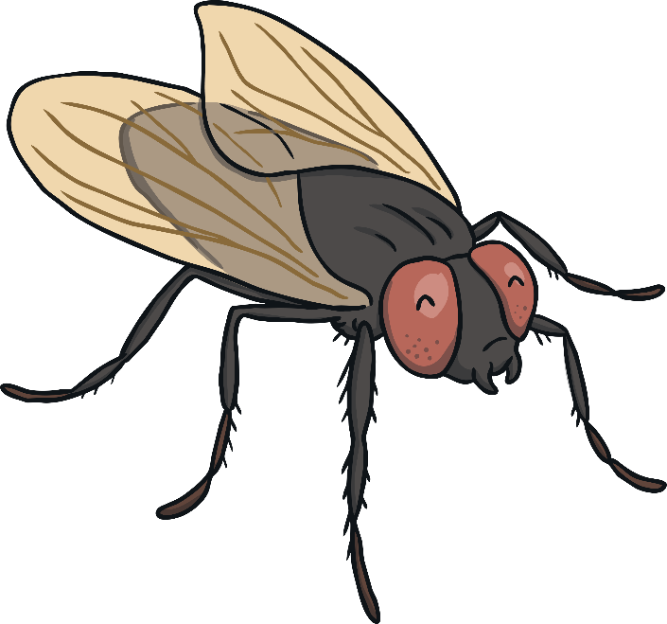
What order should the letters be in?
f
Click on the letters to spell the word
Reveal Answer
y
l
Next Slide

Slide 20
What order should the letters be in?
p
Click on the letters to spell the word
p
i
Next Slide

Slide 21
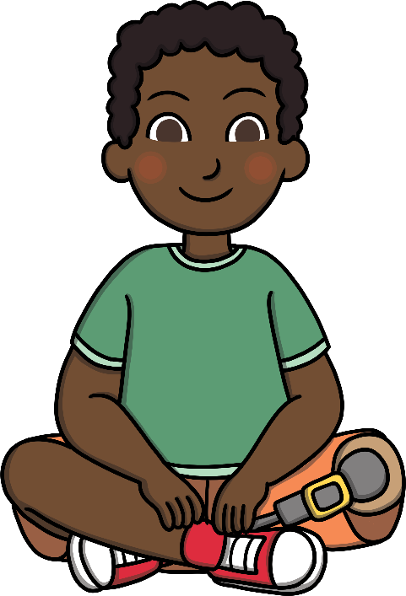
What order should the letters be in?
i
Click on the letters to spell the word
t
s
Next Slide

Slide 22
What order should the letters be in?
e
10
Click on the letters to spell the word
t
n
Next Slide

Slide 23
What order should the letters be in?
g
Click on the letters to spell the word
i
w
Next Slide

Slide 24
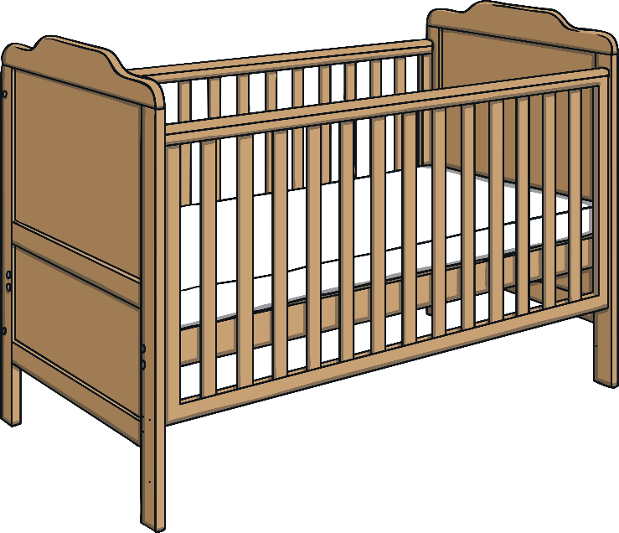
What order should the letters be in?
c
Click on the letters to spell the word
t
o
Next Slide

Slide 25
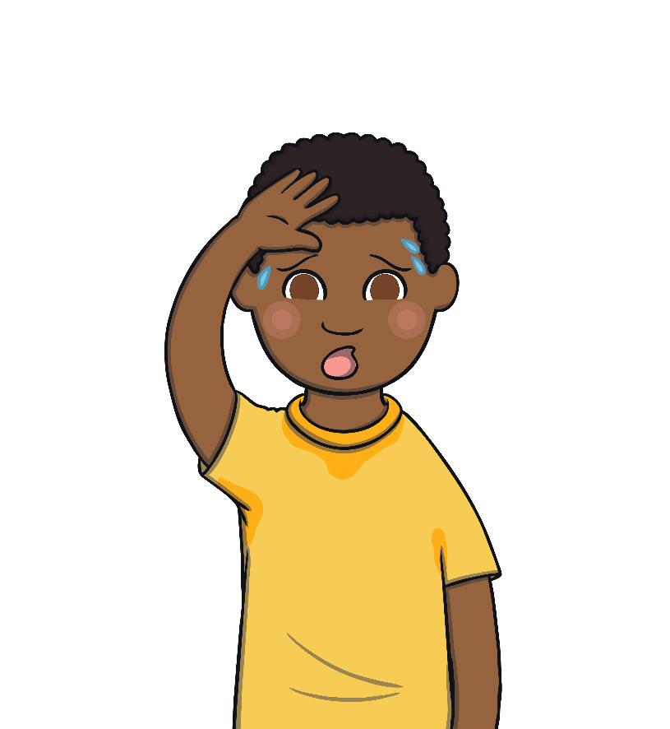
What order should the letters be in?
h
Click on the letters to spell the word
t
o
Next Slide

Slide 26
What order should the letters be in?
u
Click on the letters to spell the word
r
n
Next Slide

Slide 27
What order should the letters be in?
x
Click on the letters to spell the word
b
o
Next Slide

Slide 28
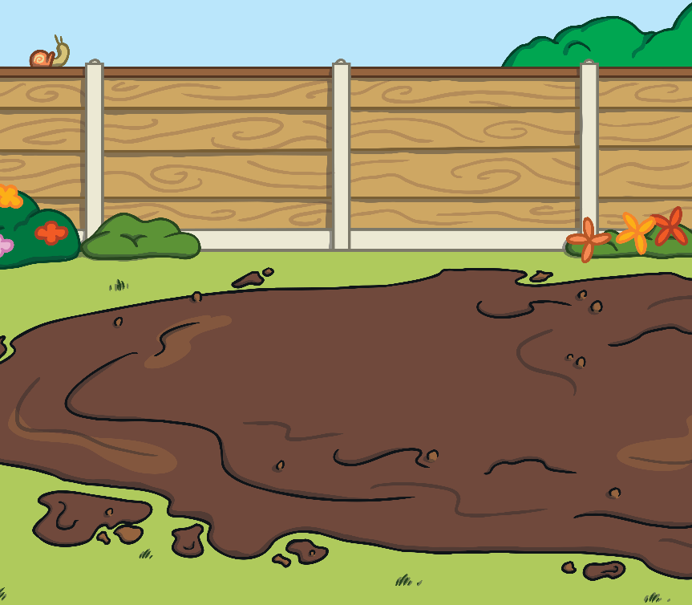
What order should the letters be in?
d
Click on the letters to spell the word
u
m
Next Slide

Slide 29
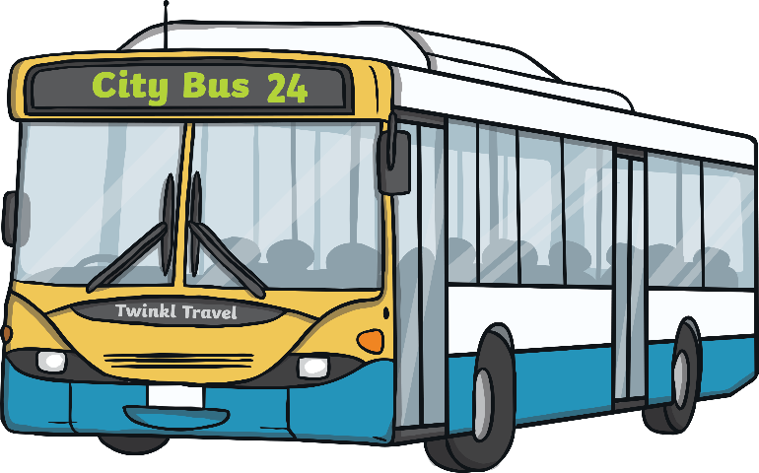
What order should the letters be in?
u
Click on the letters to spell the word
s
b
Next Slide

Slide 30
What order should the letters be in?
g
Click on the letters to spell the word
r
u
Next Slide

Slide 31
What order should the letters be in?
n
Click on the letters to spell the word
s
u
Next Slide

Slide 32
What order should the letters be in?
g
Click on the letters to spell the word
Reveal Answer
u
m
Next Slide

Slide 33
What order should the letters be in?
n
Click on the letters to spell the word
Reveal Answer
p
e
Next Slide

Slide 34
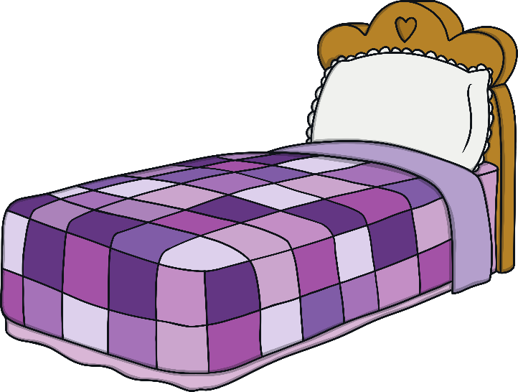
What order should the letters be in?
d
Click on the letters to spell the word
b
e
Next Slide

Slide 35
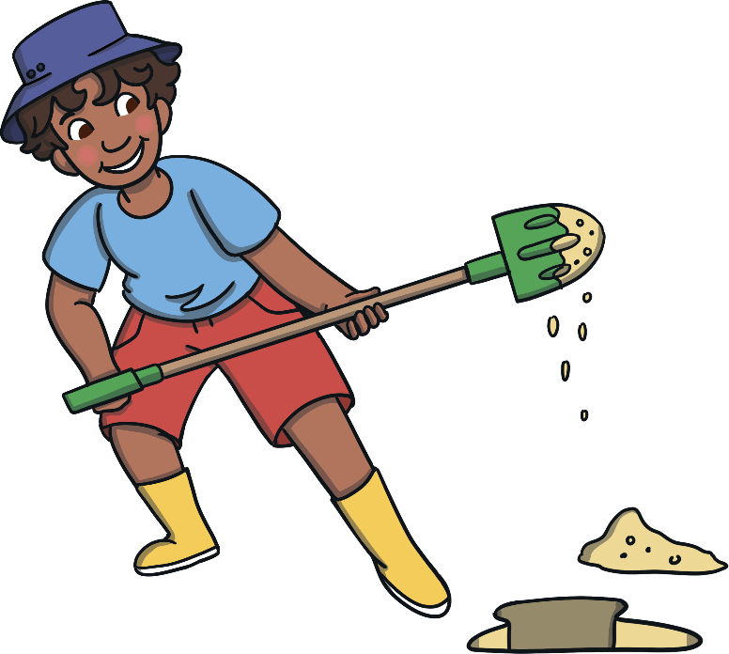
What order should the letters be in?
g
Click on the letters to spell the word
i
d
Next Slide

Slide 36
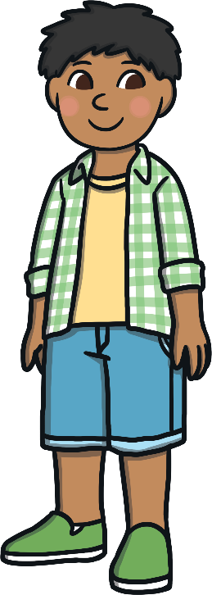
What order should the letters be in?
y
Click on the letters to spell the word
b
o
Next Slide

Slide 37
What order should the letters be in?
p
Click on the letters to spell the word
Reveal Answer
i
l
Next Slide

Slide 38
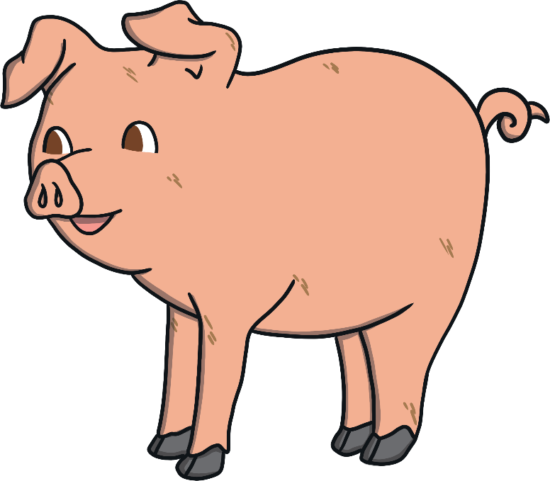
What order should the letters be in?
g
Click on the letters to spell the word
i
p
Next Slide

Slide 39
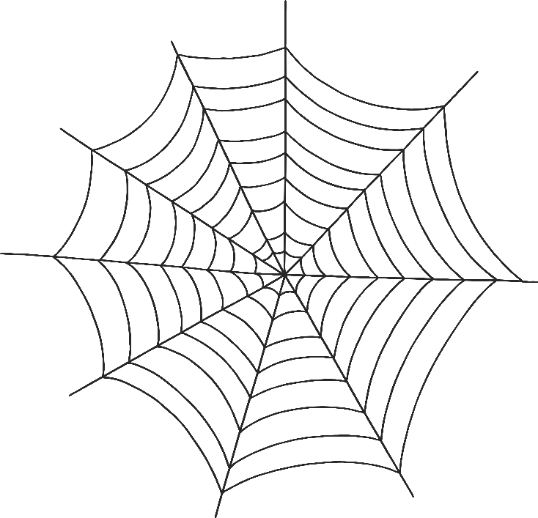
What order should the letters be in?
b
Click on the letters to spell the word
w
e
Next Slide

Slide 40
What order should the letters be in?
m
Click on the letters to spell the word
n
e
Next Slide

Slide 41
What order should the letters be in?
x
6
Click on the letters to spell the word
s
i
Next Slide

Slide 42
What order should the letters be in?
d
Click on the letters to spell the word
r
e
Next Slide

Slide 43
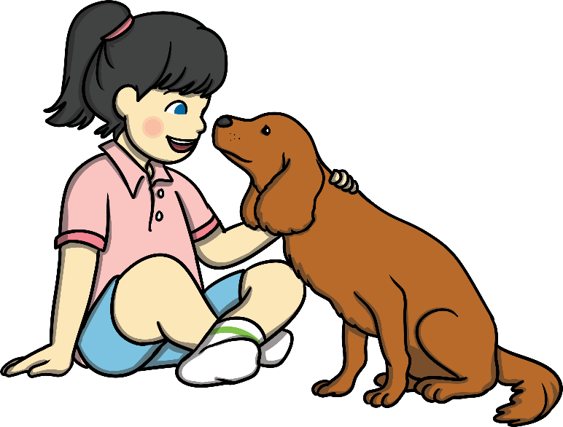
What order should the letters be in?
p
Click on the letters to spell the word
t
e
Next Slide

Slide 44
What order should the letters be in?
b
Click on the letters to spell the word
b
i
Next Slide

Slide 45
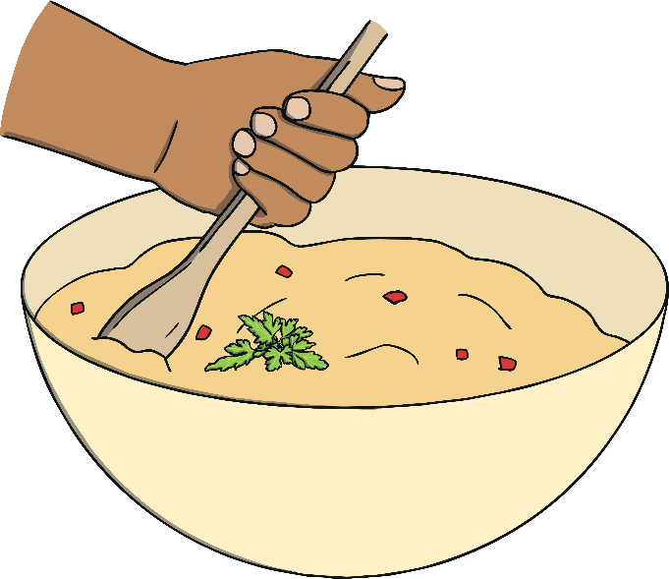
What order should the letters be in?
x
Click on the letters to spell the word
m
i
Next Slide

Slide 46
What order should the letters be in?
n
Click on the letters to spell the word
i
p
Next Slide

Slide 47
What order should the letters be in?
g
Click on the letters to spell the word
o
l
Next Slide

Slide 48
What order should the letters be in?
g
Click on the letters to spell the word
b
u
Next Slide

Slide 49
What order should the letters be in?
u
Click on the letters to spell the word
t
c
Next Slide

Slide 50
What order should the letters be in?
d
Click on the letters to spell the word
b
u
Next Slide

Slide 51
What order should the letters be in?
n
Click on the letters to spell the word
i
b
Next Slide

Slide 52
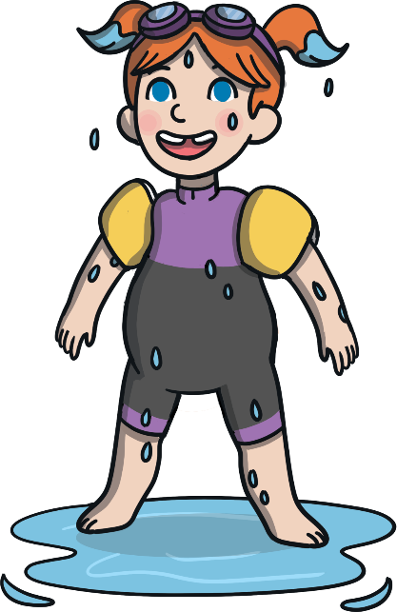
What order should the letters be in?
e
Click on the letters to spell the word
t
w
Next Slide

Slide 53
What order should the letters be in?
g
Click on the letters to spell the word
u
j
Next Slide

Slide 54
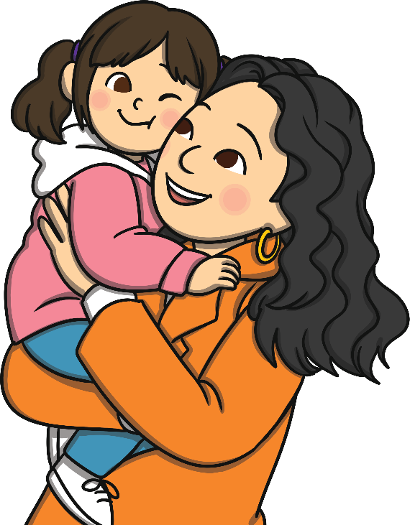
What order should the letters be in?
g
Click on the letters to spell the word
h
u
Next Slide

