Slide 2
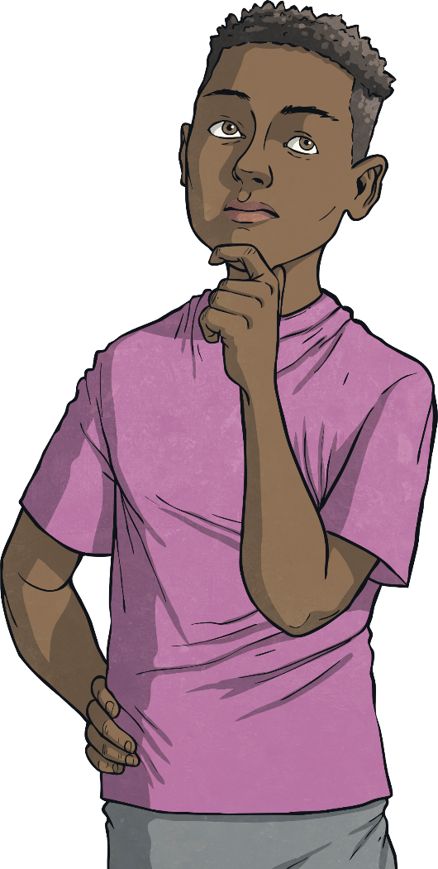
Aim
I can understand and make fact families using addition and subtraction.

Slide 3
Fact Family Triangles
I have 15 lollies.
7 are green and 8 are blue.
15
7
8

Slide 4
Fact Family Triangles
I have 15 lollies.
7 are green and 8 are blue.
7 + 8 = 15
15
7
8
8 + 7 = 15

Slide 5
Fact Family Triangles
15
I have 15 lollies.
I eat the blue ones.
7
8
15 – 8 = 7

Slide 6
Fact Family Triangles
15
I have 15 lollies.
I save the greens ones for later.
7
8
15 – 7 = 8

Slide 7
Fact Family Triangles
15
7
8
7 + 8 = 15
8 + 7 = 15
15 – 8 = 7
15 – 7 = 8

Slide 8
Fact Family Triangles
I have 20 apples.
6 are red and 14 are green.
20
6
14

Slide 9
Fact Family Triangles
I have 20 apples.
6 are red and 14 are green.
20
6 + 14 = 20
6
14
14 + 6 = 20

Slide 10
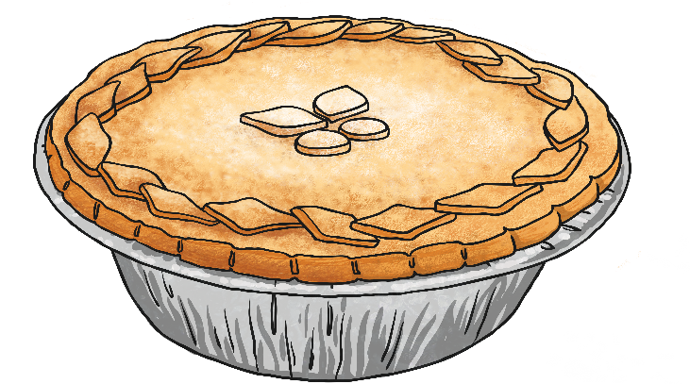
Fact Family Triangles
I have 20 apples.
I cooked the 14 green apples in a pie.
20
6
14
20 – 14 = 6

Slide 11
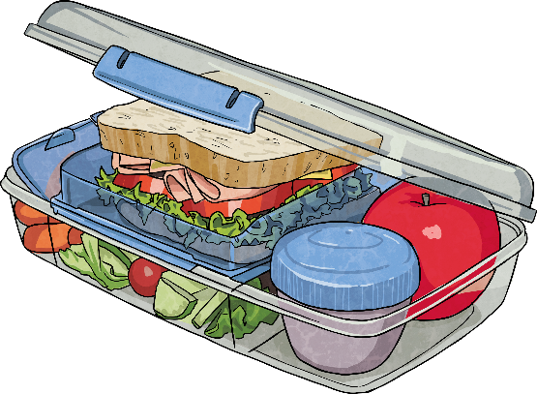
Fact Family Triangles
I have 20 apples.
I pack the 6 red apples for school lunches.
20
6
14
20 – 6 = 14

Slide 12
Fact Family Triangles
20
6
14
6 + 14 = 20
14 + 6 = 20
20 – 14 = 6
20 – 6 = 14

Slide 13
Fact Family Triangles
I have 43 flowers.
23 are pink and 20 are orange.
43
23
20

Slide 14
Fact Family Triangles
I have 43 flowers.
23 are pink and 20 are orange.
43
23 + 20 = 43
23
20
20 + 23 = 43

Slide 15
Fact Family Triangles
43
I have 43 flowers.
I send the 23 pink flowers to my Aunty.
23
20
43 – 23 = 20

Slide 16
Fact Family Triangles
43
I have 43 flowers.
I put 20 orange flowers in vases.
23
20
43 – 20 = 23

Slide 17
Fact Family Triangles
43
23
20
23 + 20 = 43
20 + 23 = 43
43 – 23 = 20
43 – 20 = 23

Slide 18
Fact Family Triangles
Can you match the triangle with the correct fact family?
7 + 11 = 18
11 + 7 = 18
22
18 + 7 = 11
18 – 11 = 7
8
14
8 + 14 = 22
14 + 8 = 22
22 – 14 = 8
22 – 8 = 14
6 + 5 = 11
5 + 6 = 11
11 – 6 = 5
Next Question
11 – 5 = 6

Slide 19
Fact Family Triangles
Can you match the triangle with the correct fact family?
7 + 11 = 18
11 + 7 = 18
18
18 – 7 = 11
18 – 11 = 7
7
11
8 + 14 = 22
14 + 8 = 22
22 – 14 = 8
22 – 8 = 14
6 + 5 = 11
5 + 6 = 11
11 – 6 = 5
Next Question
11 – 5 = 6

Slide 20
Fact Family Triangles
Can you match the triangle with the correct fact family?
7 + 11 = 18
11 + 7 = 18
11
18 – 7 = 11
18 – 11 = 7
6
5
8 + 14 = 22
14 + 8 = 22
22 – 14 = 8
22 – 8 = 14
6 + 5 = 11
5 + 6 = 11
11 – 6 = 5
11 – 5 = 6

Slide 21
Fact Family Triangles
Write your own fact families for these triangles.
40
34
19
25
15
12
22
6
13
25 + 15 = 40
12 + 22 = 34
6 + 13 = 19
Reveal Answers
Reveal Answers
Reveal Answers
15 + 25 = 40
22 + 12 = 34
13 + 6 = 19
40 – 15 = 25
34 – 12 = 22
19 – 6 = 13
40 – 25 = 15
34 – 22 = 12
19 – 13 = 6

