Slide 2
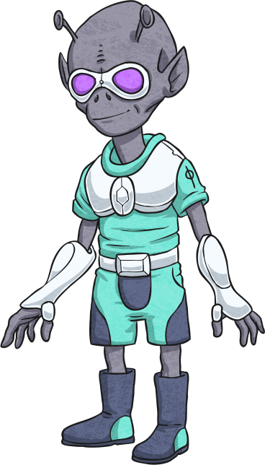
Instructions
Opening the game in 'presentation' mode will make this game clear.
You can choose to revise question words before starting, or start on slide 4. Choosing the correct question word on each slide will enable you to go to the next. If the wrong word is clicked on, you'll be unable to progress.

Slide 3
A Quick Chance to Revise
Match the question words to the descriptions of what they’re used for. Click on each question word to check your answer.
what
We use this to ask about someone’s age.
where
We use this to ask about location/place.
We use this to ask for a reason, and the answer usually begins with ‘because’.
when
why
We use this to identify a person.
who
We use this to ask about time or date.
We use this to ask about number/quantity.
how
We use this to ask someone to identify/specify something.
how many
We use this to ask about the condition of something.
how old

Slide 4
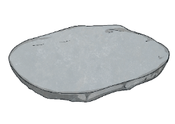
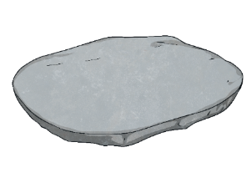
Rules of the Game
This game will help you revise the most common question words.
You must help an alien, Bimble, choose the right question word and step on the right stone to avoid the lava. If you choose the wrong stone, you must go back to the beginning of the game.
Everyone can join in by shouting ‘The floor is lava!’ If that happens, everyone must make sure that they aren’t touching the floor by jumping on a chair or other furniture.

Slide 5
Start Here
Hi there, my name is Bimble. I have to get across the river of lava. Would you help me step on the right stones?
Don’t get a question wrong because if you do, the floor turns to…
A
A
L
V
!
Start the Game

Slide 6
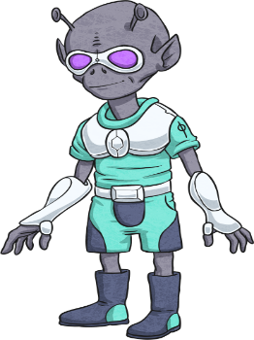
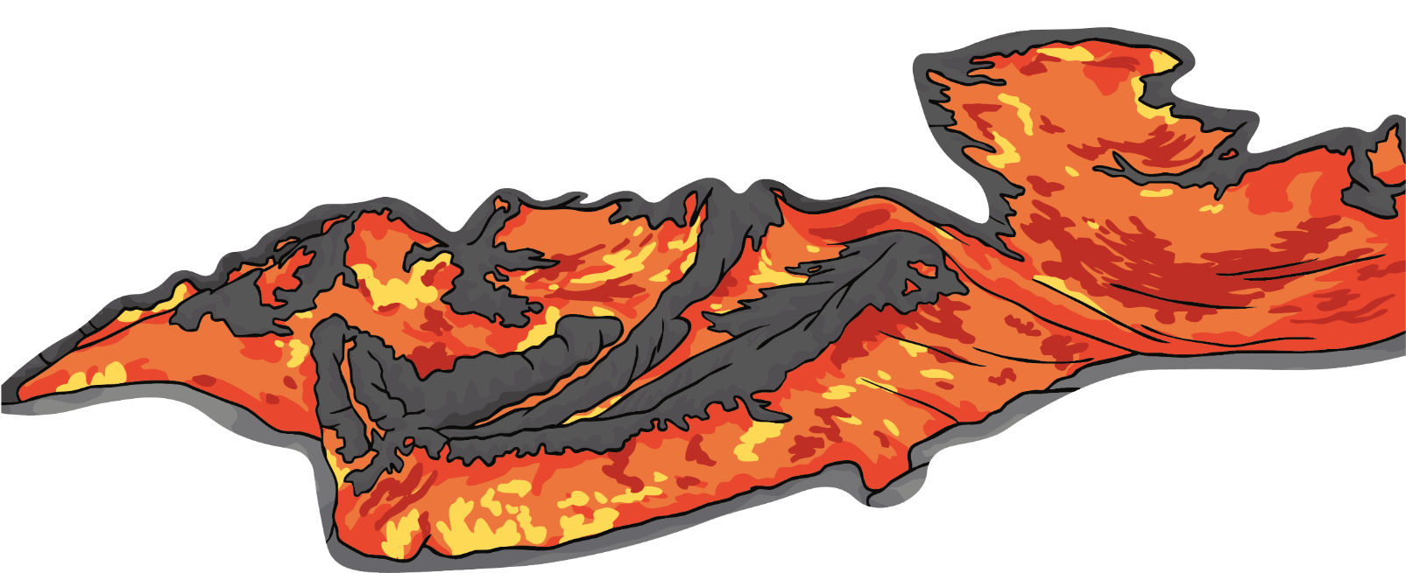
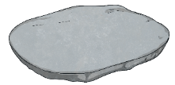
Step 1
“ ’s your name?”
“My name’s Bimble.”
Who
What
Why
Next step

Slide 7
Step 2
“ are you from?”
“I’m from Spain.”
Where
How
When
Next step

Slide 8
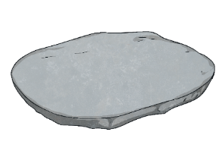
Step 3
“ do you have breakfast with?”
“I normally have breakfast with my dad and my little sister.”
How many
What
Who
Next step

Slide 9
Step 4
“ are you studying English?”
“Because I want to be a doctor.”
Who
When
Next step
Why

Slide 10
Step 5
“ are you?”
“I’m 13 years old.”
How many
How old
Next step
How

Slide 11
Step 6
“ ’s your birthday?”
“It’s on January the 1st - New Year’s Day!”
What
What time
When
Next step

Slide 12
Step 7
“ brothers and sisters do you have?”
“I have three. Two brothers and a sister.”
How many
Why
Who
Next step

Slide 13
Step 8
“ ’s this in English?”
“It’s a pencil.”
How
Who
What
Next step

Slide 14
Step 9
“ are you today?”
“I’m well, thanks!”
How many
How old
How
Next step

Slide 15
Step 10
“ do you know Monty?”
“I know him from school.”
How
Who
What
Next step

Slide 16
Step 11
“ do you usually go on holiday?”
“I normally go on holiday in July.”
Where
When
How
Next step

Slide 17
Step 12
“ students are there in your school?”
“There are more than five hundred.”
Who
What
How many

Slide 18
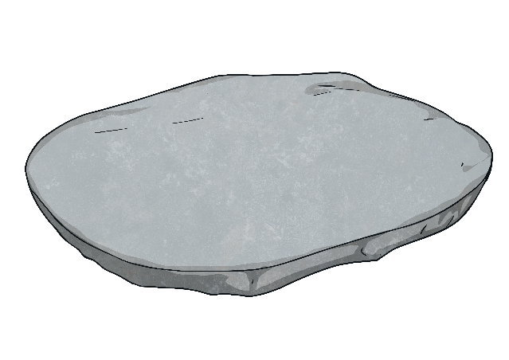
Congratulations!
We made it to the other side!

