Slide 1
English

Slide 2
Lessons Objectives
By the end of the lesson, learners will be able to :
understand and identify the main features of writing a story.
understand what conjunctions mean
01
write caption or sentences to describe a story.
02
03
present text in a range of different ways, e.g. diagrams with typed labels, storyboards with handwritten captions
04

Slide 5
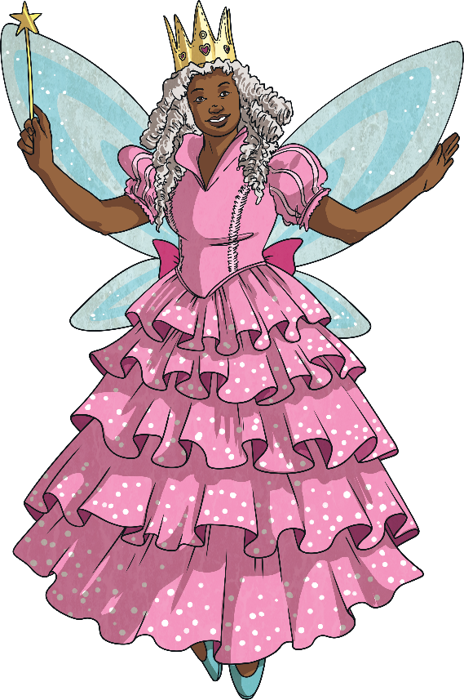
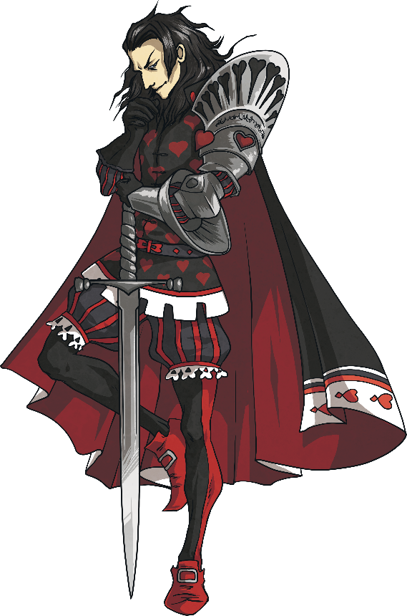
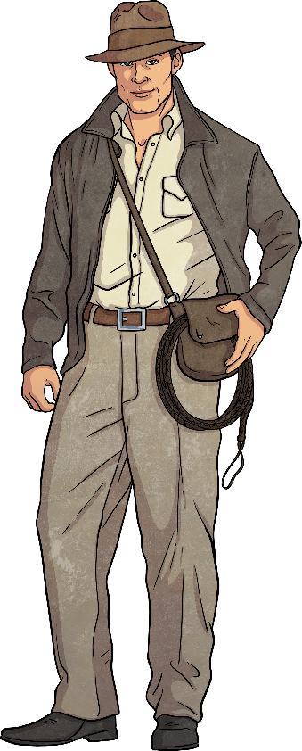
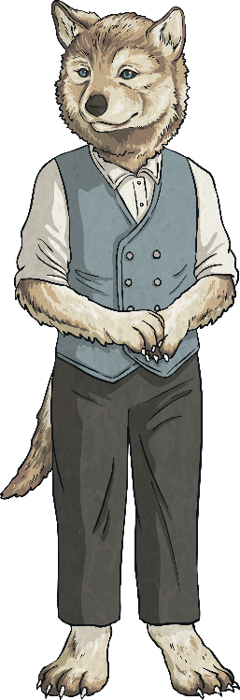
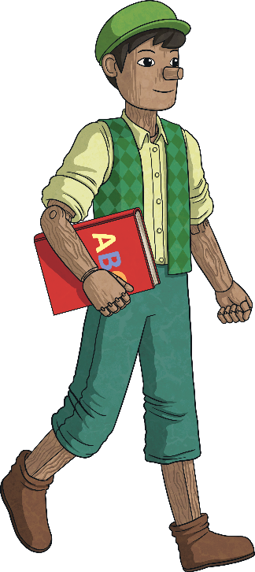
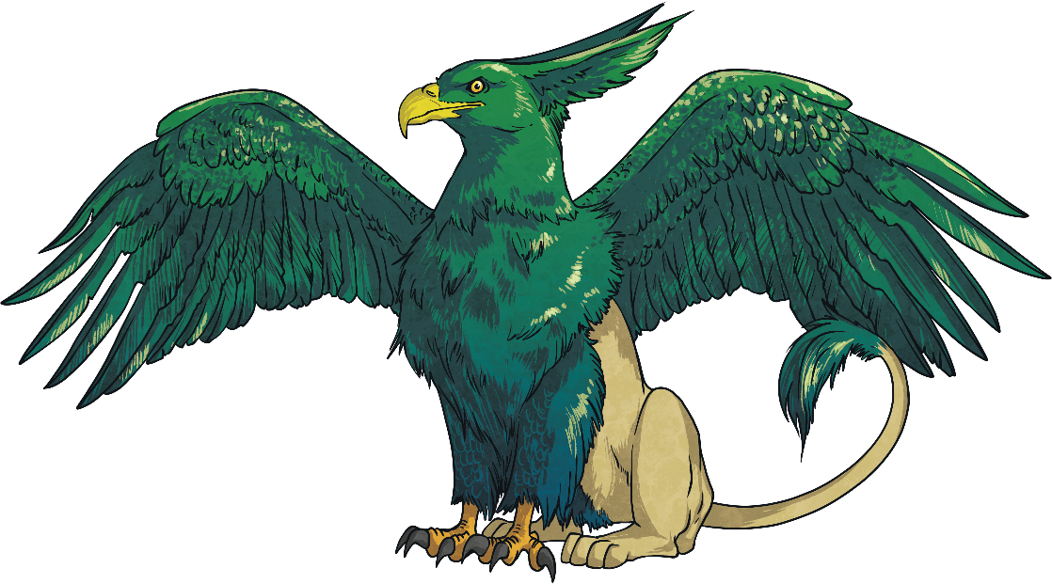
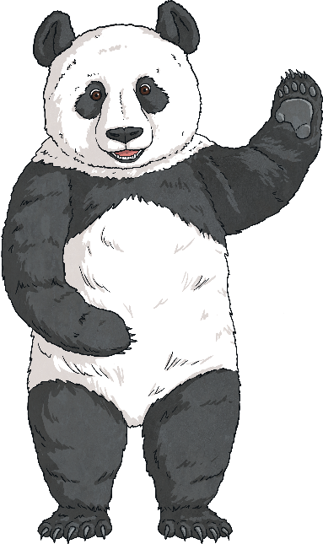
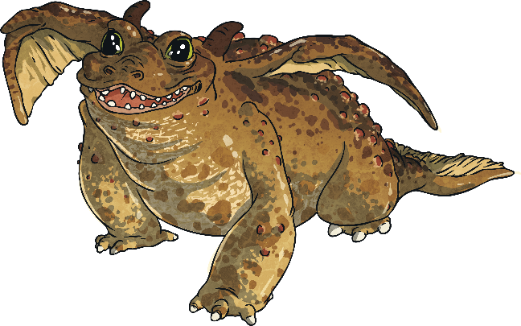
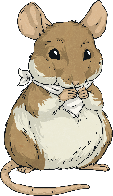
Characters
Who is the story about?
This may be people, animals, and sometimes objects that are alive.

Slide 6
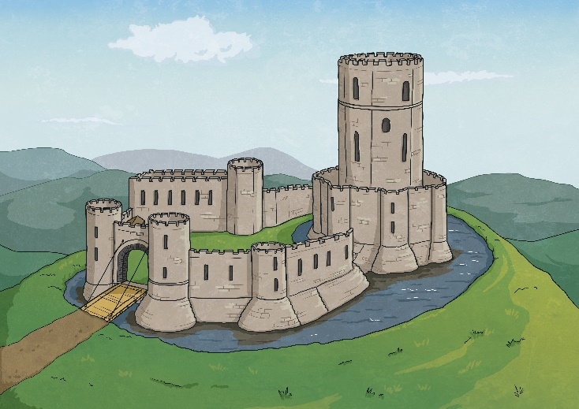
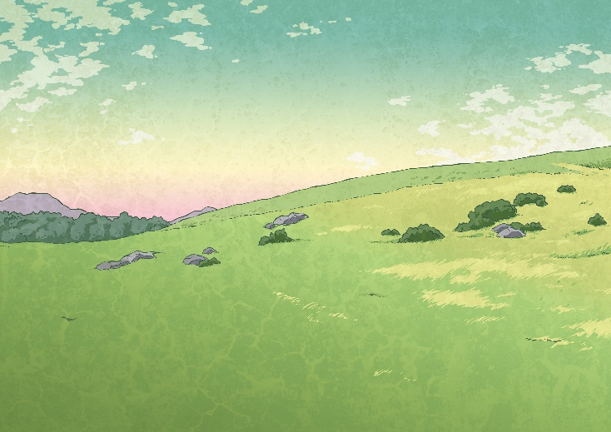
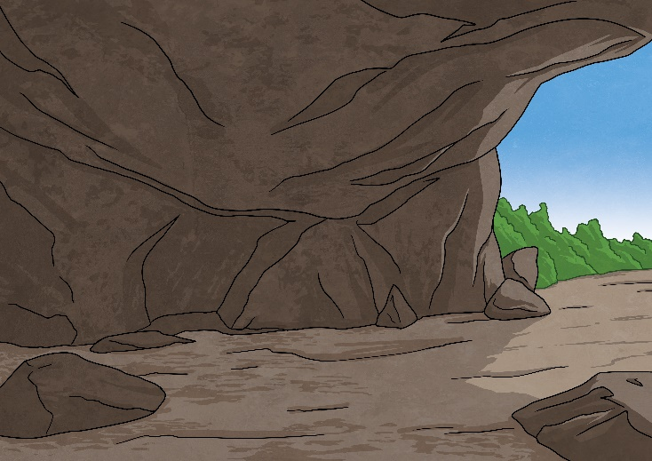
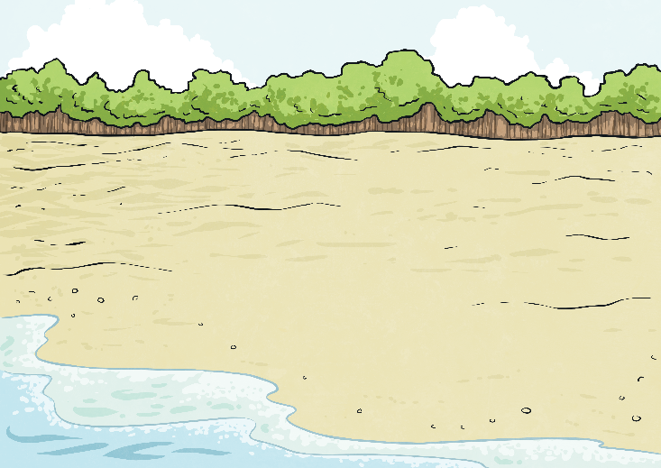
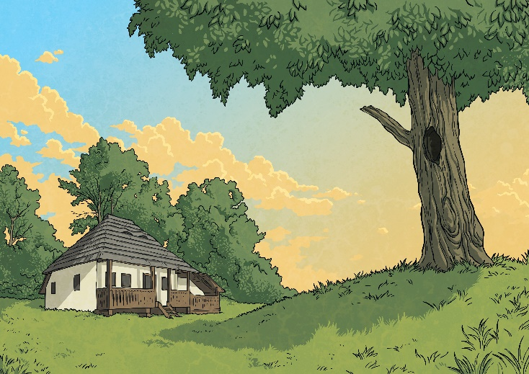
Setting
Where and when does the story take place?

Slide 7
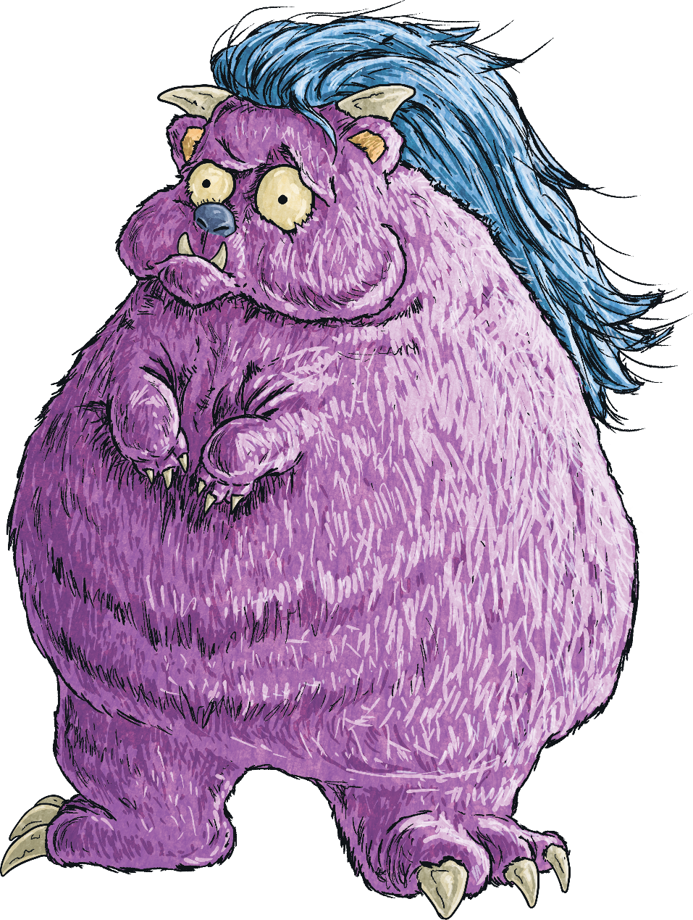
Problem
What is the character trying to fix, change, or figure out in the story?
What do I do?

Slide 8
Events
What important events happened in the story?
B
Beginning
M
Middle
E
End

Slide 9
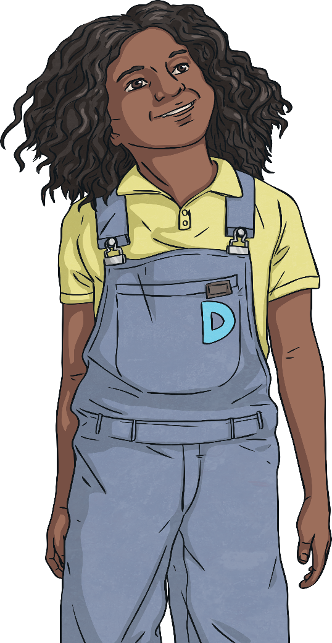
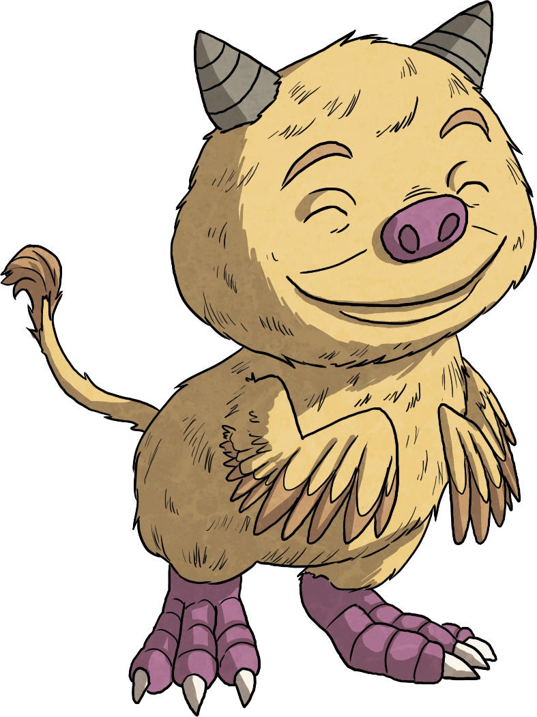
Solution
How was the problem in the story solved?

Slide 10
Watch the story

Slide 11
Lessons Objectives
Objectives check:
understand and identify the main features of writing a story.
01
write caption or sentences to describe a story.
02
03
present text in a range of different ways, e.g. diagrams with typed labels, storyboards with handwritten captions
04

