Slide 2
If 2 people were sharing this pizza equally, how many slices would they get each?
They would get 3 slices each.
6 divided equally between 2 groups = 3

Slide 3
If these lollies were to be shared equally between 3 friends, how many would each friend get?
They would each get 3 lollies each.
9 divided equally between 3 groups = 3

Slide 4
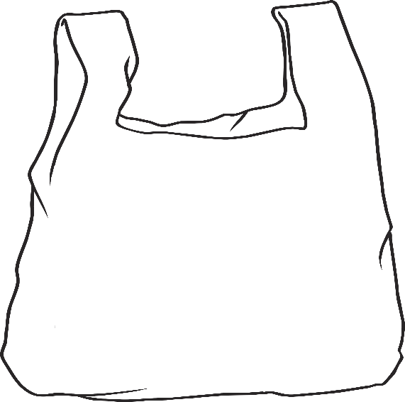
If these cookies were split evenly between 3 bags, how many would be in each bag?
There would be 4 cookies in each bag.
12 divided equally between 3 groups = 4

Slide 5
If these pencils were divided equally between 5 pencil cases. How many would be in each case?
There would be 3 pencils in each pencil case.
15 divided equally between 5 groups = 3

Slide 6
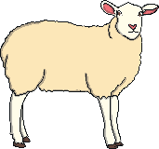
These sheep need to be divided evenly into 2 groups. How many sheep would be in each group?
There would be 10 sheep in each group.
20 sheep divided equally into 2 groups = 10

Slide 7
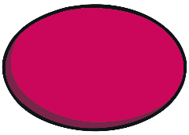
Have a go at making equal groups, use counters or cubes.
Count out 10 counters or cubes. Share them equally into 5 groups.
How many are in each group?
~
10 divided equally into 5 groups = 2

Slide 8
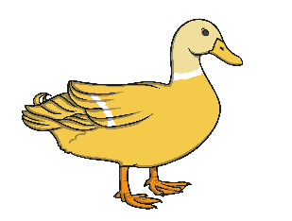
You can also draw circles around pictures of things to split them up into groups.
Have a look at this picture of 8 ducks.
They can be split up into 2 groups by drawing a circle around them.
How many are in each group?
~
8 divided equally into 2 groups = 4

Slide 9
Let's have a go at dividing by making equal groups.
Use counters or draw out circles:
6 divided equally into 3 groups =
2
12 divided equally into 2 groups =
6
16 divided equally into 8 groups =
2
18 divided equally into 6 groups =
3

