Slide 1
English

Slide 2
Lessons Objectives
By the end of the lesson, learners will be able to :
read the new words.
read the new words.
read the new words.
understand what conjunctions mean
01
identify the meaning for the new words.
identify the meaning for the new words.
identify the meaning for the new words.
02
use the new vocabulary in their writing.
03
use the new vocabulary in their writing.
04

Slide 3
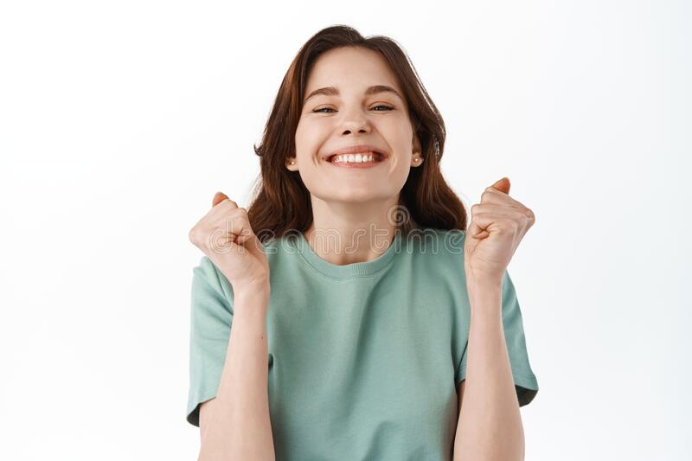
pleased
feeling or showing pleasure and satisfaction, especially at an event or a situation.
I am so pleased to meet you

Slide 4
charming
very pleasant or attractive.
This cottage is so charming.

Slide 5
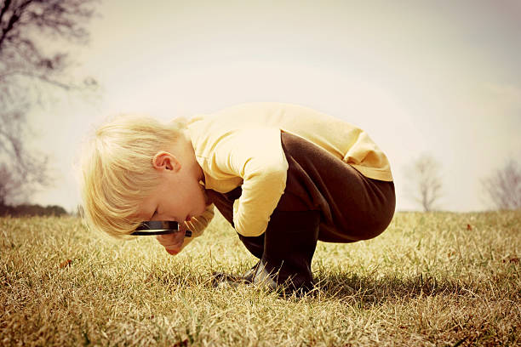
curious
eager to know or learn something.
I began to be curious about understanding all about planets.

Slide 6
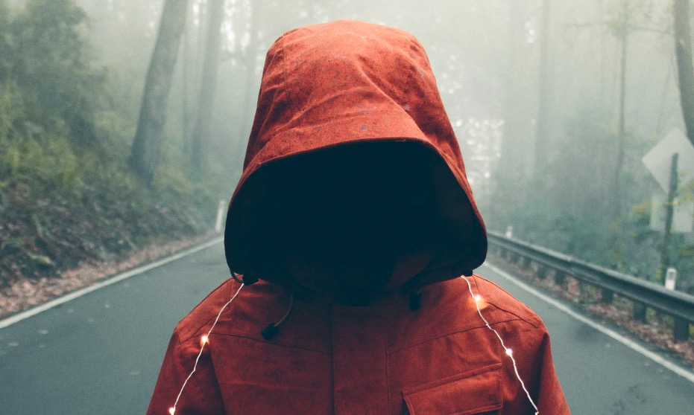
mysterious
strange, not known, or not understood:
The mysterious woman disappeared all of a sudden.

Slide 7
Can you write the words in your dictionary?

Slide 8
Lessons Objectives
Objectives check:
read the new words.
.
01
identify the meaning of the new words.
02
03
use the new vocabulary in their writing.
04

