Slide 2
Find the word using the letters given.
v
t
e
a
m
f
b
i
o
d
n
s
b
e
d

Slide 3
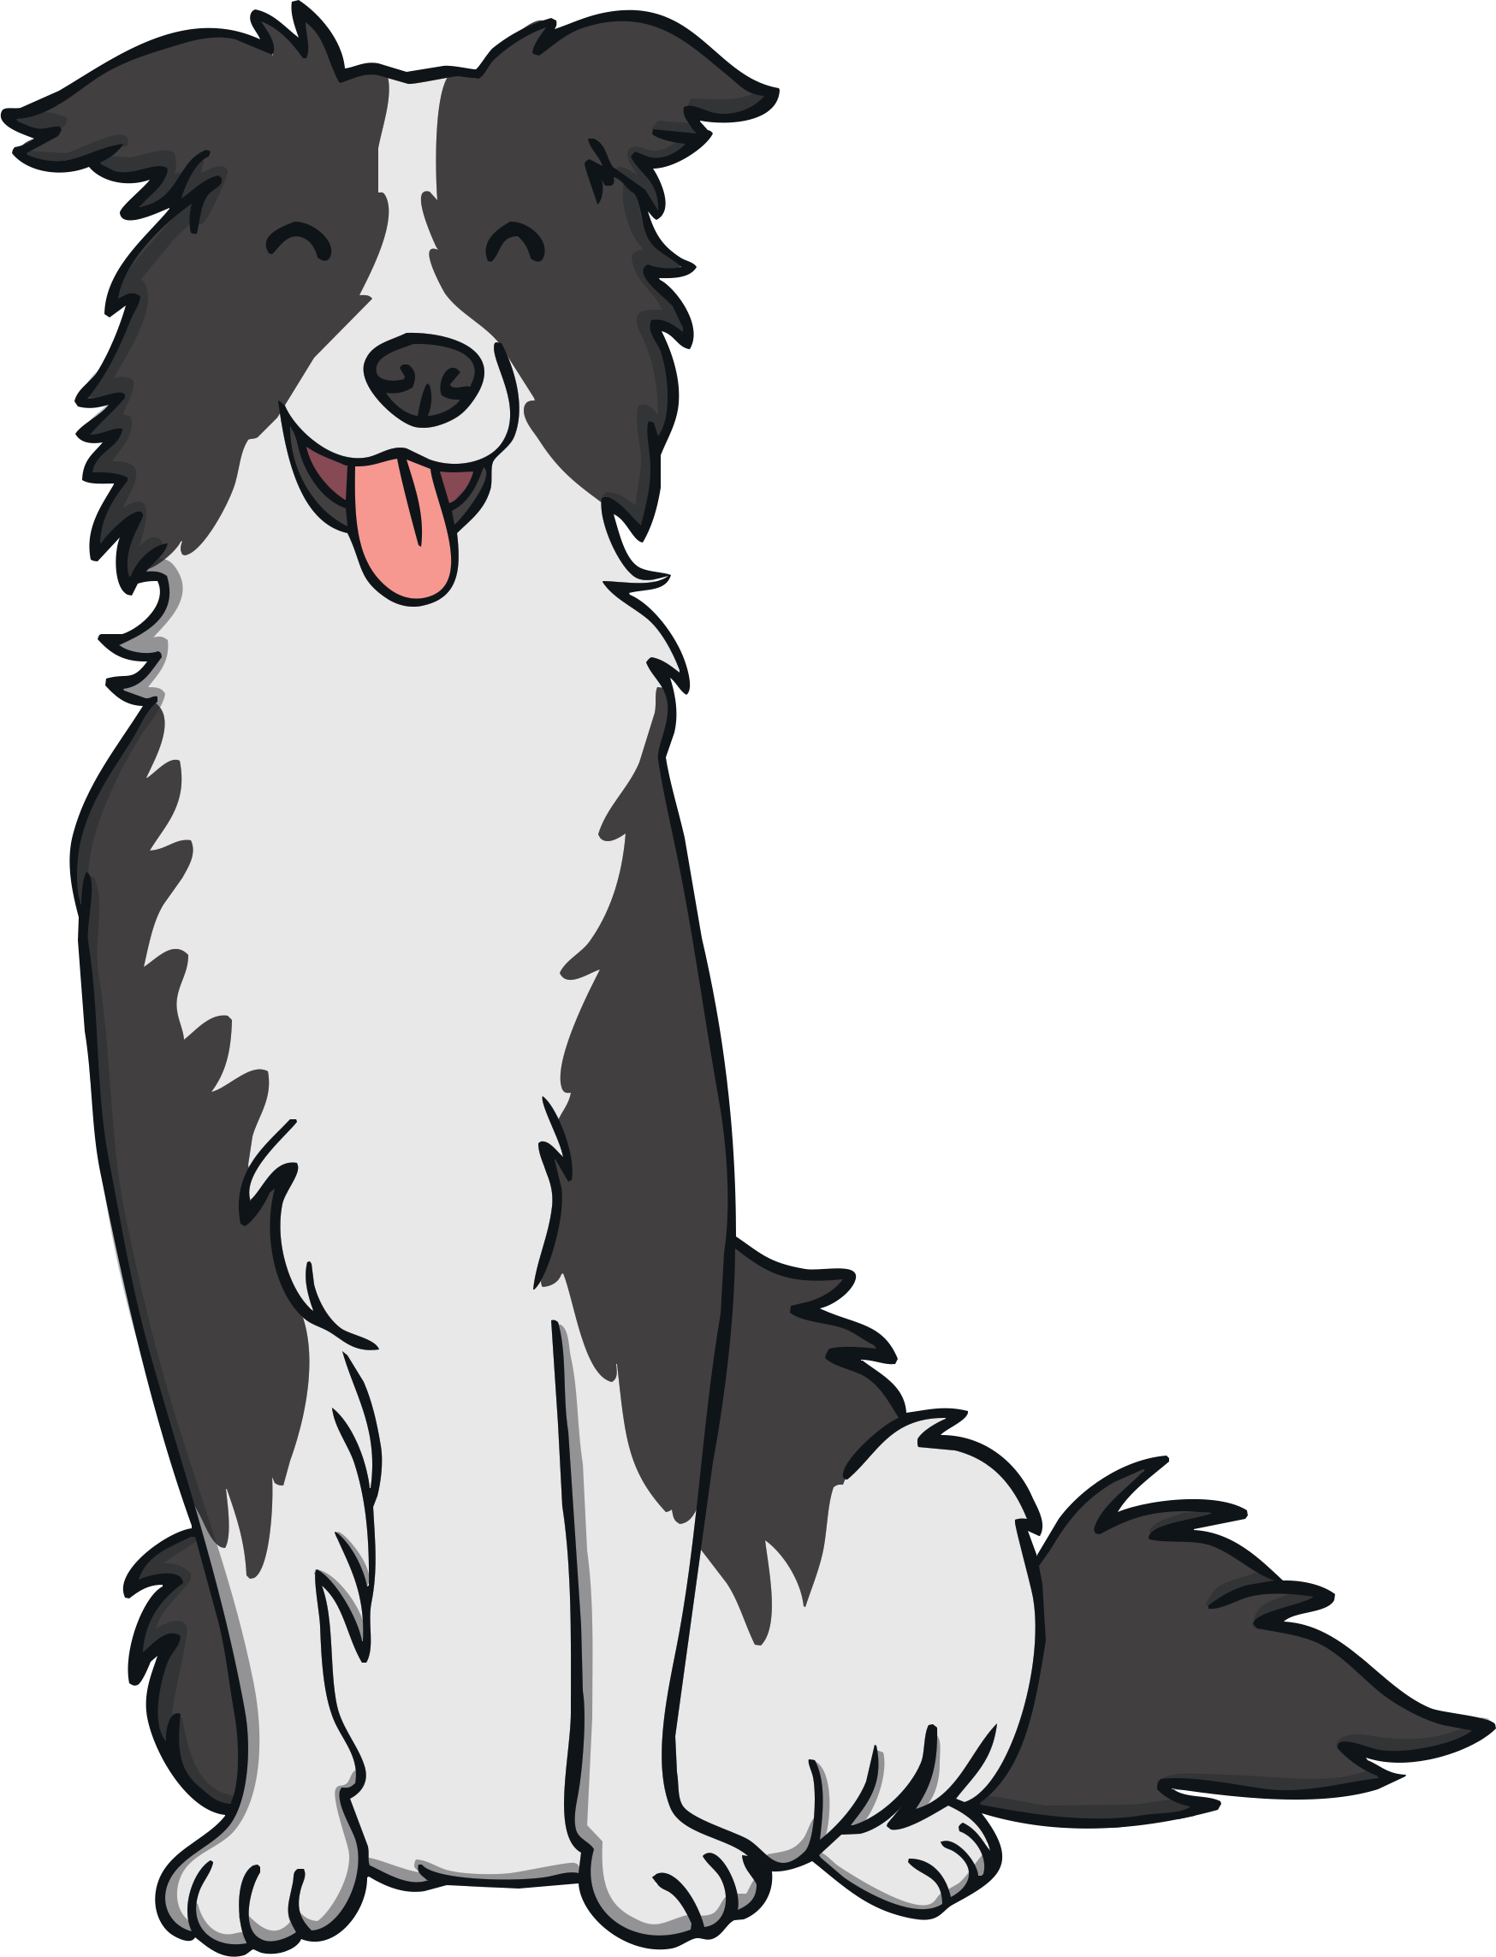
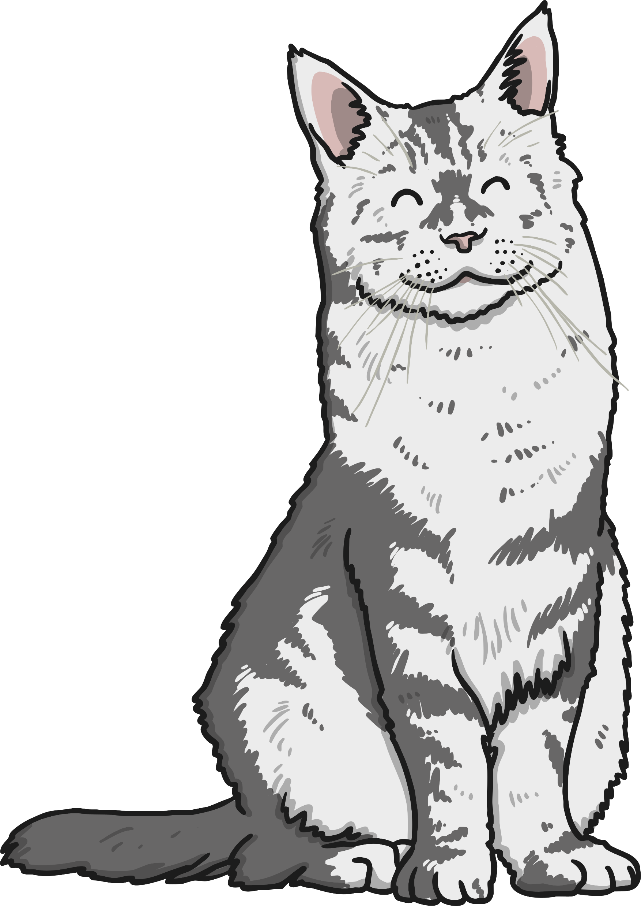
Find the word using the letters given.
v
t
e
a
m
o
p
i
c
g
n
t
p
e
t

Slide 4
Find the word using the letters given.
r
s
e
b
m
g
n
i
o
r
u
d
r
e
d

Slide 5
Find the word using the letters given.
s
h
i
b
m
g
n
e
o
p
u
t
p
e
n

Slide 6
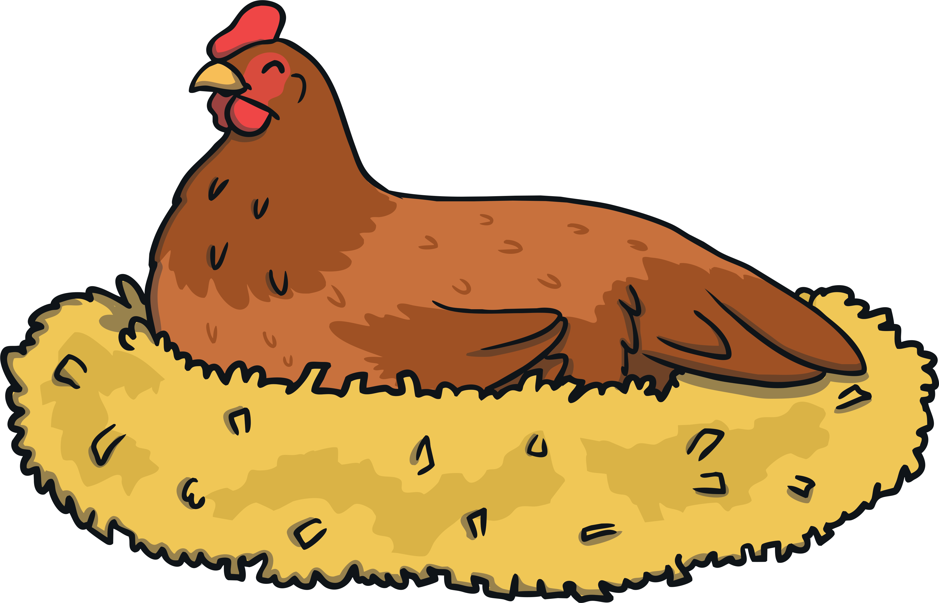
Find the word using the letters given.
e
h
i
b
s
g
n
i
o
f
n
p
h
e
n

Slide 7
Find the word using the letters given.
l
h
i
10
b
s
g
e
p
t
k
u
n
t
e
n

Slide 8
Find the word using the letters given.
f
l
i
e
s
g
g
c
o
n
b
d
l
e
g

Slide 9
Find the word using the letters given.
w
s
i
a
p
g
n
n
b
m
e
t
w
e
b

