Slide 2
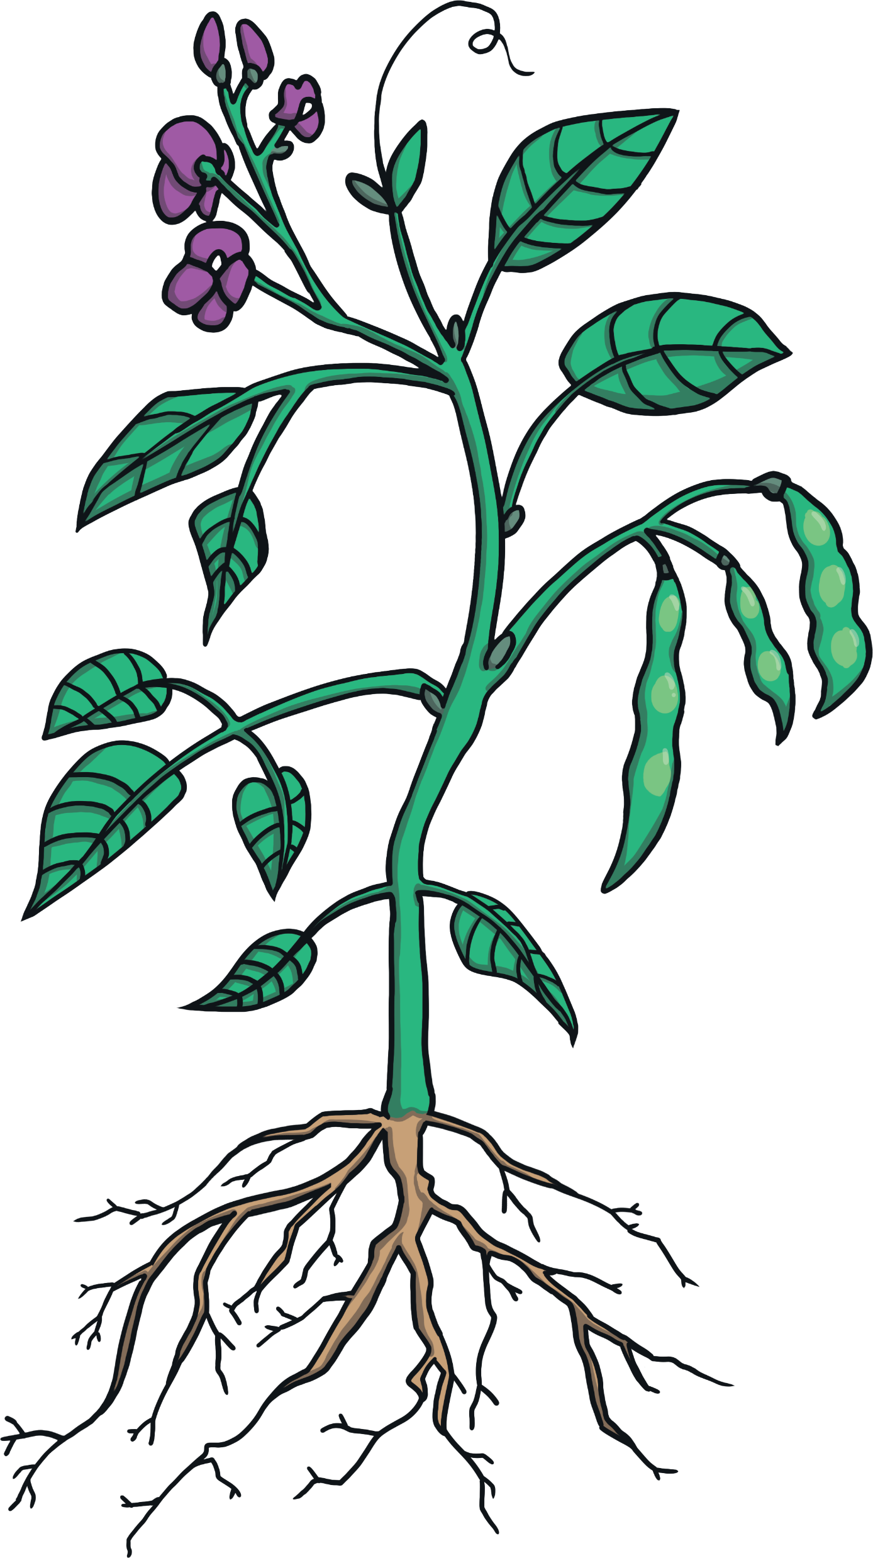
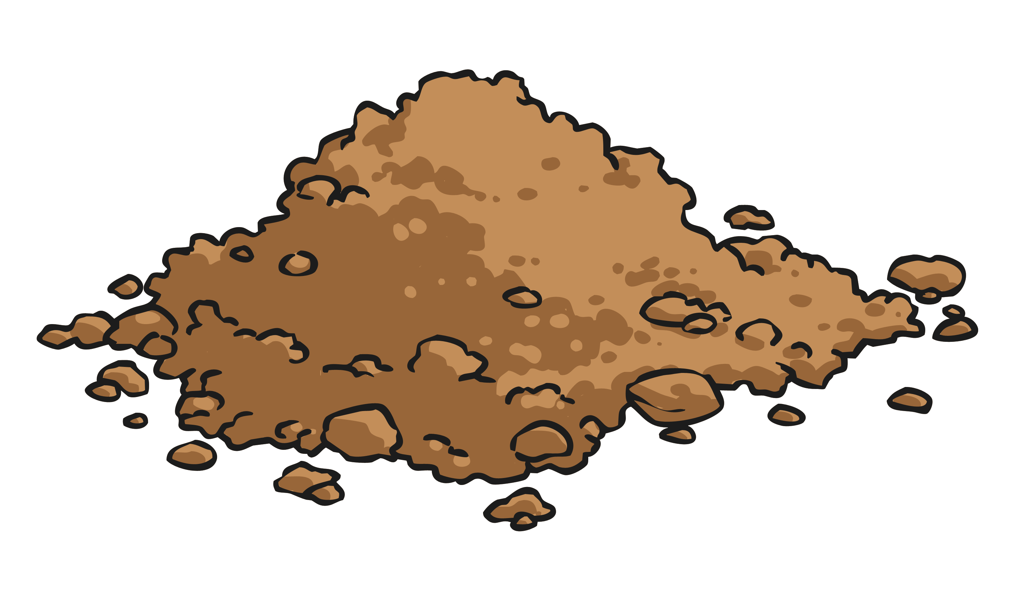
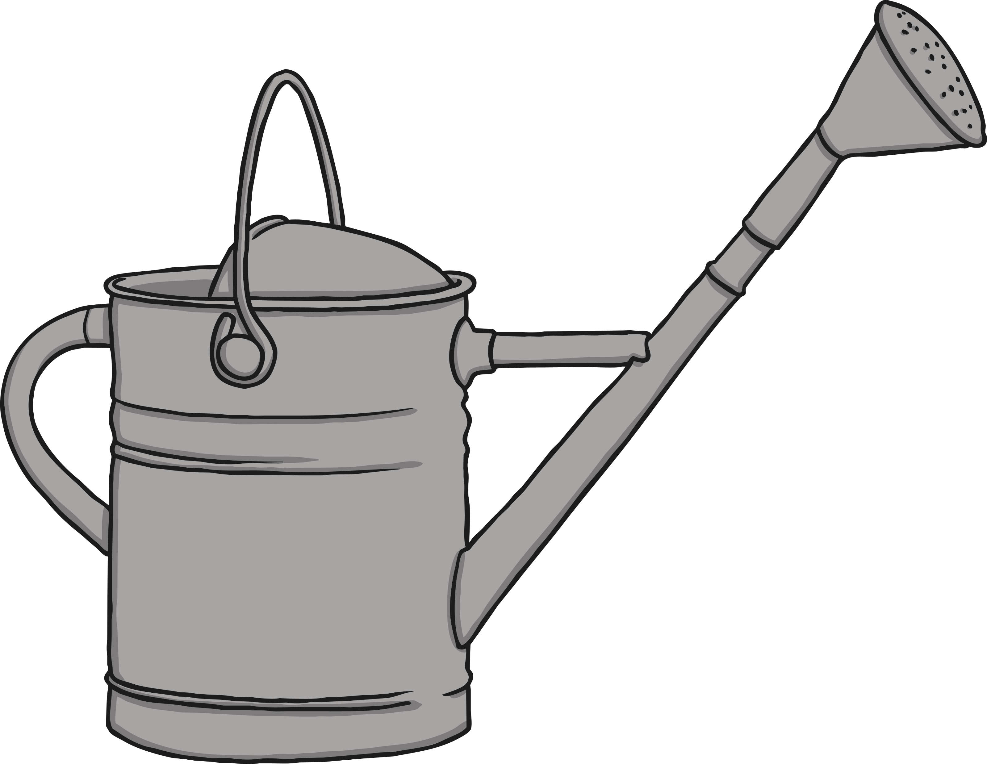
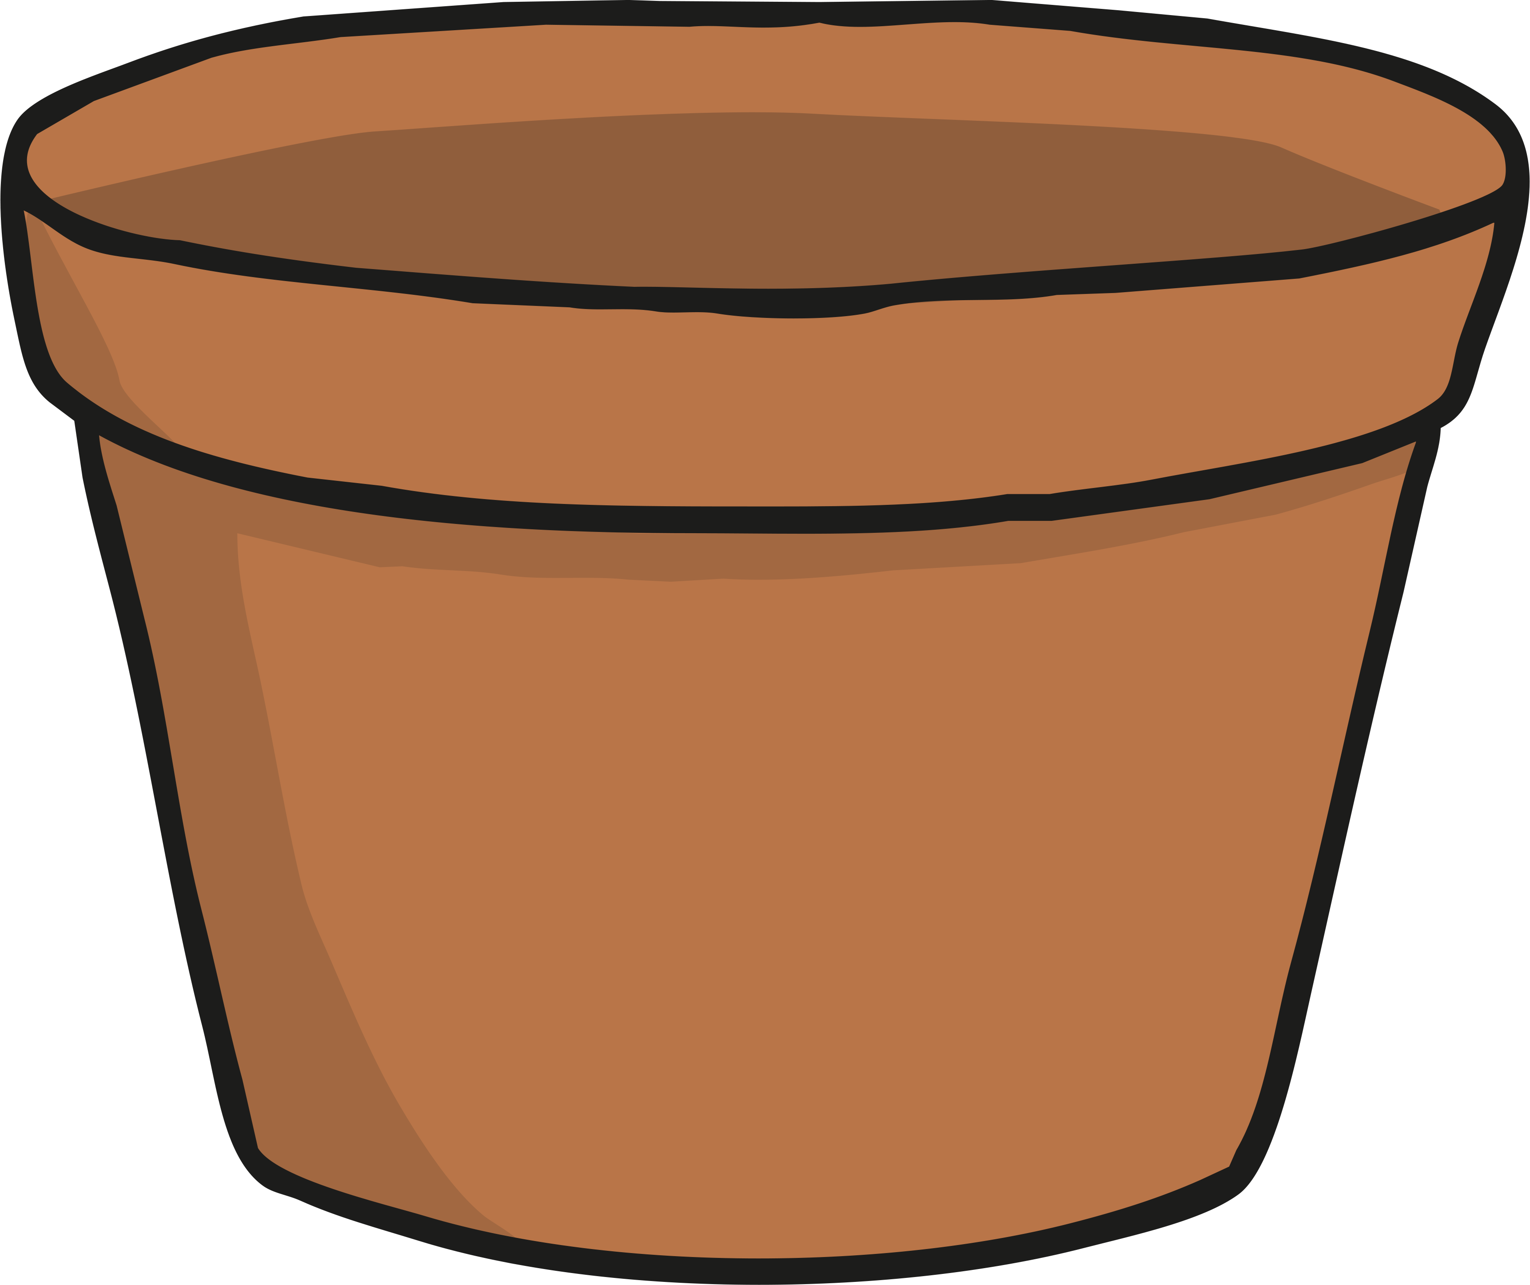
How to grow a plant
You will need:
Seeds
Soil
Plant Pot
Watering Can

Slide 3
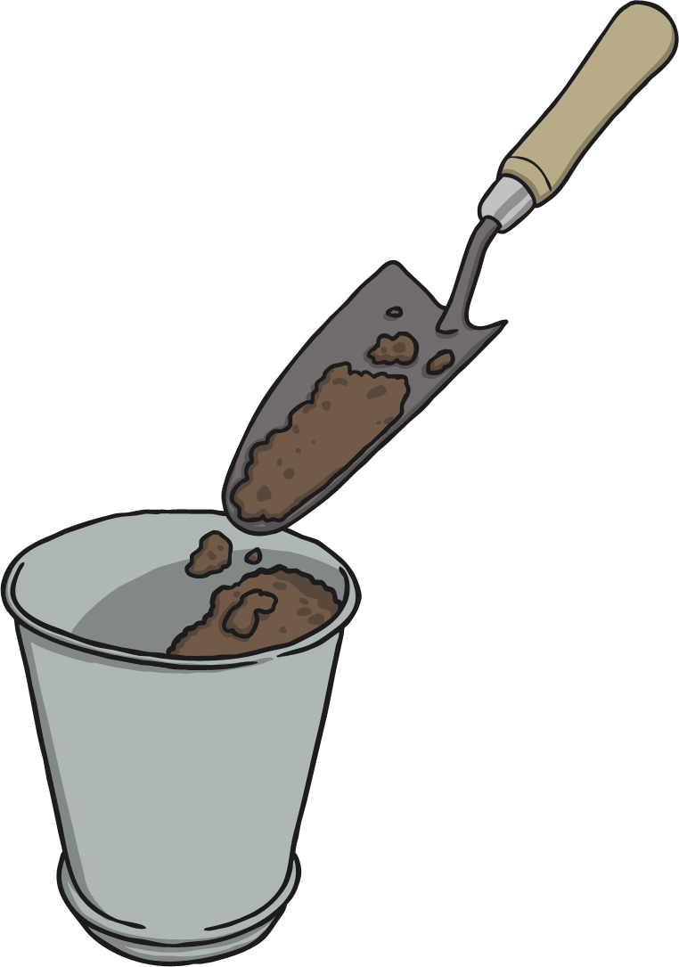
1
Fill half your plant pot with soil.

Slide 4
2
Sprinkle your seeds onto the soil.

Slide 5
3
Pour more soil over the seeds.

Slide 6
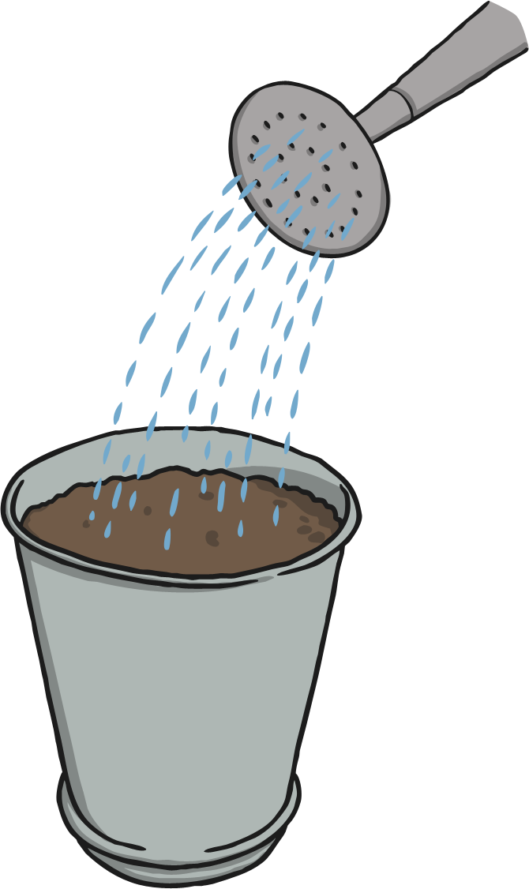
4
Use the watering can to dampen the soil.

Slide 7
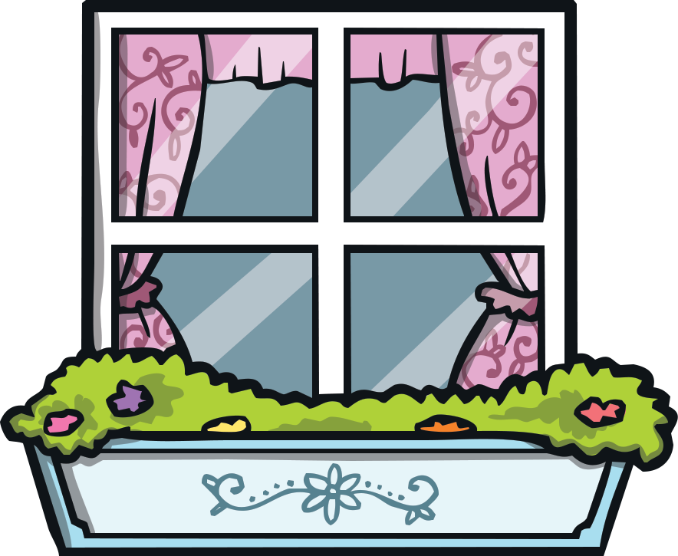
5
Set your plant pot by the window for sunlight.

Slide 8
6
Water your seeds regularly.

Slide 9
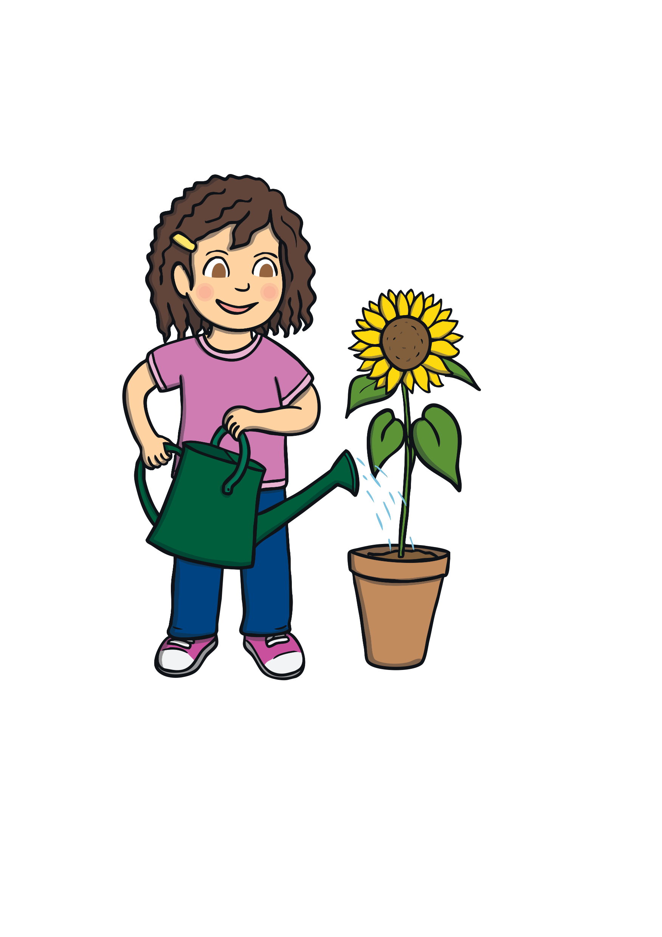
7
Soon your plant will start to grow.

