Slide 2
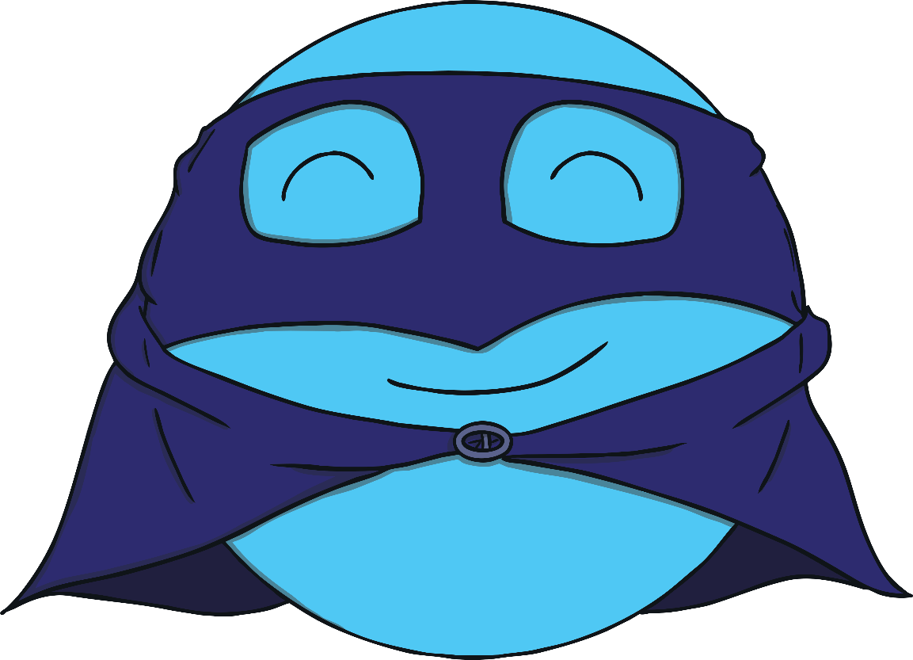
Meet Circle
My name is Circle. I am a super shape!
My special superpower is that I have just 1 curved side.
Click on me to see my special curved side..

Slide 3
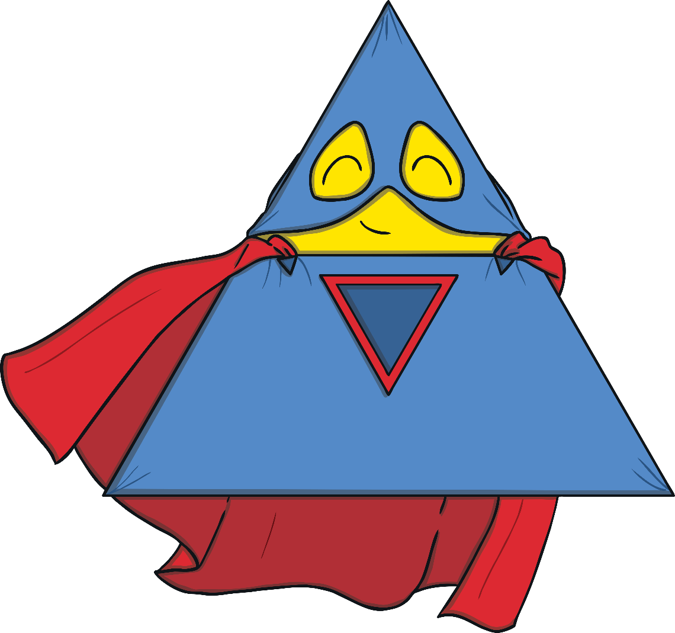
Meet Triangle
My name is Triangle. I am a super shape!
My special superpower is that I have 3 straight sides.
Click on me to see my 3 straight sides..

Slide 4
Together, we form part of the League of Shapes! We are always ready to fight crimes and help our fellow circles and triangles. Are you ready to help us?

Slide 5
Circle’s first mission is to find a missing circle. Can you spot the missing circle and save the day?
Well done! You helped to find the missing circle. How did you do it? How did you know it was a circle?

Slide 6
Triangle is on a mission now. Can you help Triangle to collect all the triangles? Only click on the triangles. When you have collected them all, click on Triangle.
Super job! You collected all of the triangles for me. How did you know they were triangles?

Slide 7
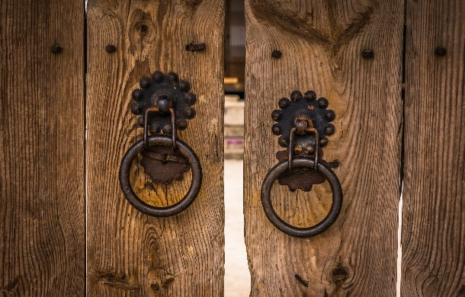
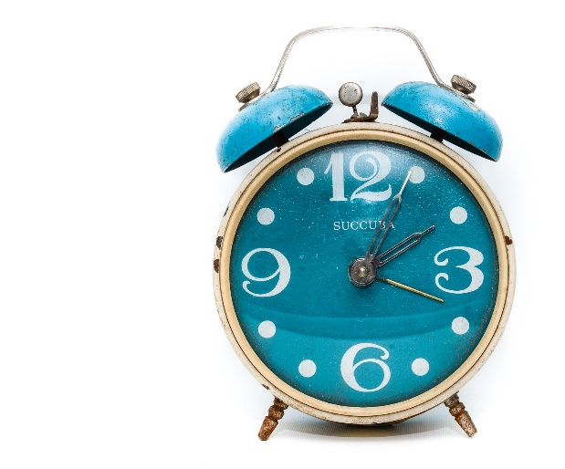
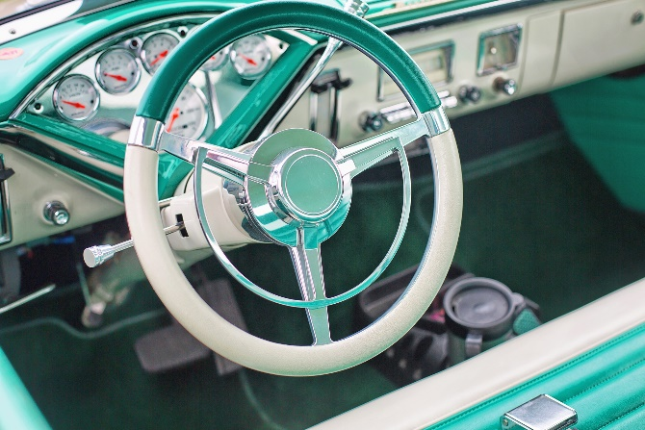
Circle has learnt that the super villain, the Shape Catcher, is planning on stealing all the circles from the town. Show Circle where the circles are hiding in these pictures so that he can protect them.
Can you show me the circles? How did you know they were circles?
Can you remember what is special about a circle?

Slide 8
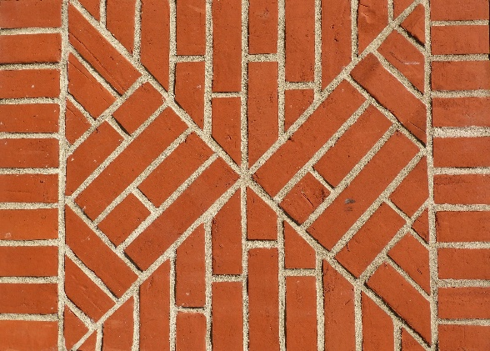
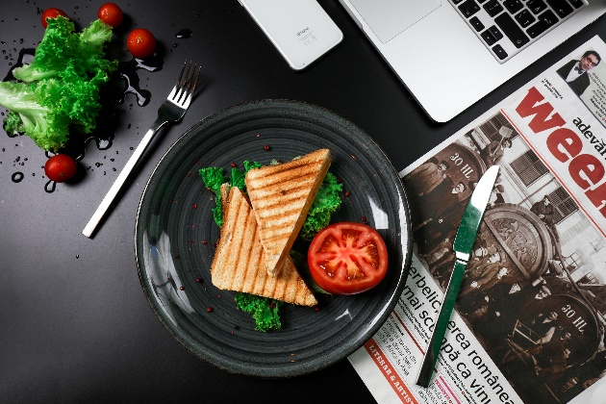
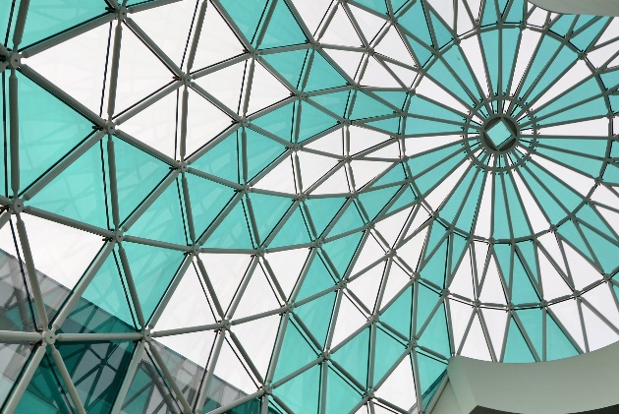
Well done! You protected all the circle shapes but now the Shape Catcher is planning on stealing the triangles.
Please can you show me where the triangles are so that I can protect them?
Can you remember what is special about a triangle?
Does it have straight or curved sides?
How many sides does it have?

Slide 9
Circle and Triangle have collected all of the circles and triangle shapes and are protecting them. Are there any shapes that are in the wrong place? Can you click them?

Slide 10
Another successful day, fighting crime and protecting the circles and triangles of the world. I think the superheroes deserve a treat! Time to go home and play with their pet rabbits. Do you know which rabbit belongs to which superhero?
Thank you for helping the League of Shapes! We look forward to fighting crime with you another day!

