Slide 3
What is an adverb?
An adverb is a word that helps us to describe a verb (action word.)
adverb

Slide 4
What is an adverb?
The relationship between verbs and adverbs is similar to the one between nouns and adjectives.
The adverbs and adjectives work hard to tell us more about the verbs and nouns beside them.

Slide 5
What is an adverb?
Adverbs can sometimes be used to help answer questions such as:
How?
Where?
When?
How much?

Slide 6
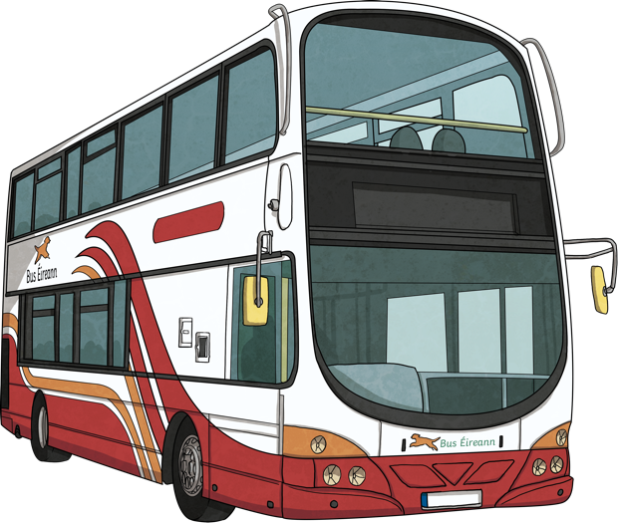
What is an adverb?
Many adverbs describe verbs by telling us how an action happens:
He ran quickly to the bus.
loudly
quickly
slowly
quietly
softly
happily
carefully
sadly
playfully

Slide 7
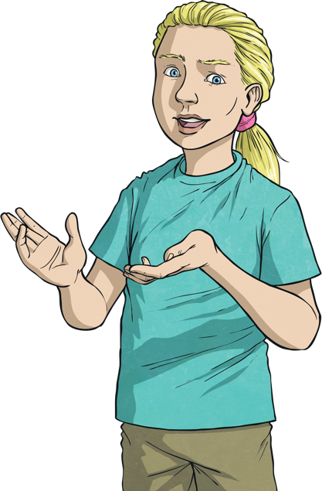
What is an adverb?
Remember we often add ‘-ly’ to the end of words to create adverbs:
Sad
Sadly
But we do not always do this, as you will see in the next few slides.

Slide 8
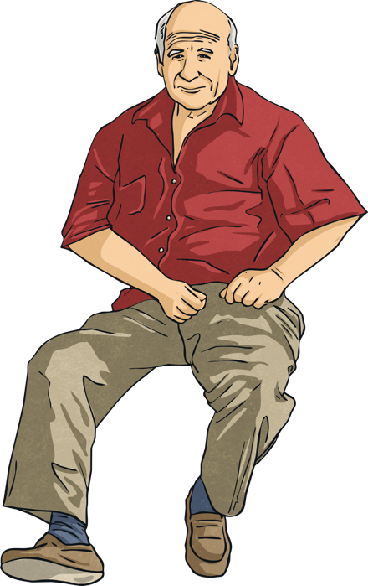
What is an adverb?
Adverbs can also be used to describe when something happens.
Grandad cut the grass yesterday.
tomorrow
today
early
after
yesterday
soon
later
before

Slide 9
What is an adverb?
We can also use adverbs to tell us where an action takes place.
The roots of the tree were below the soil.
outside
here
below
above
inside
up
under
down
over

Slide 10
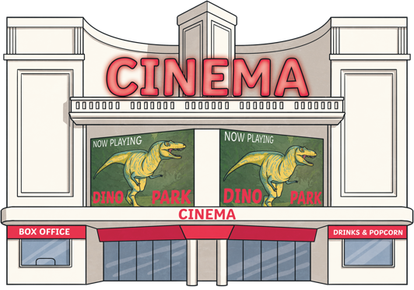
What is an adverb?
Adverbs are sometimes used to describe how often something happens.
She rarely goes to the cinema.
daily
rarely
twice
sometimes
often
usually
never
once
always

Slide 11
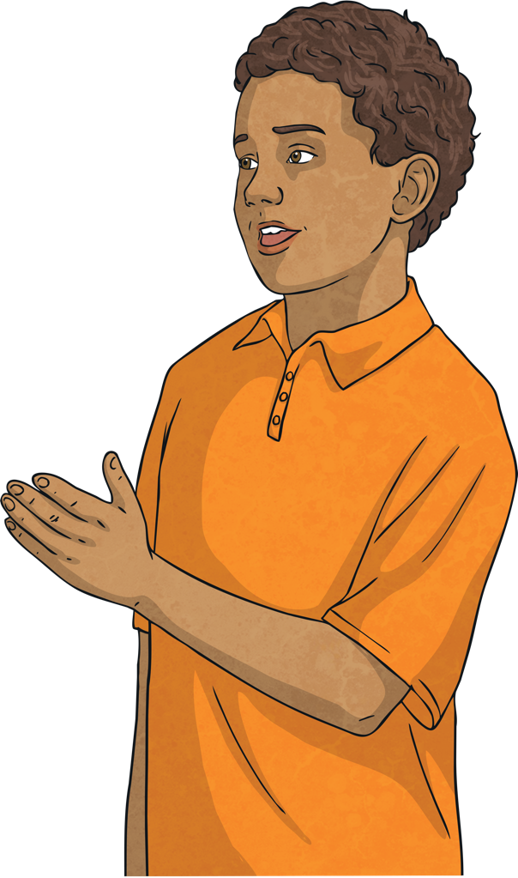
What is an adverb?
Remember to use adverbs in your own writing as they make the sentence more interesting for the reader.

Slide 12
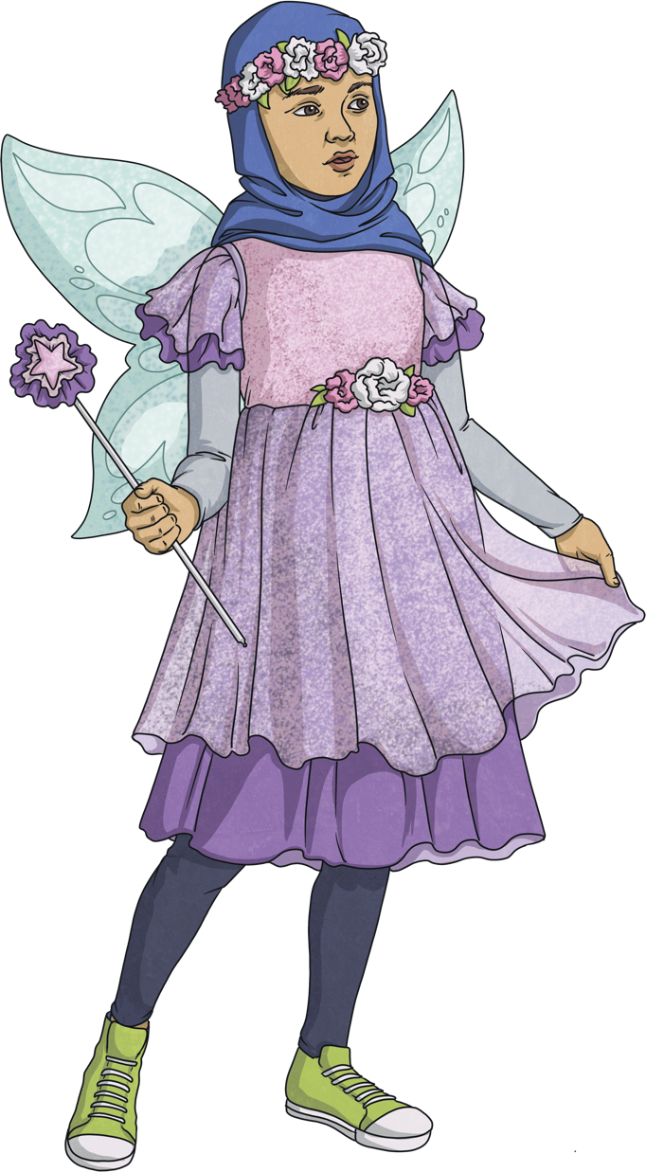
What is an adverb?
Adverbs can transform a sentence from ordinary to exciting.
The dog jumped and wagged his tail. Can you add adverbs to this sentence to make it more exciting?

Slide 13
What is an adverb?
The dog jumped excitedly and happily wagged his tail.
Adverbs can transform a sentence from ordinary to exciting.
The child ran down the road to the shop.
He cried with the pain in his tummy.
Mia laughed as she watched the movie.

