Slide 1
Water Forms

Slide 2
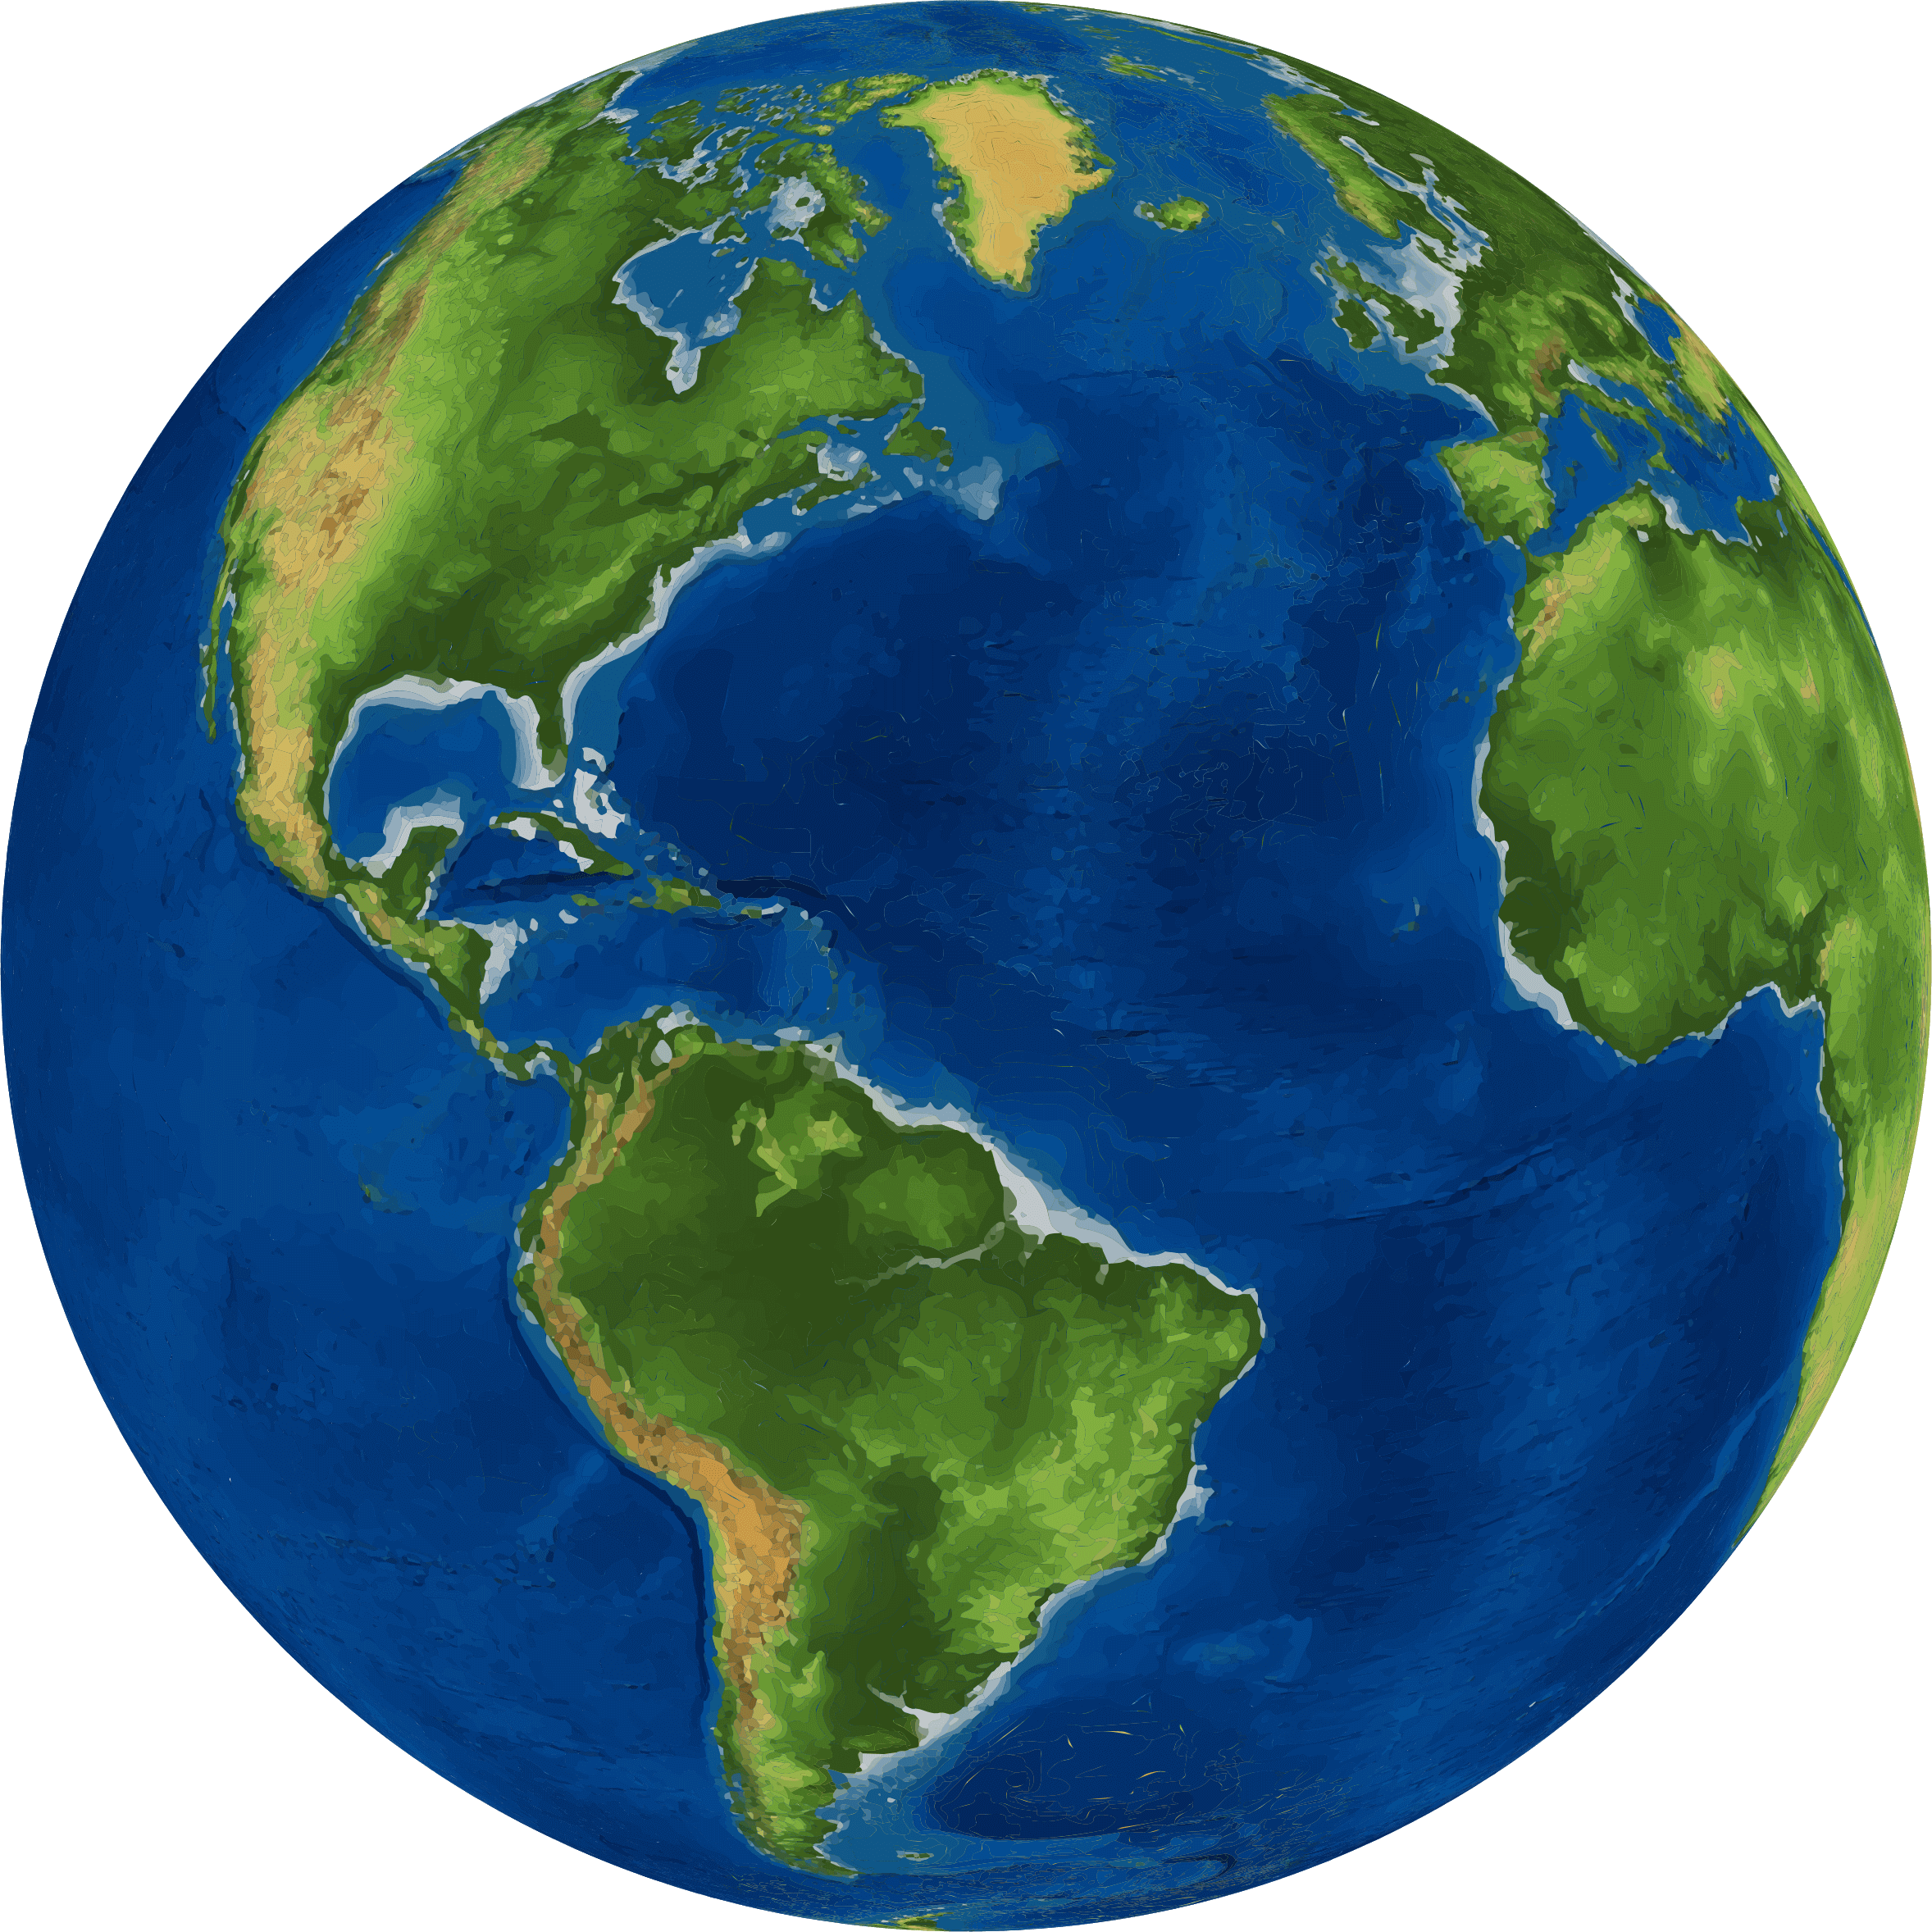
Planet Earth
Our planet Earth is mostly covered with water .

Slide 3
Types of Water:
Water on our Earth are two types:
Salt Water:
Oceans, Seas. Fresh Water:
River, Lake, Pond.

Slide 4
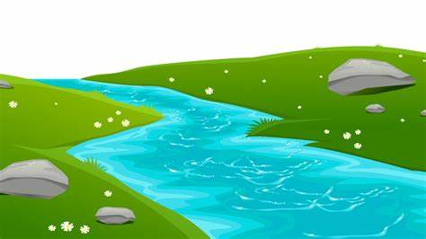
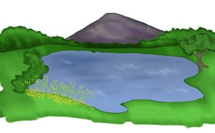
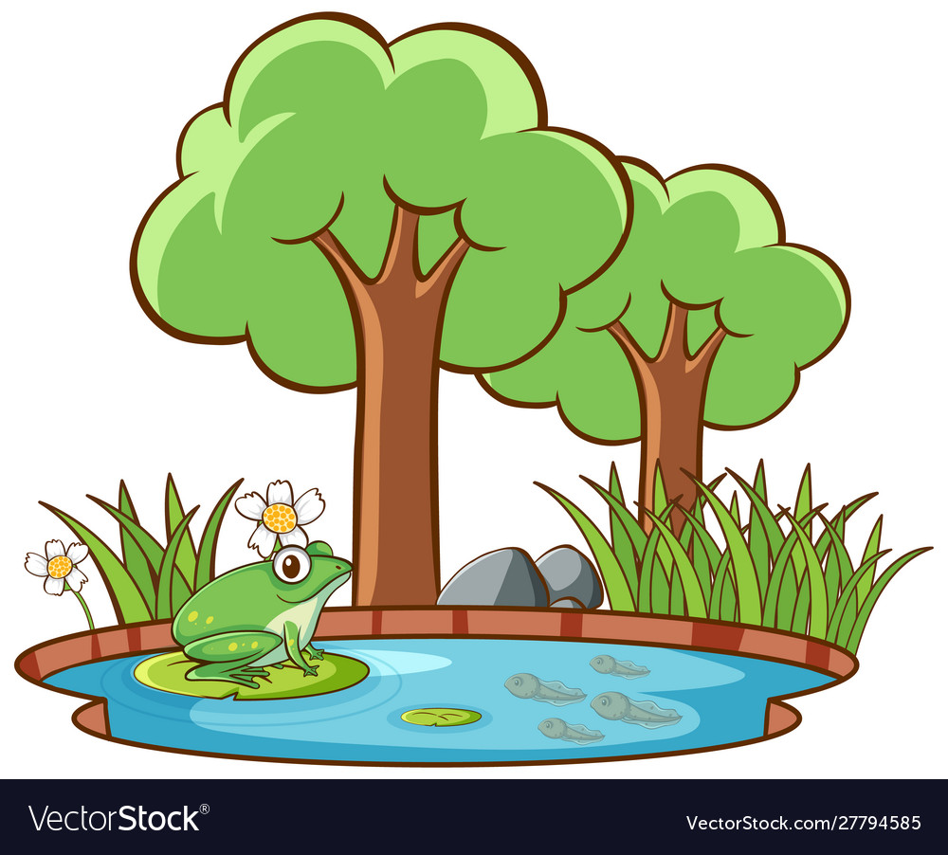
Fresh Water
River lake Pond

Slide 5
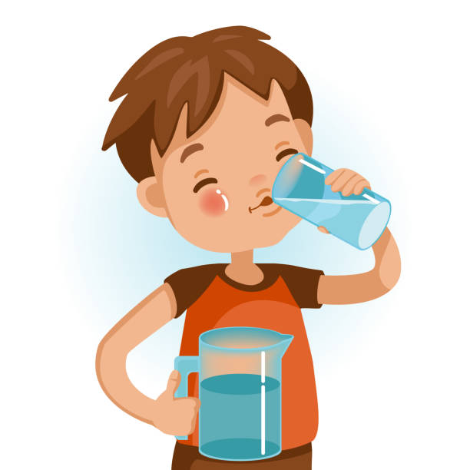
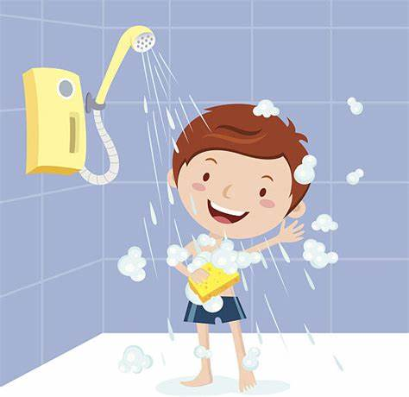
Fresh water usage:
Drinking water
Taking a shower
Watering plants

Slide 6
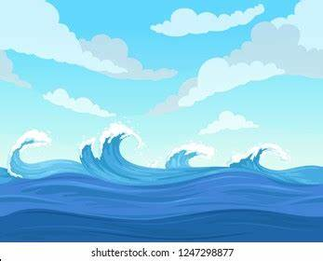
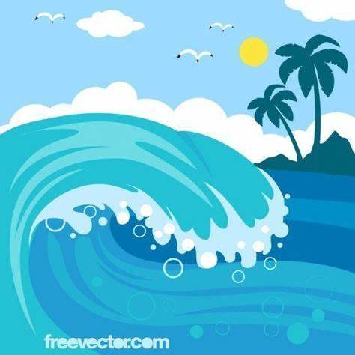
Salt Water:
Ocean Sea

Slide 7
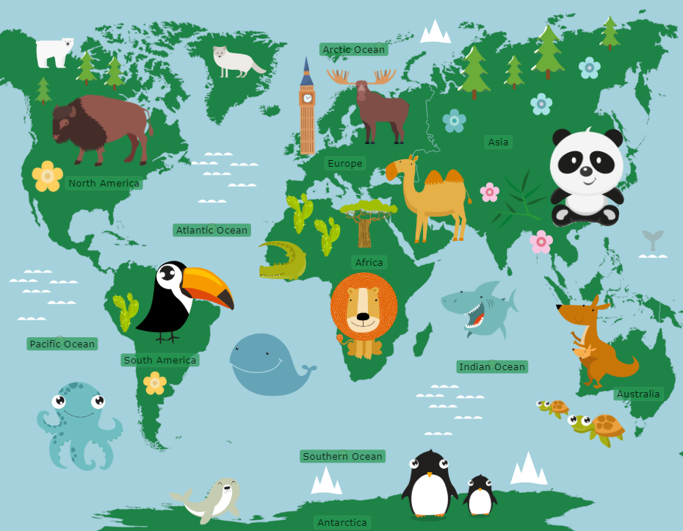
Oceans:
There are 5 five oceans at our Planet Earth:
-Pacific Ocean
-Indian Ocean
-Atlantic Ocean
-Southern Ocean
-Arctic Ocean.

Slide 8
Water, “Aquatic” Habitat
Habitat: Home of an animal or a plant.

Slide 9
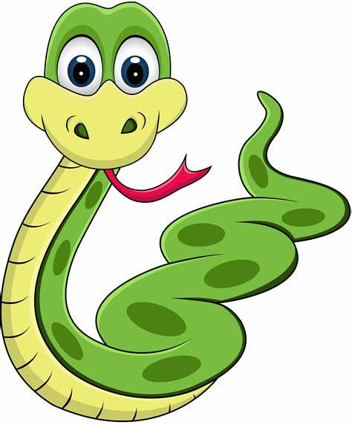
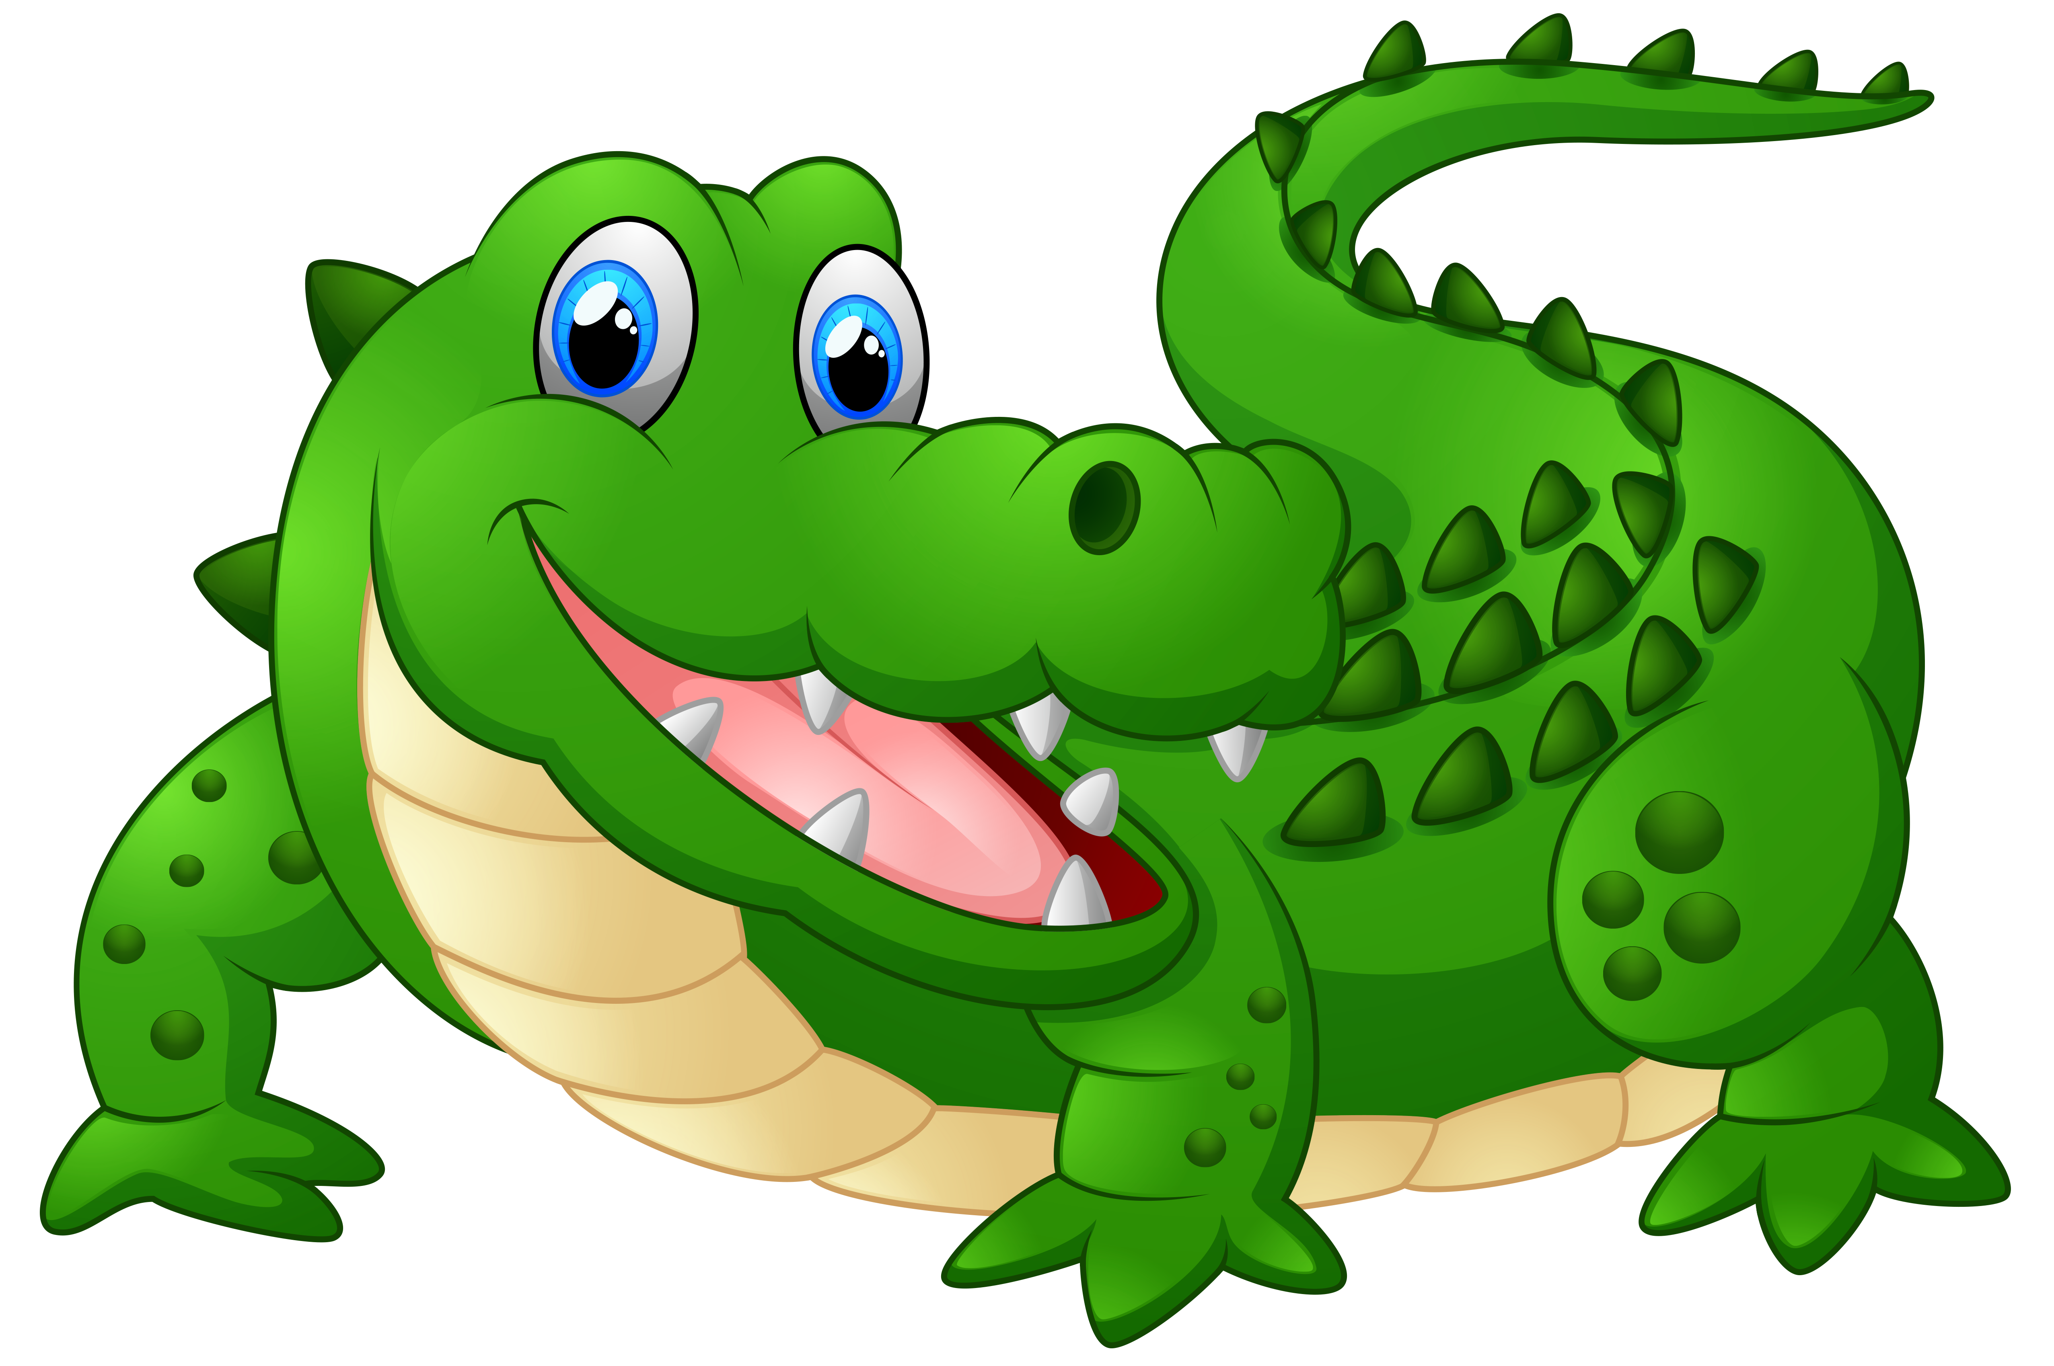
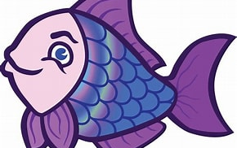
Water Habitat:
There are plenty of fish and other creatures that live at the salt water and also at the Fresh water.
All kind of fish, snakes, crocodiles are covered with scales,
To keep it safe and it also helps it to swim.

Slide 10
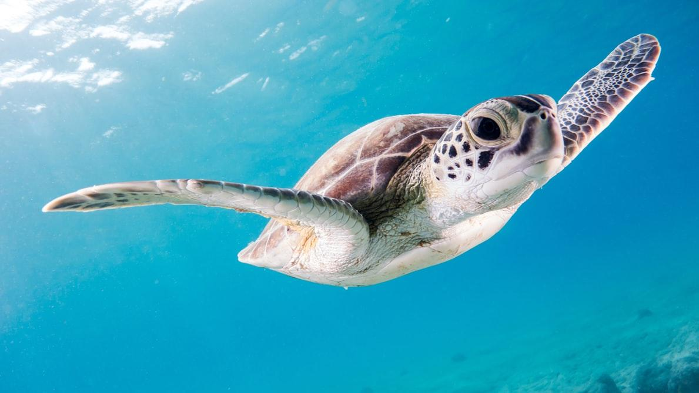
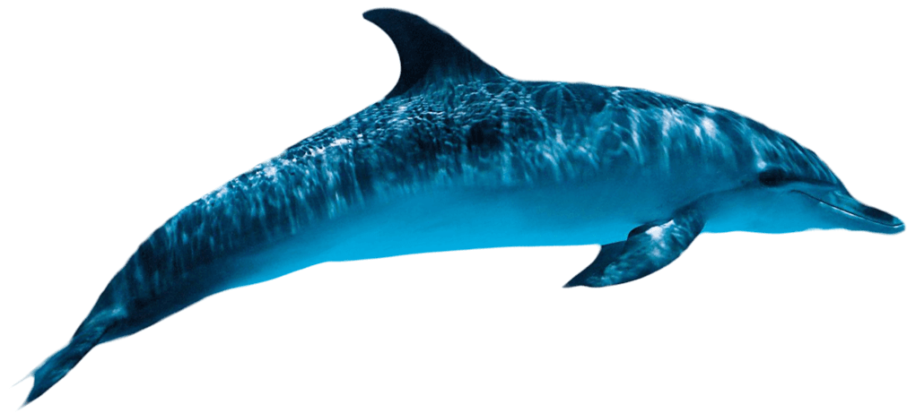
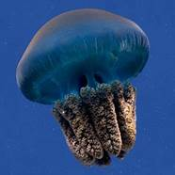
However, not all the sea creatures are covered with scales such as : sea turtles, octobus, dolphin, whale, jelly fish.

Slide 11
Ocean “ salt water” Animals

Slide 12
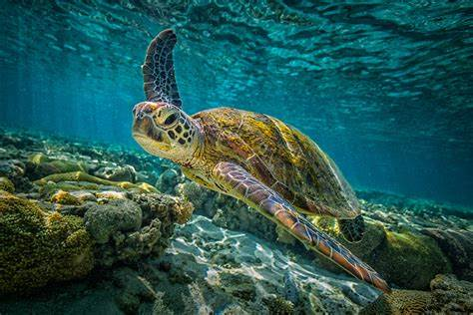
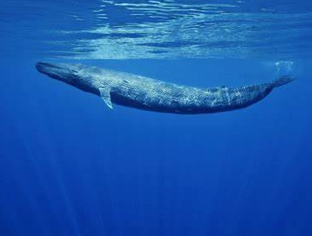
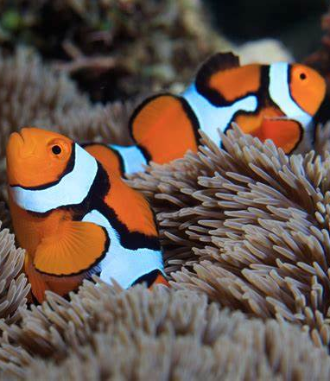
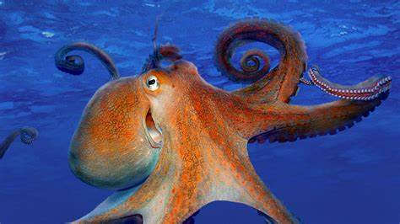
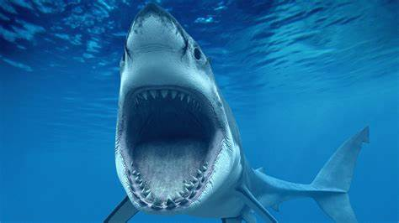
dolphin
blue whale
Sea turtle
Clown fish
Octopus
Sharks

Slide 13
“fresh water” Animals

Slide 14
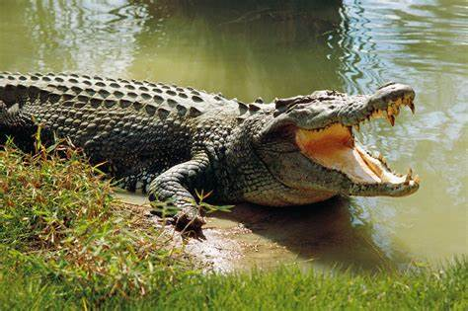
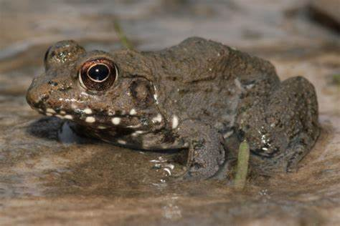
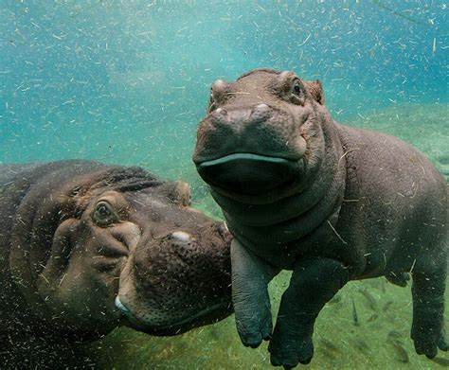
Gold fish
crocodile
hippo
Otter
Frog

