Slide 1
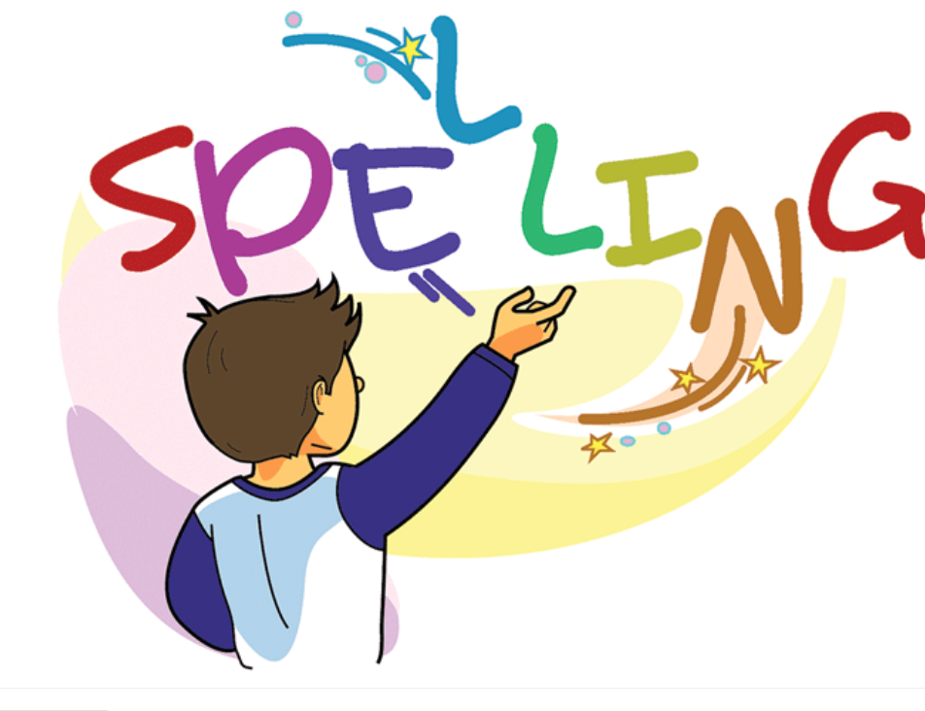

Slide 2
Words with the /ow/ sound
Spelling Group Work:
Activity Groups 1, 3 and 5
Prepare word cards with different spelling sounds
Have students highlight the /ow/ sound in the different words.

Slide 3
High light the /ow/ sound

Slide 5
Activity Groups 2 and 4
Write words related to the /ow/ sound on white boards
On the board put a 1-minute timer or transition song so student's transition
Activity Groups 1, 3, and 5
Write words related to the /ow/ sound on white boards.

Slide 6
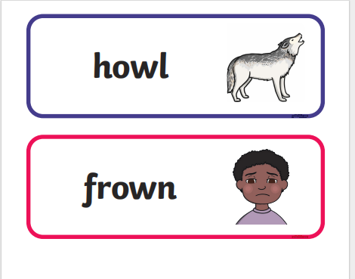

Slide 7
Groups 2 , 4 Match the picture t
Have students look at the words read them and match them to
the correct pictures.

Slide 8
cl

Slide 9
Groups 1, 3, 5
Dominoes Game with Spelling Words
Make 3 copies of the dominoes game.
Give each student domino cards.
Toss a coin to see who would be the first to put their card on the table.
Heads puts the first card.
Give turns by going clock wise

Slide 10
cl

Slide 11
Spelling Words Words with /ow/ sound
owl
An owl is a bird with a flat face, large eyes, and a small sharp beak. Most owls obtain their food by hunting small animals at night..
The owl is one of the smartest birds.

Slide 12
cow
A herd is a large group of animals of one kind that live together.
There are large herds of elephant and buffalo standing near the river.

Slide 13
crown
A germ is a very small organism that causes disease.
Germs can cause illness.

Slide 14
brown
A hammer is a tool that consists of a heavy piece of metal at the end of a handle. It is used, for example, to hit nails into a piece of wood or a wall, or to break things into pieces.
He used a hammer to chip away at the wall.

Slide 15
town
A ladder is a piece of equipment used for climbing up something or down from something. It consists of two long pieces of wood, metal, or rope with steps fixed between them.
They climbed the ladder to reach the top shelf.

Slide 16
clown
Your fingers are the four long thin parts at the end of each hand.
She suddenly held up a small, bony finger and pointed across the room.

Slide 17
towel
A flower is the part of a plant which is often brightly coloured, grows at the end of a stem, and only survives for a short time.
This white flower smells nice.

Slide 18
gown
If you write a letter to someone, you write a message on paper and send it to them, usually by post.
She wrote a letter to her friend in France.

Slide 19
frown
A river is a large amount of fresh water flowing continuously in a long line across the land.
They sat fishing by the river.

Slide 20
bow
A farmer is a person who owns or manages a farm.
The farmers are very good with planting and raising animals.

Slide 21
Thank You

