Slide 2
Features of a Non-Fiction Book
“Non-fiction” books are based in fact, they give the reader information and help us to learn more about different things. Non-fiction books will usually contain these features:
Fun Fact:
Did you know that some non-fiction books do not need to be read in order?
Headings and sub-headings
Gives information
Real facts
Contents page

Slide 3
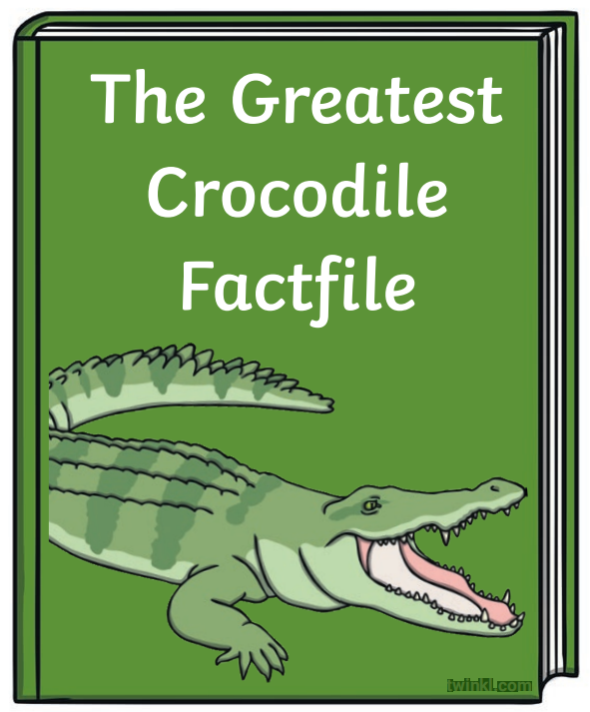
?
?
?
?

Slide 4
H
The Animals of the Rainforest
?
Appearance
?
?
?
Diet
Habitat

Slide 5
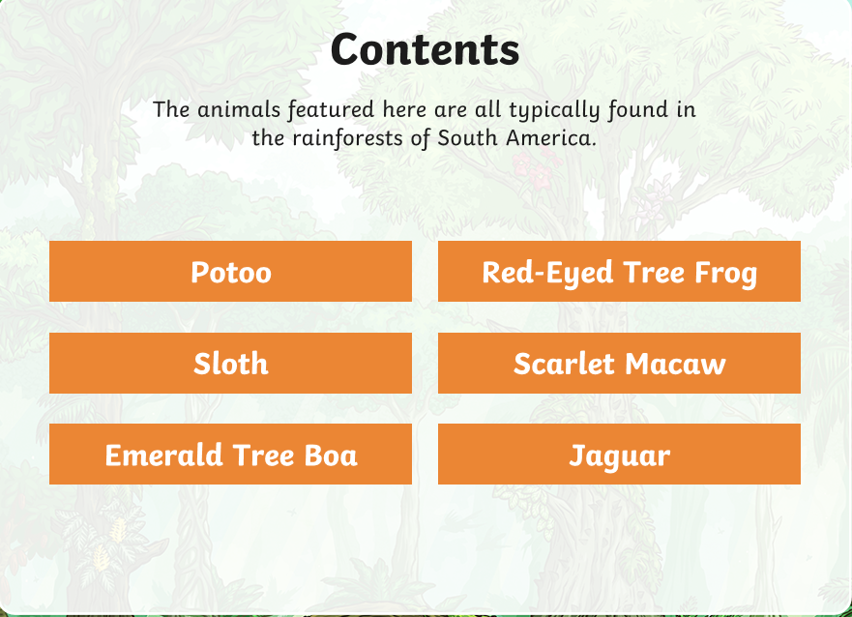
H
The Animals of the Rainforest
?
Page 1
?
?
?

Slide 6
Real Facts and Information
The Animals of the Rainforest
?
?
?
?

Slide 7
Examples of Non-Fiction
There are so many different kinds of non-fiction books and texts. These are just some of the different examples:
Fun Fact:
Non-Fiction isn’t just for books either. Documentaries are another good example of Non-Fiction.
Dictionary
History Books
Animal Nature Books
General Knowledge and Trivia
Science Books
Travel Books
Art Books
Biographies and Autobiographies

