Slide 1
English

Slide 2
Lessons Objectives
By the end of the lesson, learners will be able to :
read the new words.
read the new words.
read the new words.
understand what conjunctions mean
01
identify the meaning for the new words.
identify the meaning for the new words.
identify the meaning for the new words.
02
use the new vocabulary in their writing.
03
use the new vocabulary in their writing.
04

Slide 3
Activity Time

Slide 4
Attention Grabber
On the smart board display a picture of under the sea.
Ask students if they would
Name the picture and try to describe it to find out the vocabulary words.
Once students have guessed the words, write them on the white board.
tiny gloomy

Slide 5
Activity: Continued
Seahorse Vocabulary Words
Camouflage
Pouch
Curly tail
Scaly

Slide 6
Groups 1, 3 Activity Match word to meaning Write the vocabulary words on flash cards. Write the definition of each word on a flash card.
Have students match the word to the correct definition.

Slide 7
Group 5 Match Picture to the vocabulary word Have pictures of the vocabulary words on flash cards. Write the vocabulary words on separate flash cards. Students are to read the vocabulary word and try to match it to the correct picture, and saay the word in sentence.

Slide 8
Group 2, 4 Write a sentence using vocabulary words. Have the vocabulary words on different cards. Place the cards on the table with white board markers and boards. Students must choose a vocabulary word card and write it in a sentence. Students are to write sentences on white boards

Slide 9
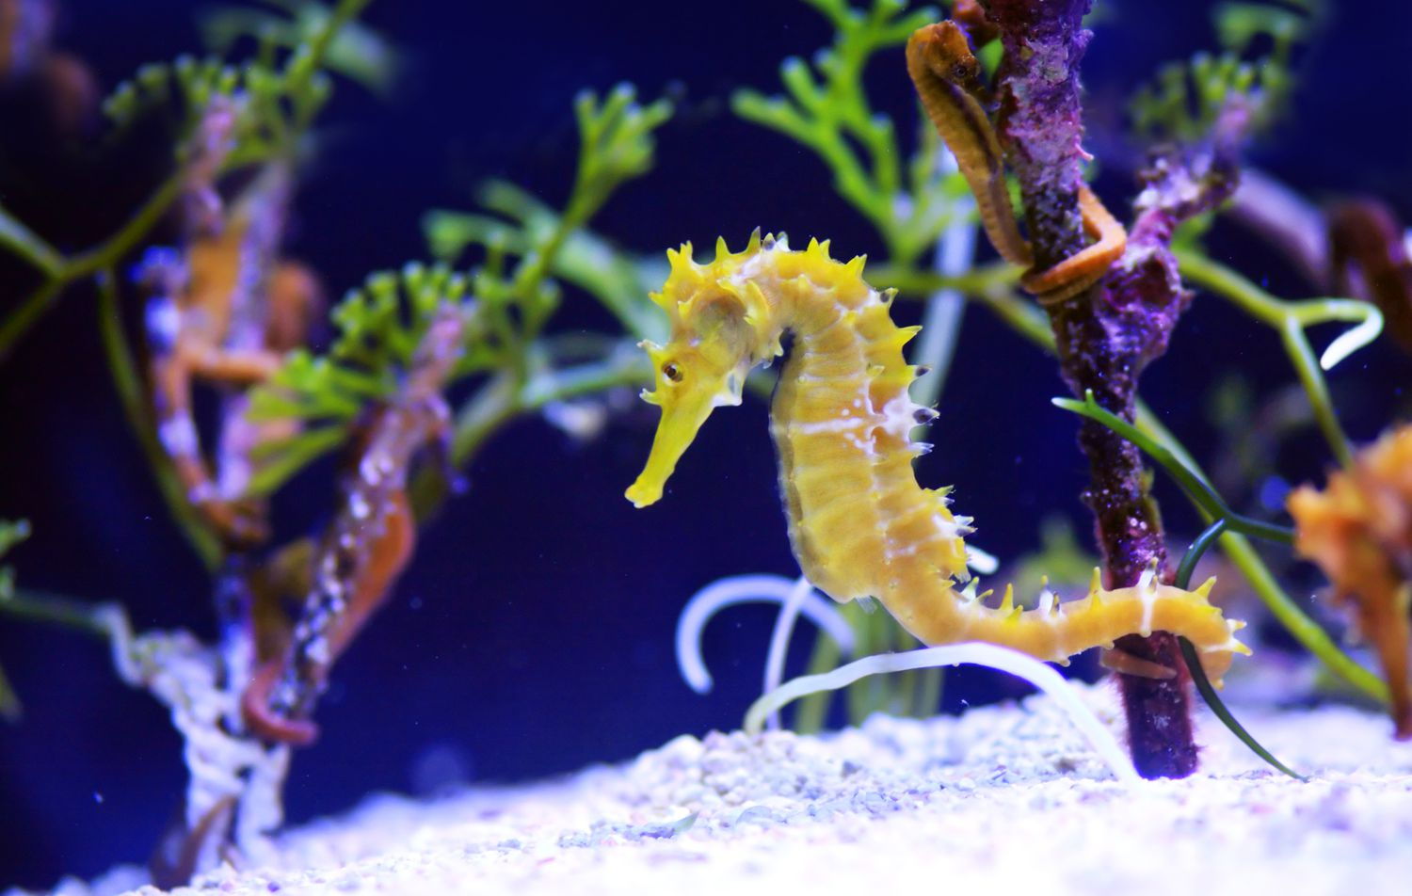
Describing-Seahorse

Slide 10
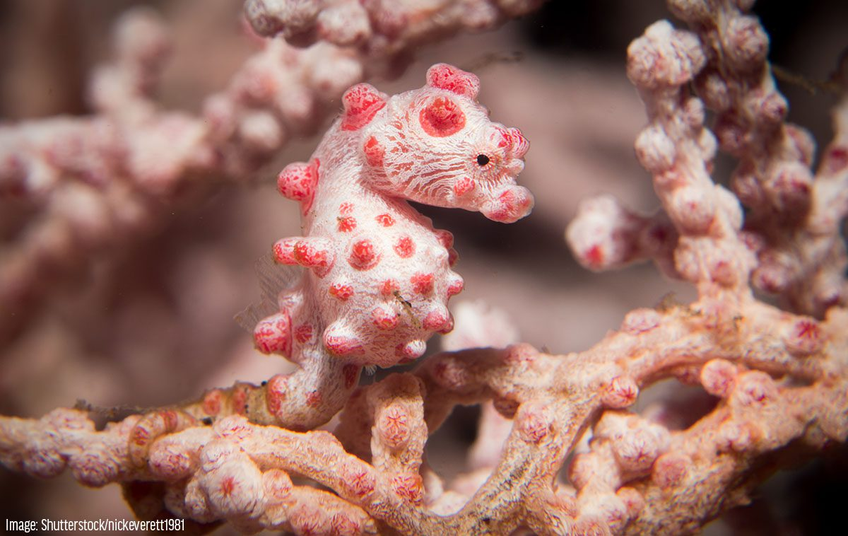
camouflage
camouflage
Some animals are coloured and shaped so that they cannot be seen by their enemies, hide.
Seahorses camouflage to hide from the enemies.
.

Slide 11
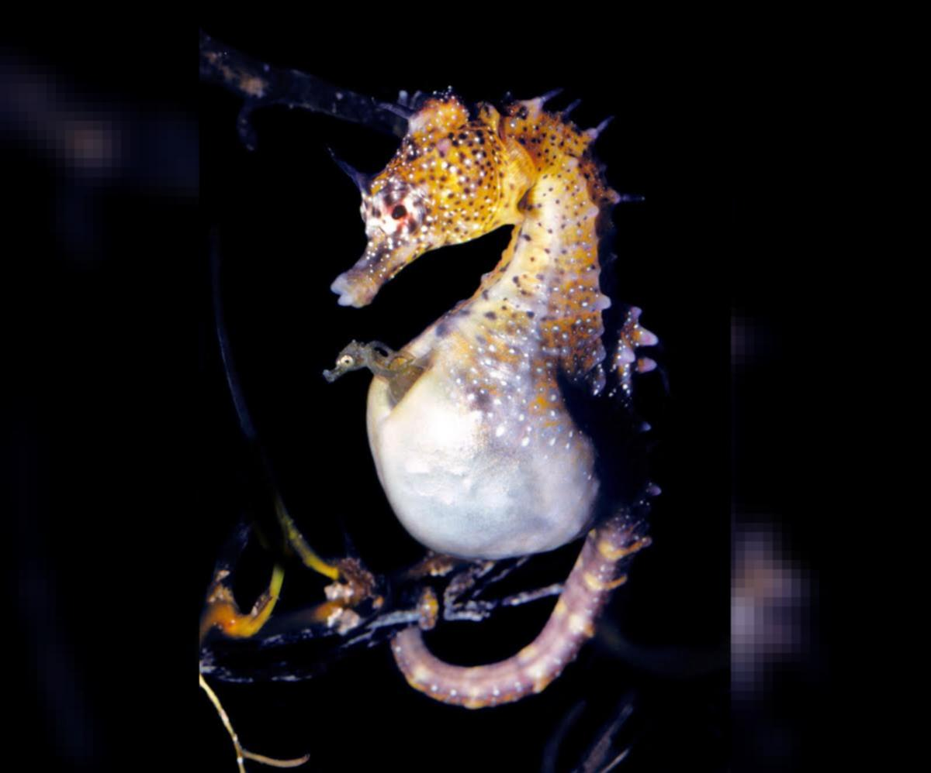
pouch
The pocket of skin on an animals stomach in which its baby grows.
The male seahorse carries the babies in a pouch.

Slide 12
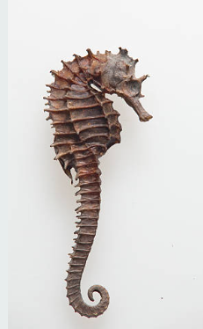
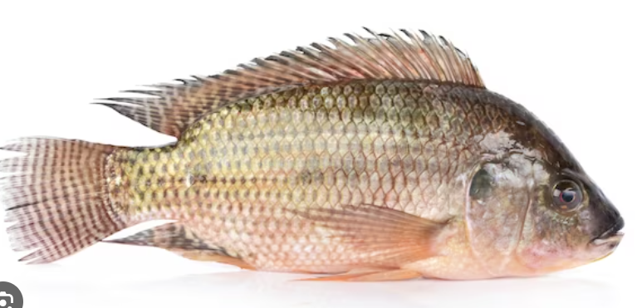
scaly
Small pieces of hard skin
covering an animal’s body.
Sea horses are not sclay.
They have skin.

Slide 13
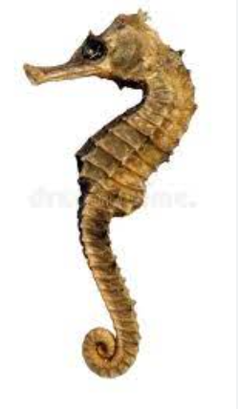
curly tail
Curly is sometimes used to describe things that are curved or spiral in shape
Seahorses have a curly tail..

Slide 14
Write the words and meanings in your copybooks.

Slide 15
Lessons Objectives
Objectives check:
read the new words.
.
01
identify the meaning of the new words.
02
03
use the new vocabulary in their writing.
04

