Slide 1
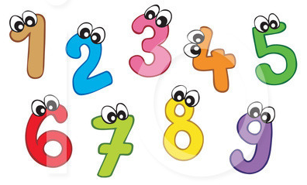
Today’s learning objectives…
I can use a pictogram to answer questions.
I can use information to fill out a pictogram.

Slide 2
I can use a pictogram to answer questions.

Slide 3
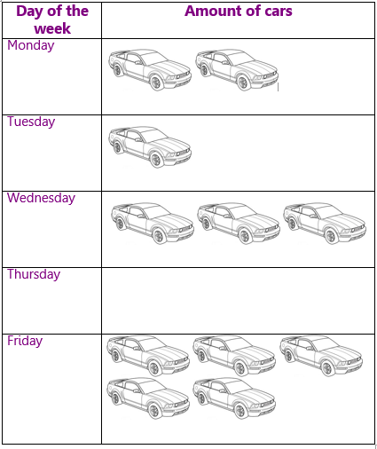
Today’s learning objectives…
I can use a pictogram to answer questions.
I can use information to fill out a pictogram.
How do we use a pictogram?

Slide 4
Today’s learning objectives…
I can use a pictogram to answer questions.
I can use information to fill out a pictogram.
How many cars were in
the garage on Monday?

Slide 5
Today’s learning objectives…
I can use a pictogram to answer questions.
I can use information to fill out a pictogram.
How many cars were in
the garage on Thursday?

Slide 6
Today’s learning objectives…
I can use a pictogram to answer questions.
I can use information to fill out a pictogram.
How many cars were in
the garage altogether on
Monday and Tuesday?

Slide 7
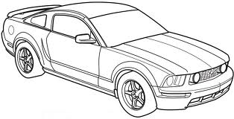
Today’s learning objectives…
I can use a pictogram to answer questions.
I can use information to fill out a pictogram.
What if
= 2 cars?

Slide 8
Today’s learning objectives…
I can use a pictogram to answer questions.
I can use information to fill out a pictogram.

Slide 9
I can use information to
fill out a pictogram.

Slide 10
Today’s learning objectives…
I can use a pictogram to answer questions.
I can use information to fill out a pictogram.
What did you learn today?
How do we use pictograms to answer questions?
How do we use information to create a pictogram?
Do you feel like you understand pictograms now?

