Slide 2
The Letter V Looks Like This…
v
Click on the pencil to see the letter formation.
Can you draw it with your finger?

Slide 3
The Letter V Sounds Like This…
V, V, V
Teaching note: Say the sound /v/ and have children repeat it back multiple times.

Slide 4
It Can Also Look Like This…

Slide 5
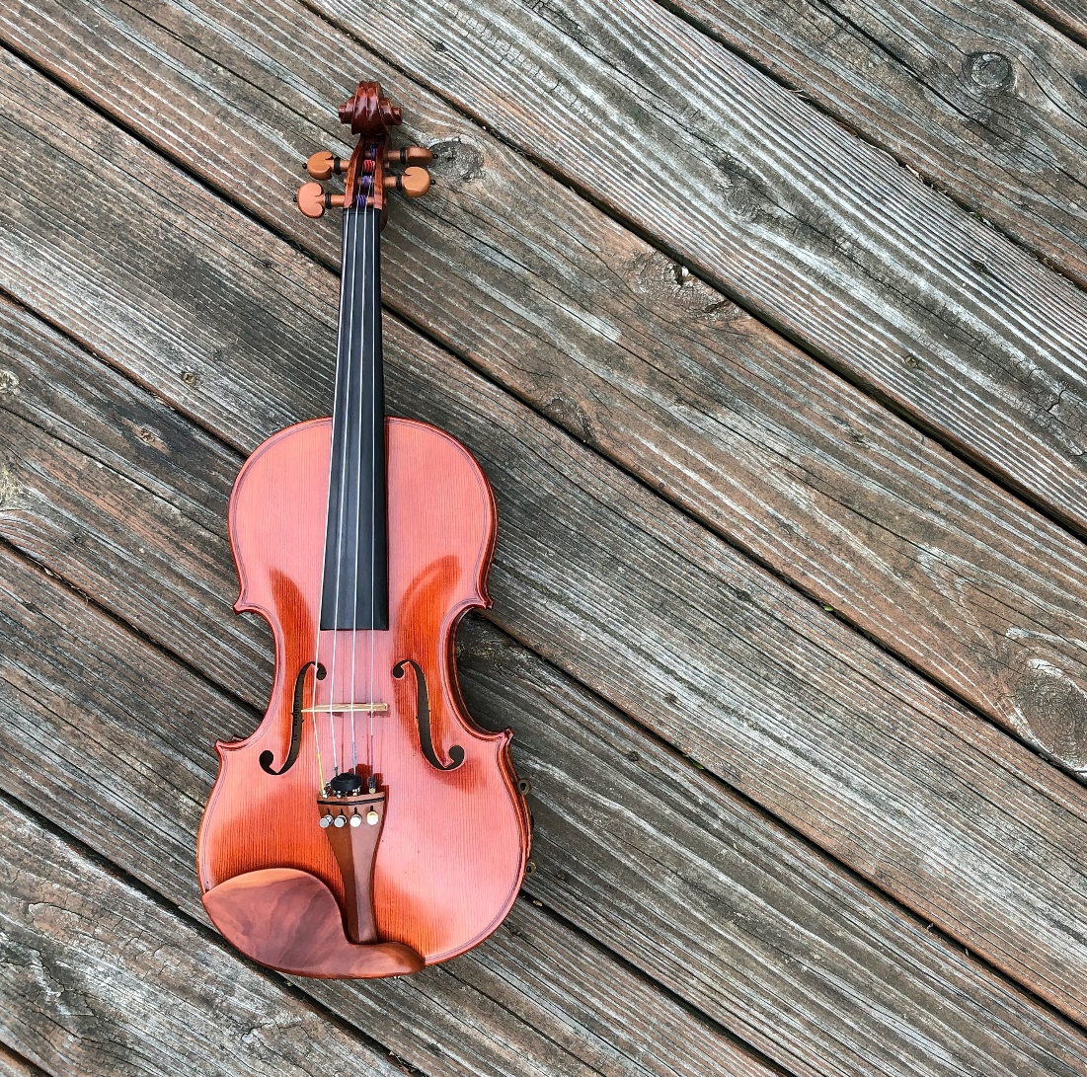
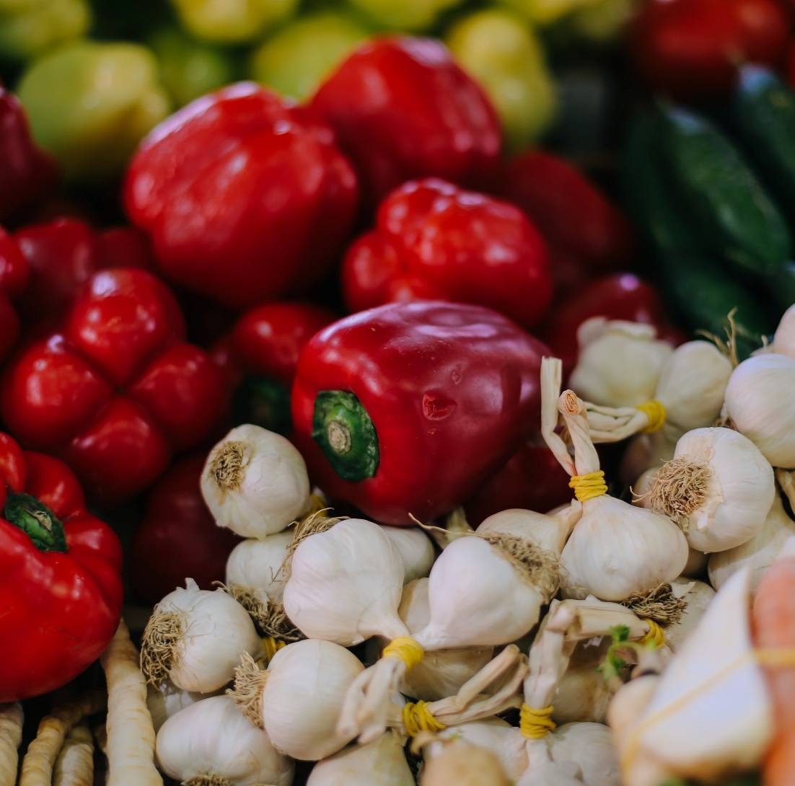
Some Things That Start With V Are…

Slide 6
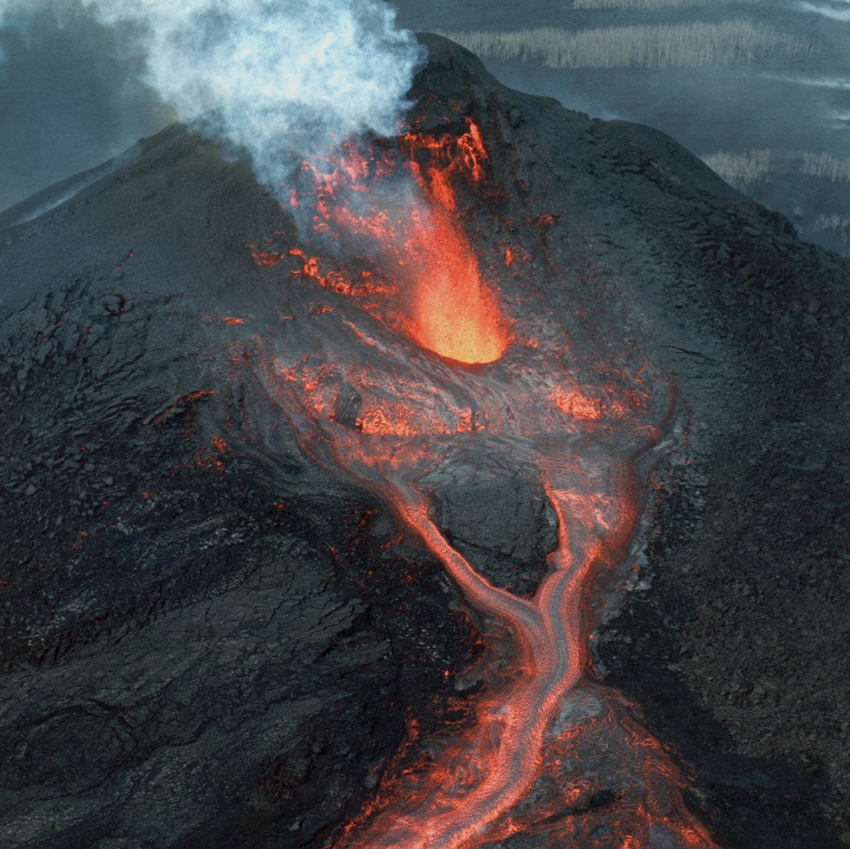
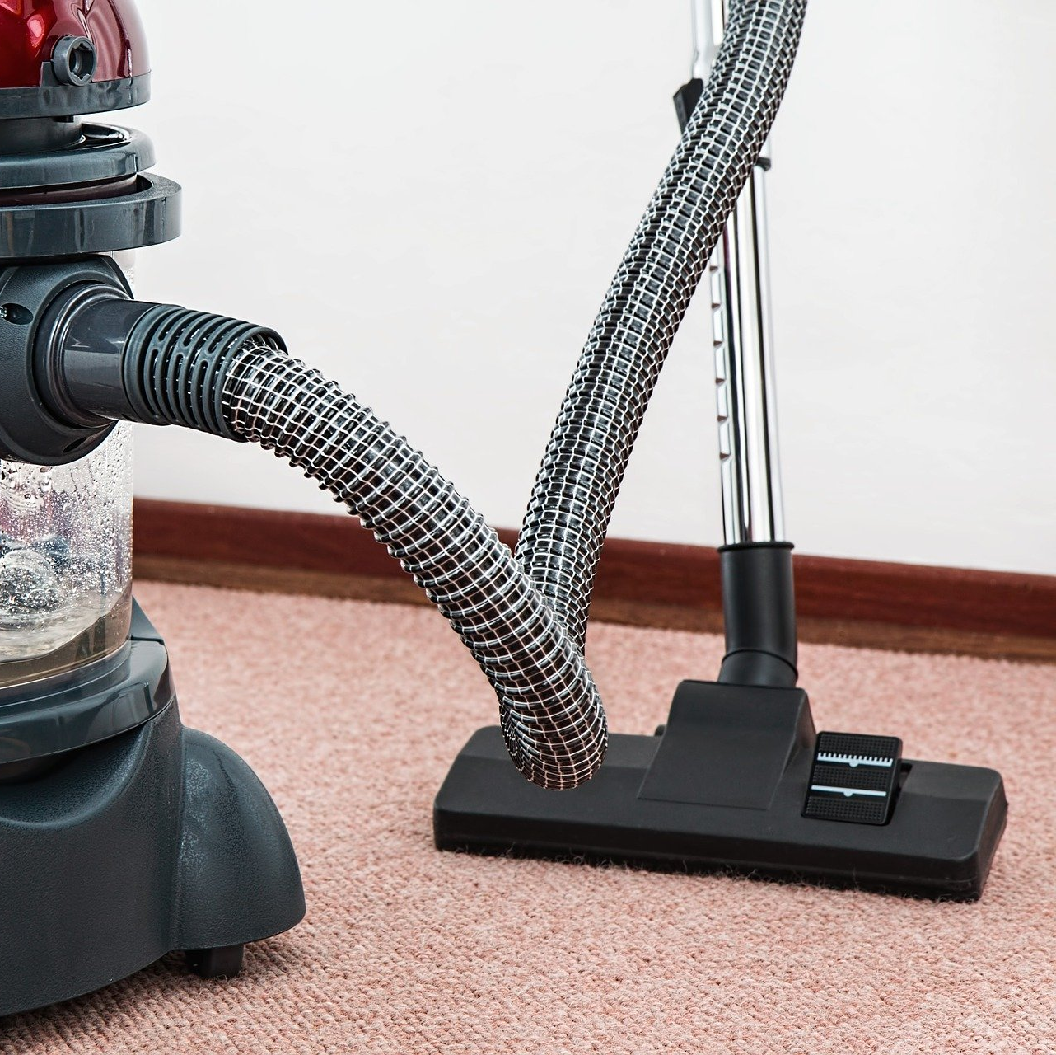
Some Things That Start With V Are…

Slide 7
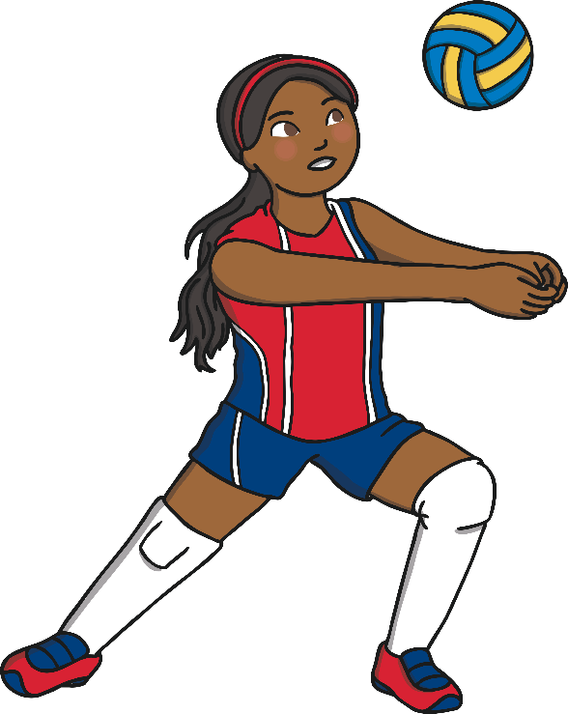
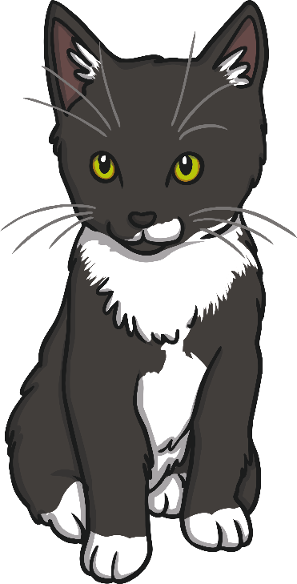
Which of These Start With V?
TRY AGAIN!
YES!
Teaching note: Pause briefly after the initial sound of each word to assist students to identify the sounds.

Slide 8
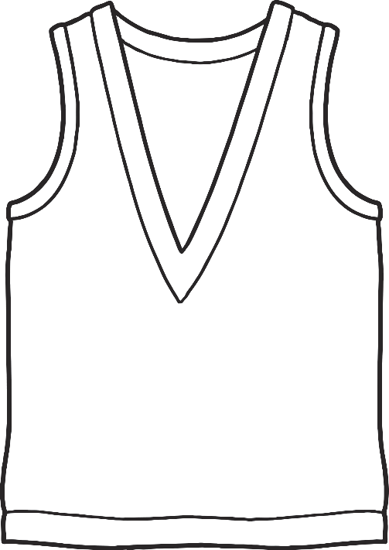
Which of These Start With V?
TRY AGAIN!
YES!
Teaching note: Pause briefly after the initial sound of each word to assist students to identify the sounds.

Slide 9
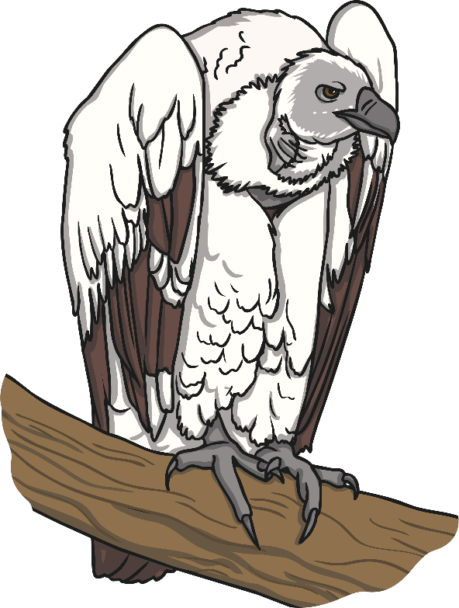
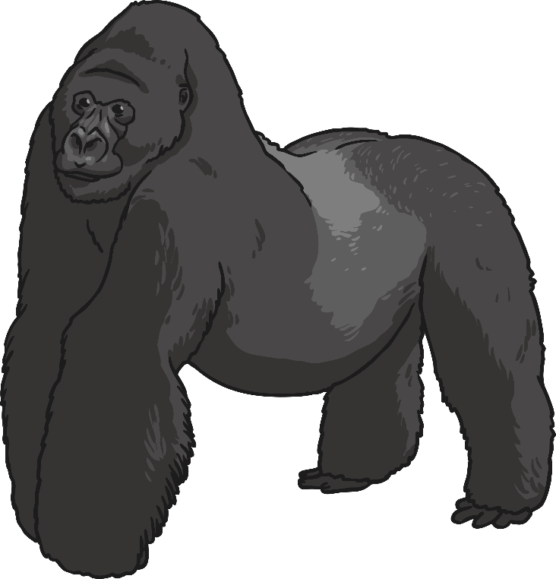
Which of These Start With V?
TRY AGAIN!
YES!
Teaching note: Pause briefly after the initial sound of each word to assist students to identify the sounds.

Slide 10
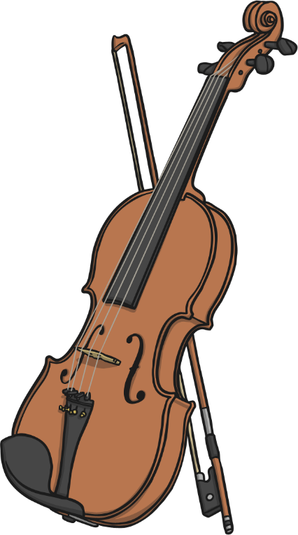
Which of These Start With V?
TRY AGAIN!
YES!
Teaching note: Pause briefly after the initial sound of each word to assist students to identify the sounds.

