Slide 1
English

Slide 2
Lessons Objectives
By the end of the lesson, learners will be able to :
recognize and read the sounds.
01
blend and segment the words.
02
Write words related to these sounds.
03
04

Slide 3
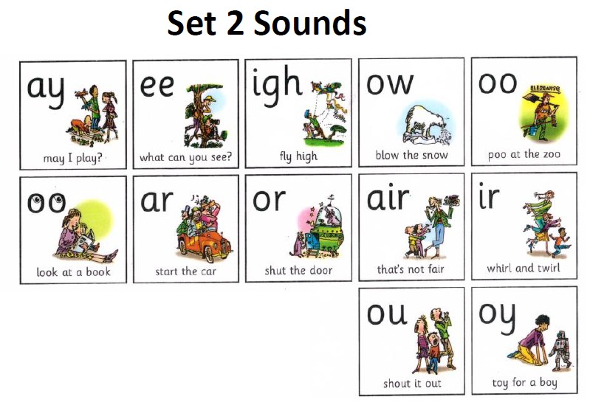

Slide 4
Listen to the video

Slide 5
Warm- up Activity
Level 3
Warm- up Activity

Slide 6
Phonics. (15 mins) Have students sit on the carpet with their whiteboards and markers .

Slide 7
Write the letter sound on the whiteboard. /air/ Ask students to sound out the letter on the board to make sure that the students know the sound.

Slide 8
Have students write a sentence with /air/ word sound. Have them circle the /air/ word sound and read out their sentences.

Slide 11
Time to read

Slide 15
Thank You

Slide 16
Practice time
Say some words with the sound
“air”

Slide 17
Lessons Objectives
Objectives check:
recognize and read the sounds.
01
blend and segment the words.
02
Write words related to these sounds.
03
04

