Slide 1
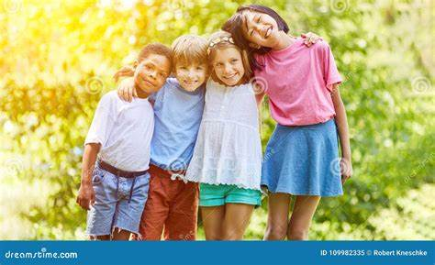
Similarities and differences in Humans: Alike, Unique, Together

Slide 2
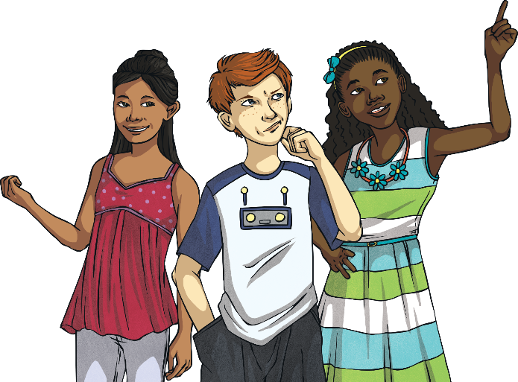
What Things Make Us Unique?
No two people are exactly the same. Discuss with a partner all the things that make us unique.
height
skin colour
eye colour
type of family
gender
hair colour
what else?
disability

Slide 3
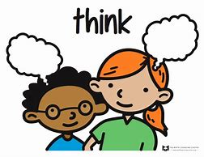
What If We Were All the Same?
Discuss with your partner what you think life would be like if everyone looked and acted in exactly the same way.

Slide 4
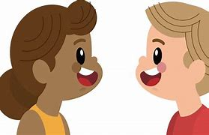
What Things Make Us Special?
Tell your partner one thing that you think is special about them. It might be their hair, their smile, their kindness or a unique talent.

Slide 5
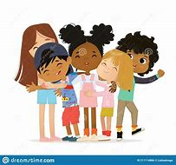
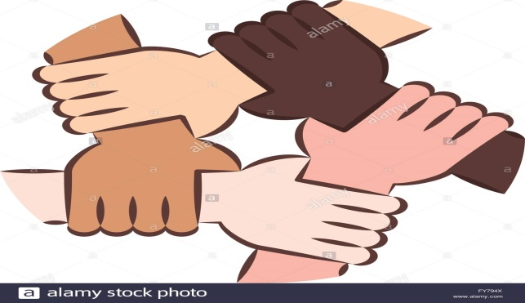
Differences
Humans: Similarities & Differences (Diversity ).
Let's explore how humans are both similar and different in design. Our bodies may look different, but we all have a heart that beats and a brain that thinks..
Humans come in all shapes, sizes, and colors. While we may look different, we share similarities like the ability to smile, laugh, and love. Let's celebrate our unique differences!

Slide 6
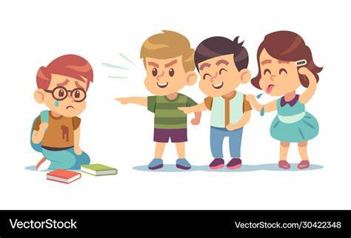
Discrimination
When a person doesn’t respect the different qualities and opinions of another person or group, this can often be called discrimination(bullying).
Please always remember "We may look different, but inside we all have the same beating heart."

Slide 7
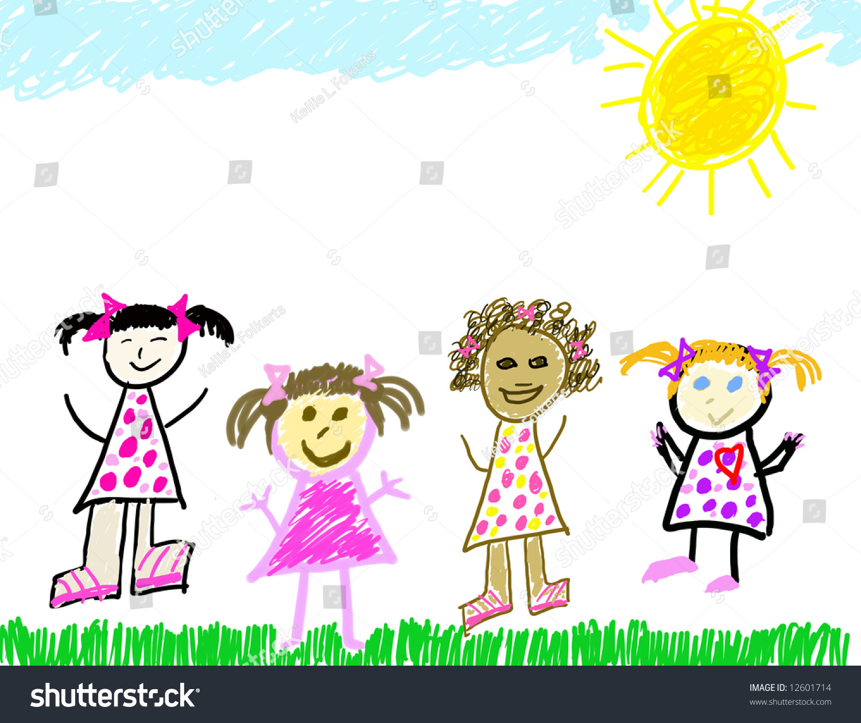
How Might People Discriminate Against Others within School?
1-Discuss with your partner, or within a group, how humans are similar, how humans are different.
2- Show and discuss your drawing with the class or your group sorting and groping all the similarities and differences you have recognised.

Slide 8
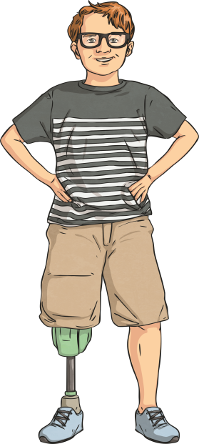
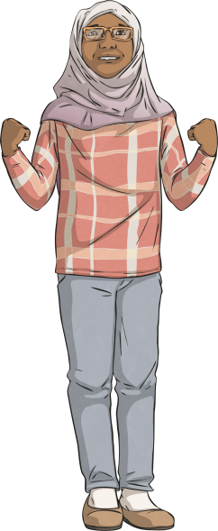
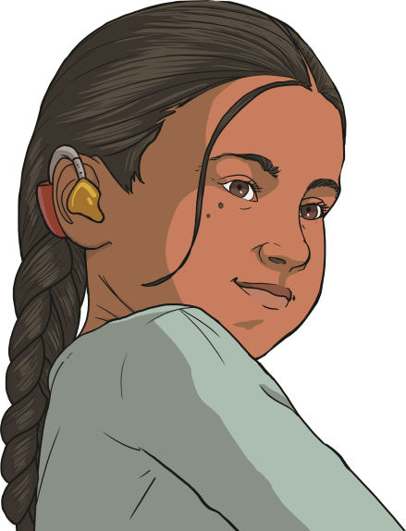
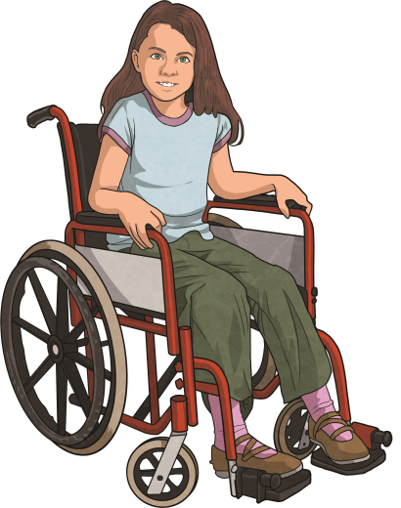
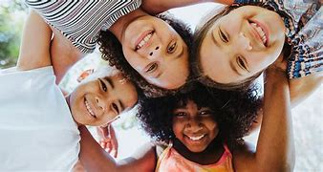

Slide 9
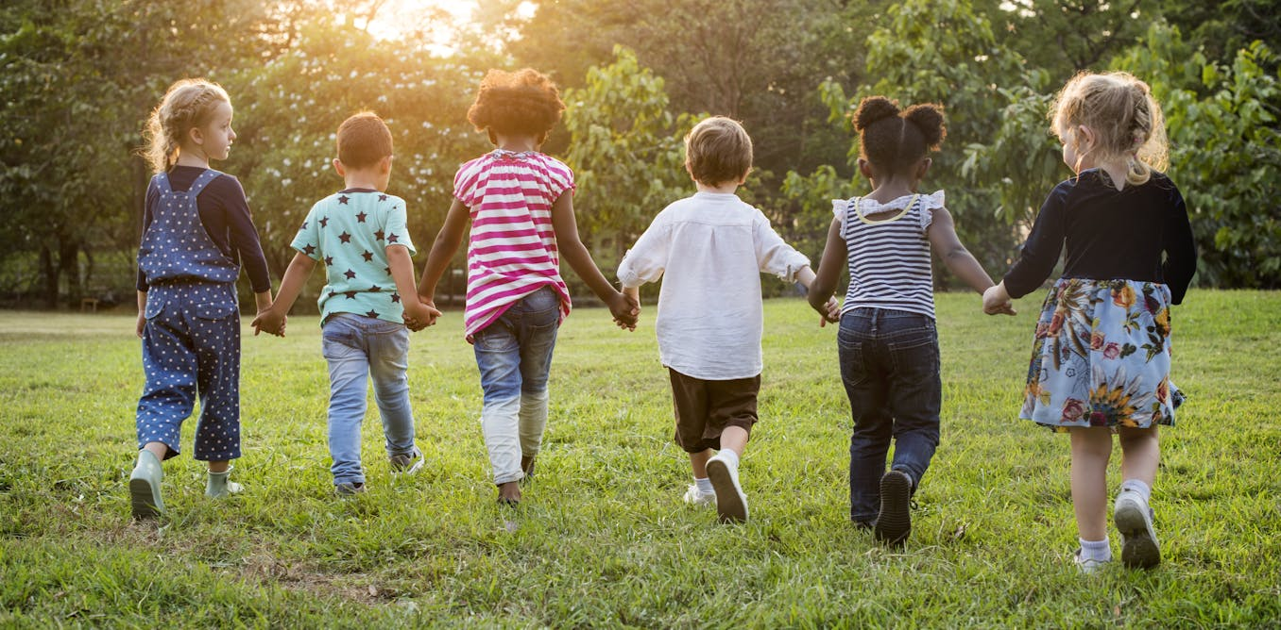
Reflection
What did you find out today that you didn’t know before?
If someone looks, acts, behaves or sounds differently to you, appreciate their differences! Diversity is a positive thing to have within society.
We are all different.
We all have the right to our own opinions and beliefs and that is what makes our school, and our world, a special place.

