Slide 1
Vocabulary words
Term1 – Week 2

Slide 2
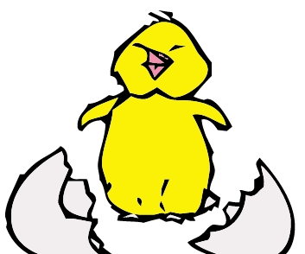
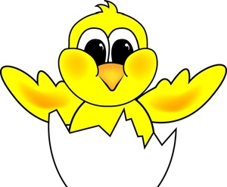
Hatch
Definition: to break out of an egg.

Slide 3
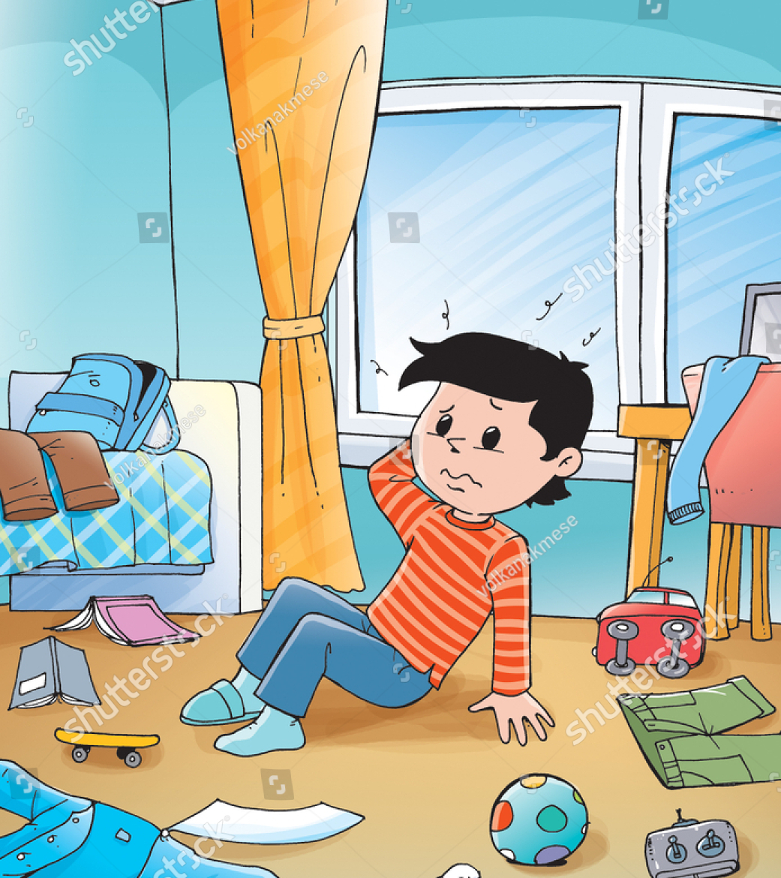
Scruffy
Definition: messy-looking.

Slide 4
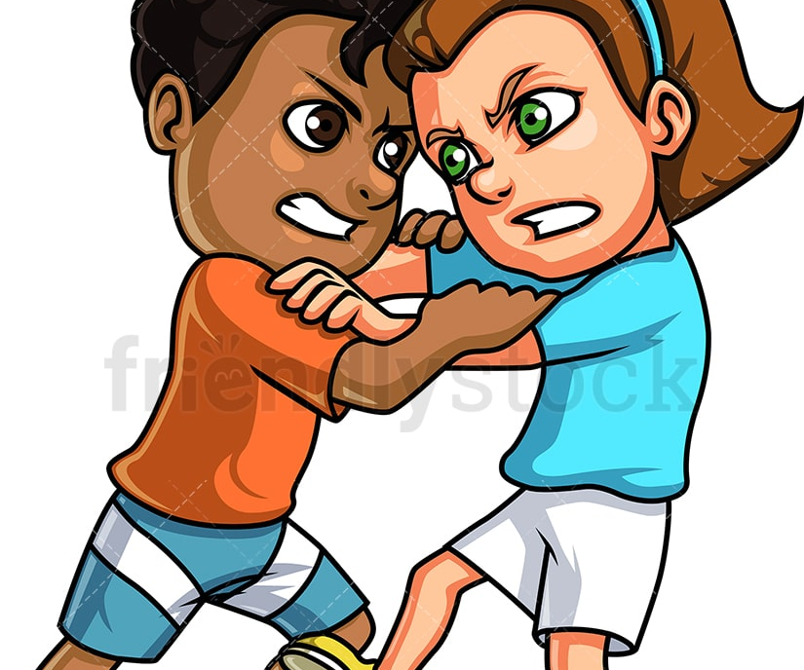
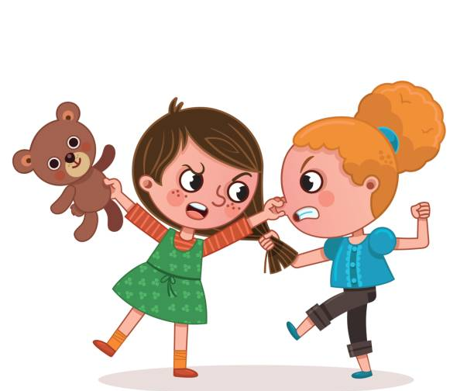
Quarrel
Definition: an argument.

Slide 5
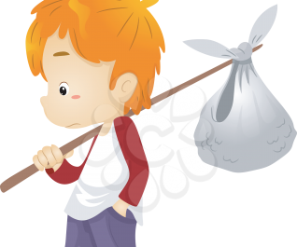
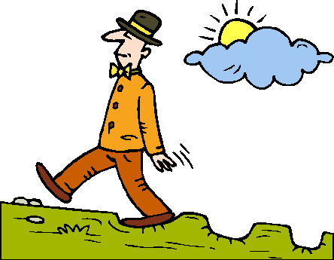
Wander
Definition: to move about with no plan

Slide 6
Gaze
Definition: to look steadily.

Slide 7
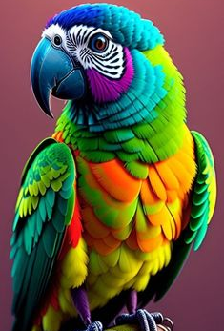
Feathers
Definition: covering on a bird's body.

Slide 8
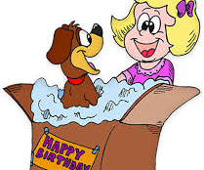
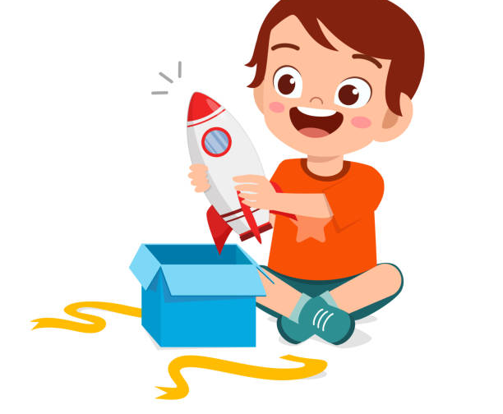
Amazement
Definition: great surprise.

