Slide 1
VOCABULARY WORDS
Week 5

Slide 2
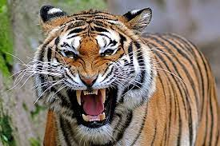
ferocious
Meaning:
fierce
Sentence:
"a ferocious beast"

Slide 3
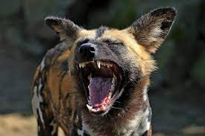
vicious
Meaning:
Cruel
Sentence:
the dog was vicious and likely to bite

Slide 4
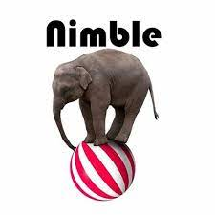
nimble
Meaning:
Quick and light
Sentence:
The nimble elephant enjoyed jumping on the ball

Slide 5
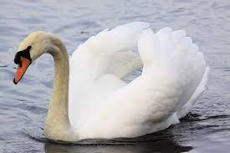
graceful
Meaning:
Beautiful
Sentence:
The ballet dancer danced in a graceful moves.

Slide 6
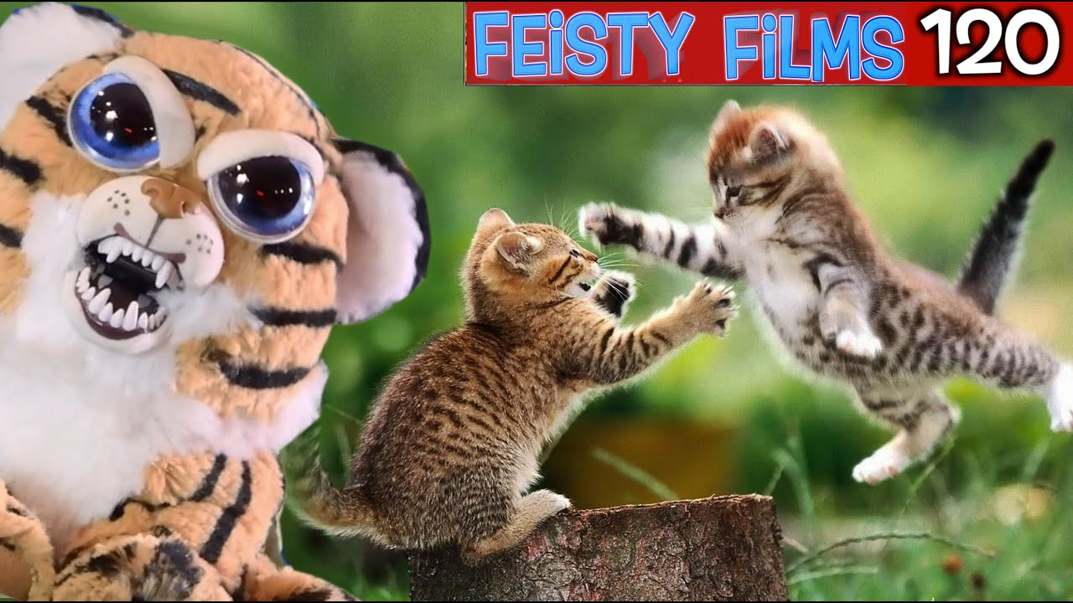
feisty
Meaning:
Very lively and aggressive
Sentence:
This cat looks feisty and playful.

Slide 7
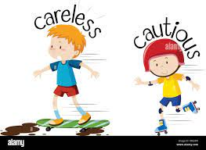
cautious
Meaning:
Very careful
Sentence:
They entered cautiously.

