Slide 2
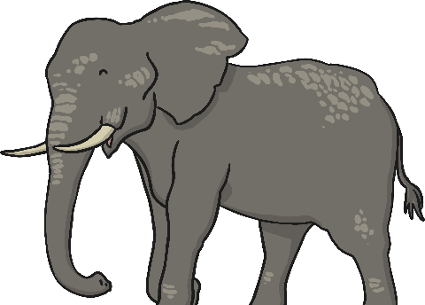
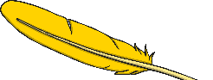
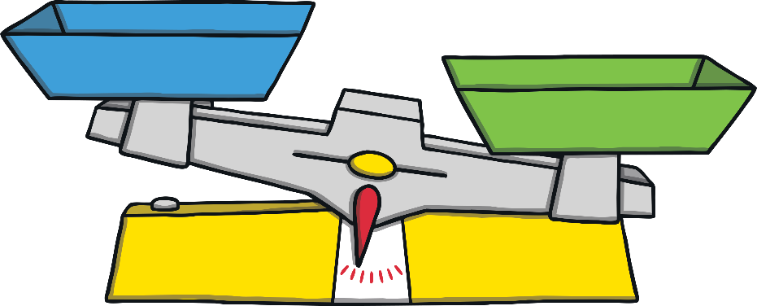
What Is Weight?
Weight is how heavy something is.
Some things are really heavy, like an elephant.
Some things are really light, like a feather.
Weight is measured using a balance or scales.
Have a look at the next few slides and see if you can identify which object is heavier and which is lighter.

Slide 3
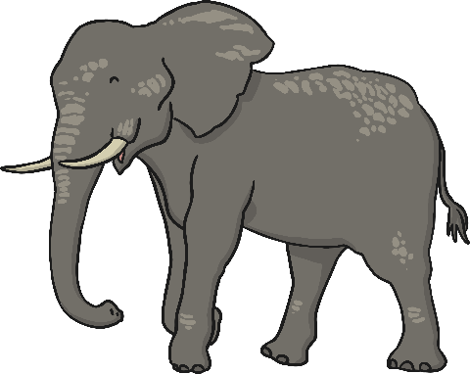
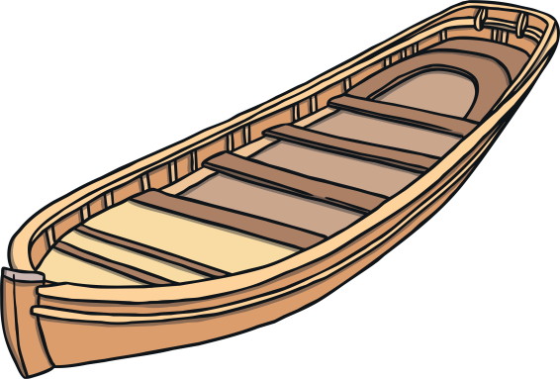
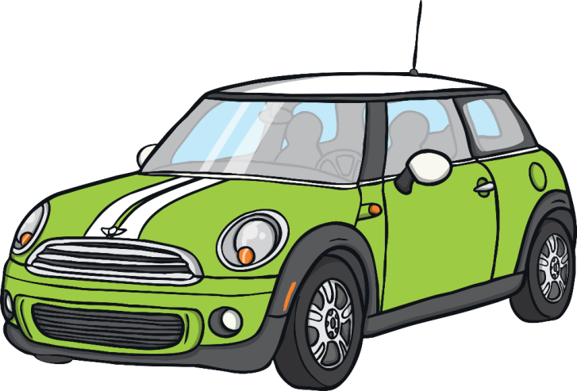
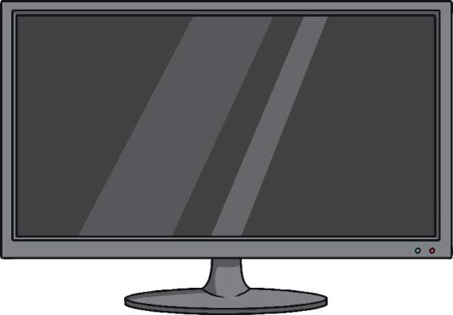
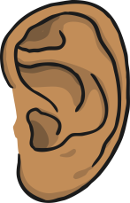
Heavy Objects
Click for
Audio

Slide 4
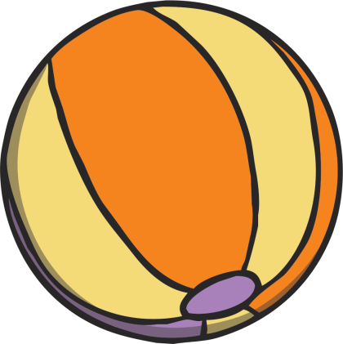
Light Objects
Click for
Audio

Slide 5
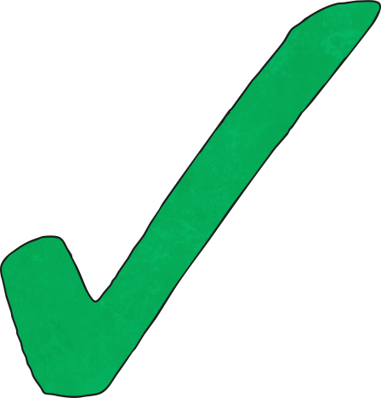
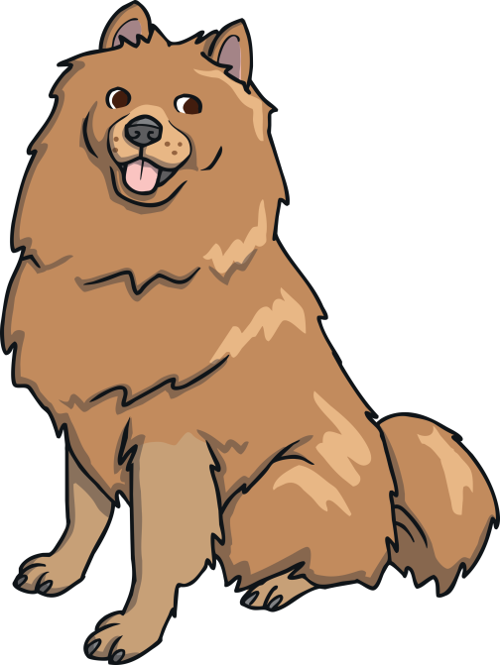
Which Animal Is Heavier?
Click for
Audio

Slide 6
Which Object is Lighter?
Click for
Audio

Slide 7
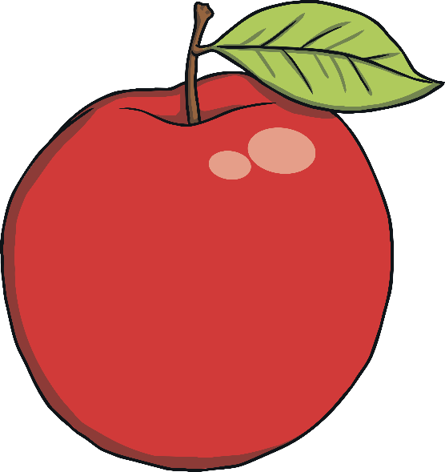
Which object is heavier?
Click for
Audio

Slide 8
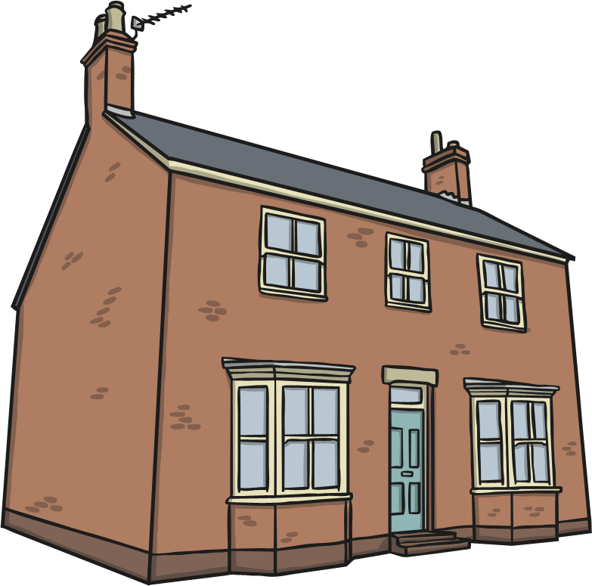
Which object is heavier?
Click for
Audio

Slide 9
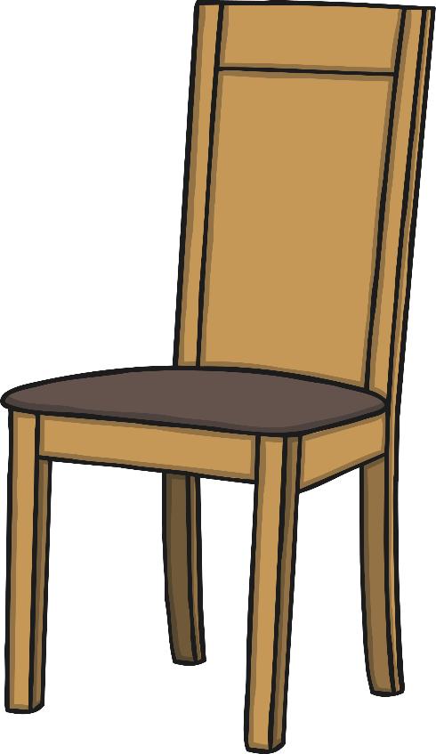
Which object is heavier?
Click for
Audio

Slide 10
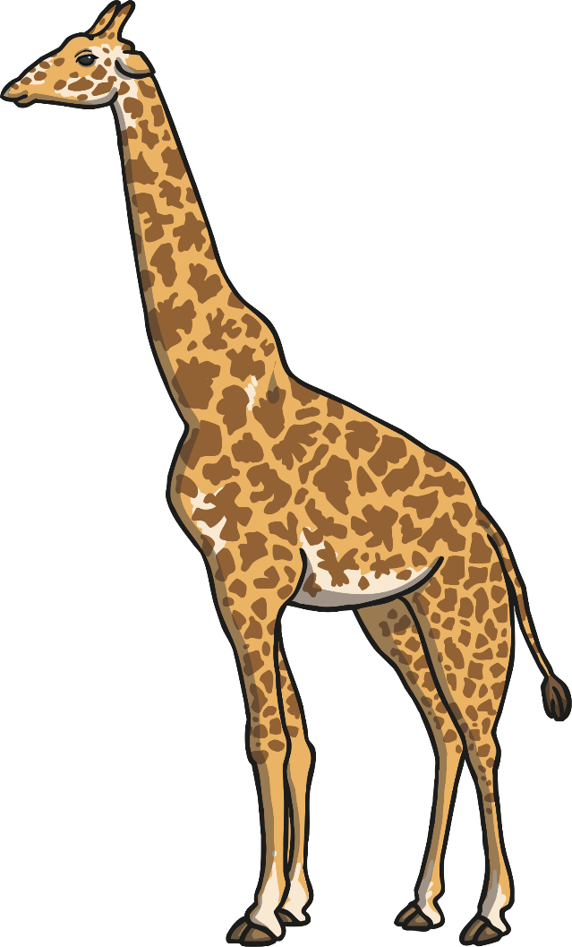
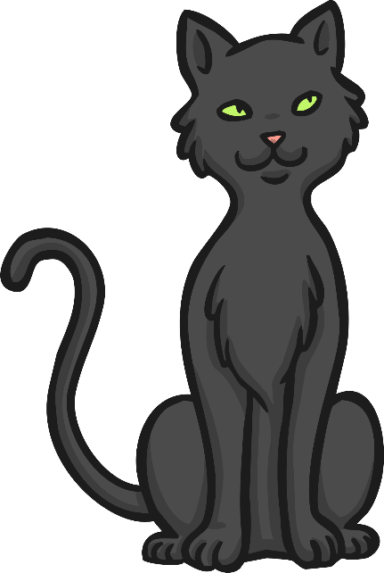
Which animal is heavier?
Click for
Audio

Slide 11
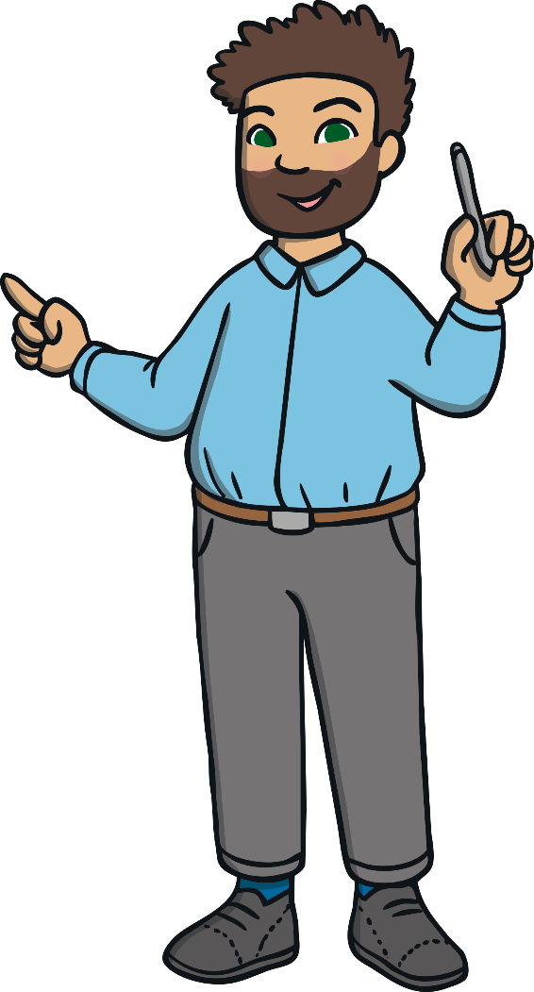
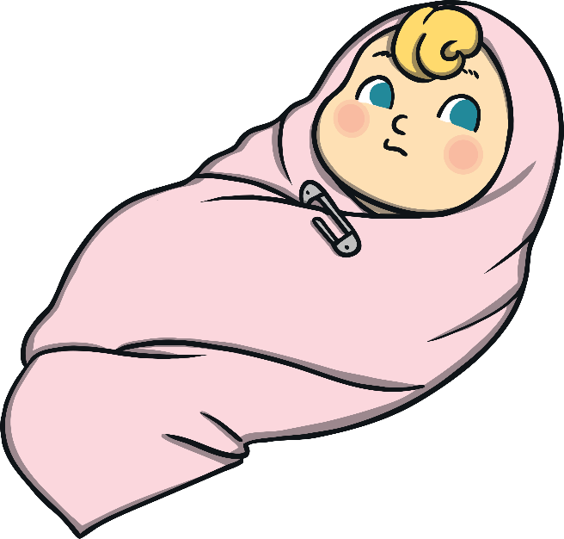
Which person is heavier?
Click for
Audio

Slide 12
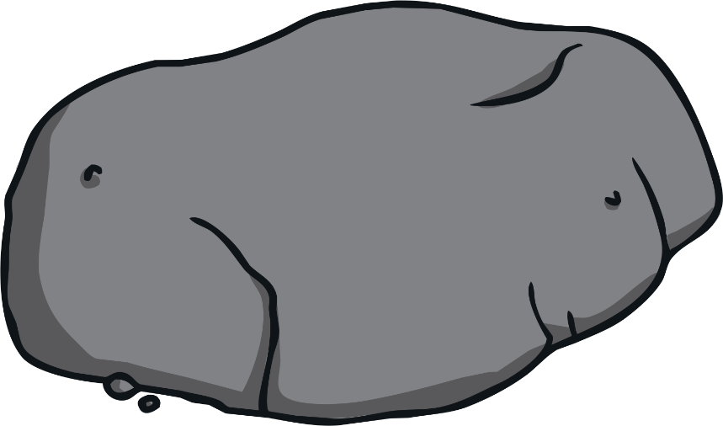
Which object is lighter?
Click for
Audio

Slide 13
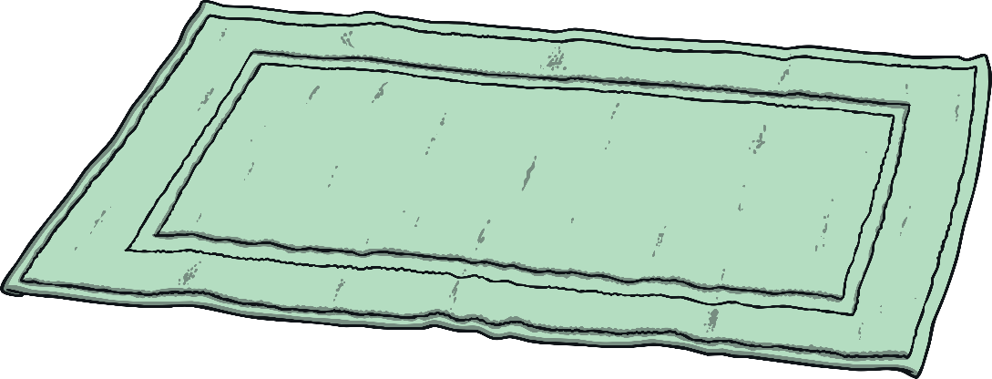
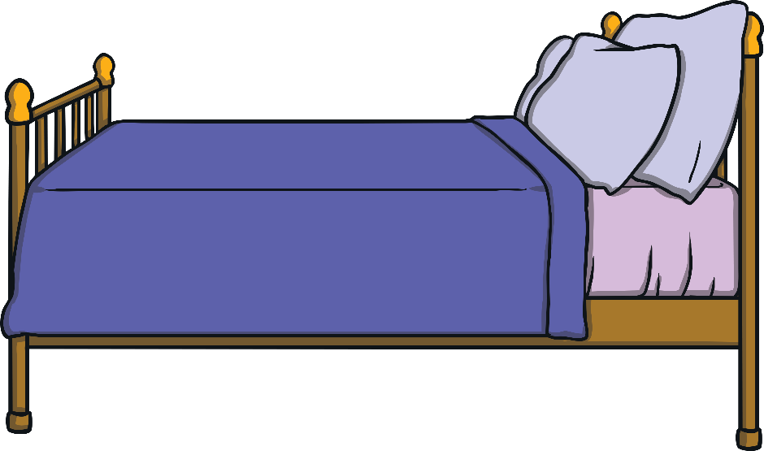
Which object is lighter?
Click for
Audio

Slide 14
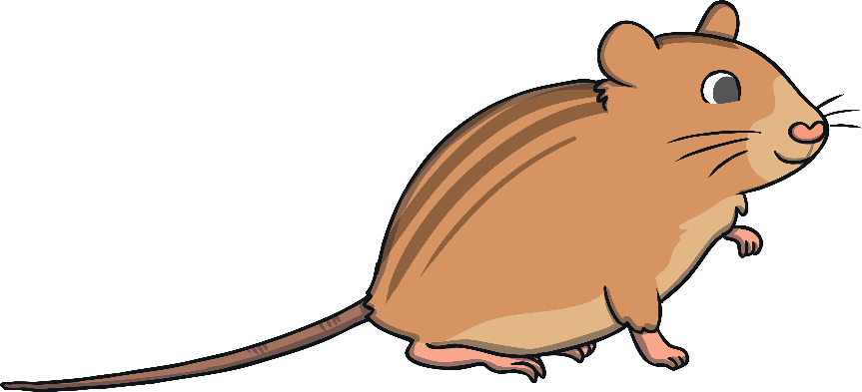
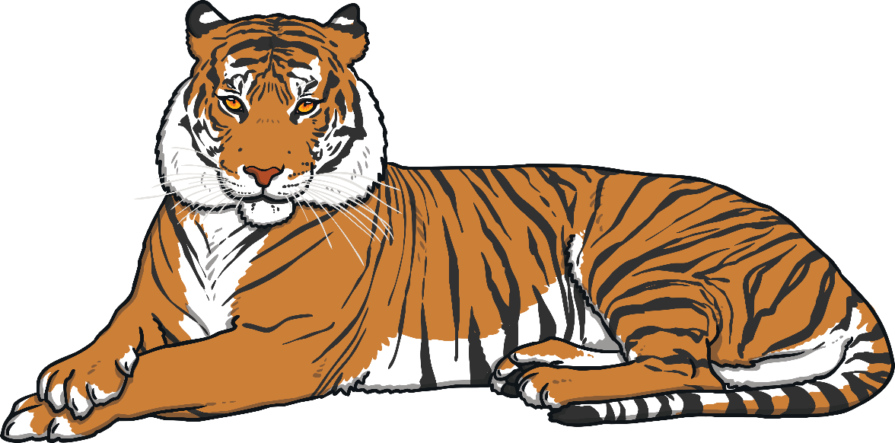
Which animal is lighter?
Click for
Audio

Slide 15
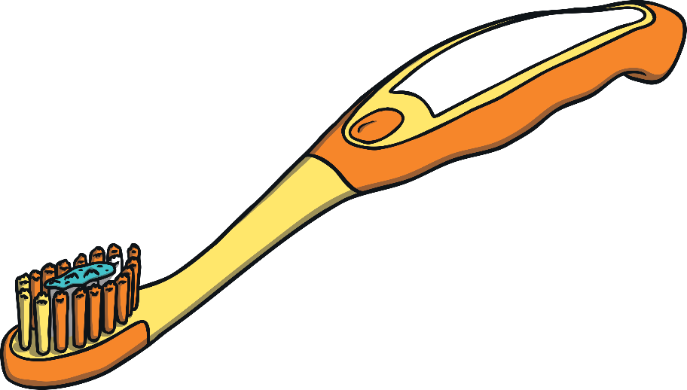
Which object is lighter?
Click for
Audio

Slide 16
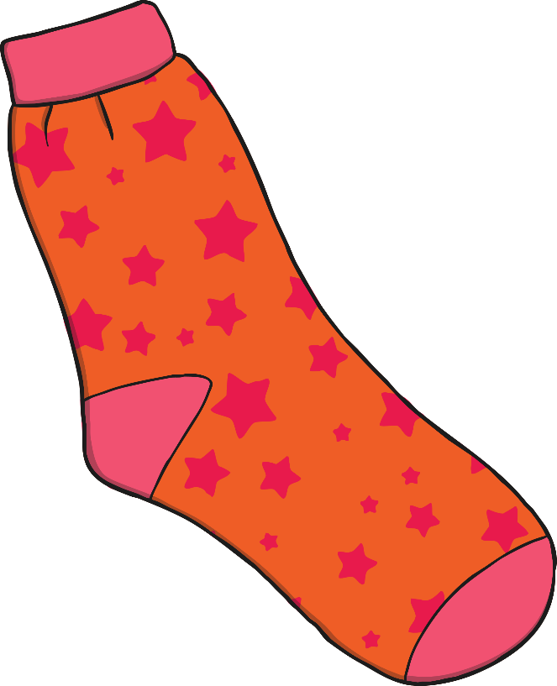
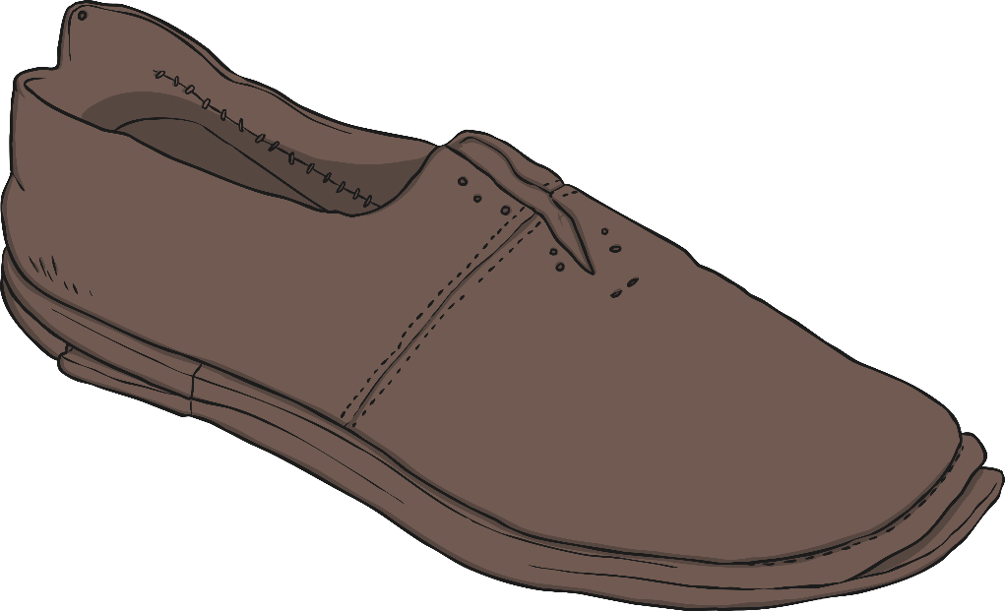
Which object is lighter?
Click for
Audio

Slide 17
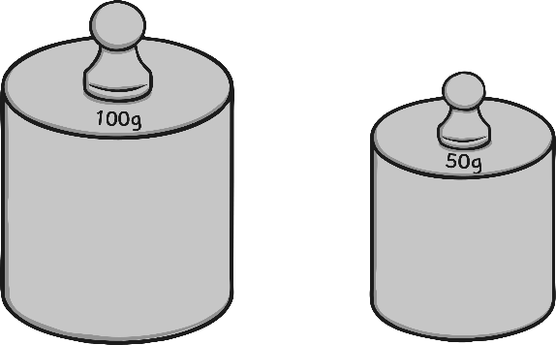
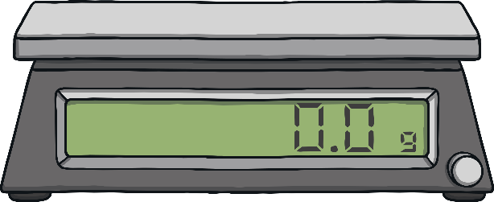
Weighty Words
We use lots of different words when we talk about weight. Can you think of any more?
Click for
Audio

Slide 18
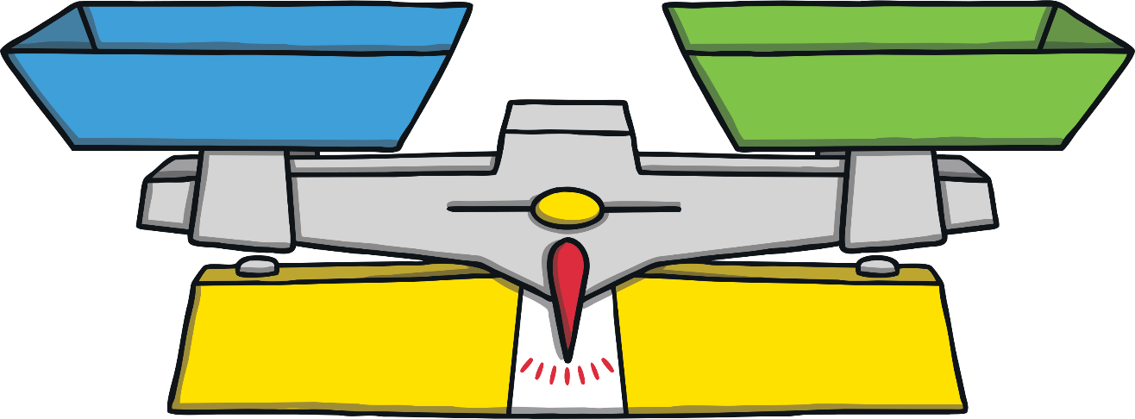
Balance
We use balances to measure weight in Senior Infants.
Click for
Audio

Slide 19
How Does a Balance Work?
Click for
Audio
Notes:
If we want to measure which of two items is the heavier or the lighter, we use a balance in the following way:
We put the two items we are measuring on the balance, one on each side.
The item that is heavier will be lower than the lighter one.
The item that is lighter will be higher than the heavier one.
Look at this balance. The elephant is heavier than the butterfly.

Slide 20
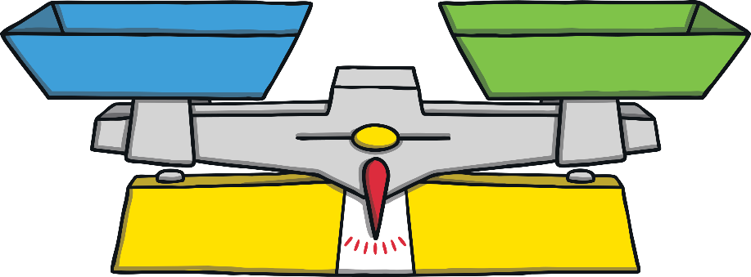
How Does a Balance Work?
Click for
Audio
Notes:
If we want to measure how heavy something is, we need to balance the balance using a selected object.
To weigh our object using cubes, we place our object on one side and add cubes onto the other until they are both the same (balanced).
The object will weigh the same as the number of cubes.
Look at this balance. The bottle of water weighs three cubes.

Slide 21
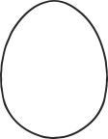
Weight and Size
Click for
Audio

Slide 22
How Many Cubes Balance the Pencil?
Click for
Audio

Slide 23
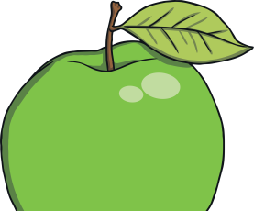
How Many Cubes Balance the Apple?
Click for
Audio

Slide 24
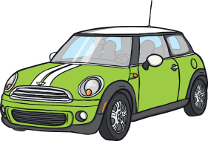
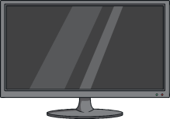
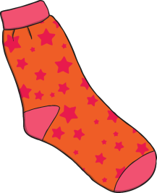
Heavy or Light?
Heavy
Click the pictures for the answers!
Light
Click the pictures for the answers!
Click for
Audio

